Slide 1
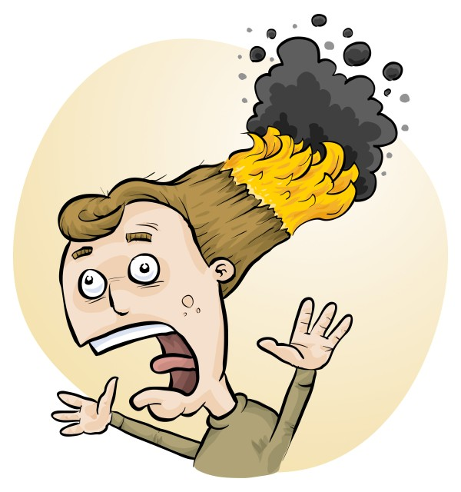
Risk assessment of science experiments: introduction to RiskAssess
Phillip Crisp and Eva Crisp

Slide 2
What is RiskAssess?
• web-based risk assessment tool
• customized to the school situation
• customized to Canada
• provides
- electronic templates (CA/ISO)
- database information on risks
(chemical, equipment, biological)
- equipment ordering/lab scheduling
- GHS labelling (WHMIS 2015)
(30 November 2018)

Slide 3
2.8 million risk assessments
2,000 schools
10 years

Slide 4
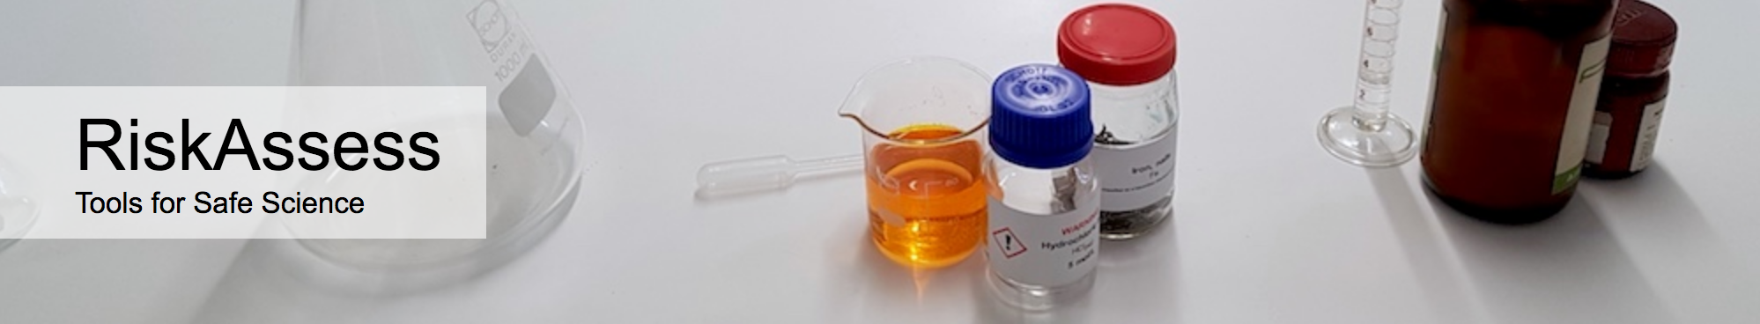

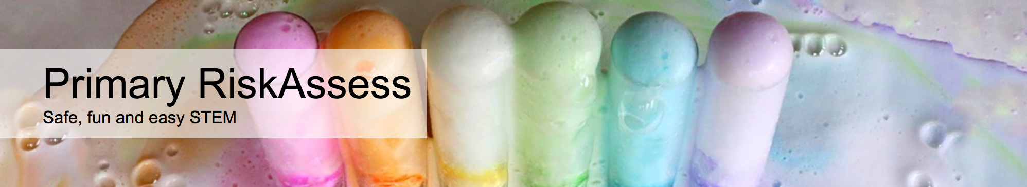
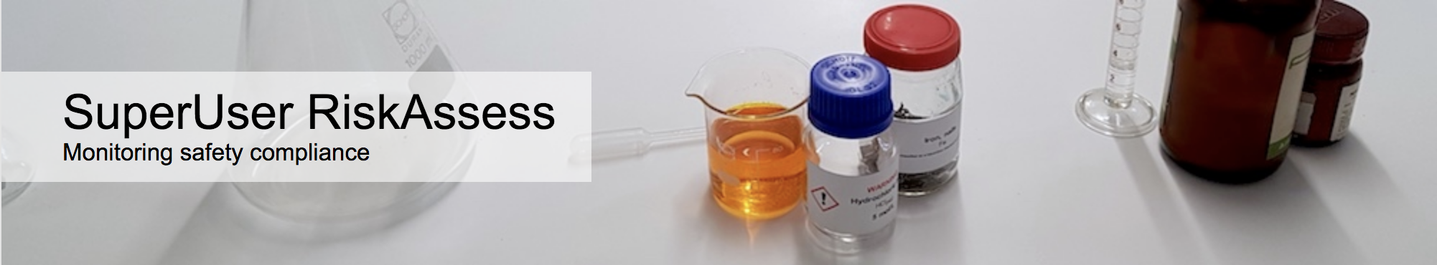
AU: 1600
½ all schools
NZ: 130
¼ all schools
420 schools
170 schools
6 groups

Slide 5
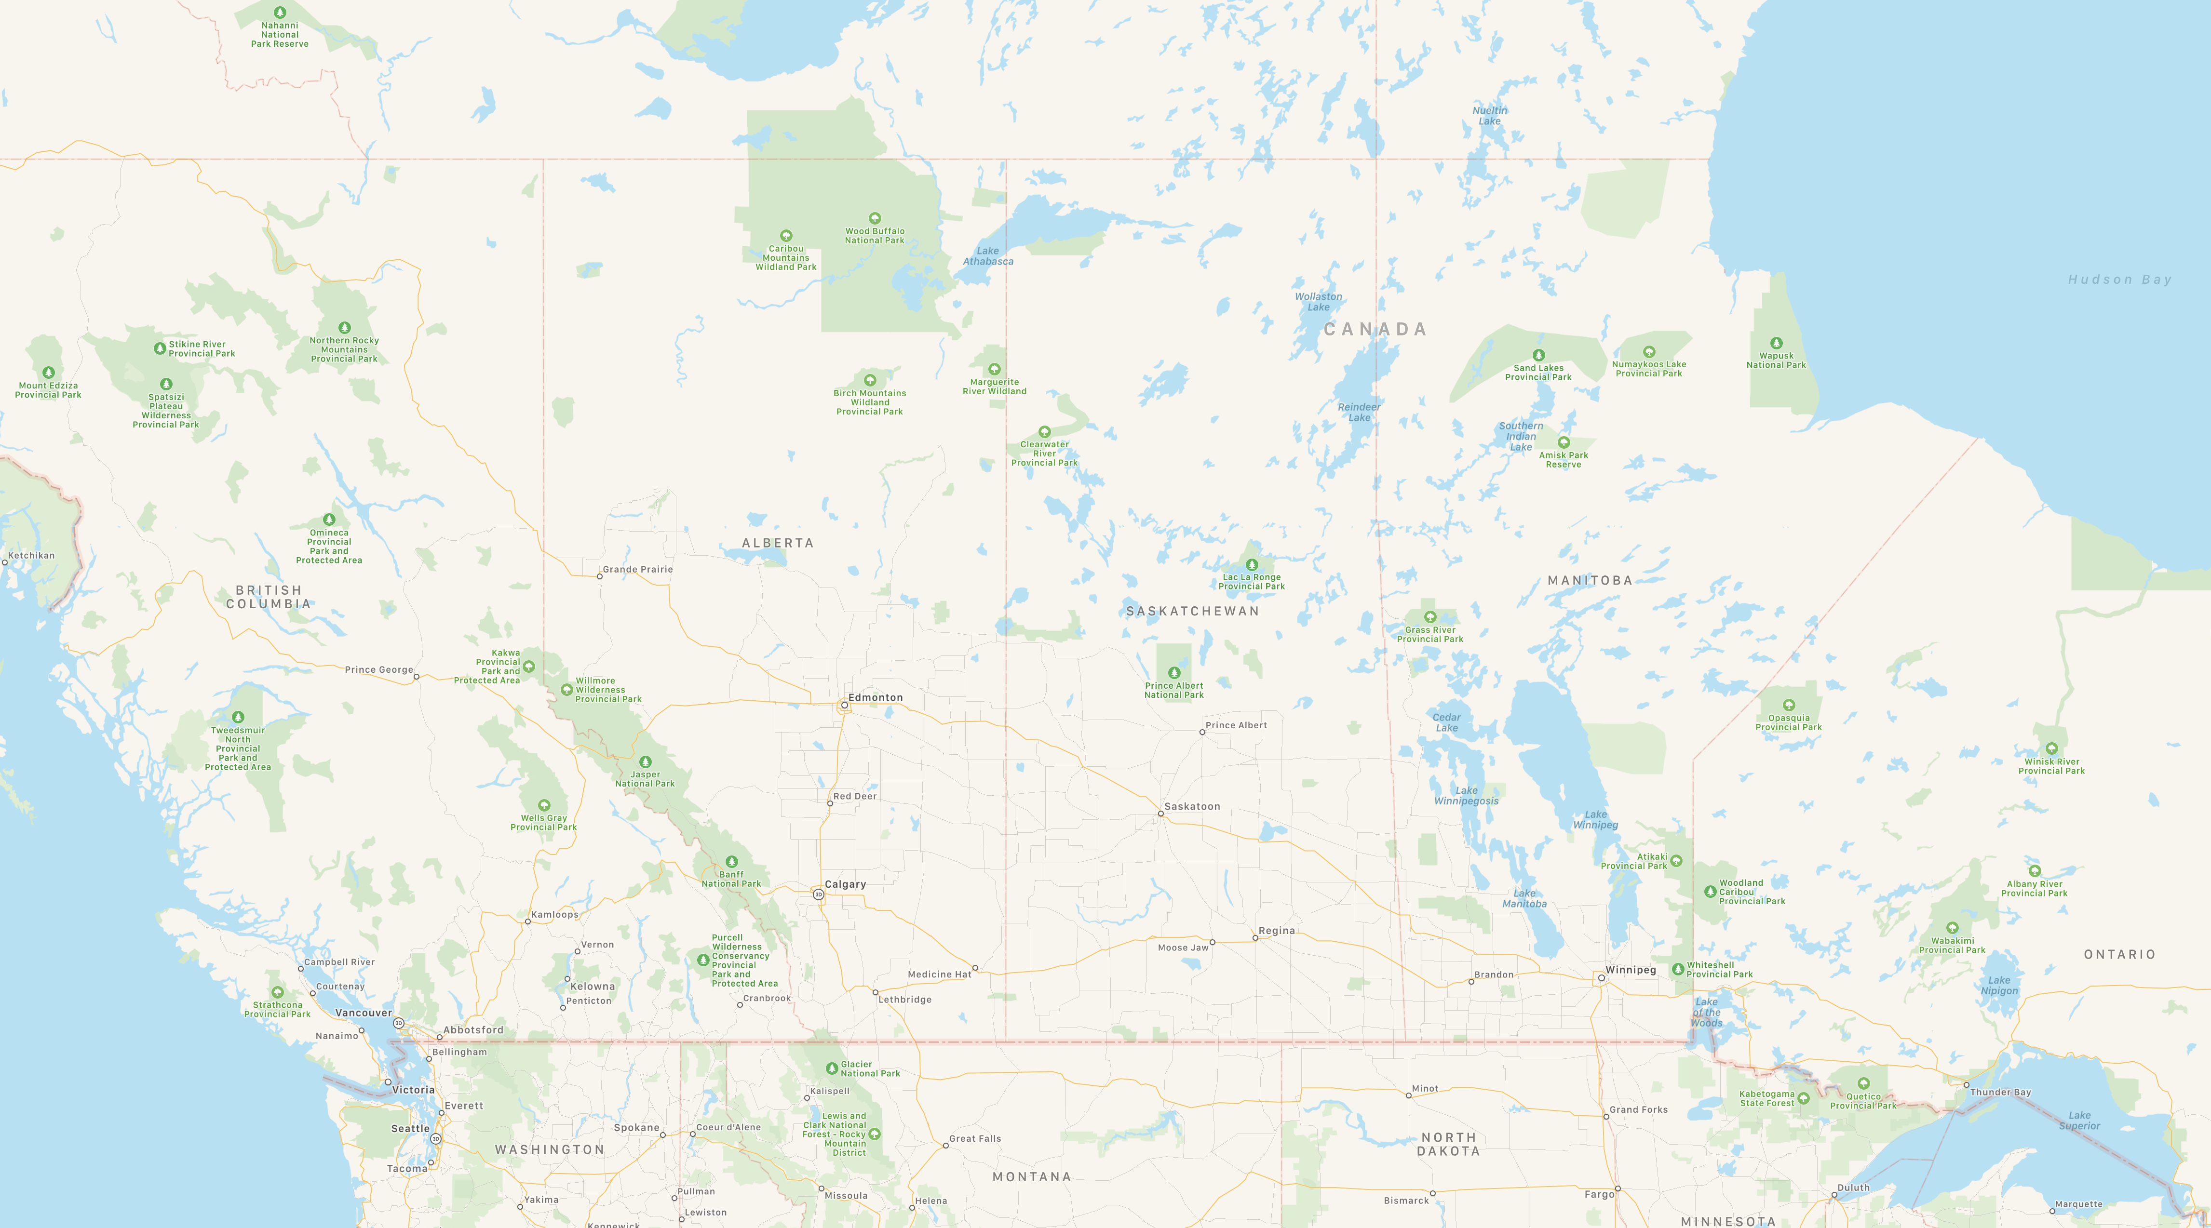
The Canada Story

Slide 6



43,000 risk assessments
60 schools
6 schools Calgary/Red Deer/Edmonton

Slide 7
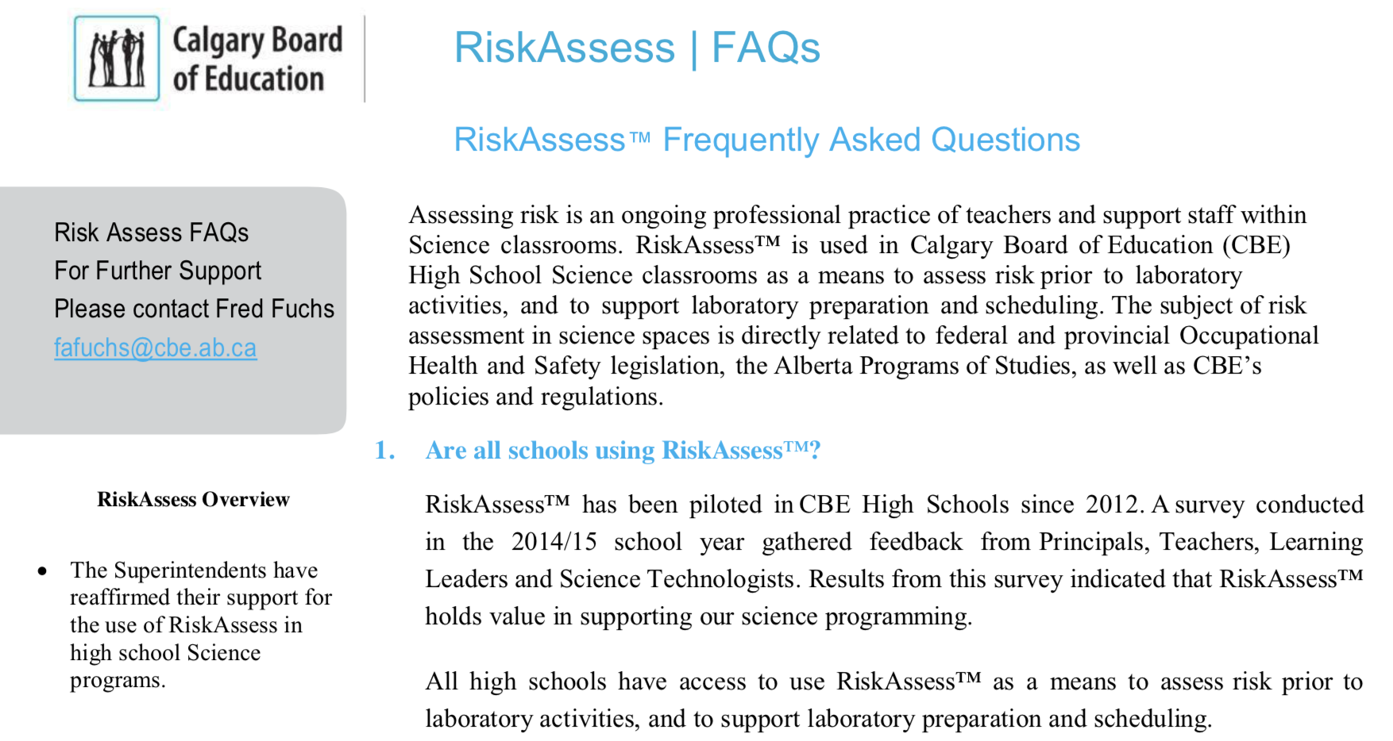

Slide 8
Advantages of risk assessments
reduced frequency of injuries
- to students
- to school staff
reduced costs for paperwork, litigation and payouts
compliance with the law:
OHS Act + OHS Code + WHMIS 2015
helps maintain variety of chemicals and equipment
compliance with: Alberta Ed Programs of Studies
IB Curriculum

Slide 9
Workplace labels
Required “when a hazardous product is decanted
(e.g. transferred or poured) into another container”
and it is not “going to be used immediately”
It is anticipated that a workplace label will require the following information:
• Product name (matching the SDS product name)
• Safe handling precautions, may include pictograms or
other supplier label information
• A reference to the SDS (if available)
Workplace label requirements fall under your Provincial or Territorial jurisdiction . . .
Canadian Centre for Occupational Health and Safety “WHMIS 2015 - Labels” https://ccohs.ca/oshanswers/chemicals/whmis_ghs/labels.html

Slide 10
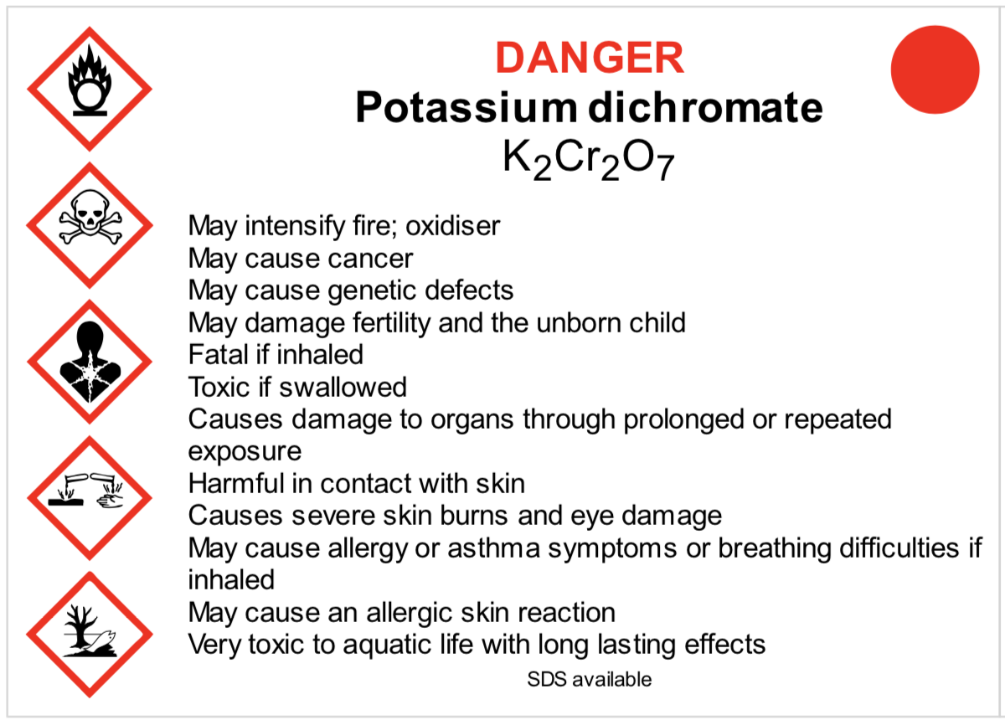
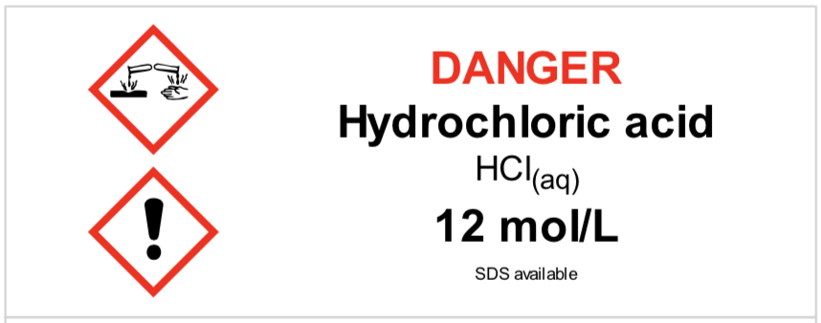
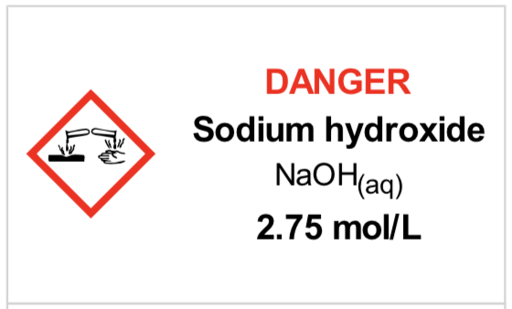
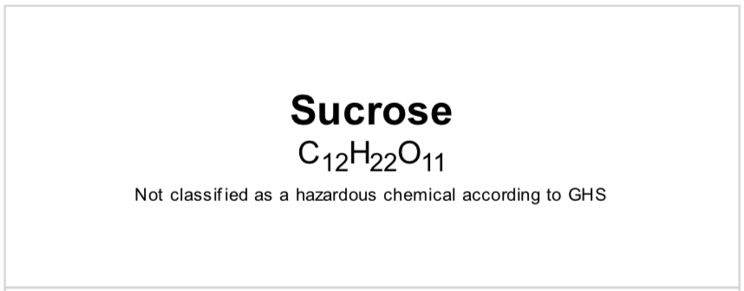
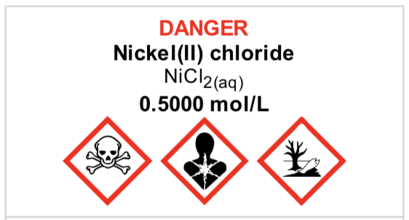
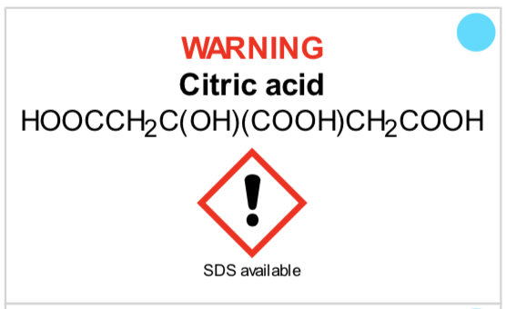
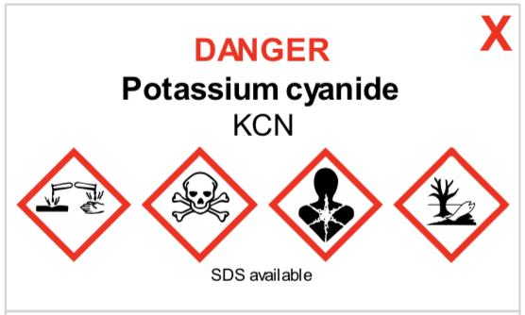
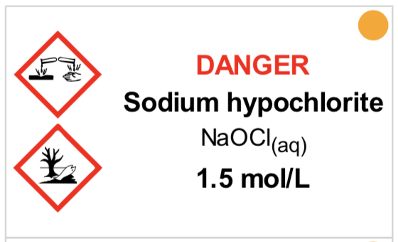
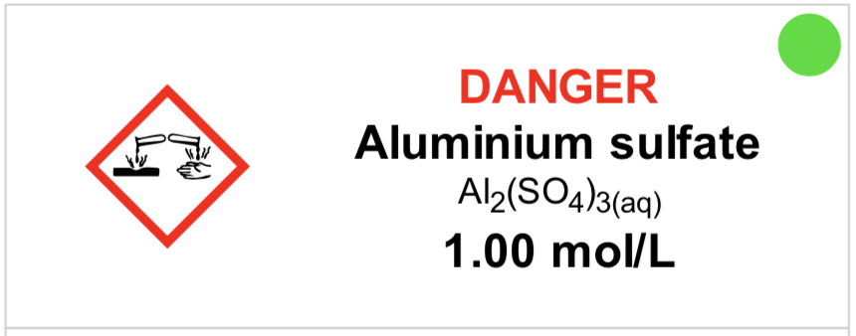
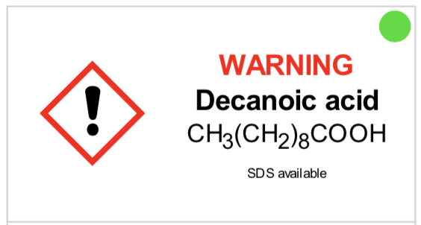
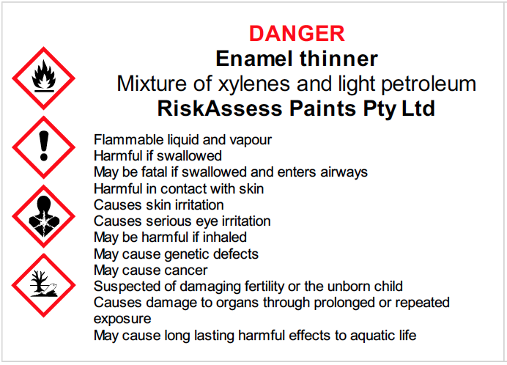
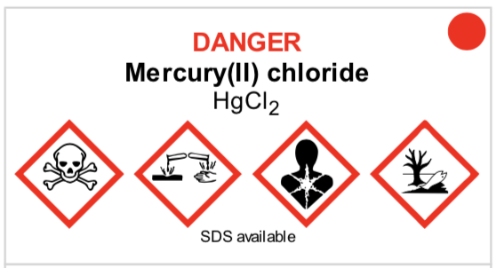
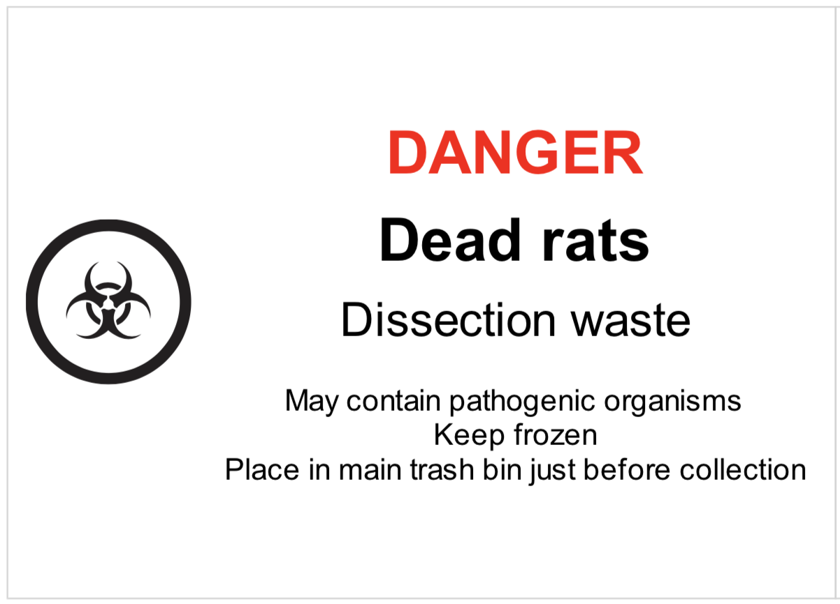
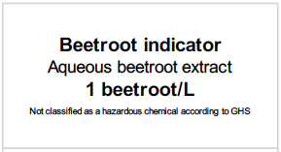
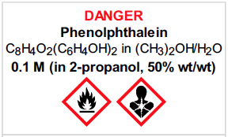

Slide 11
Logic of RiskAssess
• safety information customized for schools
• separate sections for teacher and science technician, allowing cross-checking
• initial assessment of inherent risk
- if low, go to end
- if medium or more, record control measures
- if high or extreme, third reviewer required
• scheduling and ordering system to save time
• labelling for WHMIS 2015 and learning resources
• inexpensive ($250+GST per campus per year)

Slide 12
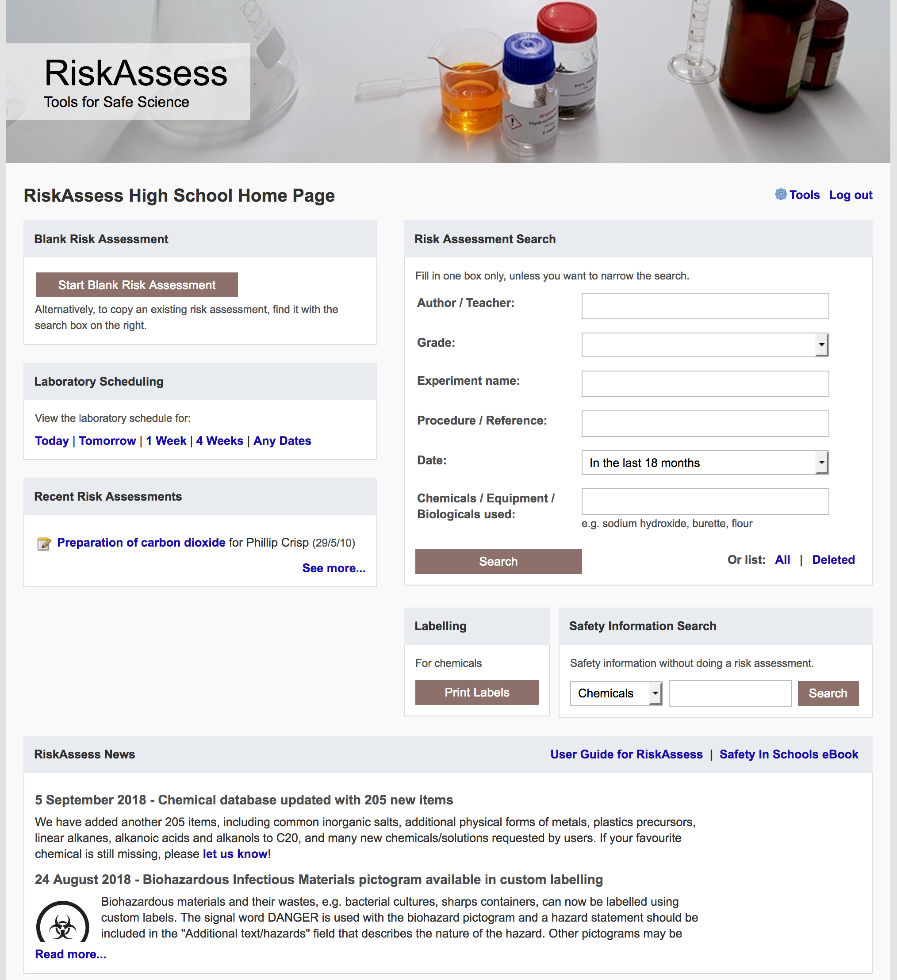
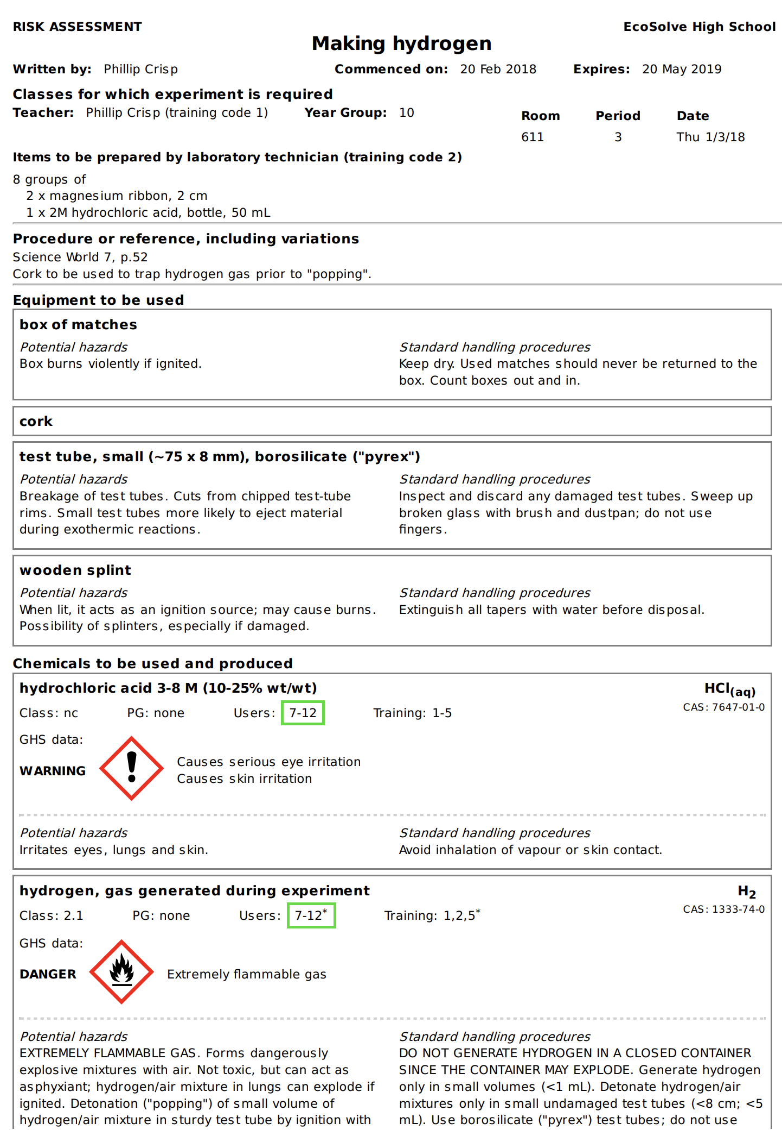

Slide 13
Details
access from school/home
nothing to install on computer, tablet or phone
(instant update)
unlimited number of simultaneous users and risk assessments
minimal data entry
complements SDSs
continuing input from science staff
multiple backups of data & backup server
support and advice

Slide 14
Advantages of RiskAssess
proper consideration of risks and control measures
standardization
storage of records for legal purposes
communication between teachers and science technicians
discourages spur-of-the-moment experiments
useful for new/inexperienced staff

Slide 15
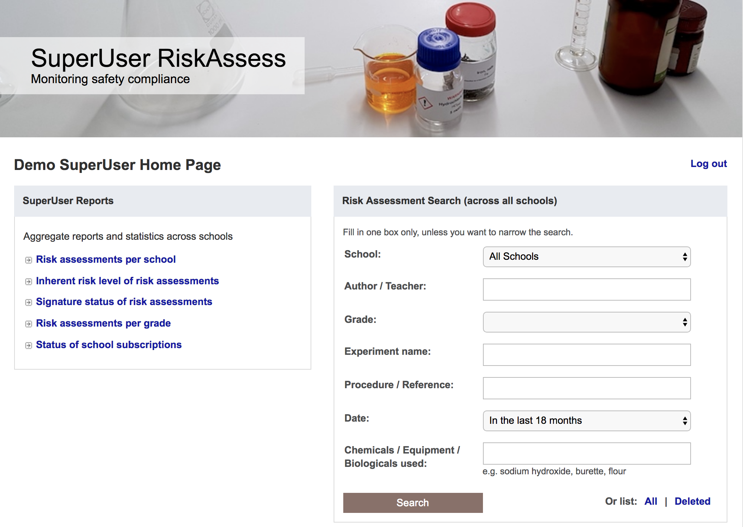

Slide 16
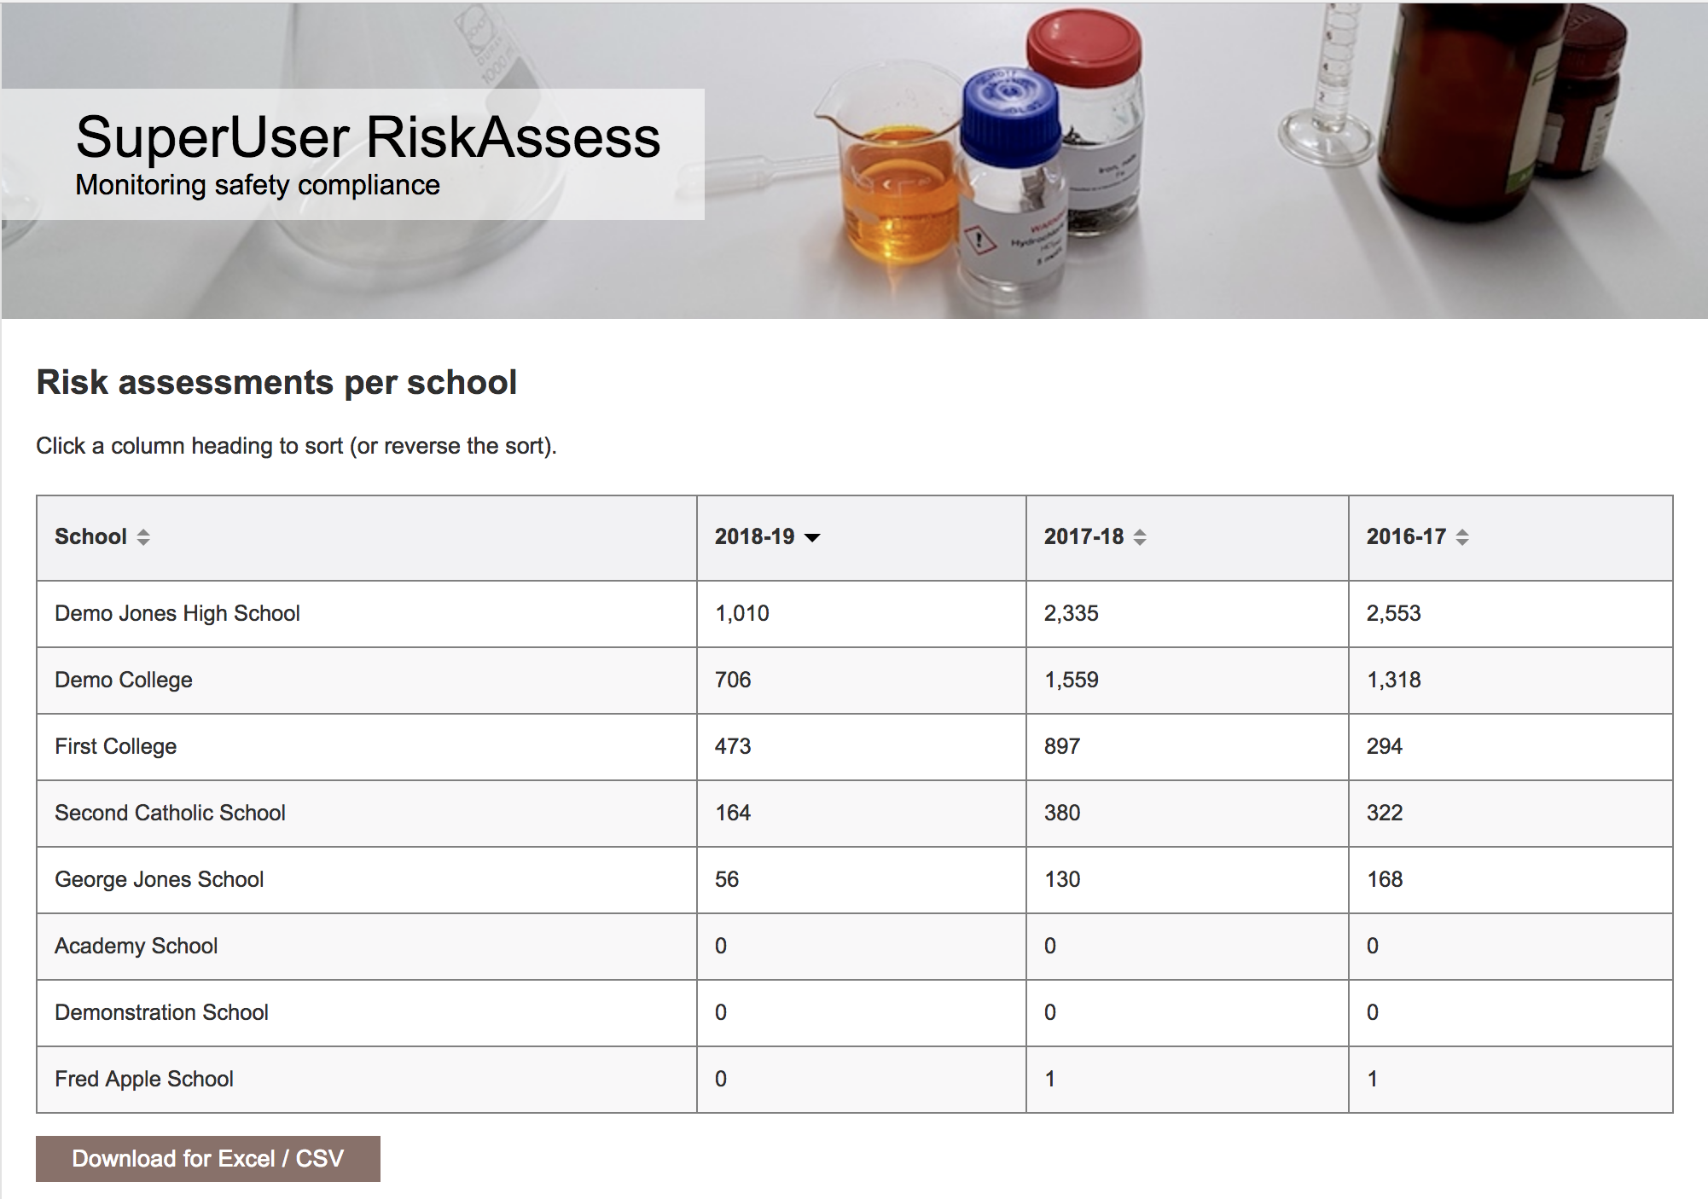

Slide 17
Future developments
• continually adding new features
https://www.riskassess.ca/info/news
e.g. biohazard pictogram added August 2018
• planned:
- chemical disposal information
- additional labelling options
- more reports for SuperUser

Slide 18
Conclusion
safer science laboratories
legally compliant system for risk assessment
easy-to-use GHS/WHMIS labelling
extensive databases, continually updated
scheduling system for lab efficiency
learning resources, staff and student
monitoring of compliance via SuperUser
new features regularly added

Slide 20
RiskAssess data source
ECHA (European Chemicals Association)
http://echa.europa.eu/information-on-chemicals/cl-inventory-database
Classification and Labelling (CL) Inventory
• notifications by chemical companies in Europe of
classifications according to GHS criteria
• harmonised classifications
Provides latest information on classification and labelling.
Some solution information.
Clumsy to use, due to need to translate codes.
Notes:
If needed for question time.

Slide 21
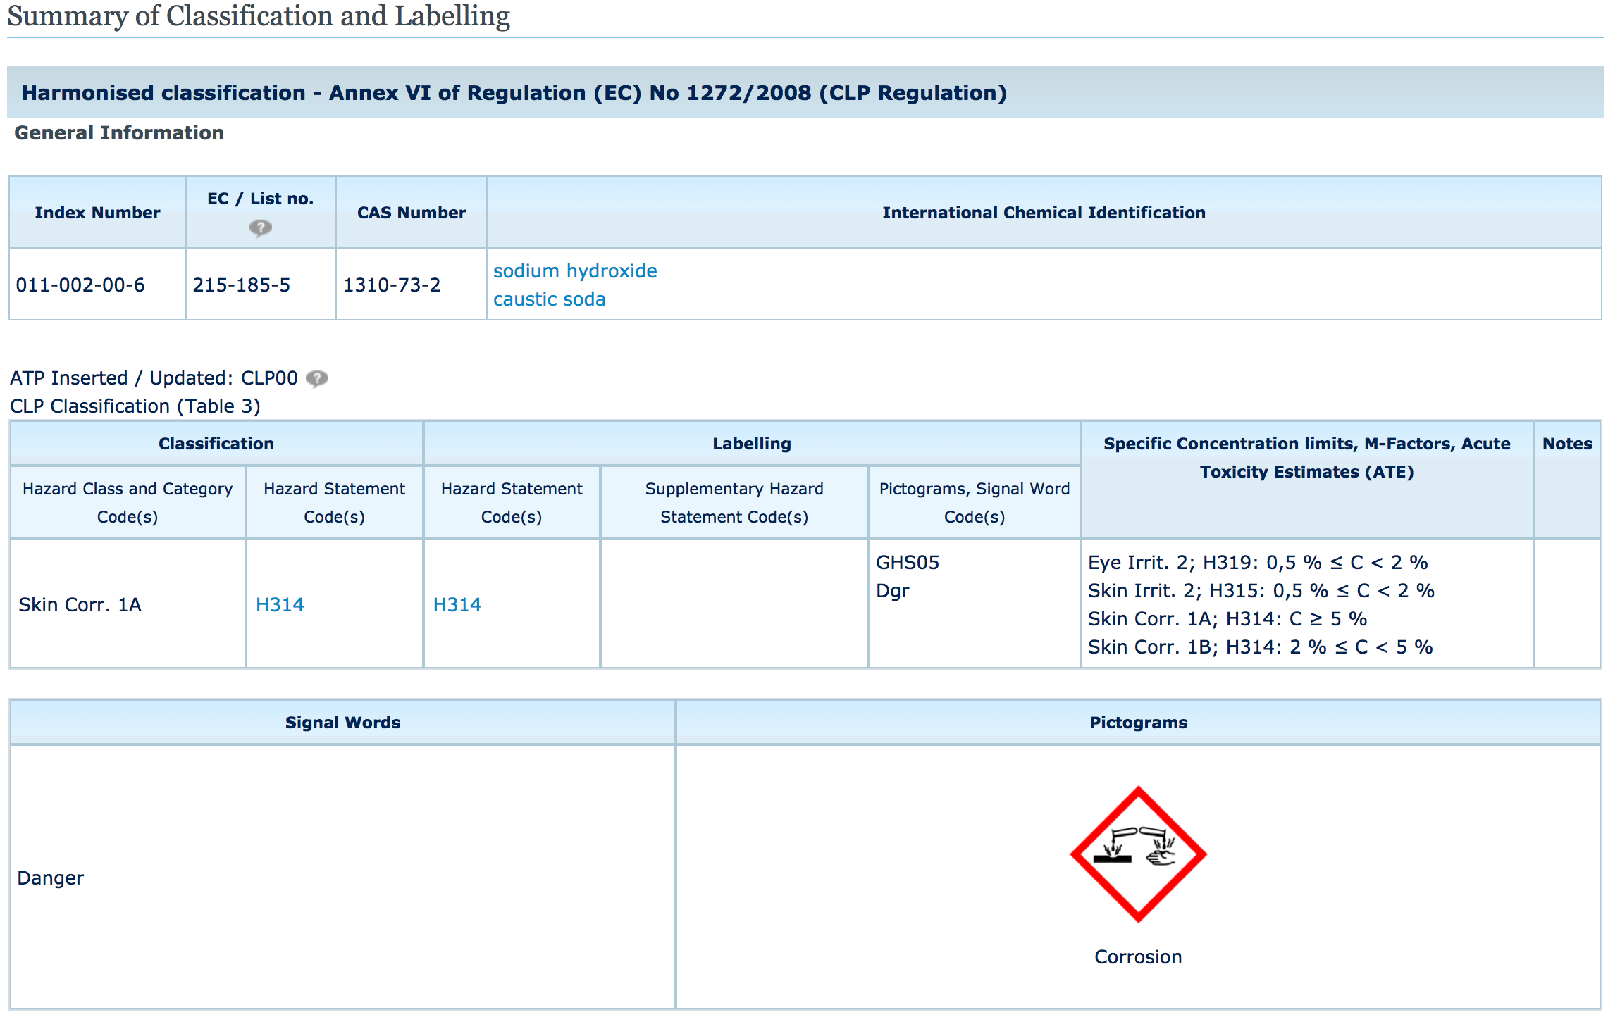
H314: Causes severe skin burns and eye damage
Notes:
If needed for question time.

Slide 22
RiskAssess data
Pure chemicals (>1200)
ECHA data “Harmonised classification”, if available
If not, most common classification (more conservative, if two)
Solutions (>1400)
ECHA data “Specific concentration limits”, if available.
If not, application of GHS rules for mixtures to ECHA data for pure chemical
RiskAssess data are updated as ECHA updates
Notes:
If needed for question time.

