Slide 1
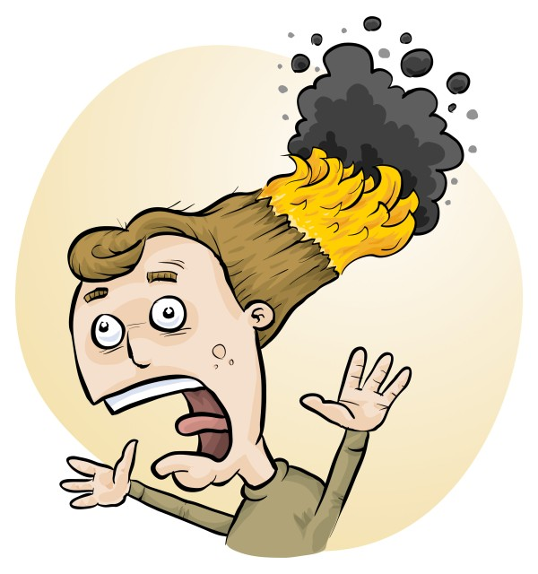
RiskAssess latest tips, tricks and new features
James Crisp

Slide 2
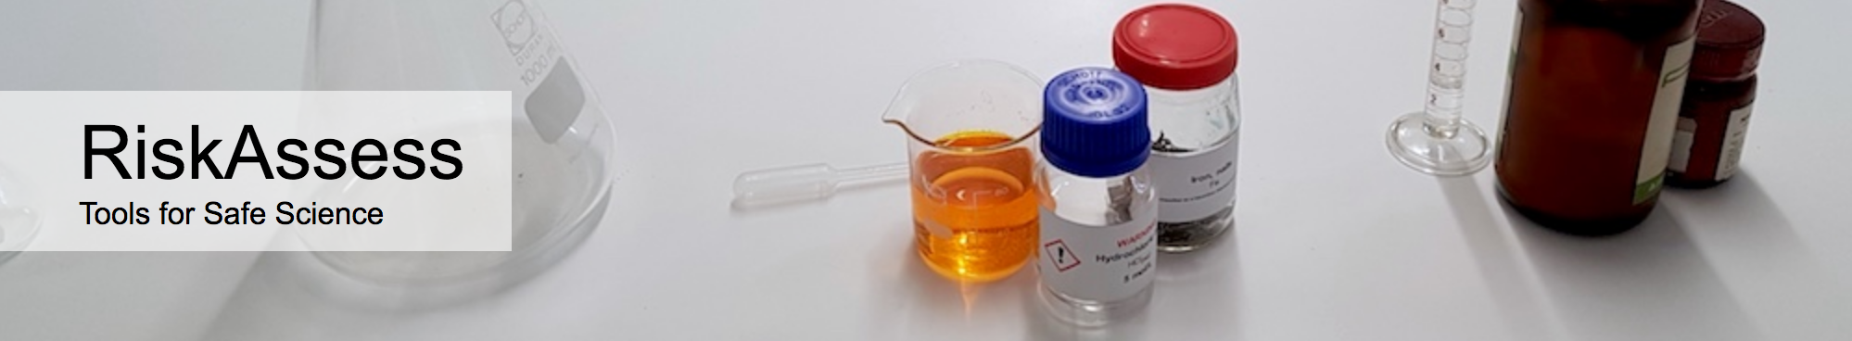
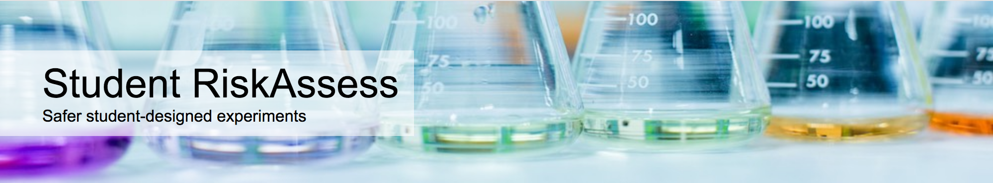
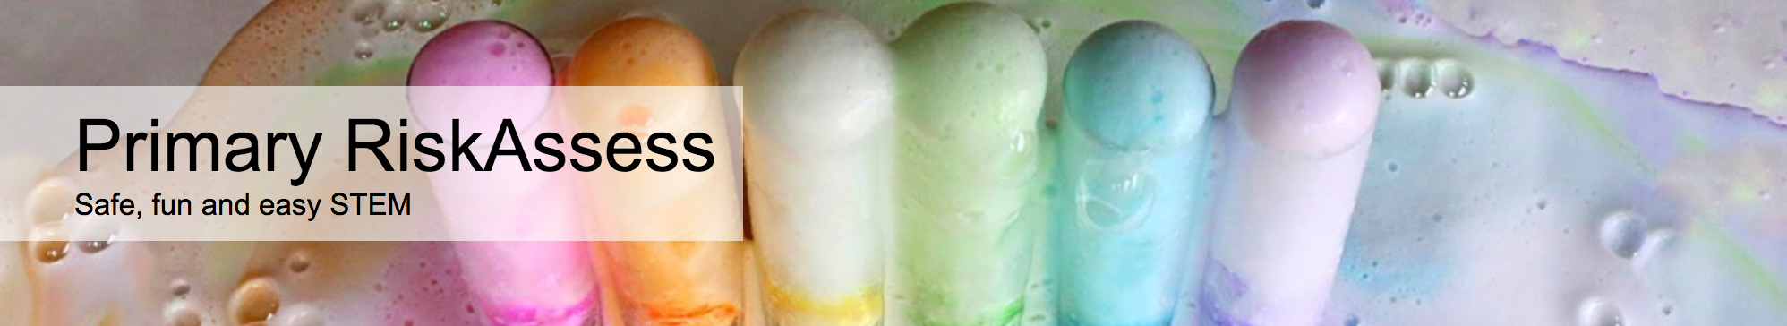
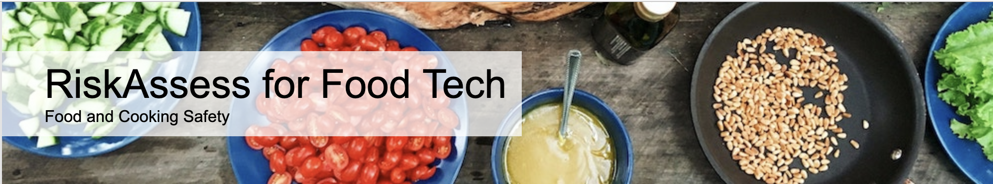
2700 schools
NSW: 829 (98%)
589 schools
NSW: 126 (15%)
200 schools
NSW: 185
82 schools
NSW: 34

Slide 3
New Features

Slide 4
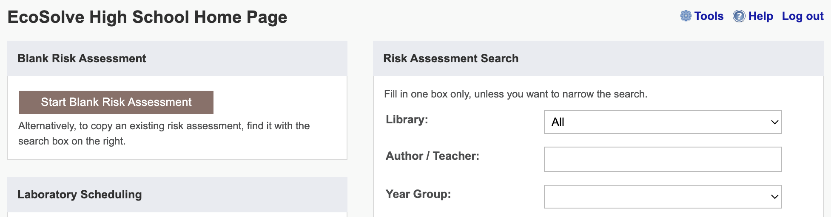
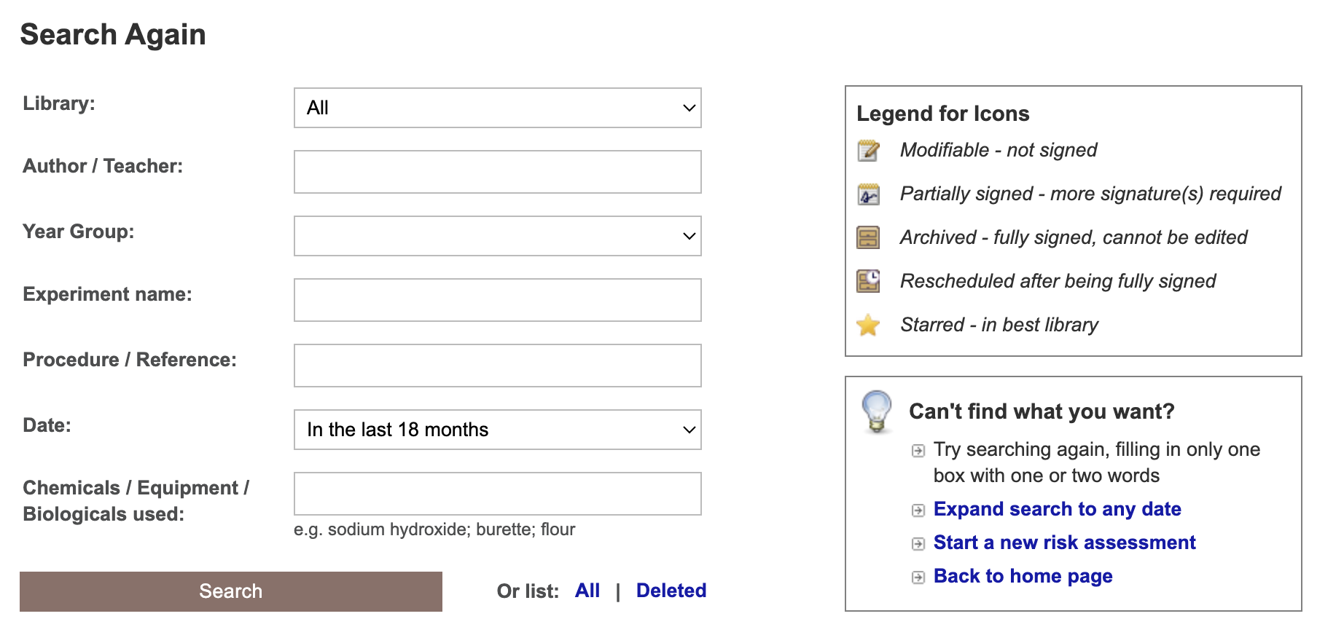
Notes:
Learning resources, videos & faq

Slide 5
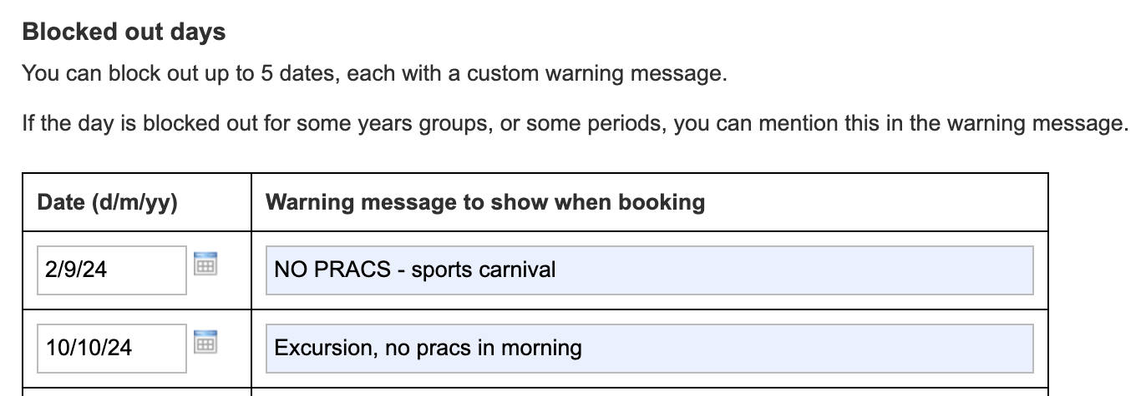
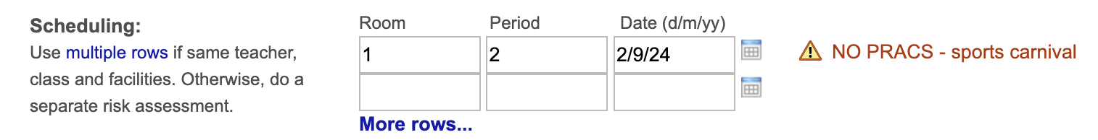

Slide 6
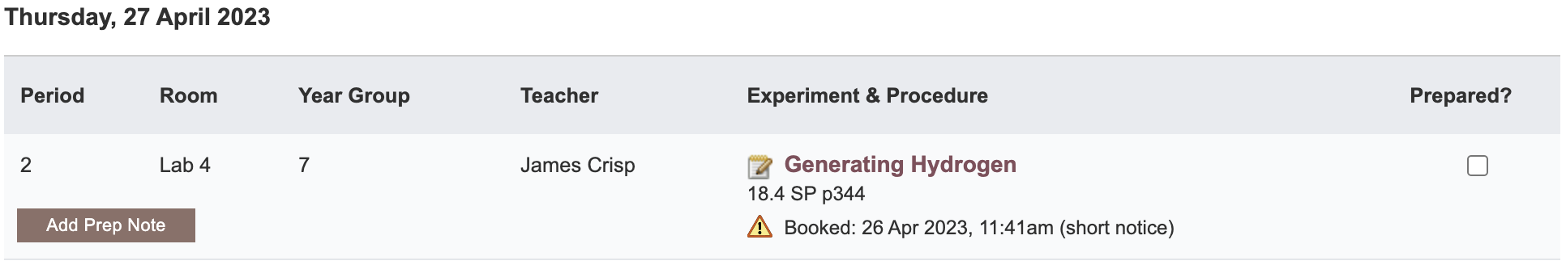

Slide 7
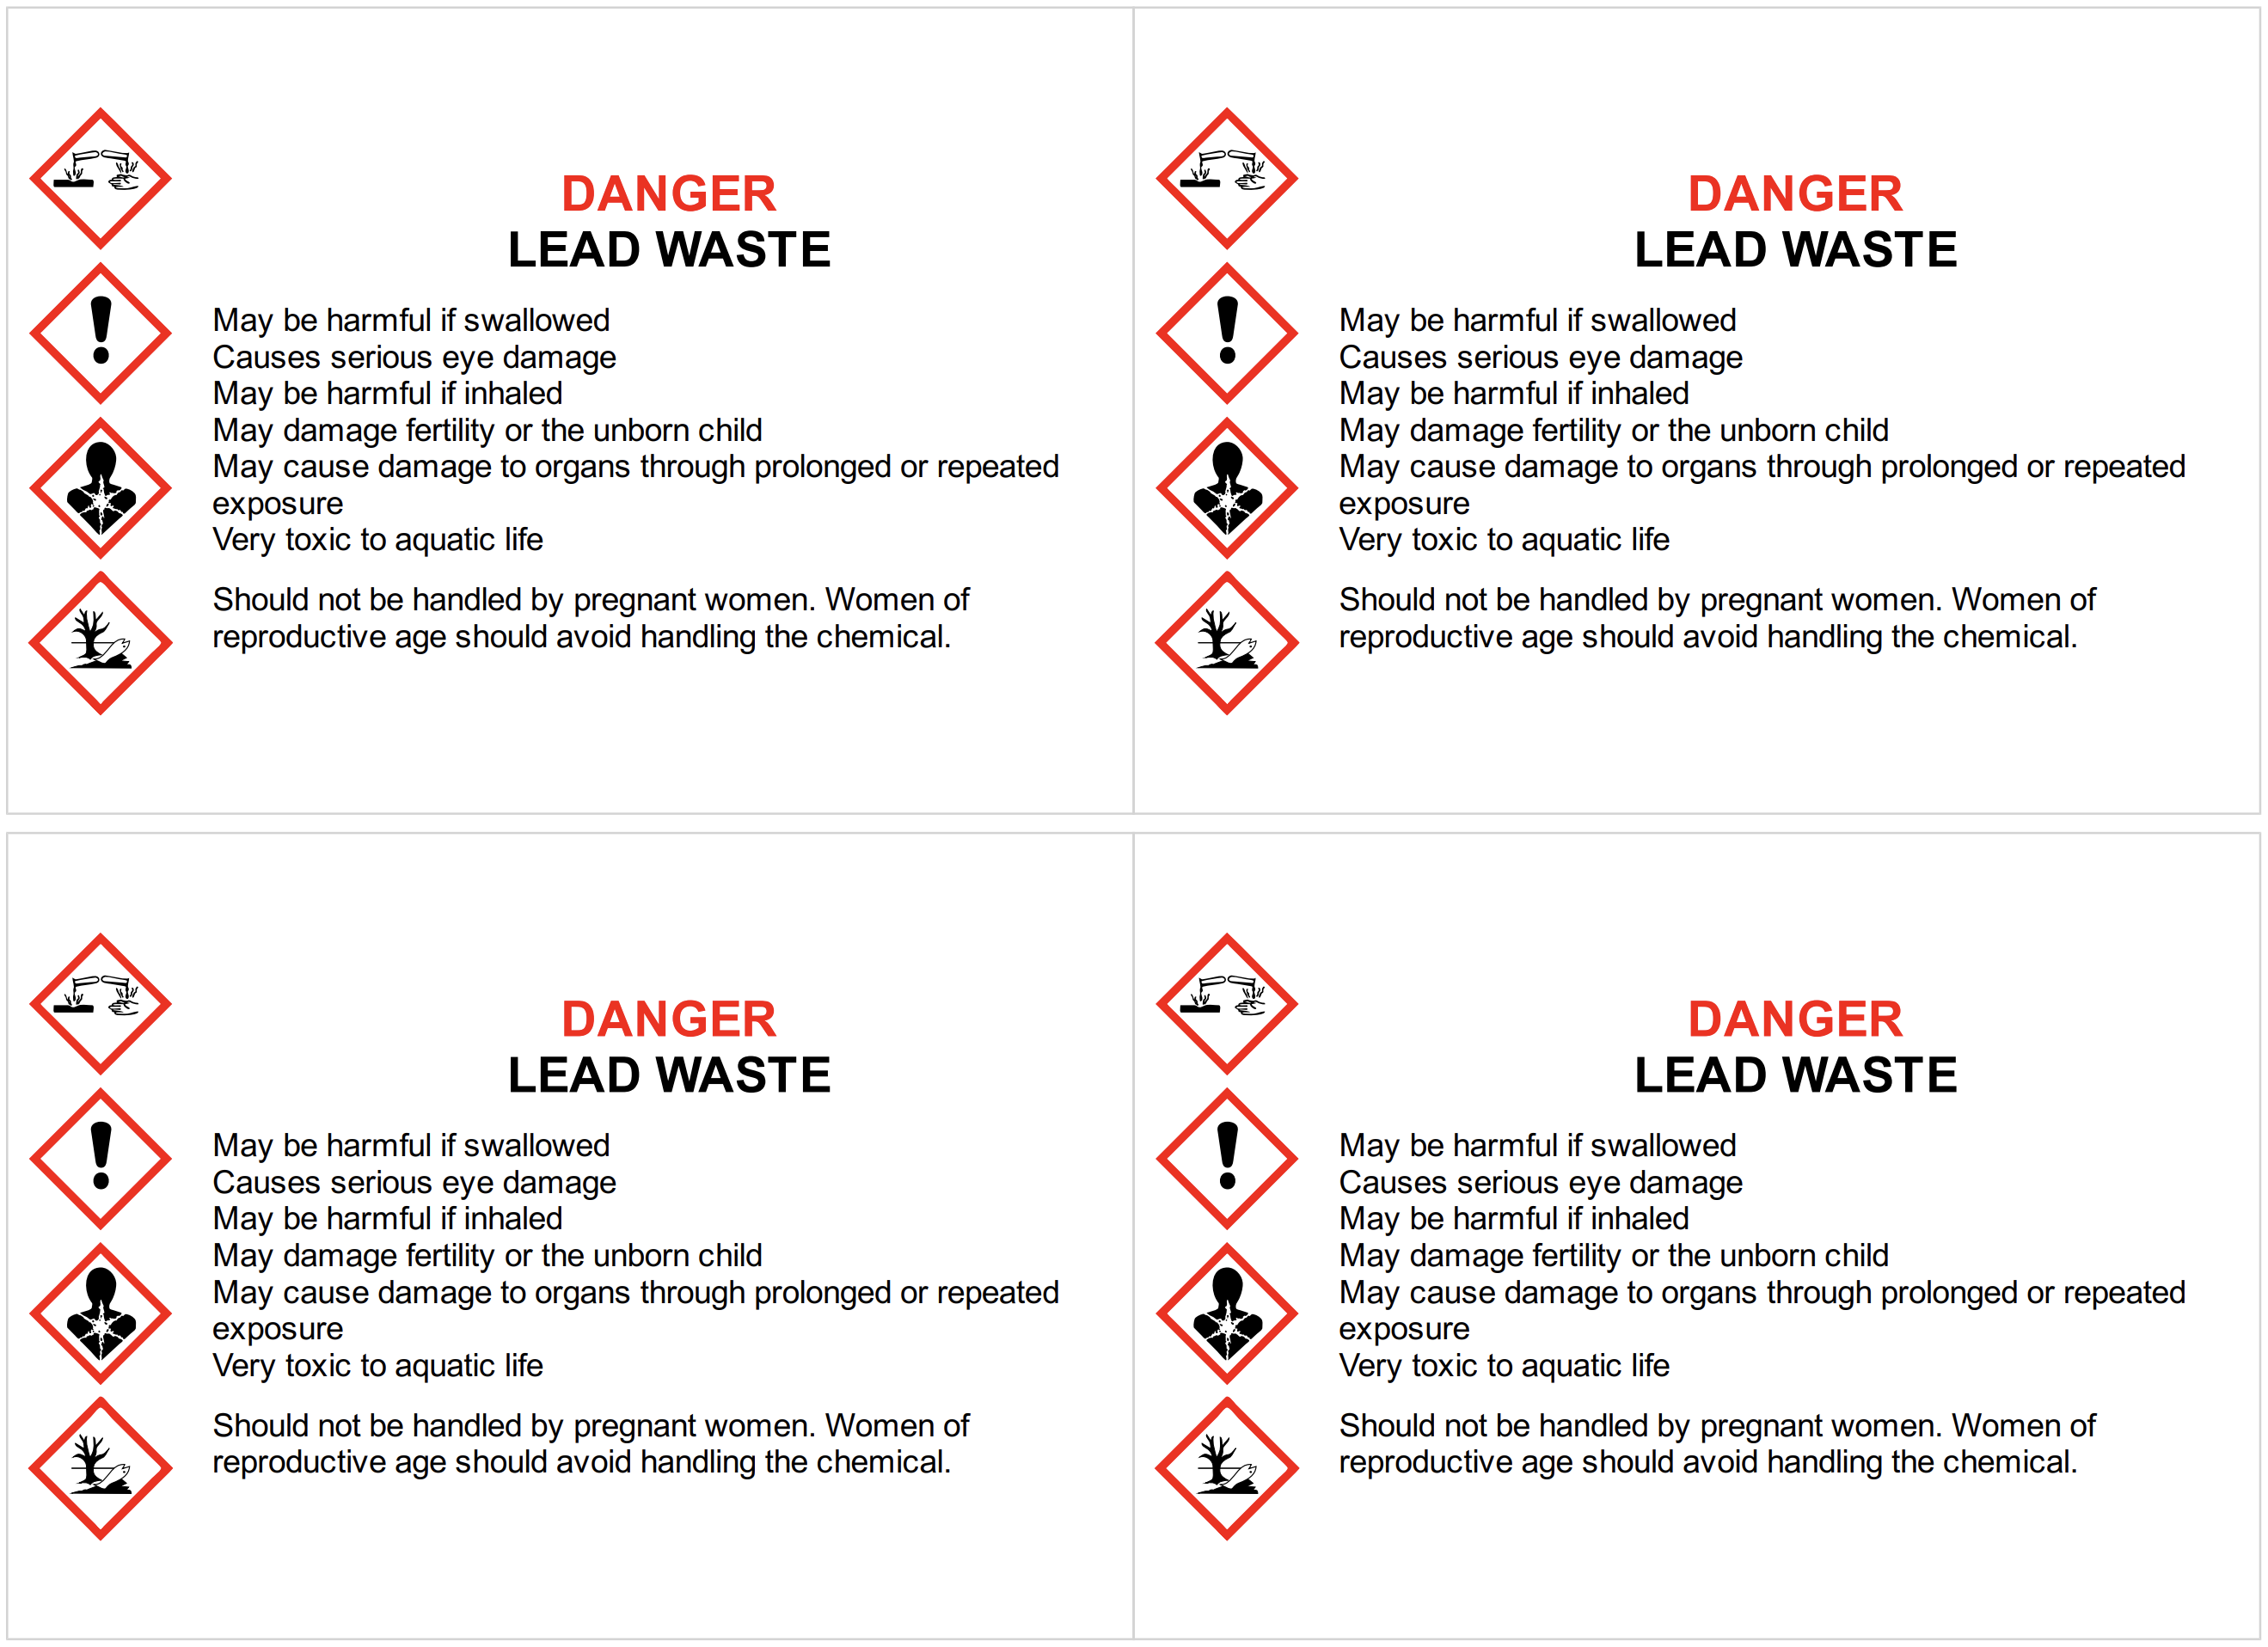
Disposal
Advice for all 3000 chemicals and solutions
Guide to disposal and waste container details
NEW Waste container labels!

Slide 8
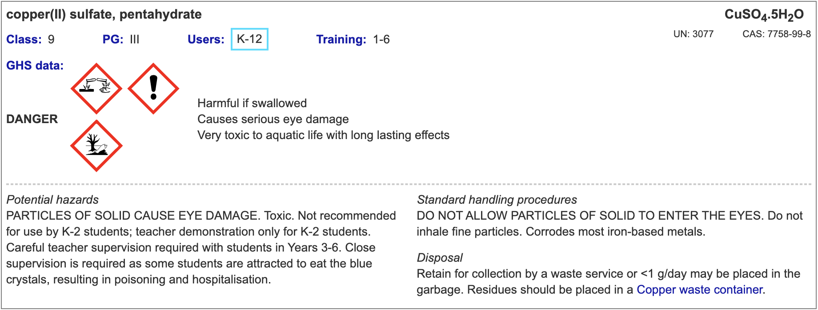
Copper sulfate hazard information upgraded
‘eye irritation’ (reversible) => ‘eye damage’ (> 0.19 M)
Take special care & safety glasses should be worn.
Update labels!

Slide 9
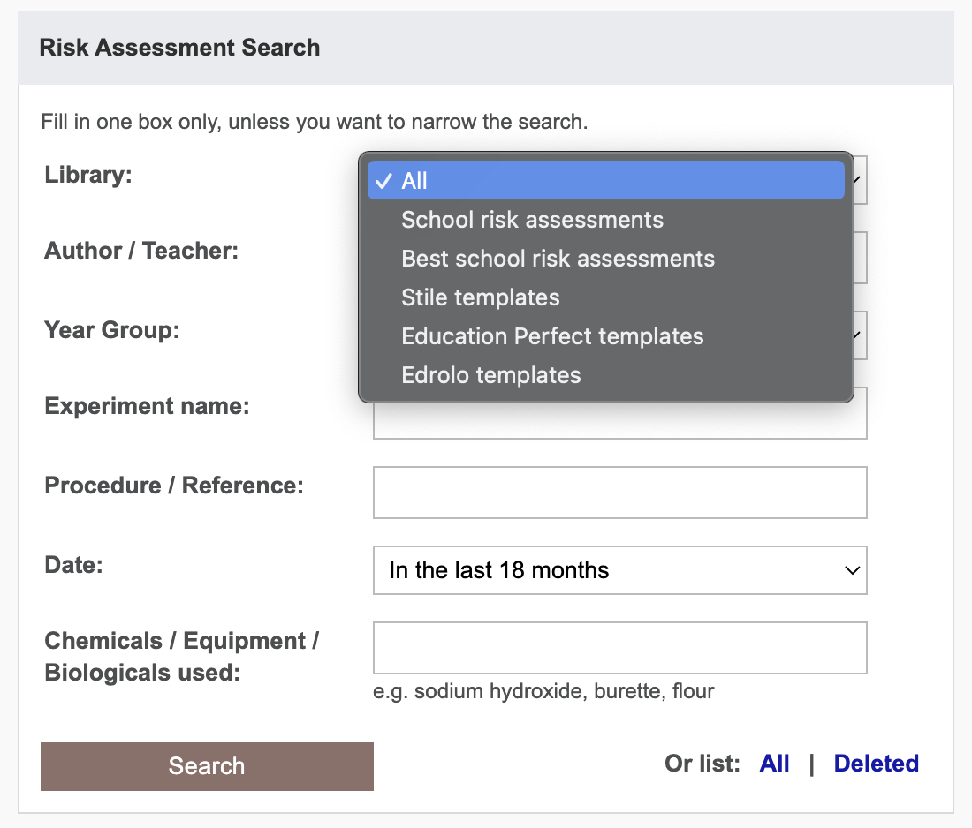

Slide 10
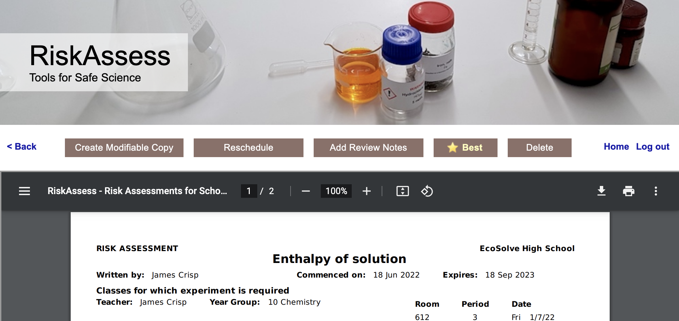
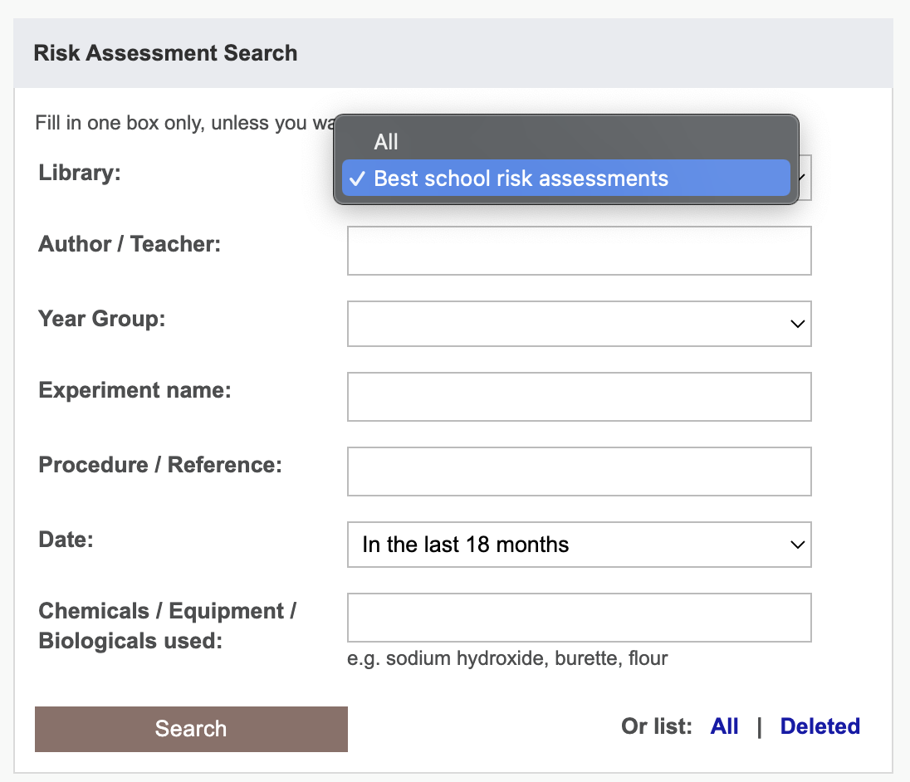
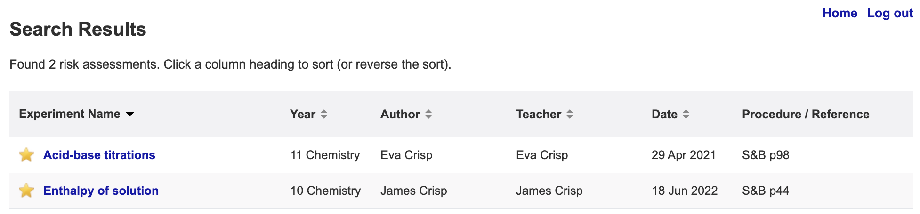

Slide 11
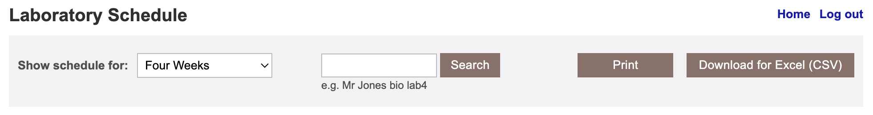
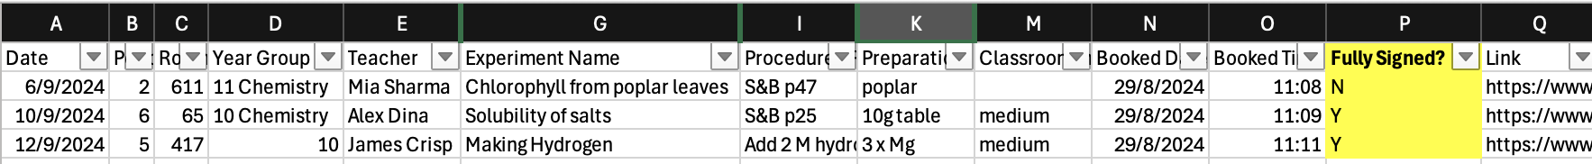

Slide 12
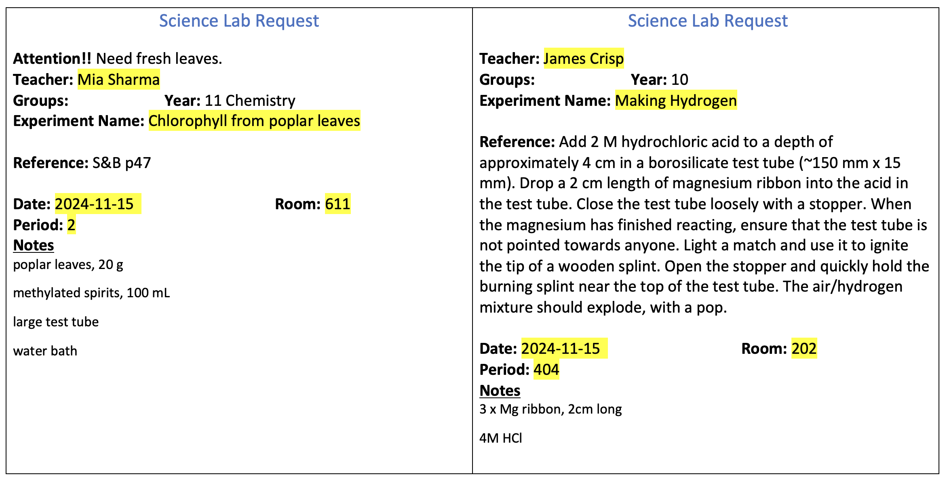
Trolley / Tub Tickets

Slide 13

NESA: 7-10 Syllabus
The Working Scientifically strand involves students in the processes of:
…
Planning investigations
…
identifying ways of reducing risks and addressing ethical guidelines in the laboratory and in the field
…
Conducting investigations
…
assessing risks and addressing ethical issues in using equipment, materials and chemicals safely
Notes:
https://c.educationstandards.nsw.edu.au/wps/wcm/connect/57e31750-9802-4808-a6ce-7a3c2df0ff04/science-years-7-10-syllabus-2018.pdf?MOD=AJPERES&CVID=
From
https://c.educationstandards.nsw.edu.au/wps/portal/nesa/k-10/learning-areas/science/science-7-10-2018

Slide 14
NESA: Working Scientifically 11-12
Opportunities should be provided for students to engage with all the Working Scientifically skills in investigations.
…
Planning investigations
Students justify the selection of equipment, resources chosen and design of an investigation. They ensure that all risks are assessed, appropriate materials and technologies are sourced, and all ethical concerns are considered.
…
Conducting investigations
Students are to select appropriate equipment, employ safe work practices and ensure that risk assessments are conducted and followed. Appropriate technologies are to be used and procedures followed when disposing of waste.
Notes:
https://educationstandards.nsw.edu.au/wps/portal/nesa/11-12/stage-6-learning-areas/stage-6-science/biology-2017/working-scientifically
Same for chemistry, physics etc

Slide 15
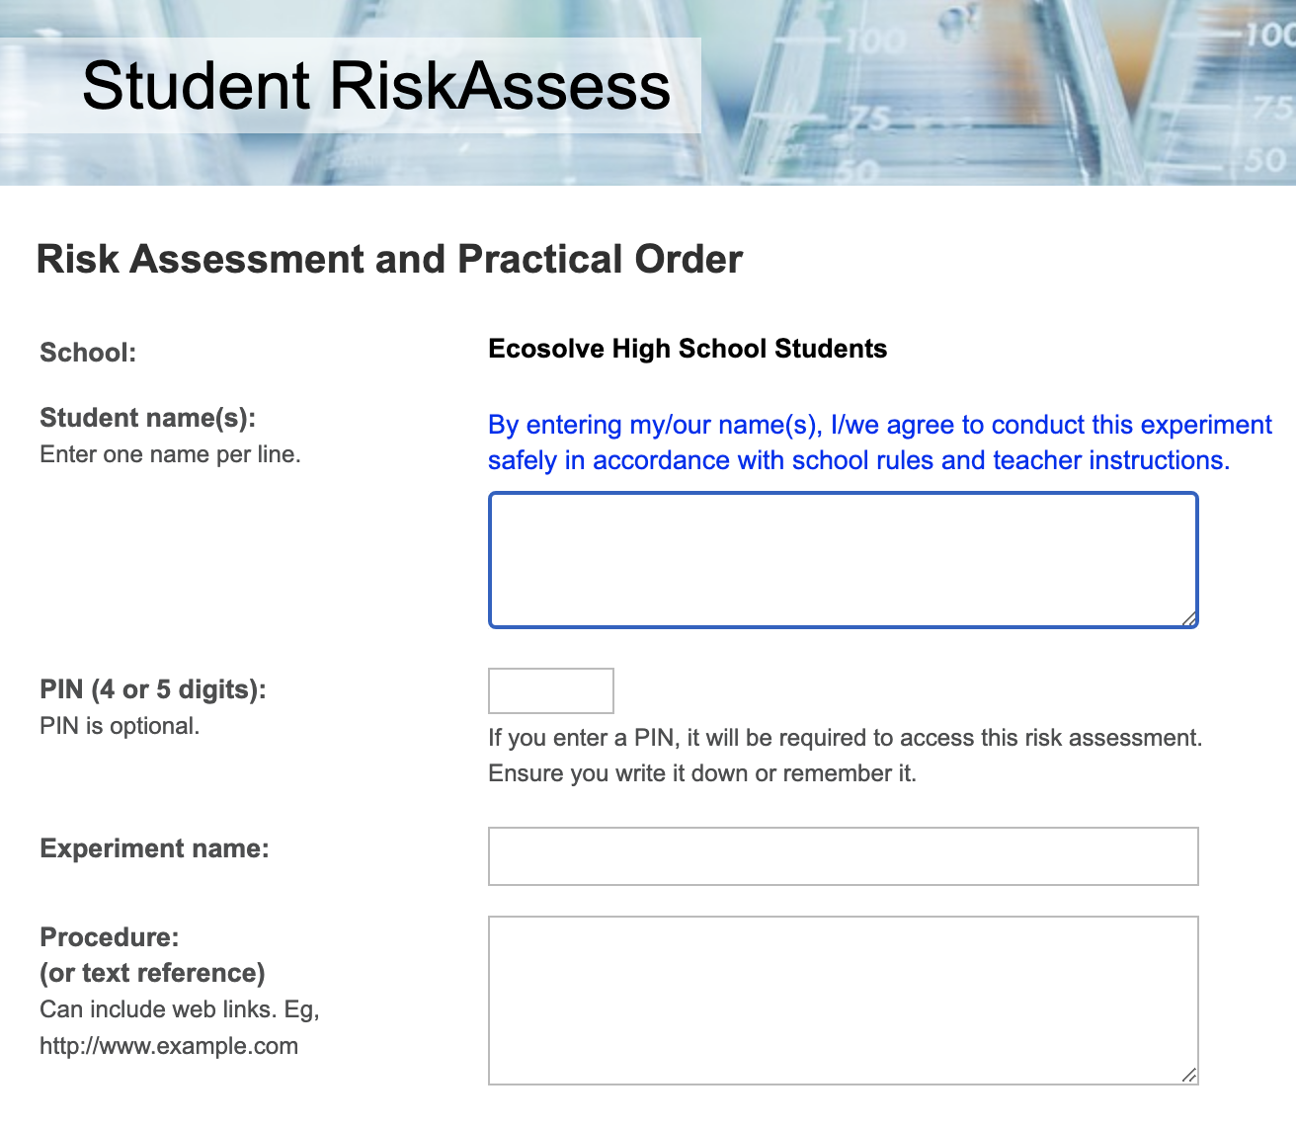

Slide 16
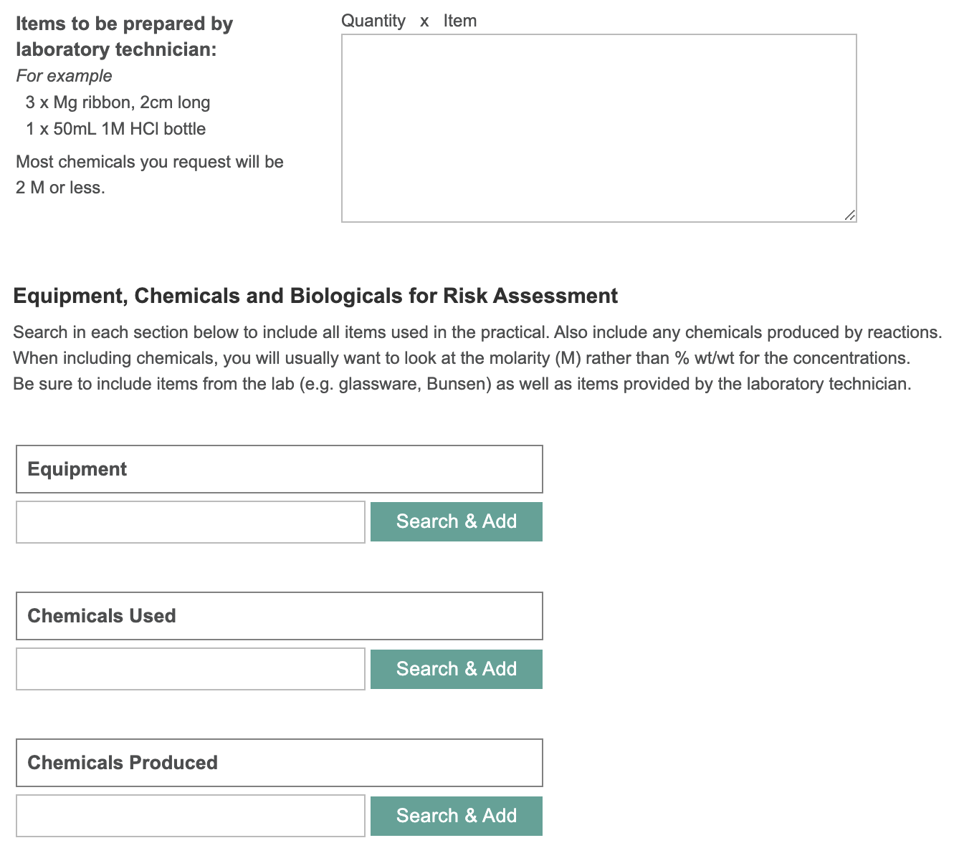

Slide 17
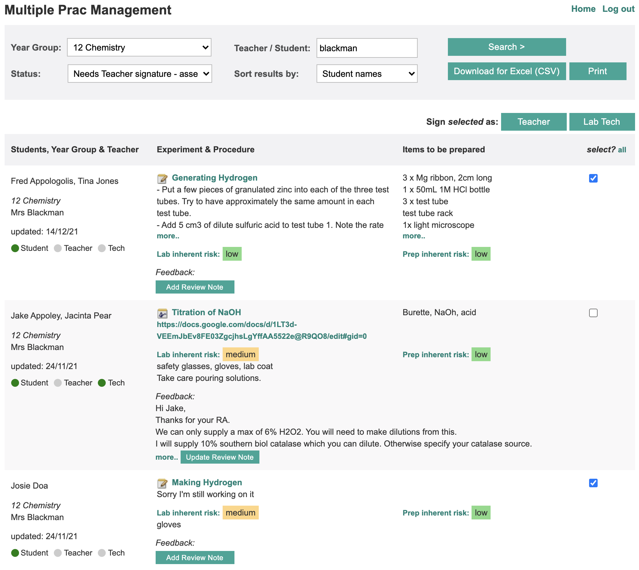

Slide 18
“Student RiskAssess helps students design their experiments more independently and become more aware of what they are doing rather than relying on the teacher to explain and confirm things like risks, and things to think about.”
Notes:
In the words of a teacher who put it better than I could..

Slide 19
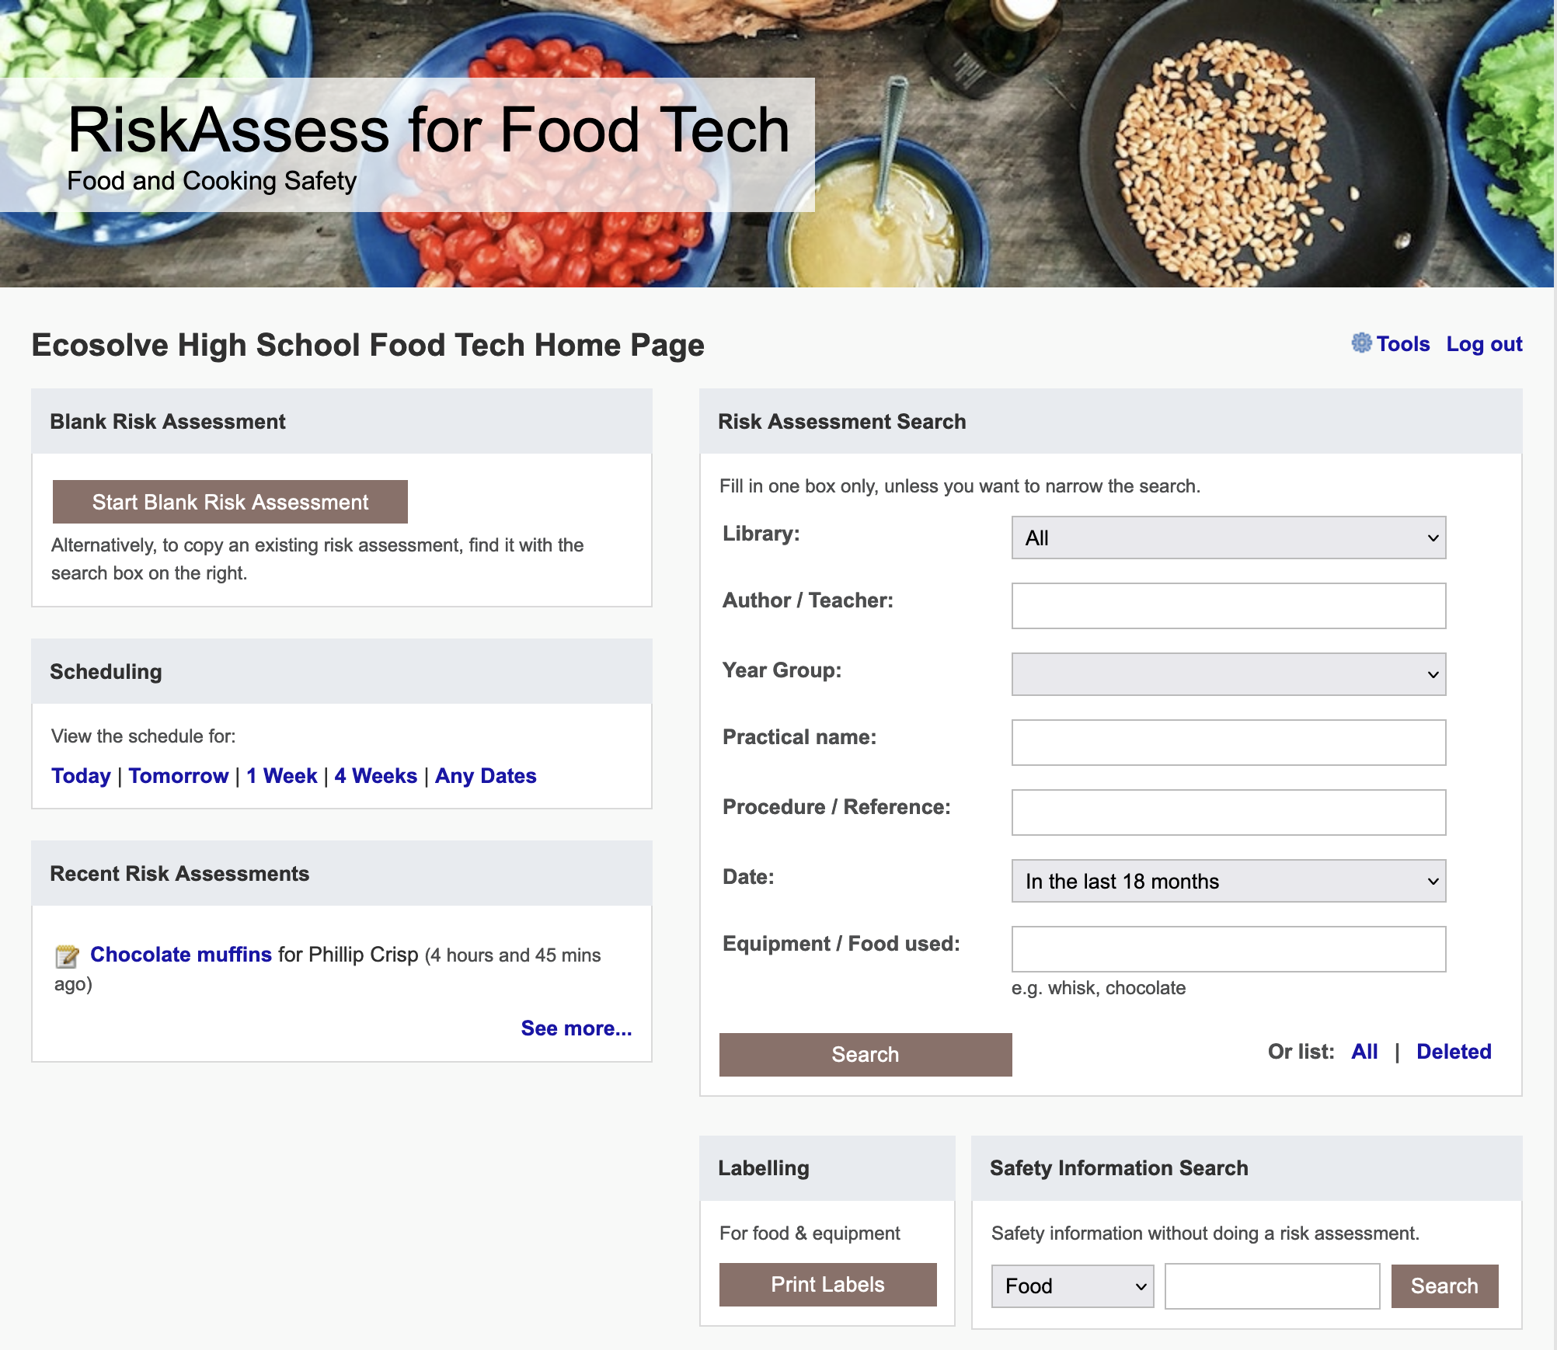

Slide 20
Future Ideas

Slide 21
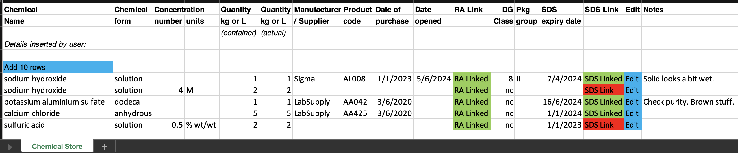
Chemical Register DRAFT
Links to RA safety info & SDS
Import from CSV/template/Chemwatch
Easy print out
Reports/Colours for SDS that need updating
Building (list), room (list), location (text)?
Access for outside Science (read-only link for all, editable link per department)?

Slide 22
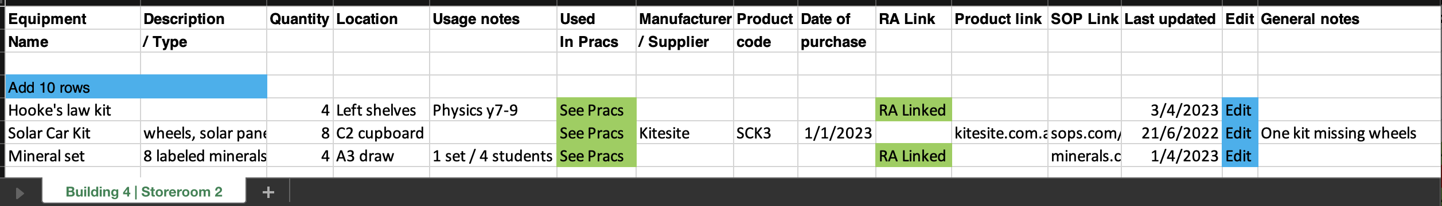
Equipment Inventory DRAFT
Building (list), room (list), location (text)?
Import from CSV/template
Easy print out
Anything missing?

Slide 23
Tips & Tricks

Slide 24
Menu
Shortcuts
icons, hcl, part name, day/month,
click banner, links, info links, delete,
Best RAs, search on less, # & sort
Scheduling
Excel/csv, any dates, last week,
search, no# pracs, prep notes,
double booking, lodged date
Tools
customise year groups,
stocktaking & usage, invoice,
backup system, defaults
Resources
learning resources, faq, eBook,
videos, libraries: Stile+EP+Edrolo
Labels
standard & custom labels
multiple chemicals on sheet
mixtures, non-chemicals
free text, biohazard symbol
Operations
reschedule, archive risk
assessments, annual review,
tech-only RAs, review notes,
high/extreme: 3 signatures, list
Multiple classes
author update/modifiable copy
Student RiskAssess
view student PINs, not last year
multiple prac management

