Slide 1
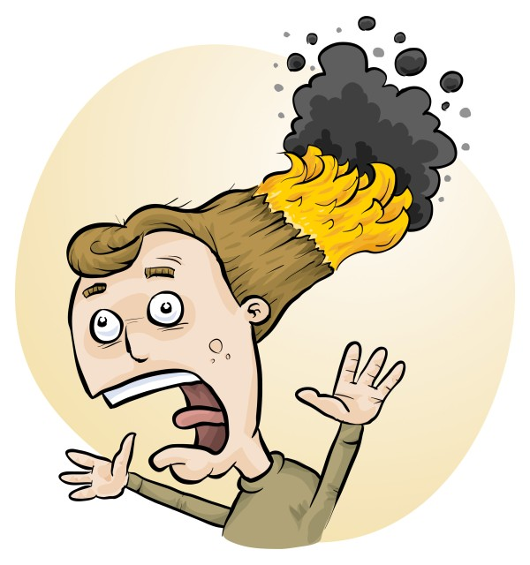
RiskAssess: Introduction, Logic and Latest Features
Phillip Crisp

Slide 2
• reduce injuries
• increase legal protection
Why do risk assessments?

Slide 3
Issues
facilities available
behaviour of the class
students with special needs
students with allergies
. . . . . . . .
Issues may, and commonly will,
differ from class to class.
No one hat fits all!

Slide 4
THE LAW
Work Health & Safety Act 2012
. . . a duty . . . to eliminate/minimise risks to health and safety as far as is reasonably practicable.
. . . taking into account and weighing up
all relevant matters including:
(a) the likelihood of the hazard or the risk concerned occurring; and
(b) the degree of harm that might result from the hazard or the risk
. . . .
Part 2, Sections 17 and 18
Notes:
NOT book “risk assessment”, tick sheet, etc
likelihood
degree of harm consideration requires
proper risk assessment using a risk matrix
e.g. Aust/ISO Standard on Risk Management

Slide 5
What is RiskAssess?
• web-based risk assessment tool
• customised to the school situation
• provides
- electronic templates (AU/ISO)
- database information on risks
(chemical, equipment, biological)
- equipment ordering/lab scheduling
- labelling (GHS)
- learning resources
• easy sharing of experiment templates for customisation

Slide 6
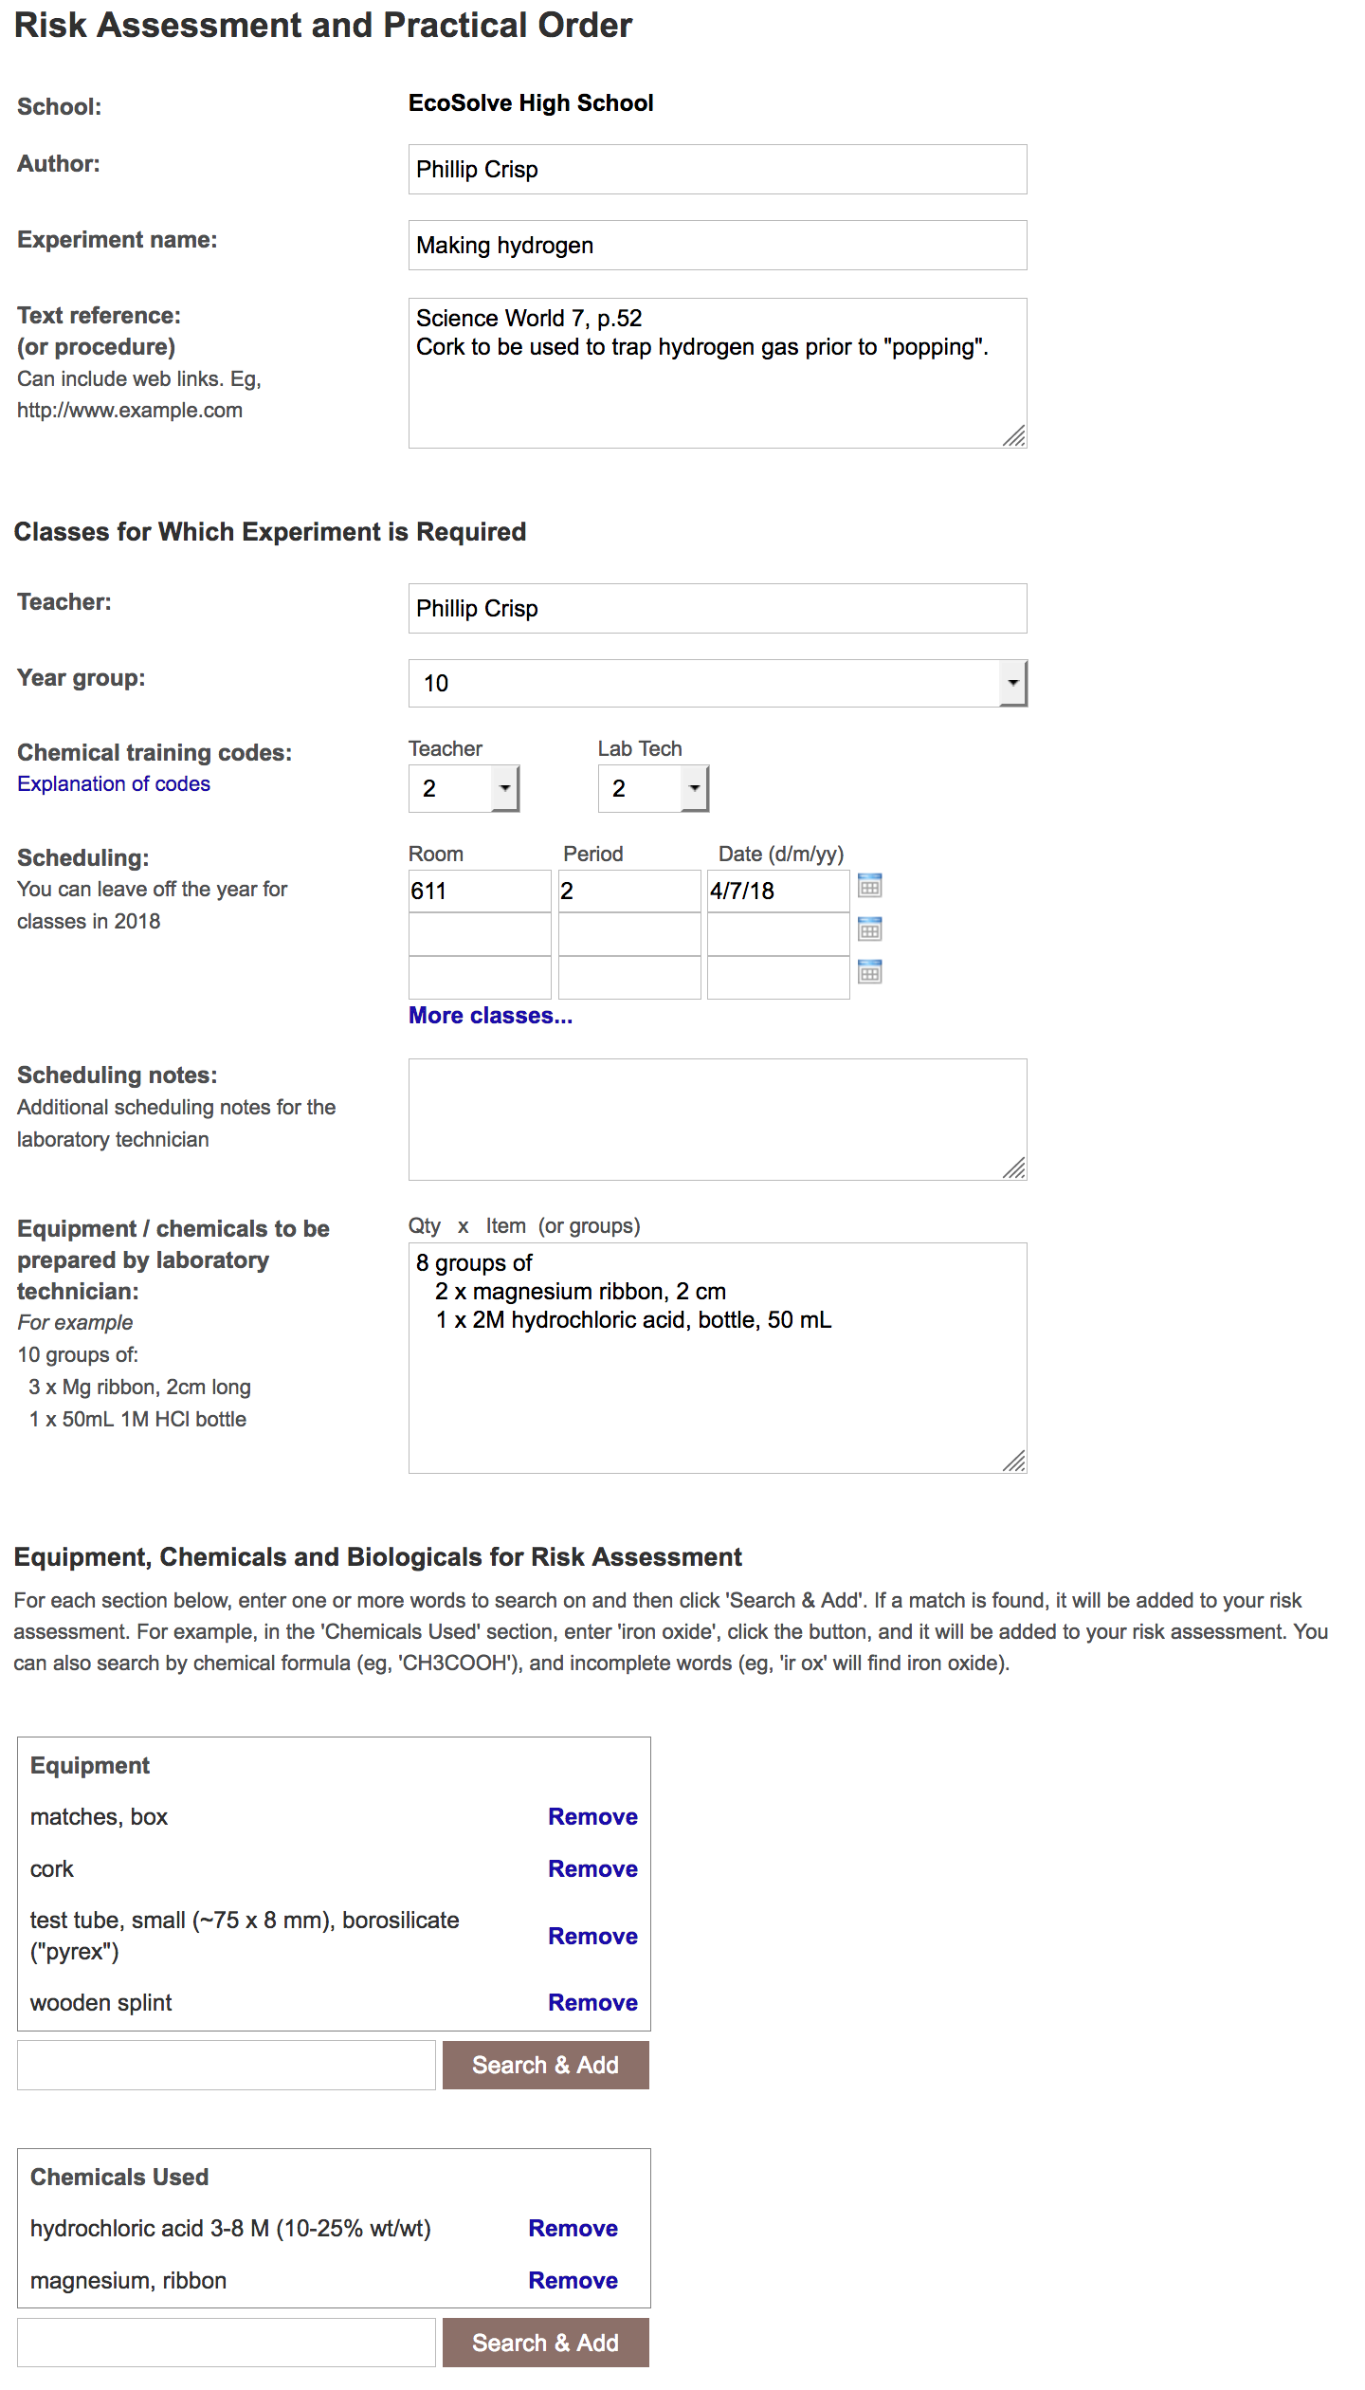
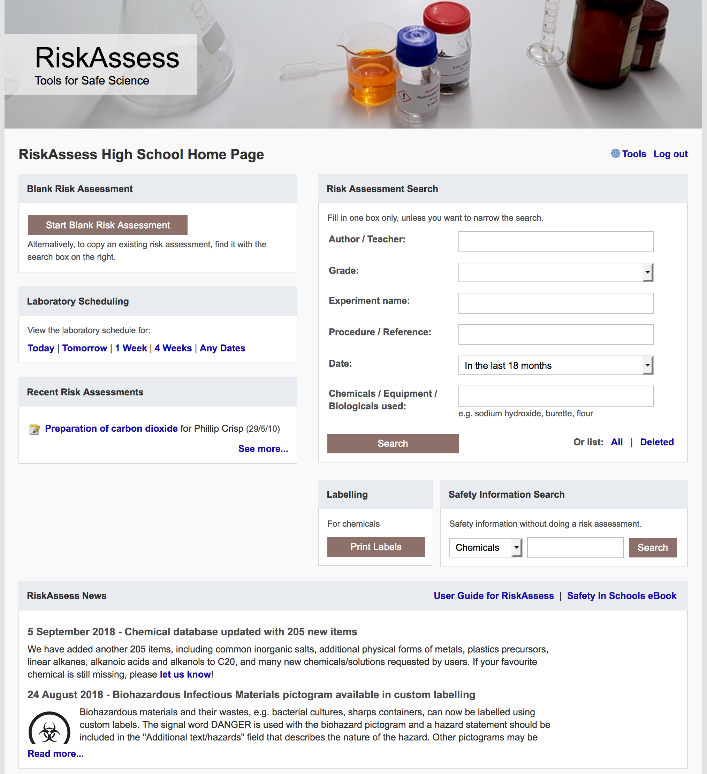

Slide 7
Logic
• separate sections for teacher and laboratory technician
• initial assessment of inherent risk
- if low, go to end
- if medium or more, introduce control measures
- if high or extreme, third reviewer required
• cross-checking by teacher/labtech/reviewer
• scheduling, ordering, labelling to save time
• inexpensive ($300+GST per campus per year)

Slide 8
Electronic system
• relatively rapid
• prompts sensitive to context
• reduces paper consumption
• easy to review and update
• easy monitoring and statistics
• easy storage
• demonstrated to work in schools RiskAssess: 2500 schools AU+NZ+CA
5,500,000 risk assessments
84% TAS

Slide 9
Details
• access from school/home
• nothing to install on computer, tablet or phone
(instant update)
• unlimited number of simultaneous users and risk assessments
• minimal data entry
• complements SDSs
• continuing input from science staff
• multiple backups of data & backup server
• support and advice

Slide 10
Advantages of RiskAssess
• proper consideration of risks and control measures
• standardisation
• storage of records for legal purposes
• communication between teachers and laboratory technicians
• discourages spur-of-the-moment experiments
• useful for new/inexperienced staff

Slide 11
Outcomes
• reduced frequency of injuries
- to students
- to school staff
• reduced costs for paperwork, litigation and payouts
• compliance with the law
• helps maintain variety of chemicals and equipment
• compliance with the Australian Curriculum

Slide 12
Shortcuts and ease
login, hcl, part name, click banner
icons, Best, links, hot links
Scheduling
download csv (for any dates)
double booking
new schedule search
Tools
customise year groups, backup
stocktaking & usage
Learning resources
Getting Started Video
Student RiskAssess
view student PINs, not last year
Multiple prac management
Disposal of chemicals
generic advice
individual chemical advice
Labels
standard & custom labels
commercial products, mixtures
non-chemicals
Operations
reschedule experiments, delete
archive risk assessments
labtech-only RAs, 3rd reviewer
annual review
RiskAssess for Food Tech
New version!

