Slide 1
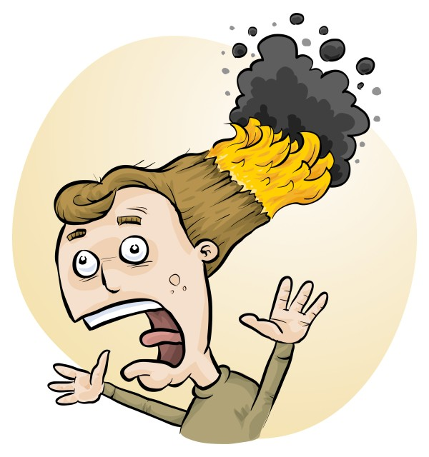
Mandatory risk assessment of science experiments
Phillip Crisp
Eva Crisp
James Crisp

Slide 2
THE LAW?
Work Health & Safety Act
. . . a duty . . . to eliminate/minimise risks to health and safety as far as is reasonably practicable.
. . . taking into account and weighing up
all relevant matters including:
(a) the likelihood of the hazard or the risk concerned occurring; and
(b) the degree of harm that might result from the hazard or the risk
. . . .
Part 2, Sections 17 and 18

Slide 3
all relevant matters includes
facilities available
behaviour of the class
students with special needs
students with allergies, etc
(NOT book “risk assessment”, tick sheet, etc)
likelihood
degree of harm consideration requires
proper risk assessment using a risk matrix
e.g. Aust/ISO Standard on Risk Management

Slide 4
You should:
identify
assess
control
risks
Before: Establish the context
After: Monitor and review
Always: Consult and communicate

Slide 5
Risk identification
• history of “accidents” and “near-accidents”
- at school
- at similar schools
• brainstorming, preferably with colleagues
• checklists of possible risks
• authoritative sources e.g. SDSs, databases

Slide 6
Risk assessment
To assess the severity of a risk,
you need to consider:
• the consequences of the event, and
• the chance that it will occur (likelihood)
AU ISO 31000:2009 “Risk management”
HB 436:2013 “Risk management guidelines”
Risk matrices used in schools are 3 x 3 to 5 x 5
See www.riskassess.com.au/info/learning_resources

Slide 7
Risk control
Hierarchy of options:
elimination
substitution
isolation
engineering
administration
personal protective equipment

Slide 8
Assess risks
≥Medium
risk level
Low
risk level
Add control measures
DO
EXPERIMENT
Inherent level of risk
= risk level without any control measures besides “routine procedures”
Residual level of risk
= risk level with control measures in place

Slide 9
What is RiskAssess?
• web-based risk assessment tool
• customised to the school situation
• provides
- electronic templates (AU/ISO)
- database information on risks
(chemical, equipment, biological)
- equipment ordering/lab scheduling
- labelling (GHS)
- learning resources
• easy sharing of experiment templates for customisation

Slide 10
Logic
• separate sections for teacher and laboratory technician
• initial assessment of inherent risk
- if low, go to end
- if medium or more, record control measures
- if high or extreme, third reviewer required
• cross-checking by teacher/labtech/reviewer
• scheduling, ordering, labelling to save time
• inexpensive ($250+GST per campus per year)

Slide 11
Details
• access from school/home
• nothing to install on computer, tablet or phone
(instant update)
• unlimited number of simultaneous users and risk assessments
• minimal data entry
• complements SDSs
• continuing input from science staff
• multiple backups of data & backup server
• support and advice

Slide 12
Advantages of risk assessments
• reduced frequency of injuries
- to students
- to school staff
• reduced costs for paperwork, litigation and payouts
• compliance with the law
• helps maintain variety of chemicals and equipment
• compliance with the Australian Curriculum

Slide 13
Advantages of a formalised system
• proper consideration of risks and control measures
• standardisation
• storage of records for legal purposes
• communication between teachers and laboratory technicians
• discourages spur-of-the-moment experiments
• useful for new/inexperienced staff

Slide 14
Paper-based system
• time consuming
• unwieldy forms
• non-searchable
• difficult to update
• storage problems

Slide 15
Electronic system
• relatively rapid
• prompts sensitive to context
• reduces paper consumption
• easy to review and update
• easy monitoring and statistics
• easy storage
• demonstrated to work in schools RiskAssess: 1800 schools AU+NZ+CA
2,400,000 risk assessments

Slide 16
Even more!
• scheduling system
• prac ordering
• GHS labelling
- standard
- customised

Slide 17
Summary of benefits
• safer laboratories
• better communication
• meets legal requirements
• reduced costs
• improved efficiency
• happy lab techs and teachers!

Slide 18
Student RiskAssess
• meets safety training requirements of
- new Australian Curriculum for Science
- International Baccalaureate
- extended investigations (student-initiated)
• optimised for student use
- students must agree to follow rules and instructions
- online help screens and documents
- PINs to prevent copying/allow use for assessment
• continues to have all facilities of RiskAssess
• class of 30 simultaneous users no problem
• can be used on
- laptops, iPads and other tablets
- smart phones (iPhones, Android, etc)
• costs an additional $250 + GST per campus per year

Slide 19
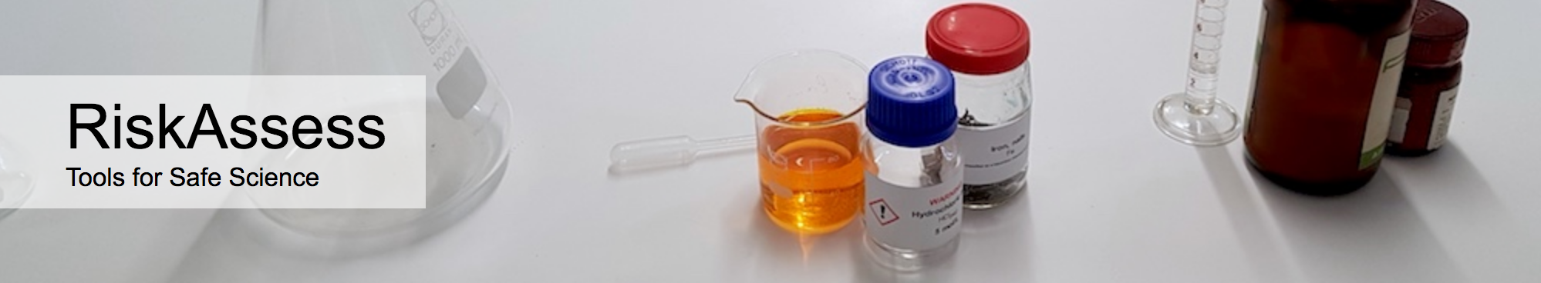

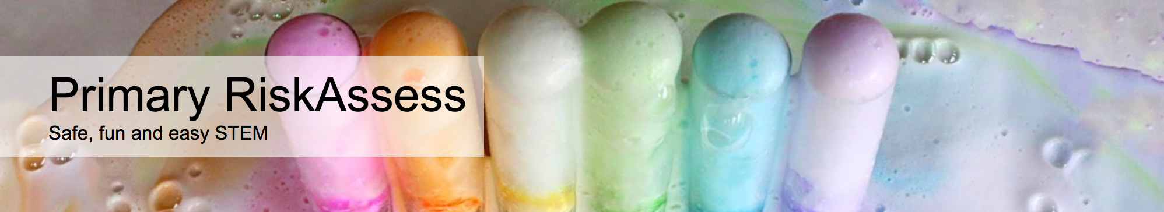
1800 schools
NSW: 530 (50%)
400 schools
NSW: 92 (8%)
160 schools
NSW: 158 (3%)

