Slide 1
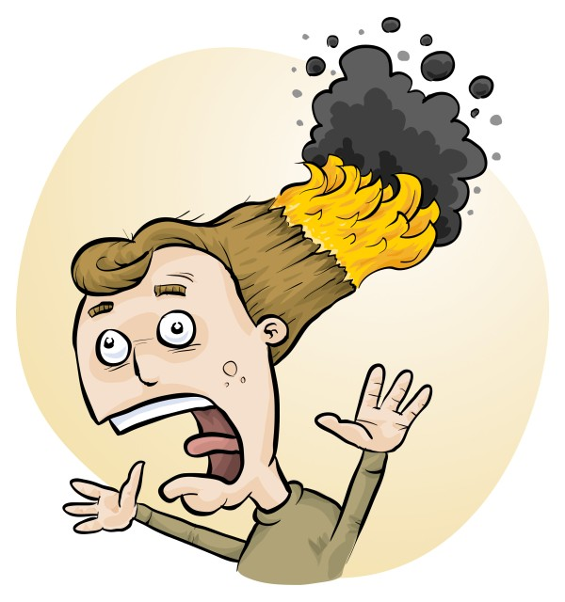

Student-led investigations made easier using
Student RiskAssess
Eva Crisp
Phillip Crisp
James Crisp

Slide 2
Student RiskAssess
is a
fun
interesting
instructive
way to meet the safety requirements
of the Australian Curriculum

Slide 3
RiskAssess
“RiskAssess”
“Student RiskAssess”
for Staff
for Students
Started 2008
Started 2013
to meet
Aust Curriculum
1980 schools
470 schools

Slide 4
Safety requirements in the Australian Curriculum for Science
Years 4-12
Students to take increasingly active role in consideration of risk and safety
Years 9 &10
“Assess risk” (Content description)
“identify potential hazards of chemicals and biological materials . . .” (Elaboration)
Years 11 & 12
“Conducting risk assessments (Inquiry skill)

Slide 5
Student RiskAssess
• web-based risk assessment tool
• tailored to the school situation
• customised for students
• provides
electronic templates (AU/ISO)
database information on risks
(chemical, equipment, biological)
equipment ordering
lab scheduling
• easy for teachers, especially RA users

Slide 6
Logic
• separate sections for student, teacher and laboratory technician
• initial assessment of inherent risk
if low, go to end
if medium or more, record control measures
if high or extreme, third reviewer required
• cross-checking by teacher / lab tech / reviewer
• scheduling and ordering system to save time
• PINs to prevent student copying (when required)
• inexpensive ($250 + GST per campus per year)
Notes:
PINs mean you can use it for assessment purposes

Slide 7




Electronic devices
Digital technologies* are emphasised in
Science Inquiry Skills, Years 7-10
*technology systems that handle digital data including hardware and software for specific purposes

Slide 8
Details
• access from school/home
• nothing to install on computer (instant update)
• unlimited number of simultaneous users and risk assessments
• minimal data entry
• complements SDSs
• continuing input from science staff
• multiple backups of data & backup server
• support and advice

Slide 9
Special Staff Login
Student UserName
Staff Password

Slide 10
Staff Tools
see risk assessments without entering PINs
enter comments and corrections in Notes
view lab schedule & stocktaking
sign that risks are adequately controlled
handle large numbers of student RAs with search and data downloads
Notes:
Data downloads == CSV for Excel so you can cut and slice your data as you need

Slide 11
Advantages of risk assessments
• reduced frequency of injuries
to students
to school staff
• reduced costs for paperwork, litigation and payouts
• compliance with the law (c.f. industry)
• helps maintain variety of chemicals and equipment
• compliance with the Australian Curriculum

Slide 12
Summary of benefits
• student engagement
• can be used for assessment
• uses newest technologies
• training in life skills
• inexpensive
• happy students and teachers!

