Slide 1
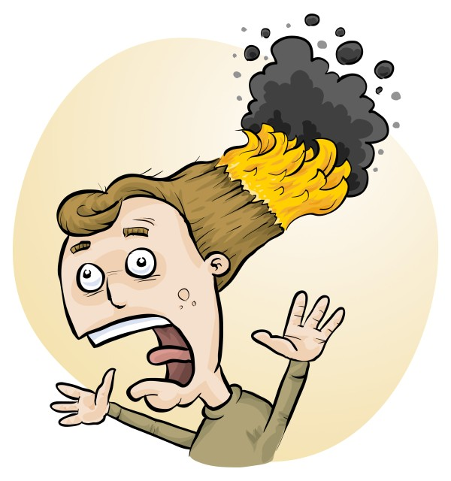
Primary STEM: fun examples of safe chemical activities
Eva Crisp, Phillip Crisp and Mia Sharma

Slide 2
Engagement
• bright colour(s)
• movement
• smell
• noise
• gross
• sparks/explosion
• lots to do

Slide 3
Pedagogy
Students should actually learn something
Not just gee whiz!

Slide 4
Teacher challenges
Lack of familiarity with chemicals
Fear of injuries
Limited understanding of science
Don’t follow YouTube without further research!

Slide 5
Primary RiskAssess
Helps with
advice on potential hazards:
chemicals, equipment, biological
including allergies
risk assessments, as required by law

Slide 6
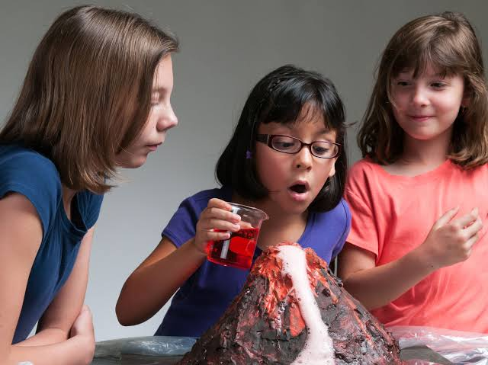
Volcano
https://www.thoughtco.com/baking-soda-volcano-science-fair-project-602202

Slide 7
Primary RiskAssess
Demonstration
Notes:
We will first show you how PRA works, then go through some favourite experiments that you might wish to try in the classroom.

Slide 8
Examples of fun experiments
• Investigating food dyes
• Investigating inks
• Sniff testing
• Water walking
• Pineapple eating jelly
• Red cabbage magic dye
• Tie dye with red cabbage

Slide 9
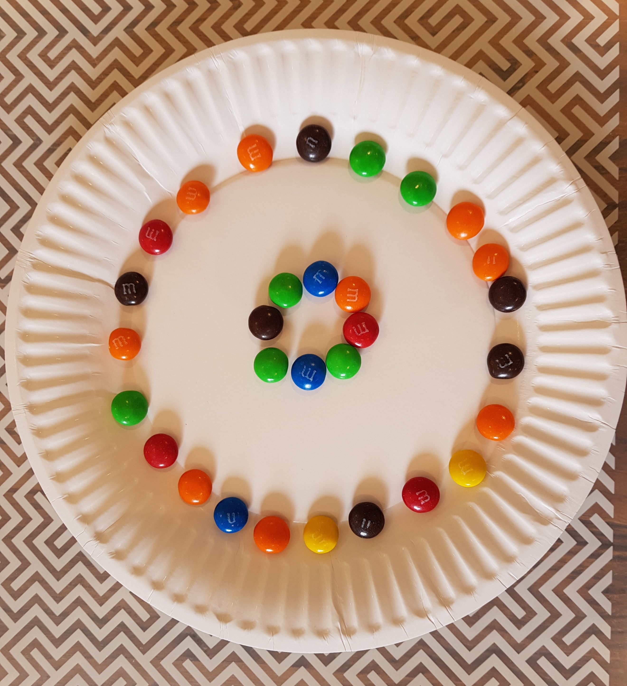
Investigating food dyes

Slide 10
Question (what are you trying to find out?)
What will happen to M&Ms when you put them in water?
Hypothesis (a guess that you can test)
. . . . . . . . . . . . . . . . . . . . . . . . . . . . . . . . . . .
Method (step-by-step list of what you will do)
Arrange an inner and outer ring of M&Ms on a paper plate on a flat table. The colours can be in any order. It should look a bit like the photo.
Add water from a bottle slowly:
• enough to wet all of the bottom of the plate
• only go about halfway up the side of M&Ms.
Leave the plate for about 5 minutes and record 3 observations in the table below.

Slide 11
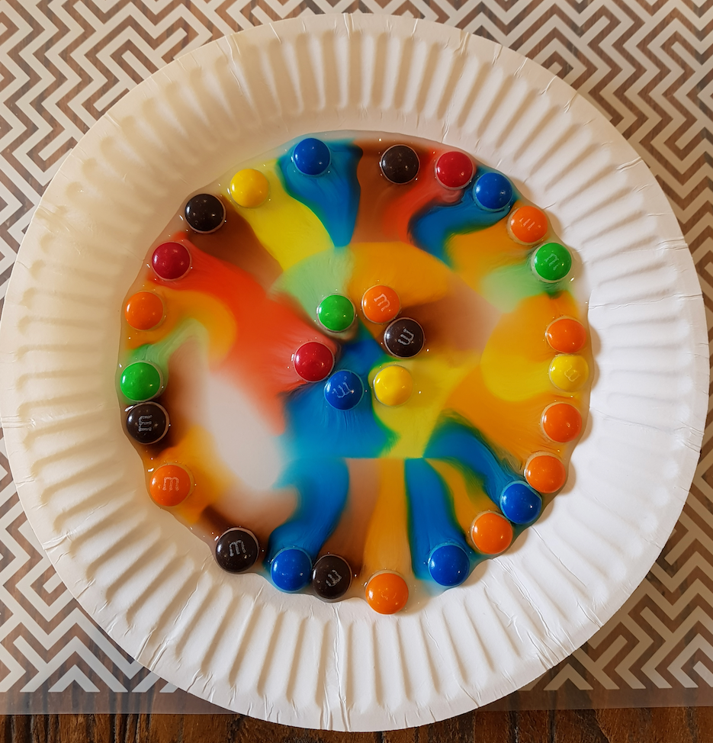
M&Ms with water

Slide 12
Observations
(what you see, hear, smell or touch)
(1) . . . . . . . . . . . . . . . . . . . . . . . . . . . . . . . . . . . .
(2) . . . . . . . . . . . . . . . . . . . . . . . . . . . . . . . . . . . .
(3) . . . . . . . . . . . . . . . . . . . . . . . . . . . . . . . . . . . .
Draw a diagram of the colours on the plate
Discussion
(Why did you get those results? What further experiments could you conduct?)
. . . . . . . . . . . . . . . . . . . . . . . . . . . . . . . . . . . .
. . . . . . . . . . . . . . . . . . . . . . . . . . . . . . . . . . . .
Conclusion
(Did your results support your hypothesis?)
. . . . . . . . . . . . . . . . . . . . . . . . . . . . . . . . . . . .

Slide 13
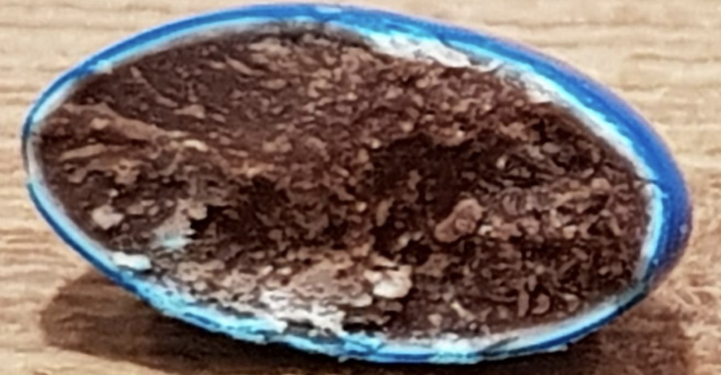
Half a blue M&M

Slide 14
Explanations
Coloured dye is in the surface layer
Dye is soluble in water
Dye is spread by diffusion and water currents
Dyes interact to produce new colours
e.g. blue + yellow = green

Slide 15
Learning skills
observation
descriptive writing
scientific thinking
art
Topic links
colour
eyes
rainbows

Slide 16
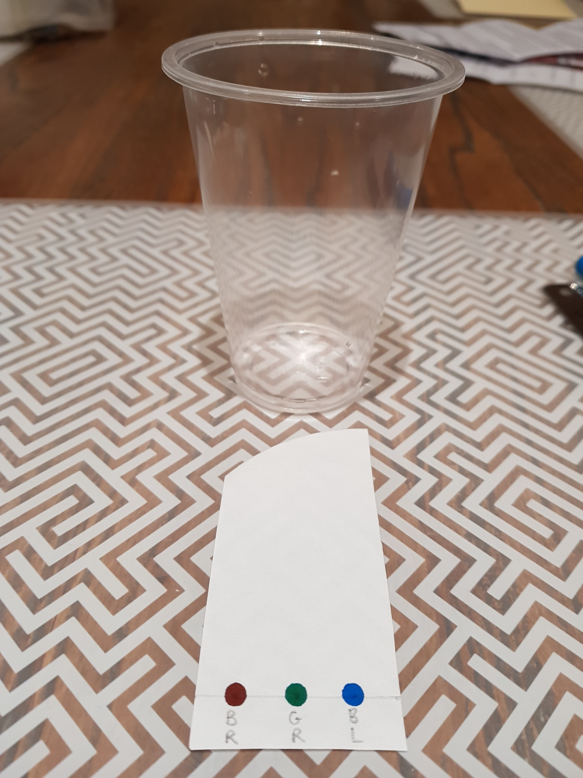
Investigating inks

Slide 17
Question (what are you trying to find out?)
What colours are different inks made from?
Hypothesis (a guess that you can test)
. . . . . . . . . . . . . . . . . . . . . . . . . . . . . . . . . . .
Method (step-by-step list of what you will do)
Prepare the filter paper.
Using the 3 different coloured pens, place an ink dot of each colour on top of the pencil dot. Leave the pen on the paper for about a second, so that the ink spreads a little and makes a slightly larger dot.
Pour a very small volume of water into the cup. Just enough to cover the bottom fully. The water should be less than half a centimetre deep.
Put the filter paper into the cup carefully, so it stands up on the bottom of the cup. The coloured ink dots should be slightly above the waterline. Watch and wait!

Slide 18
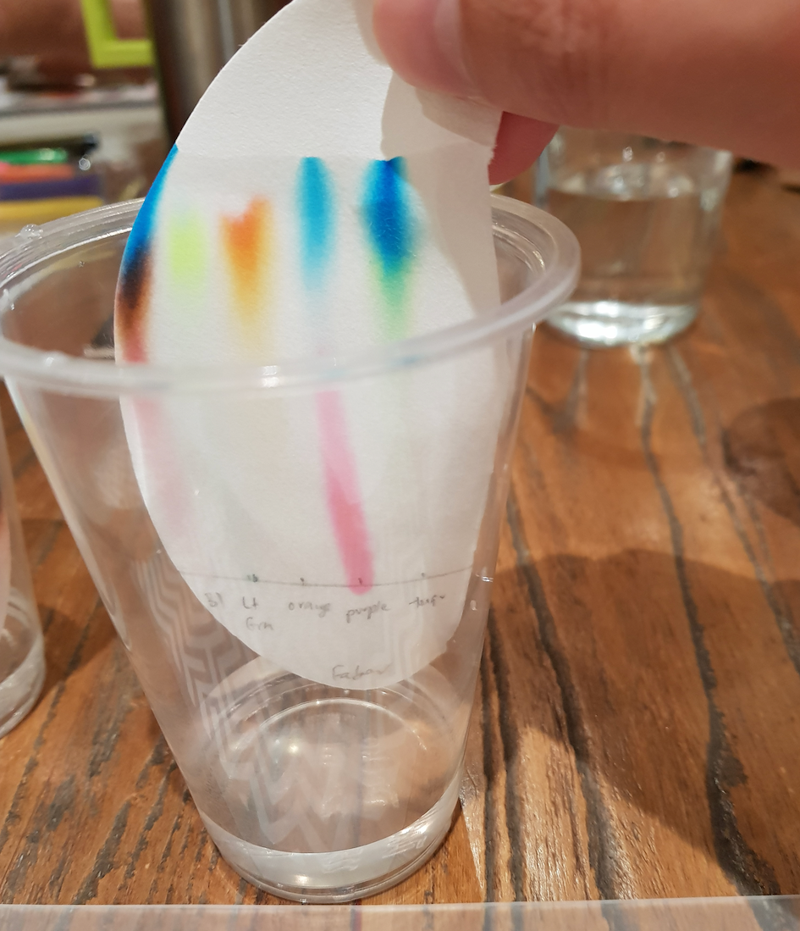
Chromatogram

Slide 19
Observations
(what you see, hear, smell or touch)
General observations. . . . . . . . . . . . . . . . . . . . . . . .
Colour 1 . . . . . . . . . . . . . . . . . . . . . . . . . . . . . . . . . .
Colour 2 . . . . . . . . . . . . . . . . . . . . . . . . . . . . . . . . . .
Colour 3 . . . . . . . . . . . . . . . . . . . . . . . . . . . . . . . . . .
Draw the chromatogram
Measure distances travelled by water and each spot
Calculate ratios of distances travelled
Discussion
(Why did you get those results? What further experiments could you conduct?)
. . . . . . . . . . . . . . . . . . . . . . . . . . . . . . . . . . . .
Conclusion
(Did your results support your hypothesis?)
. . . . . . . . . . . . . . . . . . . . . . . . . . . . . . . . . . . .

Slide 20
Explanations
Inks are usually mixtures of coloured chemicals
Different coloured chemicals stick more or less to paper fibres as they migrate, so travel more slowly or more quickly
Called ‘chromatography’ and used to separate mixtures for analysis
e.g. rapid antigen test (RAT)

Slide 21
Learning skills
observation
descriptive writing
scientific thinking
drawing
measurement
ratios (Rf)
Topic links
colour
perception
colour blindness
displays (RBG)
printers (CYMK)

Slide 22
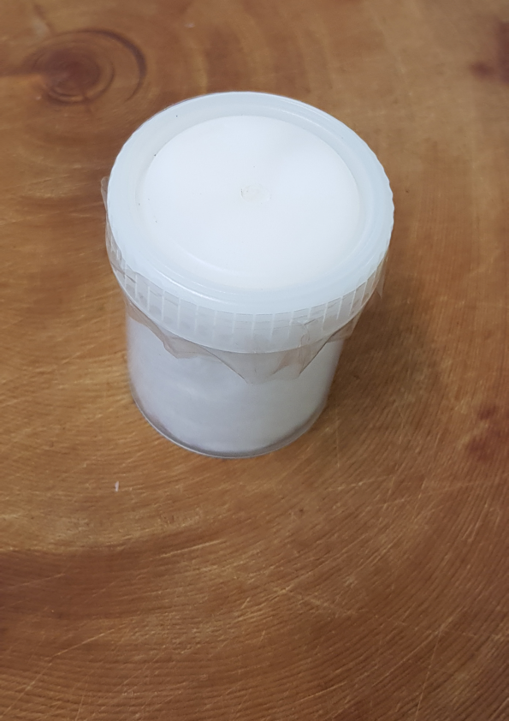
Sniff testing

Slide 23
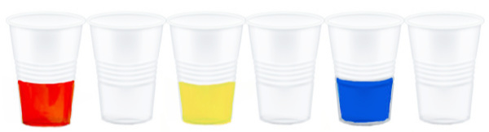
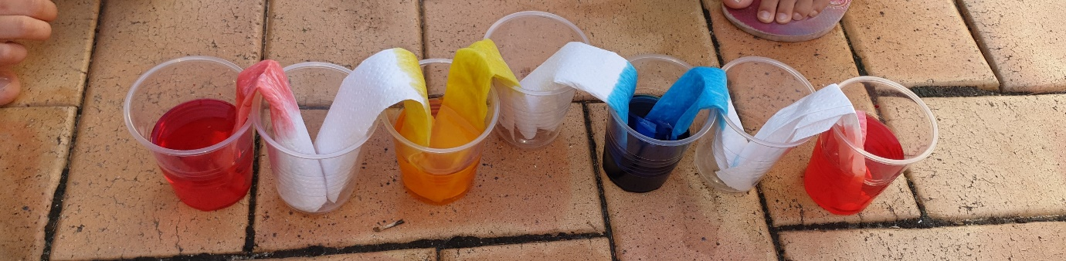
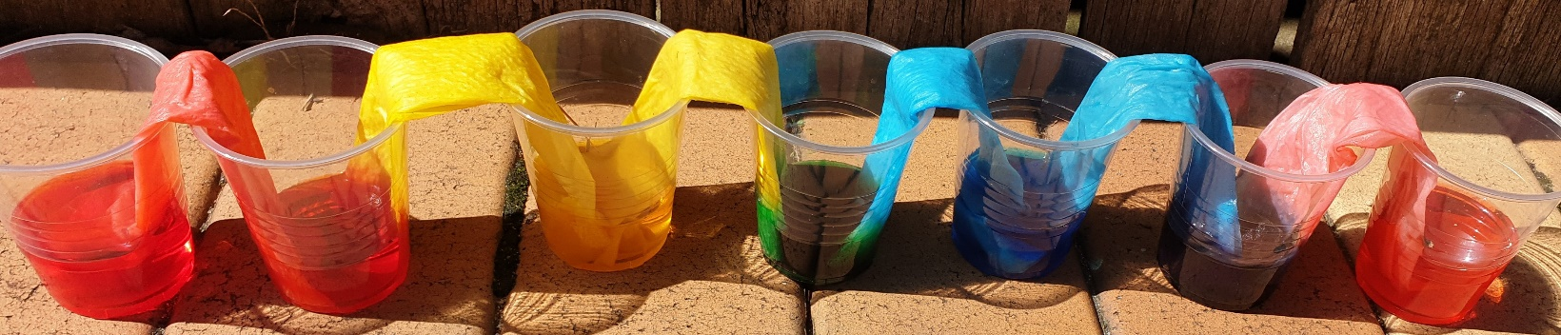
Walking water to make a rainbow

Slide 24
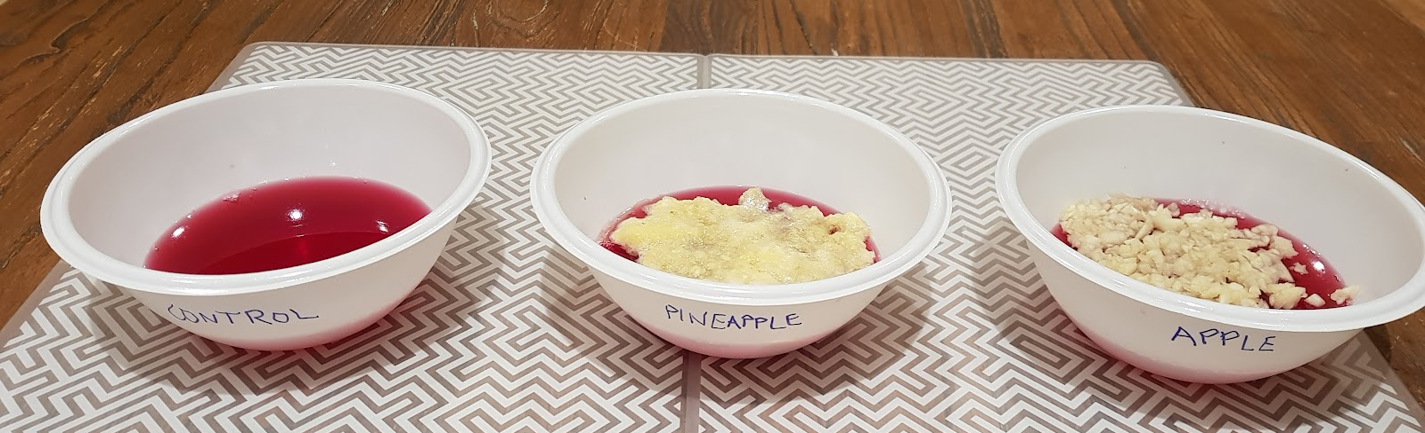
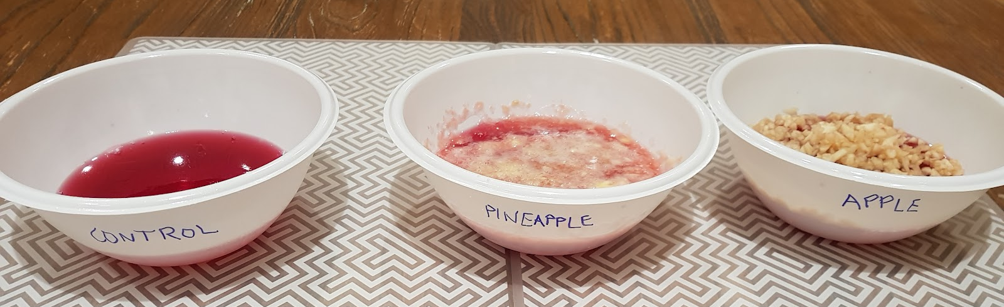
Pineapple eating jelly

Slide 25
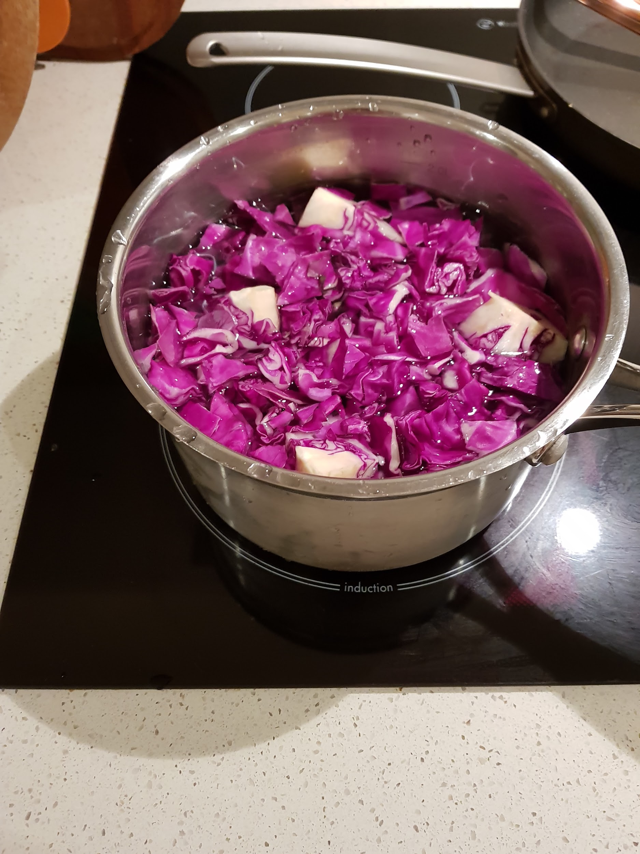
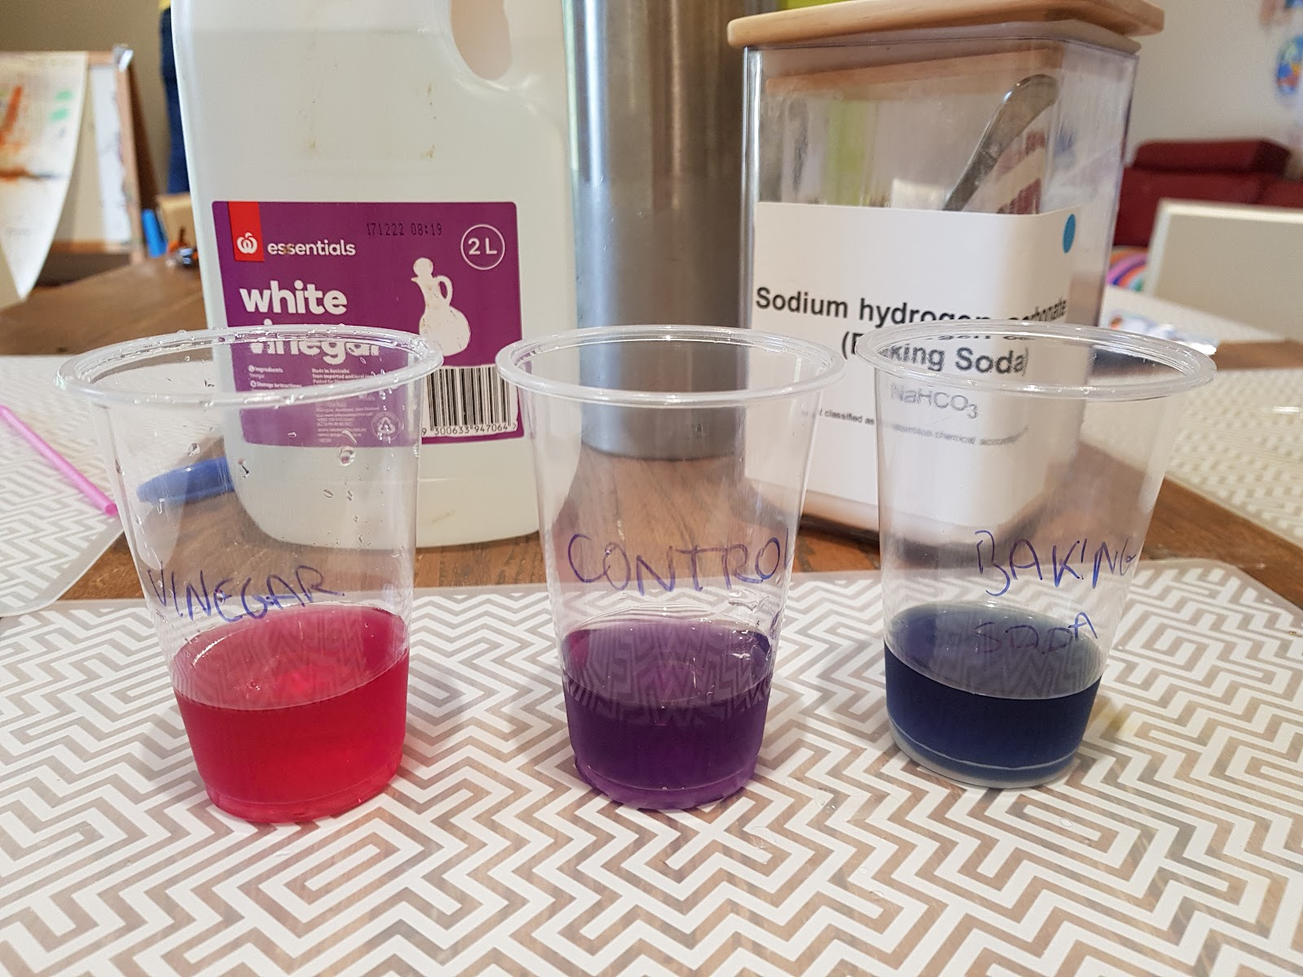
Red cabbage magic dye

Slide 26
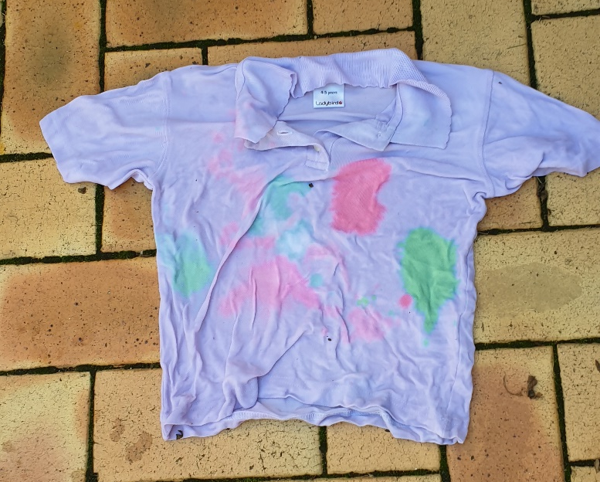
Tie dye with red cabbage

Slide 27
More experiments
• Electrolysis of water
- 9 V battery, wires, magnesium sulfate
- watch gas bubbles form and wire dissolve
• Ignition of steel wool (DEMO!)
- 9V battery, fine dry steel wool
- electrical energy to heat energy
- iron reacting with oxygen in air
• Copper growing on zinc
- zinc (galvanised nail), copper sulfate

Slide 28
Conclusion
• Lots of fun chemical experiments!
• Easy to check for potential hazards
in Primary RiskAssess
• Easy to carry out risk assessments,
as required by law
• Explore the scientific method
• Experiential learning of the physical world

