Slide 1
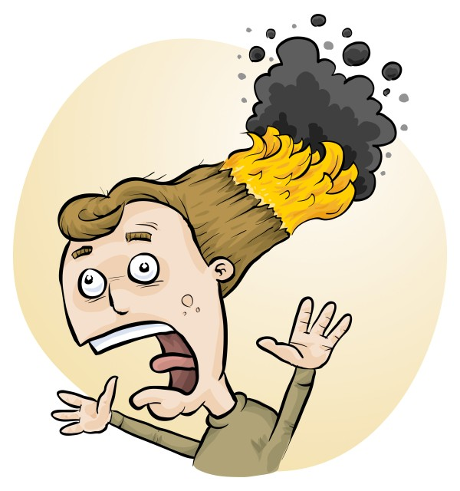

How best to manage student-designed investigations
James Crisp & Phillip Crisp
Notes:
Quick feeling for who we have in the room. Hands up for teachers / lab techs; then use RiskAssess, use Student RA.

Slide 2
Managing multiple different student-designed investigations at the same time can be…

Slide 3

Notes:
Pretty challenging and chaotic. Emails, paper everywhere, too much to prepare, so many to review, what is the teacher responsible for, what is the lab tech responsible for etc

Slide 4

Steps for Student Designed Pracs
Staff collaborate & plan type of investigation
Students design the investigations and do risk assessments
Staff review and provide feedback on planned pracs
Source items required and prepare for all the pracs
Get the items to the right students
Students do the pracs
Disposal and cleanup
Student write up of investigation
Marking and feedback
Student RA
Notes:
To make it easier to get a handle and talk about, we’ve done our best to break running student designed investigations down into a list of steps. As you know, there’s quite a bit to it!!
So I’d like to be upfront about this. Phillip is a scientist and I am a software developer. We’re not high school teachers. We will not cover the the steps around pedagogy, assessment and marking since you know these areas far better than we do!
We’re going to focus on the areas we understand well, which are the hands-on pracs, and managing these with the help of software.
We can help with (1) based on the de-identified data from Student RiskAssess. We can definitely help with 2, 3, 4, and 5, and also with 7.
We’ll be referring to these steps throughout the presentation, so you know where we are and how it all fits together.

Slide 5
Steps for Student Designed Pracs
Staff collaborate & plan type of investigation
Students design the investigations and do risk assessments
Staff review and provide feedback on planned pracs
Source items required and prepare for all the pracs
Get the items to the right students
Students do the pracs
Disposal and cleanup
Student write up of investigation
Marking and feedback
Notes:
OK, so let’s dive in to #1!

Slide 6
Type of Investigation
Small variations in procedure
Suggested experiments
Fixed set of items
Open ended
Notes:
Level of choice and open endedness.
e.g. concentrations and temperatures to choose for a reaction.
Students choose from a list of suggested experiments.
Can be from same topic like the science week topic of the year.
Teacher requests trolley of items.
Students choose what they want to use from the trolley.
Students have flexibility in choosing investigation
and what equipment, chemicals and biologicals to use.
Hands up for each type. Any missed?

Slide 7
Ideas for Student Designed Pracs
Look at the de-identified data in Student RiskAssess (560 schools)!

Slide 8
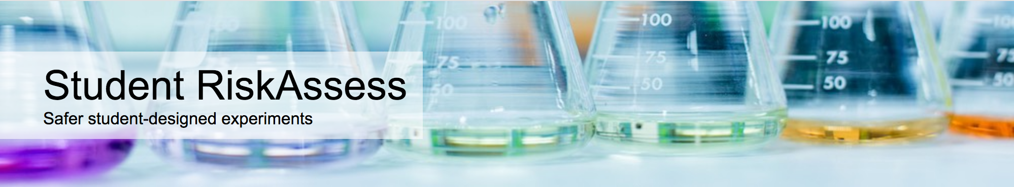
Online system that helps:
  students design and document their pracs
  staff to review, provide feedback and sign off on the pracs
  with ordering & preparation; and disposal afterwards.
Used by 560 schools.

Slide 9
Finding the most popular…
2022 only
62,746 pracs by 2 Sept
By year group
More than 30 with same name
Notes:
We wrote in the abstract for the talk that we’d give you ideas for student designed pracs based on the de-identified data in RiskAssess. We thought this would be easy but when we came to do it, it wasn’t so easy, because there is just so much data and variation! The initial plan was to show you the most popular pracs so we worked this out by looking at all pracs this year, breaking the pracs down by year group and looking at ones with over 30 risk assessments on each. This worked OK and we’ll show you soon what we found. However.. This didn’t necessarily lead to the most interesting students designed pracs and also highlights pracs done with the whole class using Student RiskAssess. So Phillip also went through and hand picked pracs and brainstormed pracs that he thought sounded the most interesting and also added some of his own ideas.

Slide 10

Notes:
Who can guess the #1 most popular across all year groups!!?

Slide 11
Rate of reaction
☺
Notes:
(11,453 including variations of name)

Slide 12
Most Popular in Year 10
Rate of Reaction
Hooke's Law Investigation
Gravimetric Analysis of Chicken Soup
Benedict's test for glucose
Motion of a Cart
Notes:
Combined all year groups and many pracs were just under year 10, not split by chemistry, bio, physics etc

Slide 13
Most Popular in 11 & 12
Chemistry
Effect of Concentration on Reaction Rate
Chemical composition of a compound
Metal Reactivity
Combustion of fuels
Precipitation Reactions
Properties of Substances
Electrolysis
Galvanic cells
Biology
Yeast Experiment
Physics
Projectile Motion
Notes:
Some might be class pracs

Slide 14
Phillip’s top 5
Amazing slime mould solves a maze!
Determine the pH ranges of indicators from lichens and bush-tucker fruits
Build a moisture meter using a one-transistor circuit and test local soils
Show the effects of osmosis with naked eggs
Measure Vitamin C in bush foods, e.g., finger lime
Notes:
Most popular doesn’t mean most interesting. Phillip went through a list of over 4,000 pracs and brainstormed and hand picked the ones he thought sounded the most interesting.
Slime mould communication
See photo next slide. Communication between bits of slime mould is not understood.
Home made gel electrophoresis
I haven't done this, but the procedure on the web looks like it should work.
Unusual indicators from lichens (litmus) and aboriginal bush-tucker fruits
There are some bush-tucker fruits with blue and red colours, e.g. Dianella sp., Davidson's Plum, quandong, bush tomato, lillipilli etc.
These can either be collected in the bush or purchased, often in dried form, which should still work to produce dye solutions.
Transistor operation: building a moisture meter
I have an old Dick Smith electronics book which describes this.
Osmosis with naked eggs
Obtained by placing eggs in vinegar to dissolve the shell, leaving a semi-permeable membrane.
Vitamin C in bush foods, e.g. finger lime
Titration with iodine solution. Compare with lemons and oranges.

Slide 15
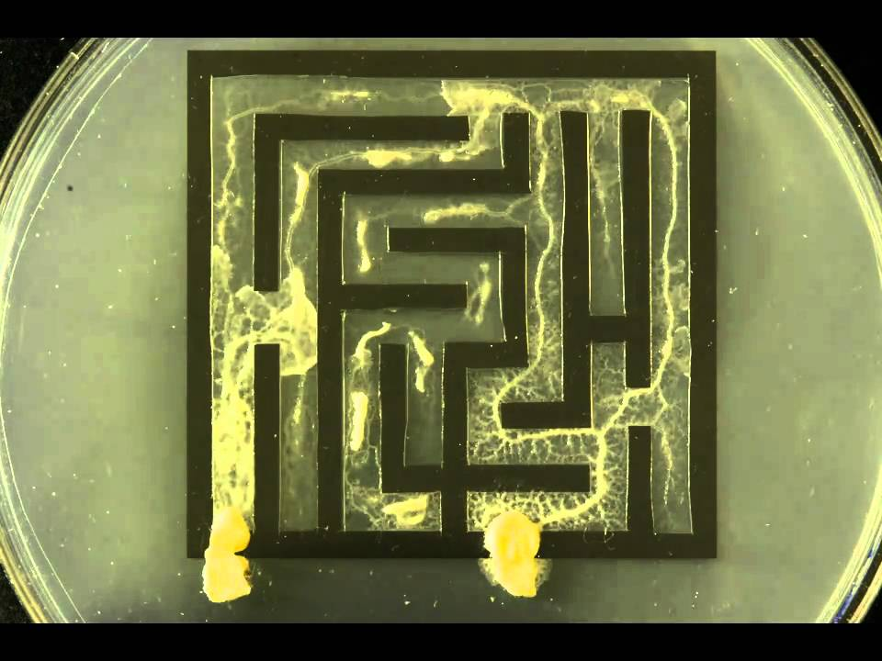
https://edenney.weebly.com/egg-osmosis-experiment/egg-osmosis-experiment
https://www.youtube.com/watch?v=5UfMU9TsoEM

Slide 16
Steps for Student Designed Pracs
Staff collaborate & plan type of investigation
Students design the investigations and do risk assessments
Staff review and provide feedback on planned pracs
Source items required and prepare for all the pracs
Get the items to the right students
Students do the pracs
Disposal and cleanup
Student write up of investigation
Marking and feedback
Notes:
Back to our steps – let’s look at software that can help students design their investigations and do risk assessments.

Slide 17
“Student RiskAssess helps students design their experiments more independently and become more aware of what they are doing rather than relying on the teacher to explain and confirm things like risks, and things to think about.”
Notes:
In the words of a teacher who put it better than I could..

Slide 18
DEMO
From a student perspective

Slide 19
Why do a risk assessment?
Reduced frequency of injuries
  to students
  to school staff
Reduced costs for paperwork, litigation and payouts
Compliance with the law
(c.f. industry)
Helps maintain variety of chemicals and equipment
Compliance with the Australian Curriculum
Students learn a lifelong skill
Notes:
A quick aside.. Why do a risk assessment..anyway?
Inquiry skills include identifying risks from year 5, assessing risk from year 9 and conducting risk assessments in Years 11 and 12.

Slide 20
Steps for Student Designed Pracs
Staff collaborate & plan type of investigation
Students design the investigations and do risk assessments
Staff review and provide feedback on planned pracs
Source items required and prepare for all the pracs
Get the items to the right students
Students do the pracs
Disposal and cleanup
Student write up of investigation
Marking and feedback
Notes:
Tackle these 3 in a demo from the staff perspective.

Slide 21
DEMO
From a STAFF perspective

Slide 22
Details
Web based: nothing to install, access from school/home
Unlimited number of simultaneous users and risk assessments
Inexpensive: $300+GST per year
Legal record with electronic signatures and documents
Training videos, support and advice

Slide 23
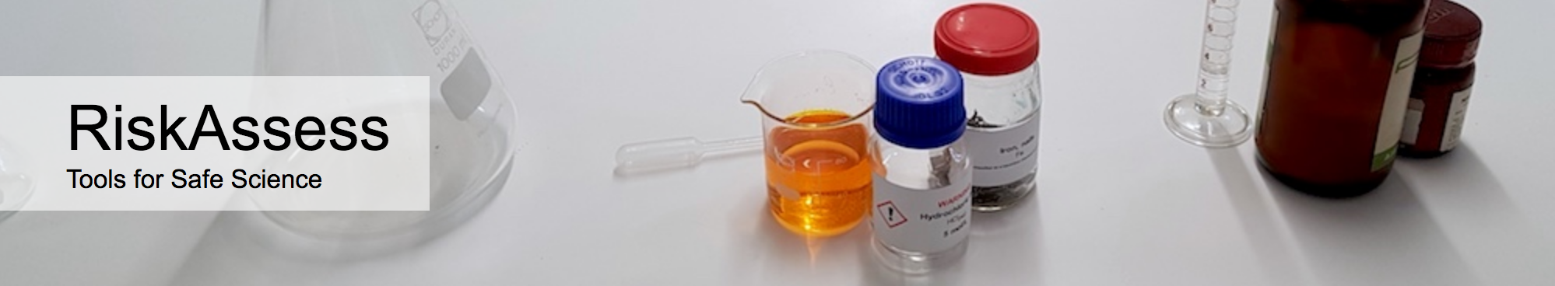
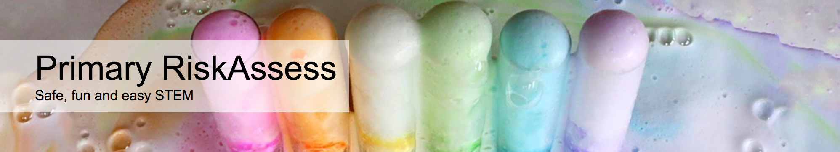

2400 schools
ACT: ~100%
560 schools
ACT: 36%
190 schools
30 schools
Notes:
How does it fit with other versions of RiskAssess?

Slide 24
Steps for Student Designed Pracs
Staff collaborate & plan type of investigation
Students design the investigations and do risk assessments
Staff review and provide feedback on planned pracs
Source items required and prepare for all the pracs
Get the items to the right students
Students do the pracs
Disposal and cleanup
Student write up of investigation
Marking and feedback

Slide 25
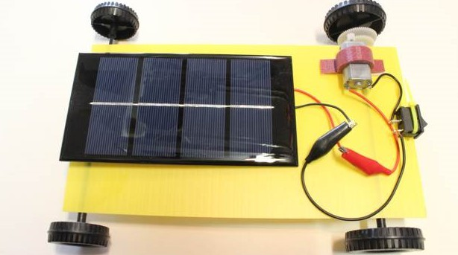
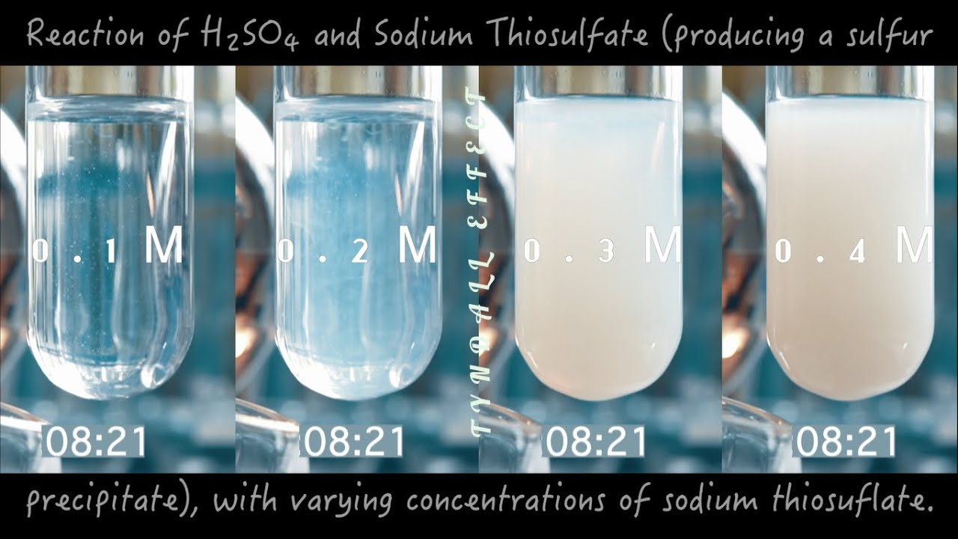
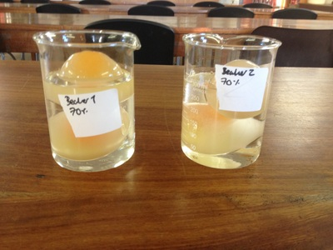
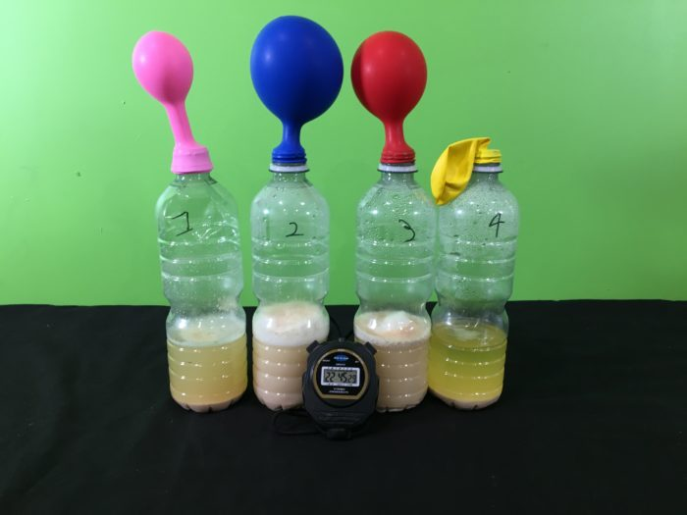
https://sispprogram.schools.nsw.gov.au/stem/stem21/istem-stage-5/sampleresources.html
https://www.youtube.com/watch?v=8Fkj9fSkTL0
https://www.fizzicseducation.com.au/150-science-experiments/kitchen-chemistry-experiments/grow-yeast-experiment/
https://edenney.weebly.com/egg-osmosis-experiment/egg-osmosis-experiment

Slide 26
Steps for Student Designed Pracs
Staff collaborate & plan type of investigation
Students design the investigations and do risk assessments
Staff review and provide feedback on planned pracs
Source items required and prepare for all the pracs
Get the items to the right students
Students do the pracs
Disposal and cleanup
Student write up of investigation
Marking and feedback
Notes:
Show you how Student RA can help with disposal and cleanup. Leave 8-9 in your capable hands.

Slide 27
DEMO
Disposal information
Notes:
Show disposal info on risk assessments and safety information search of copper sulfate, 4 M nitric acid (reacting with solid calcium hydroxide – in waste containers), silver chloride

Slide 28
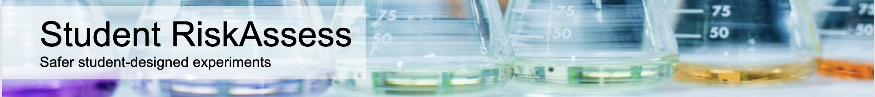
  Students
  Standard template
  Lots of background, safety & disposal info
  Makes them think independently
  Staff
  Quickly review, provide feedback and sign off on pracs
  Meets legal requirements
  Helps with preparation & cleanup
Popular, convenient, web based and inexpensive
Notes:
We’ve seen how Student RiskAssess can help with many of the steps in doing student design pracs.
Any questions?

