Slide 1
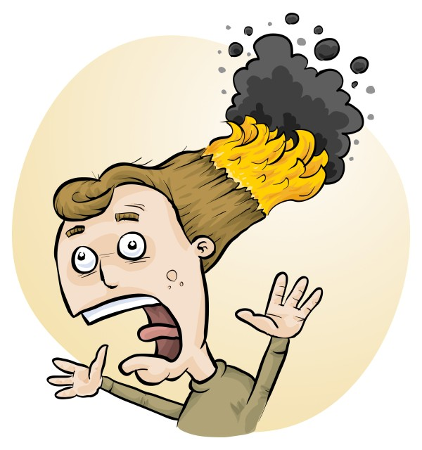

How best to organise and manage student-designed investigations
Phillip Crisp & Eva Crisp

Slide 2
VCAA
LEVELS 9-10
Planning and conducting
Independently plan, select and use appropriate investigation types, including fieldwork and laboratory experimentation, to collect reliable data, assess risk and address ethical issues associated with these investigation types (VCSIS135)

Slide 3
VCAA
LEVELS 11-12: VCE
Scientific investigations
Prior to undertaking an investigation, students should produce a plan in their logbooks that:
. . . .
• outlines the methods / techniques that will be used, including an investigation procedure and risk management for the investigation
. . . .
• identifies and suggests how potential safety risks and anticipated problems can be managed

Slide 4
Why do a risk assessment?
Reduced frequency of injuries
  to students
  to school staff
Reduced costs for paperwork, litigation and payouts
Compliance with the law
(training for industry)
Helps maintain variety of chemicals and equipment
Compliance with the Victorian Curriculum
Students learn a lifelong skill

Slide 5

Steps for Student Designed Pracs
Staff collaborate & plan type of investigation
Students design the investigations and do risk assessments
Staff review and provide feedback on planned pracs
Source items required and prepare for all the pracs
Get the items to the right students
Students do the pracs
Disposal and cleanup
Student write up investigation
Marking and feedback
Student RA

Slide 6
Steps for Student Designed Pracs
Staff collaborate & plan type of investigation
Students design the investigations and do risk assessments
Staff review and provide feedback on planned pracs
Source items required and prepare for all the pracs
Get the items to the right students
Students do the pracs
Disposal and cleanup
Student write up investigation
Marking and feedback

Slide 7
Type of Investigation
Small variations in procedure
Suggested experiments
Fixed set of items
Open ended

Slide 8
Ideas for Student Designed Pracs
Look at the de-identified data in Student RiskAssess (560 schools)!

Slide 9
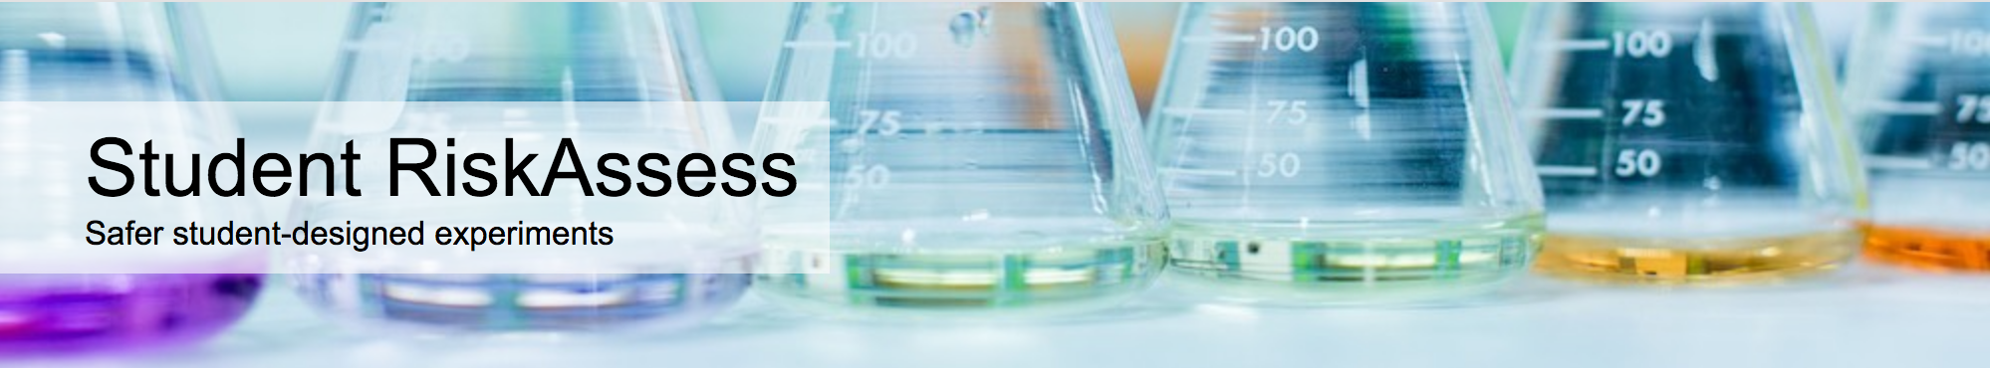
Online system that helps:
  students design and document their pracs
  staff to review, provide feedback and sign off on the pracs
  with ordering & preparation; and disposal afterwards.
Used by 580 schools.

Slide 10
Finding the most popular…
2022 only
62,746 pracs by 2 Sept
By year group
More than 30 with same name

Slide 11


Slide 12
Rate of reaction
☺
Notes:
(11,453 including variations of name)

Slide 13
Most Popular in Year 10
Rate of Reaction
Hooke's Law Investigation
Gravimetric Analysis of Chicken Soup
Benedict's test for glucose
Motion of a Cart

Slide 14
Most Popular in 11 & 12
Chemistry
Effect of Concentration on Reaction Rate
Chemical composition of a compound
Metal Reactivity
Combustion of fuels
Precipitation Reactions
Properties of Substances
Electrolysis
Galvanic cells
Biology
Yeast Experiment
Physics
Projectile Motion
Notes:
Some might be class pracs

Slide 15
Suggestions
Amazing slime mould solves a maze!
Determine the pH ranges of indicators from lichens and bush-tucker fruits
Build a moisture meter using a one-transistor circuit and test local soils
Show the effects of osmosis with naked eggs
Measure Vitamin C in bush foods,
e.g., finger lime

Slide 16
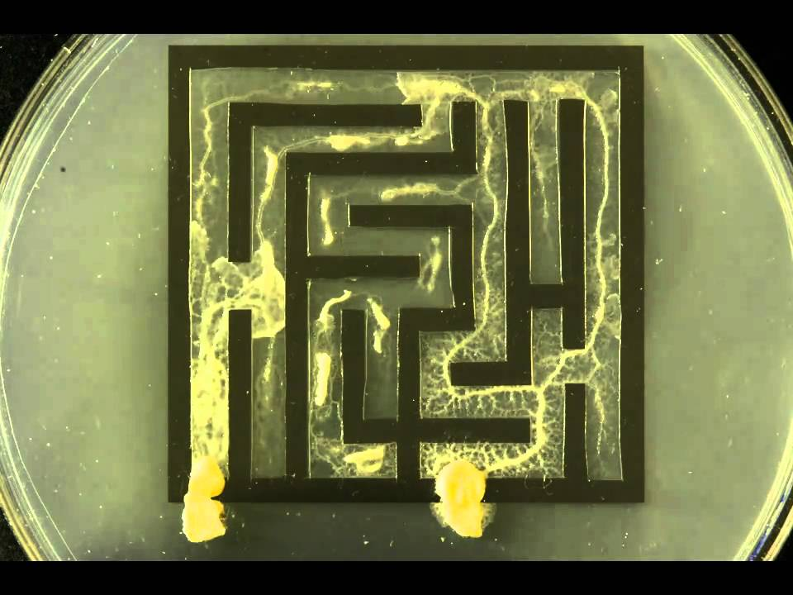
https://edenney.weebly.com/egg-osmosis-experiment/egg-osmosis-experiment
https://www.youtube.com/watch?v=5UfMU9TsoEM

Slide 17
Steps for Student Designed Pracs
Staff collaborate & plan type of investigation
Students design the investigations and do risk assessments
Staff review and provide feedback on planned pracs
Source items required and prepare for all the pracs
Get the items to the right students
Students do the pracs
Disposal and cleanup
Student write up of investigation
Marking and feedback
Notes:
Back to our steps – let’s look at software that can help students design their investigations and do risk assessments.

Slide 18
Student RiskAssess: advantages for students
easy, follow your nose, stores procedure, links to online documents, etc
private, if use PINs
good for obtaining teacher feedback
can check hazards of any chemicals, equipment, biological/food items
fun!
See DEMO !

Slide 19
“Student RiskAssess helps students design their experiments more independently and become more aware of what they are doing rather than relying on the teacher to explain and confirm things like risks, and things to think about.”

Slide 20
Steps for Student Designed Pracs
Staff collaborate & plan type of investigation
Students design the investigations and do risk assessments
Staff review and provide feedback on planned pracs
Source items required and prepare for all the pracs
Get the items to the right students
Students do the pracs
Disposal and cleanup
Student write up of investigation
Marking and feedback
Notes:
Tackle these 3 in a demo from the staff perspective.

Slide 21
Student RiskAssess: advantages for staff
see risk assessments without entering PINs
enter comments and corrections in Notes
view lab schedule & stocktaking
sign that risks are adequately controlled
quickly review, provide feedback and sign off
Multiple Prac Management system:
handle large numbers of student RAs easily
See DEMO !

Slide 22
Student RiskAssess:
Details
web based: nothing to install, access from school/home
unlimited number of simultaneous users and risk assessments
inexpensive: $350+GST per year
legal record with electronic signatures and documents
training videos, support and advice

Slide 23
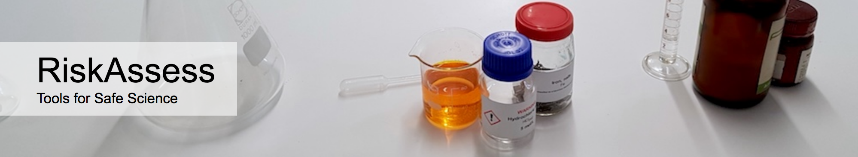
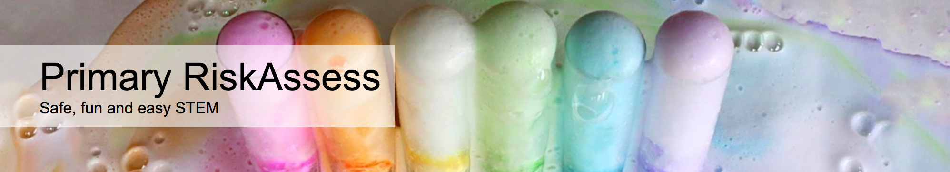

2700 schools
VIC: ~100%
580 schools
VIC: 28%
200 schools
80 schools

Slide 24
Steps for Student Designed Pracs
Staff collaborate & plan type of investigation
Students design the investigations and do risk assessments
Staff review and provide feedback on planned pracs
Source items required and prepare for all the pracs
Get the items to the right students
Students do the pracs
Disposal and cleanup
Student write up of investigation
Marking and feedback

Slide 25
Student RiskAssess: advantages for disposal
disposal advice for every chemical and solution
explanatory documentation for disposal
advice on waste containers + labels
advice on waste minimization & recycling
See DEMO !

Slide 26
Summary of benefits
• student engagement
• can be used for assessment
• uses newest technologies
• training in life skills
• inexpensive
• happy students and teachers!

Slide 27
DEMO
From a STAFF perspective
From a STUDENT perspective
Disposal information

