Slide 1
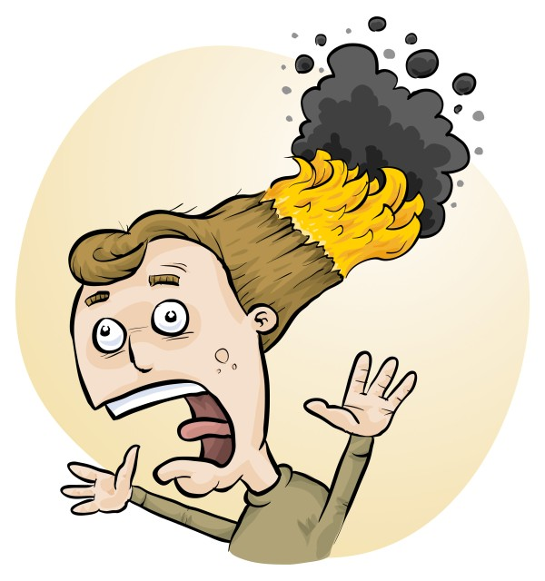
RiskAssess and
Chemical Disposal
Phillip Crisp and Eva Crisp

Slide 2
Chemical Disposal
The quantity of chemical wastes generated in a school is insignificant.
HOWEVER
• A school is an educational institution
• Attitudes adopted during youth continue into adulthood
• Proper training should be given to those who will later be decision makers

Slide 3
The improvement process
eliminate unwanted chemicals
redesign procedures to minimize waste production, e.g. spot reactions
dispose of wastes LEGALLY
SAFELY by
- sewer
- garbage
- waste collection service

Slide 4
Chemical wastes in schools
*
Aqueous liquid wastes
• dissolved salts
• acidic or basic
• suspended particles
Water-miscible organic wastes
alcohols, e.g. methylated spirits
ketones, e.g. acetone
Water-immiscible organic wastes
• hydrocarbons, e.g. hexane, kerosene
• special chemicals, mostly for organic chemistry
Solid wastes
• precipitates, e.g. BaSO₄, Fe oxides

Slide 5
Problems in the sewer!
• toxic metals
e.g. Hg, Cd, Pb, As, . . . VERY BAD
Cu, Ni, Co, . . . BAD
since contaminate sludge $$$
• toxic persistent organic chemicals
e.g. pesticides
since contaminate sludge $$$
• highly acidic/alkaline liquids
since may damage pipes
• flammable liquids (water-immiscible)
since may cause an explosion!

Slide 6
Aqueous liquid wastes
Pour down the sewer ONLY if the criteria of the water authority are met.
Otherwise, an environmentally responsible approach:
• neutralize to ~pH 6.5-8.5 (natural waters)
• only “safe” amount of each chemical down the drain
in order to minimise environmental harm from treated sewage when it is released into river or ocean.
All wastes exceeding a “safe” amount of a chemical should be retained for a waste collection service.
WHAT IS SAFE?

Slide 7
Estimation of “safe” quantities
Consider the cation and anion in a salt separately.
Toxicity of a salt is dominated by the most toxic ion:
e.g. lead chloride, potassium dichromate
Some ions should not go down the drain at all
e.g. Hg²⁺, Pb²⁺, Cd²⁺, . . .
while others are ok almost without (school) limit
e.g. Na⁺, Ca²⁺, Cl⁻, SO₄²⁻, . . .
and other ions in between
Place each toxic waste in a SEPARATE container!

Slide 8
Tabulation and calculation
“Safe” disposal quantity for an ion for a class:
0 – 1000 g/day
Copper sulfate
copper: 1 g/day [Very toxic to aquatic life
with long lasting effects]
sulfate: 1000 g/day. [In solid laundry detergent]
Therefore, copper sulfate: 1 g/day
Enough for some spot tests down the drain.
Beyond that, wastes need to be collected!

Slide 9
Organic liquid wastes
Water-miscible
e.g. methylated spirits, acetone
Dilute 1 part to 20 parts water, then down the drain.
Prevents explosive air/vapour mixture.
Microorganisms in sewer will consume the chemicals.
Water-immiscible
e.g. hexane, kerosene
Retain for collection by waste service.
Separate hydrocarbon waste from halogenated waste.

Slide 10
Solid wastes
Only “material of a domestic nature”
is allowed to be disposed of in the garbage
Consider
transport of garbage
leaching from landfill
Geologically-stable minerals
(precipitated during reactions)
e.g. barium sulfate (baryte)
No leaching of toxic chemicals in a domestic landfill.

Slide 11
RiskAssess disposal advice
• focuses on avoiding serious environmental harm
• reduces the cost of waste collection service
• decreases focus on less harmful substances
• provides a learning tool for staff and students
Future basis for individual chemical advice in RiskAssess

Slide 12
Conclusion
RiskAssess advice is only an approximate guide.
Priority given to avoiding contamination of the environment with the most toxic chemicals.
We hope that it will help schools to think about the environmental consequences of chemical disposal.
Plan: disposal advice for each of the
1400 chemicals and 1200 solutions in RiskAssess.
.

Slide 13
What is RiskAssess?
• web-based risk assessment tool
• customised to the school situation
• provides
- electronic templates (NZ/ISO)
- database information on risks
(chemical, equipment, biological)
- equipment ordering/lab scheduling
- labelling (GHS)
- learning resources
• easy sharing of experiment templates for customisation

Slide 14
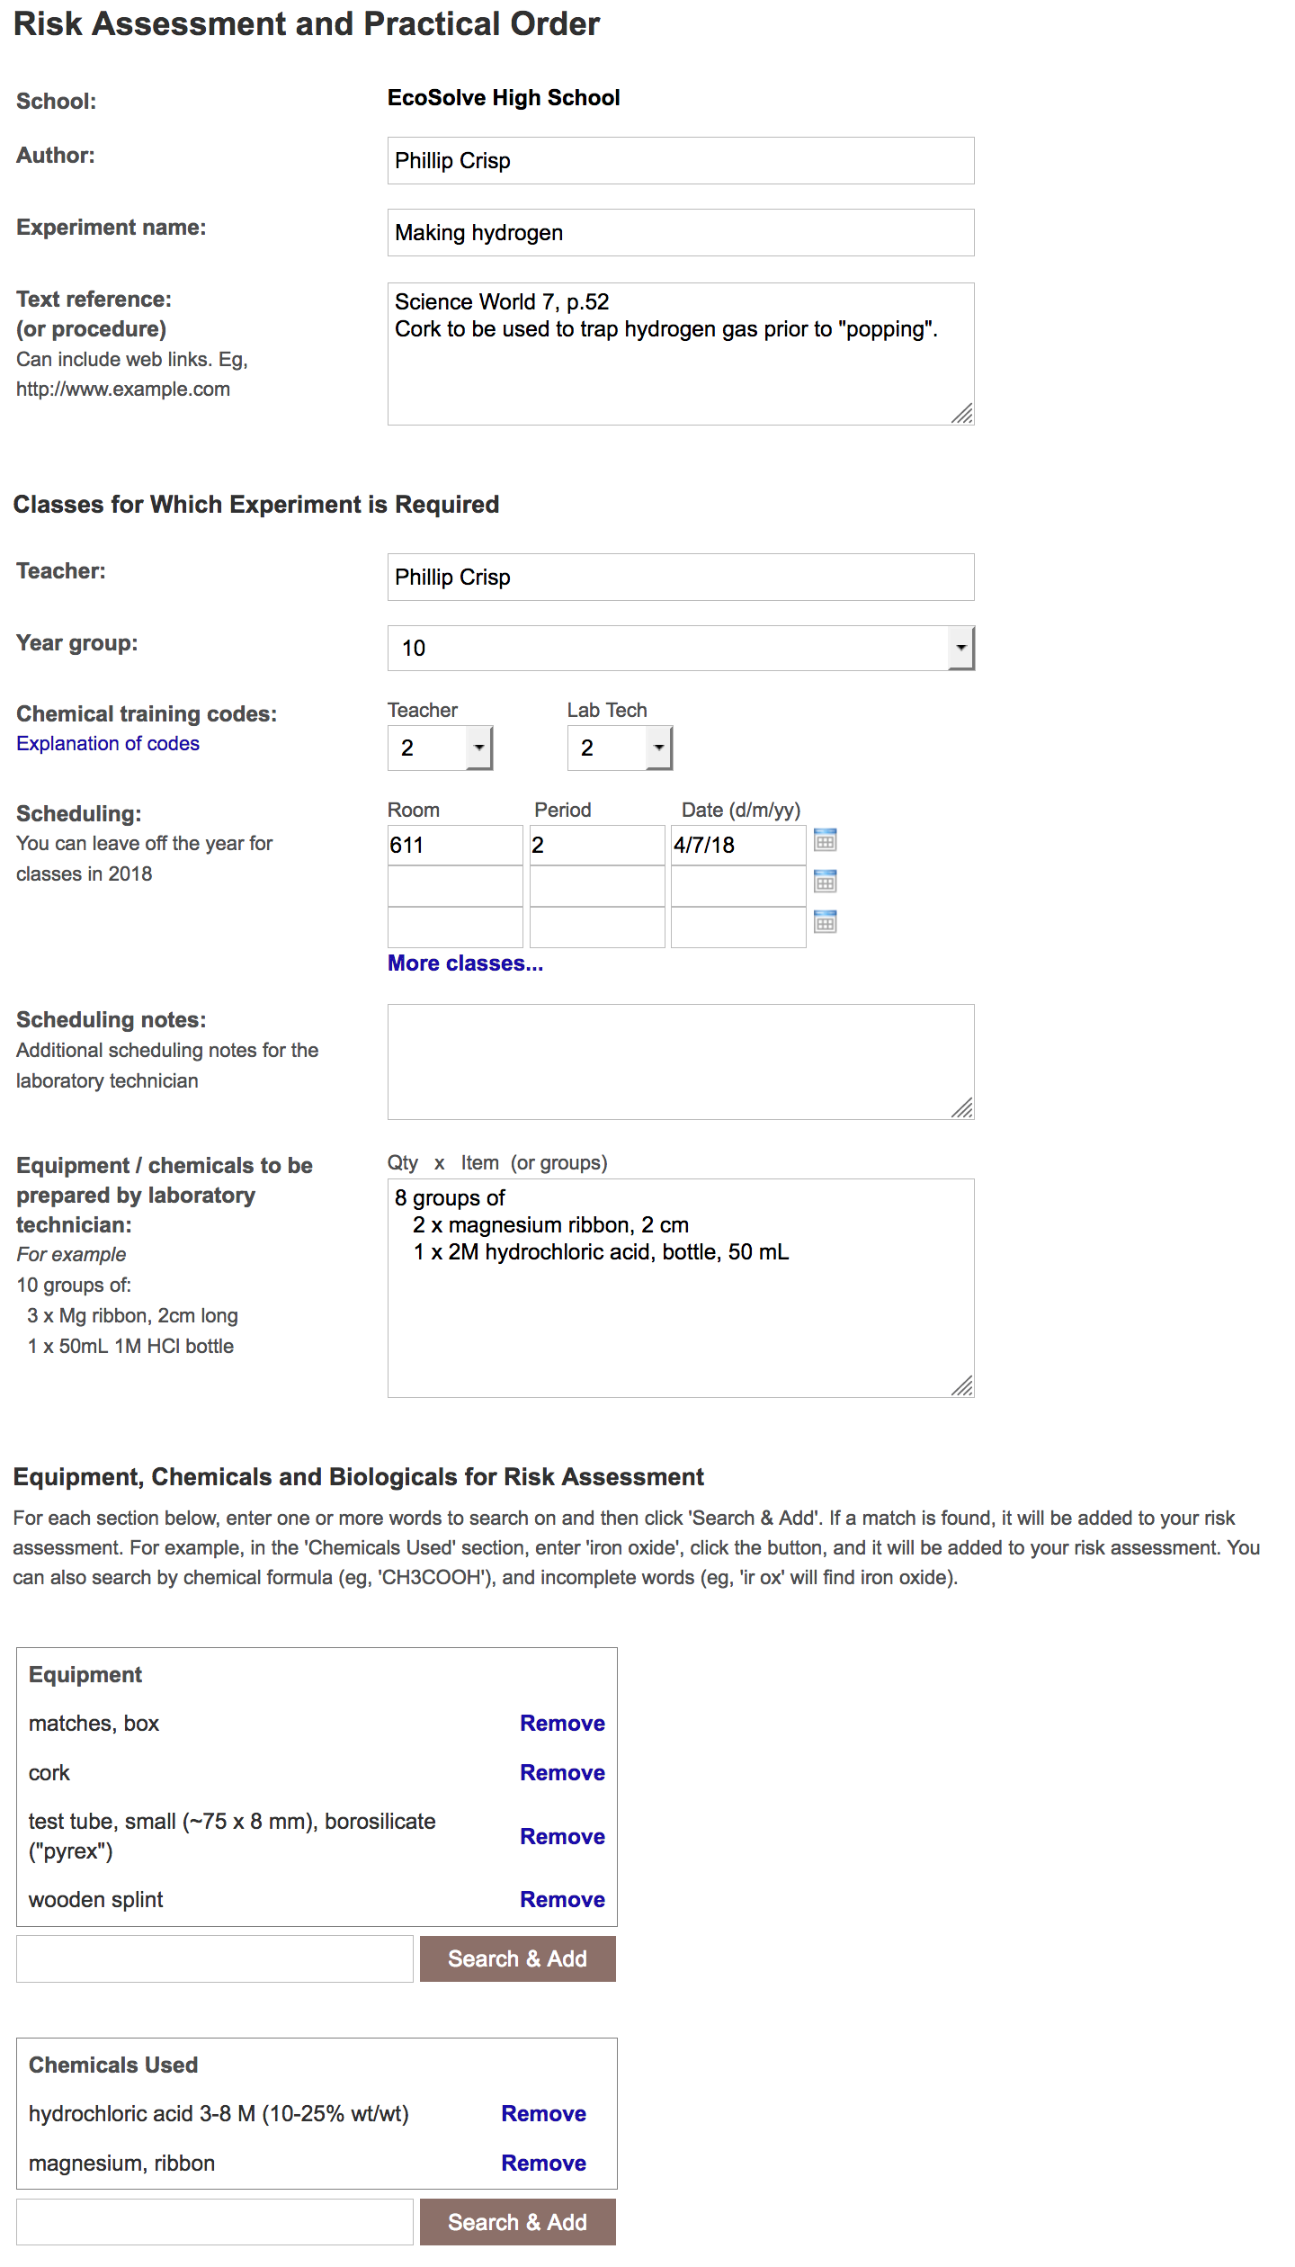
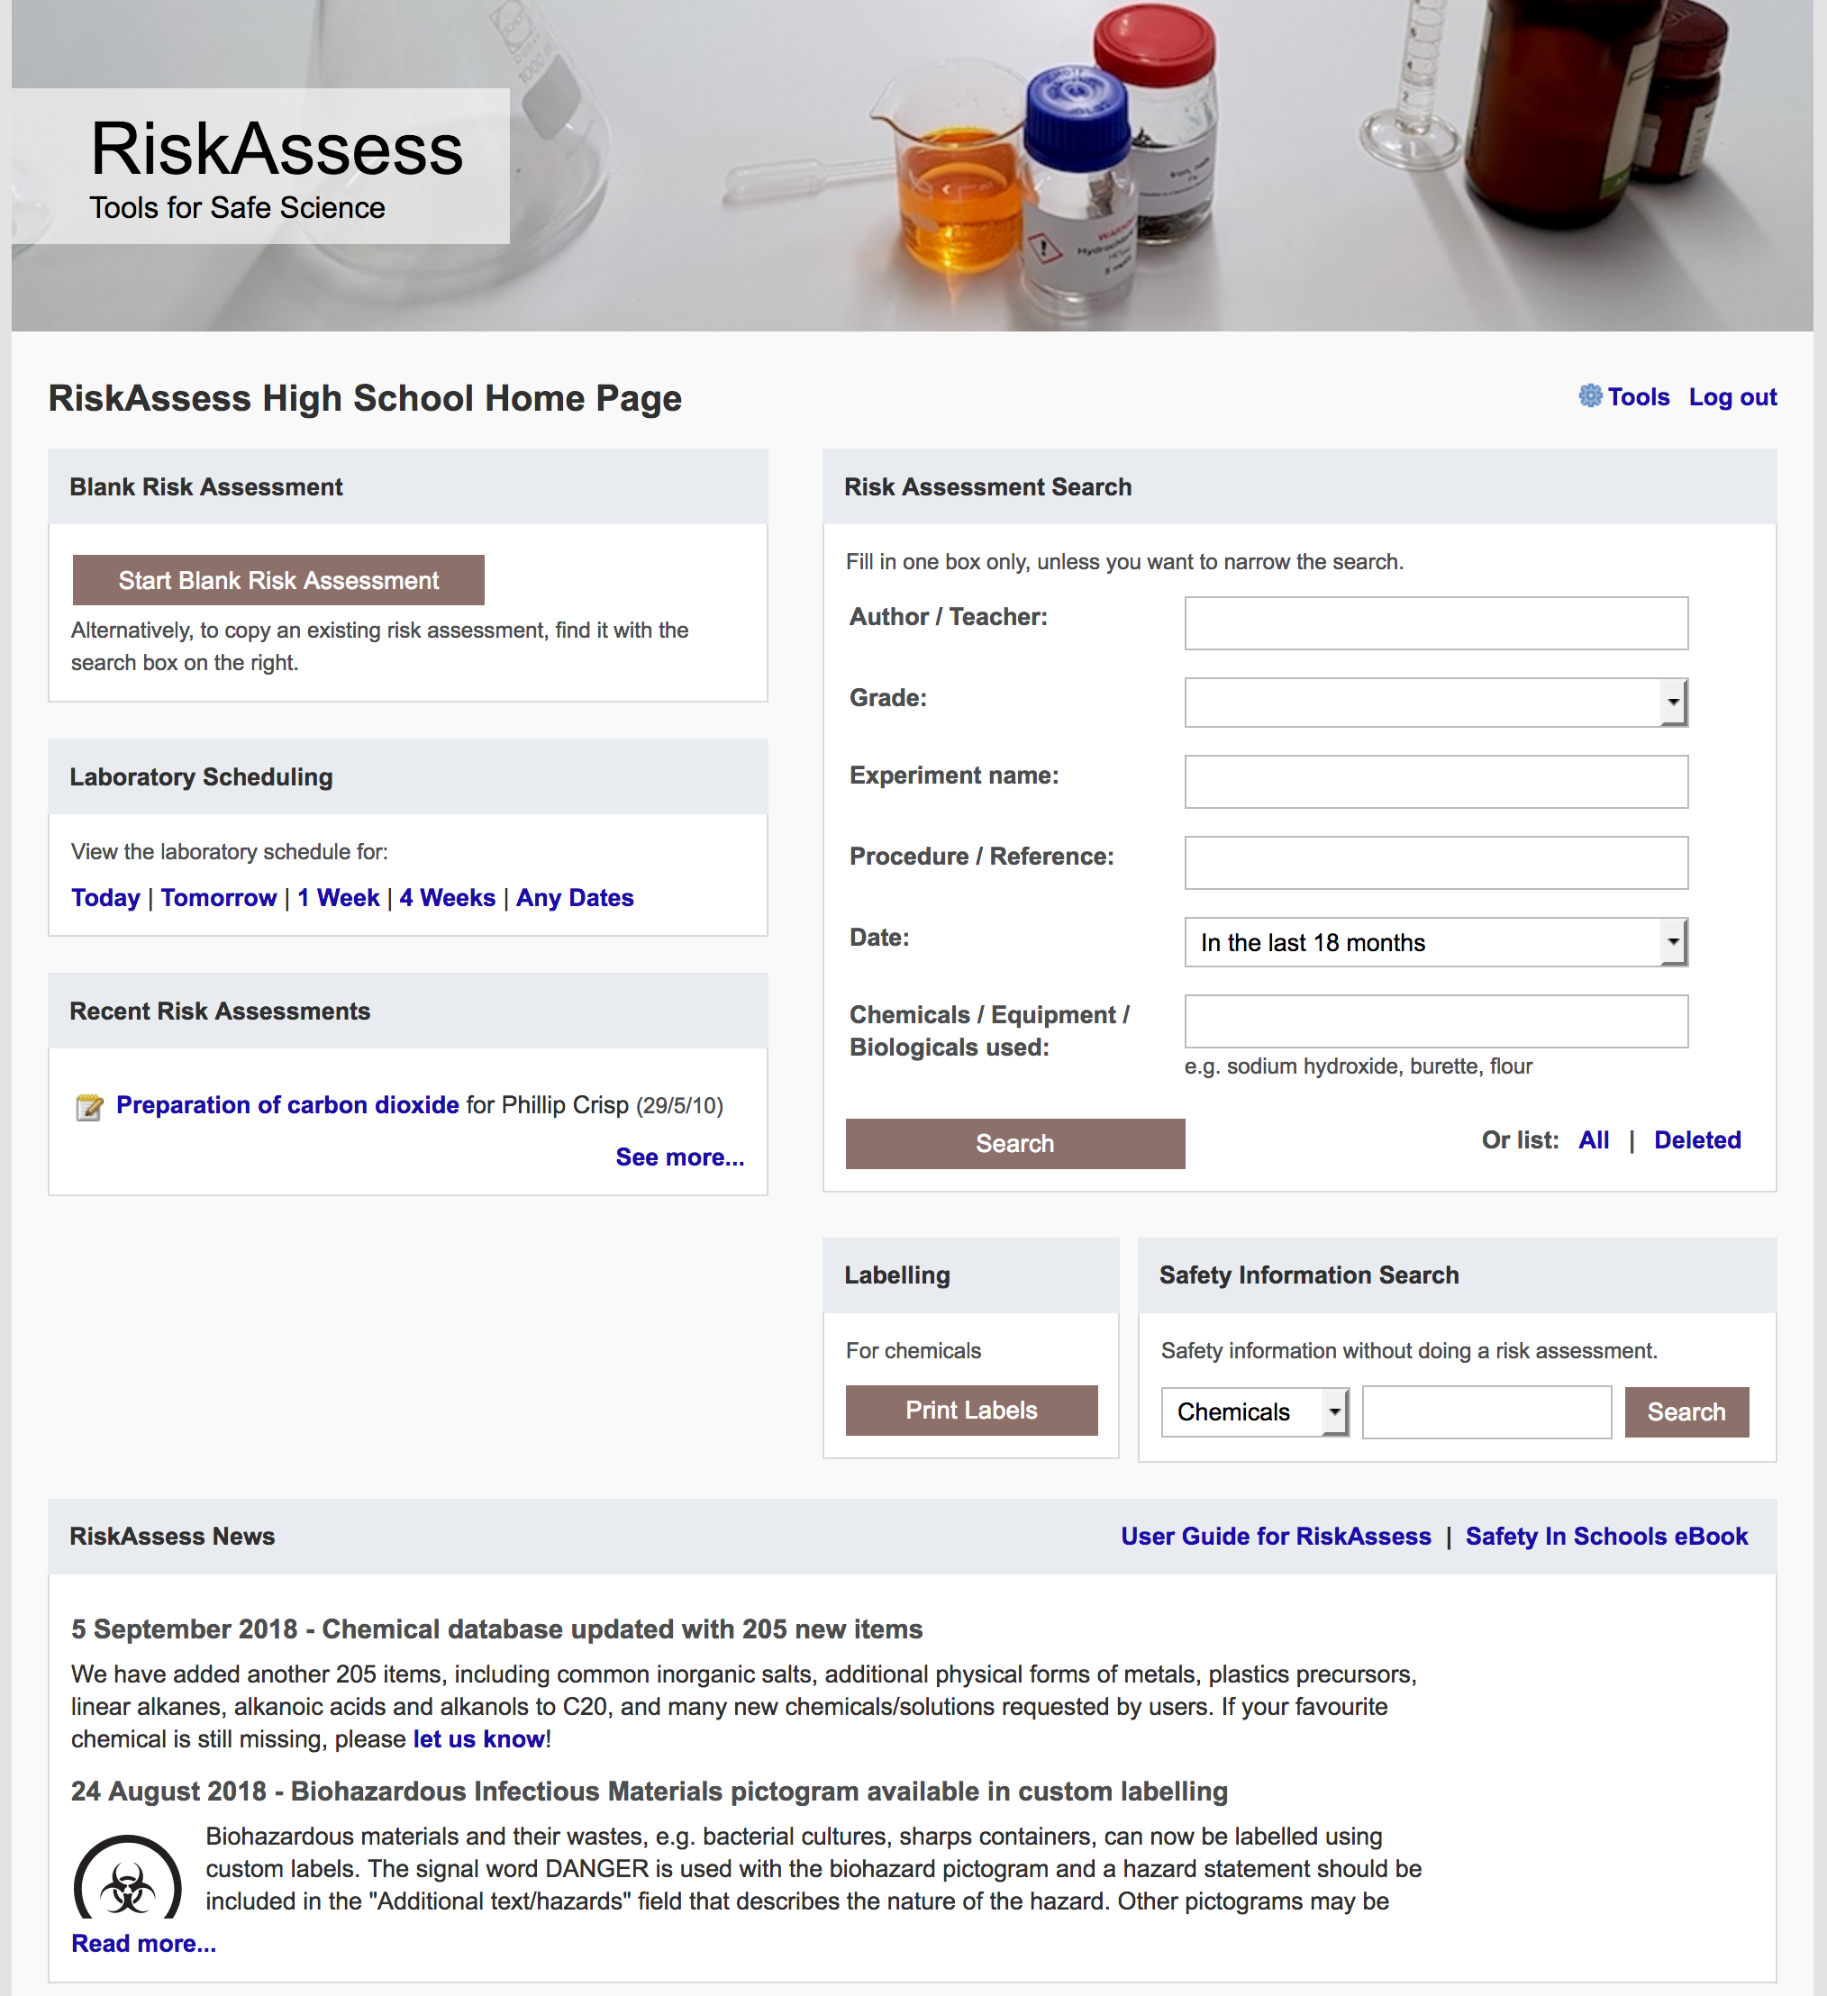

Slide 15
Logic
• separate sections for teacher and laboratory technician
• initial assessment of inherent risk
- if low, go to end
- if medium or more, record control measures
- if high or extreme, third reviewer required
• cross-checking by teacher/labtech/reviewer
• scheduling, ordering, labelling to save time
• inexpensive ($250+GST per campus per year)

Slide 16
Electronic system
• relatively rapid
• prompts sensitive to context
• reduces paper consumption
• easy to review and update
• easy monitoring and statistics
• easy storage
• demonstrated to work in schools
RiskAssess: 2250 schools AU+NZ+CA
NZ: >150 (27%)
3,700,000 risk assessments

Slide 17
Details
• access from school/home
• nothing to install on computer, tablet or phone
(instant update)
• unlimited number of simultaneous users and risk assessments
• minimal data entry See brochure!
• complements SDSs
• continuing input from science staff
• multiple backups of data & backup server
• support and advice

Slide 18
Advantages of RiskAssess
• proper consideration of risks and control measures
• standardisation
• storage of records for legal purposes
• communication between teachers and laboratory technicians
• discourages spur-of-the-moment experiments
• useful for new/inexperienced staff

Slide 19
Even more!
• scheduling system
• prac ordering
• GHS labelling
- standard
- customised
And an exciting new video . . .
“Getting Started with RiskAssess”
starring Phillip and Eva!

Slide 20
