Slide 1
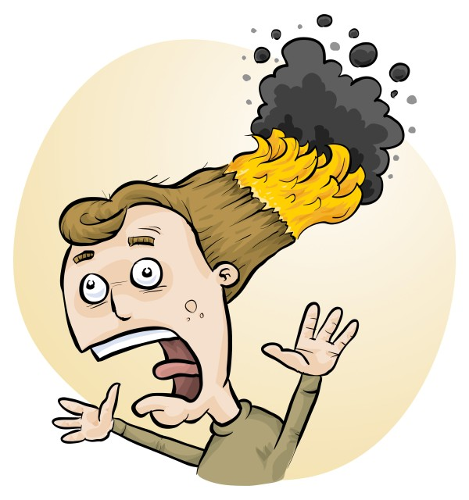
RiskAssess for New and Experienced Users
James Crisp

Slide 2
• reduce injuries
• increase legal protection
Why do risk assessments?

Slide 3
Issues
facilities available
behaviour of the class
students with special needs
students with allergies
. . . . . . . .
Issues may, and commonly will,
differ from class to class.
No one hat fits all!

Slide 4
What is RiskAssess?
• web-based risk assessment tool
• customised to the school situation
• provides
- electronic templates (NZ/ISO)
- databases of information on risks
• easy sharing of risk assessments
• plus ordering, scheduling & labelling

Slide 5
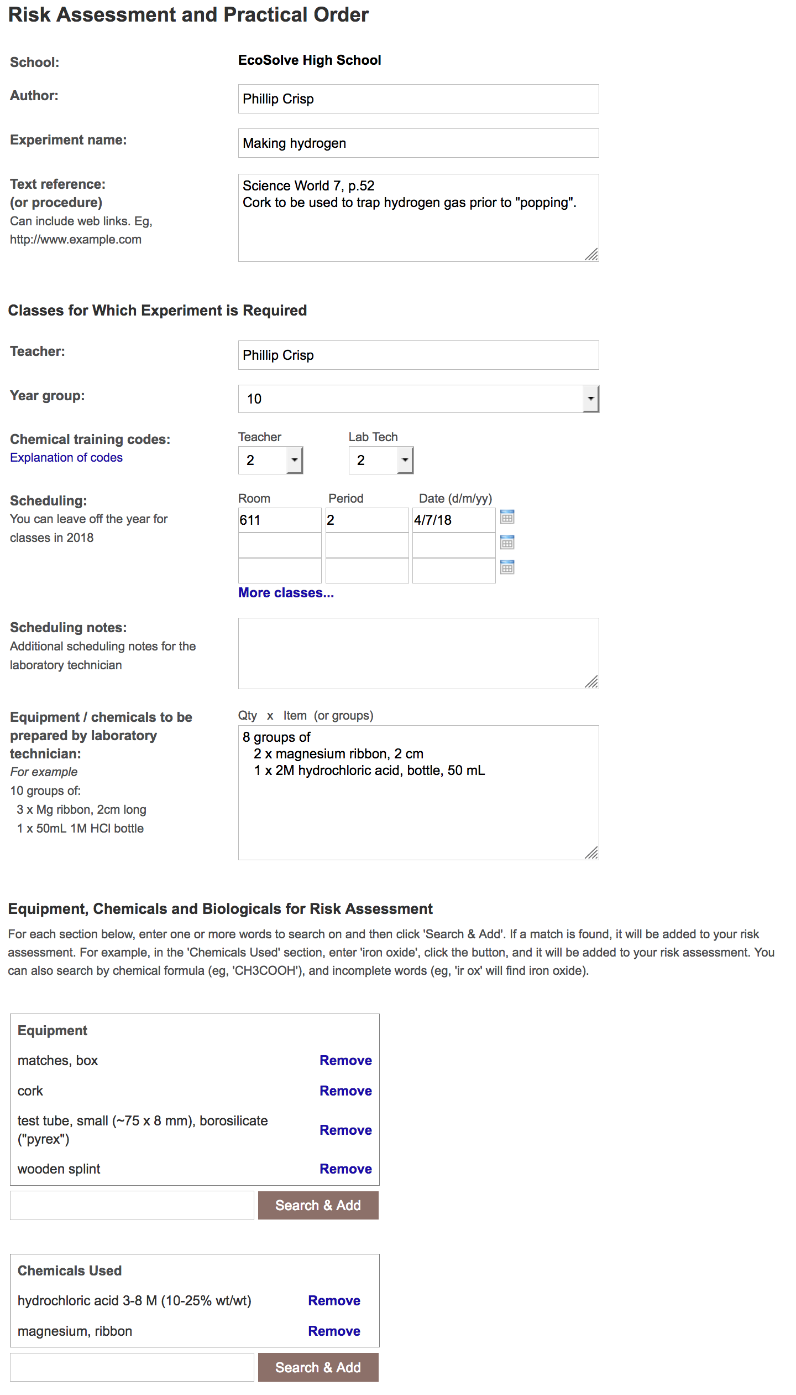
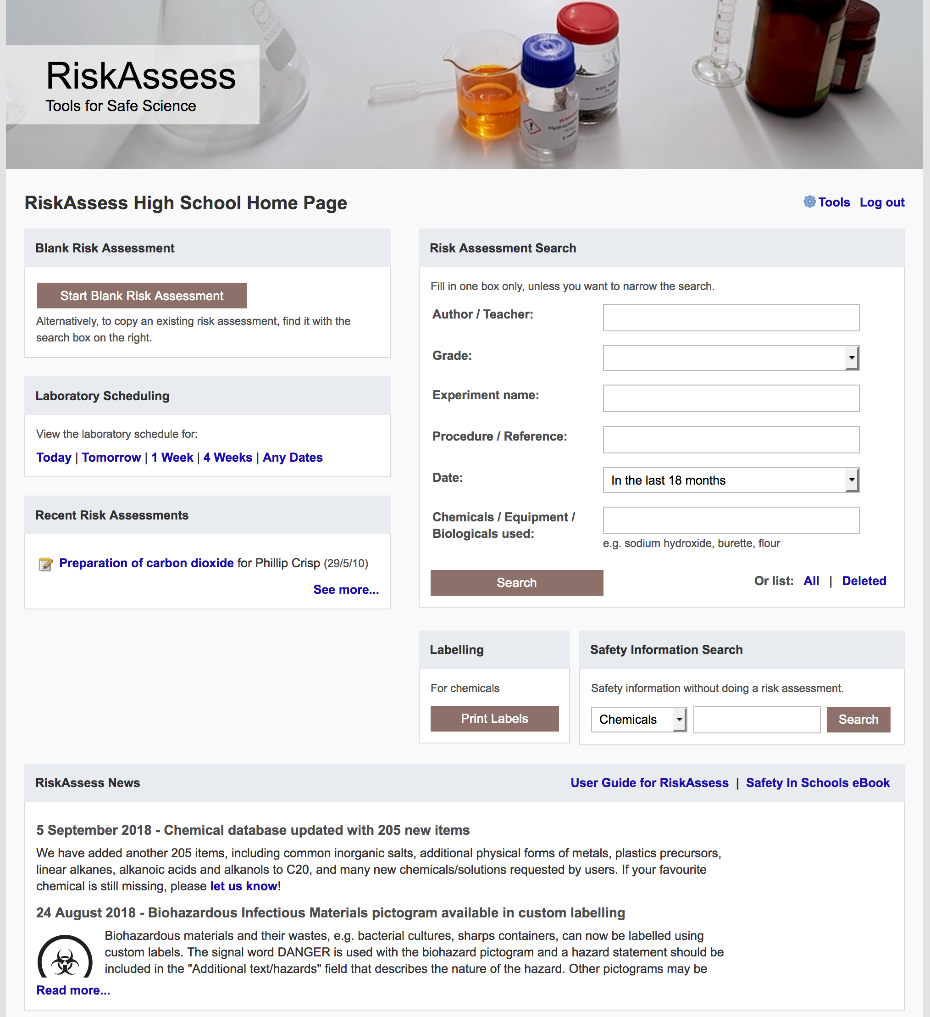

Slide 6
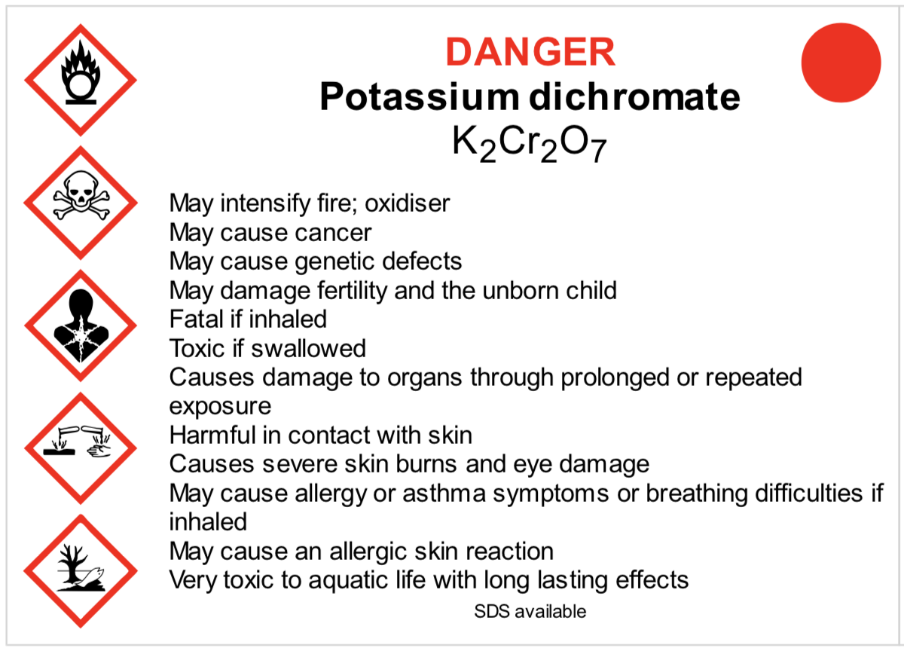
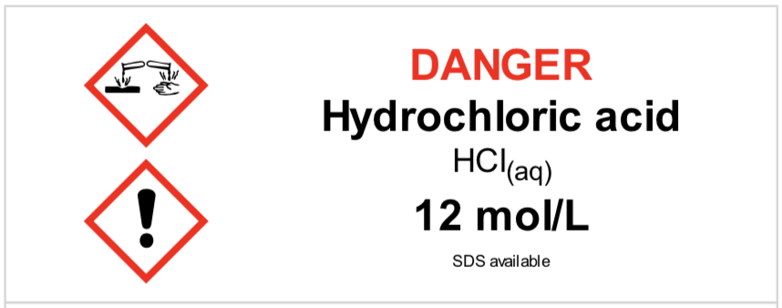
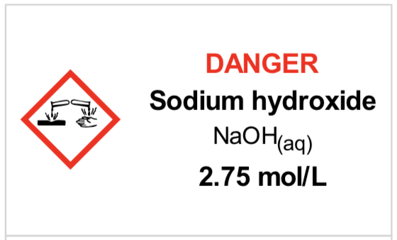
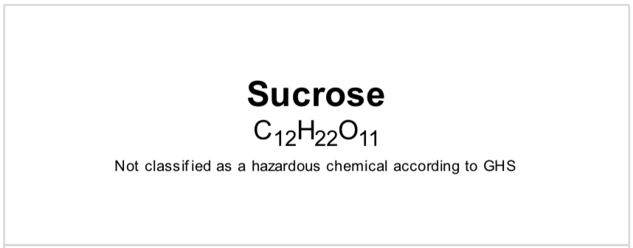
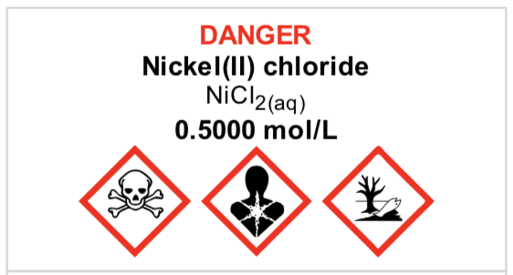
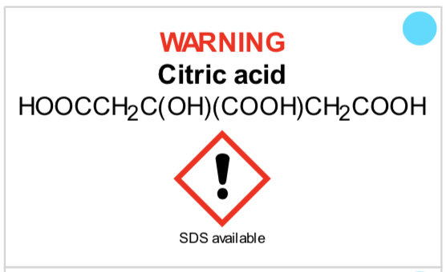
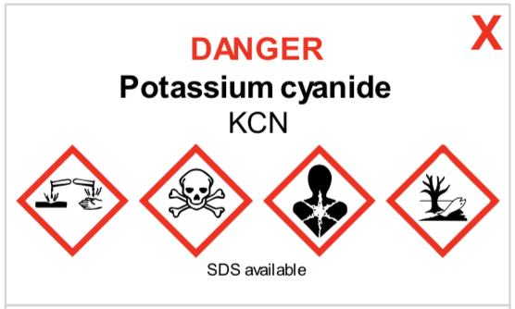
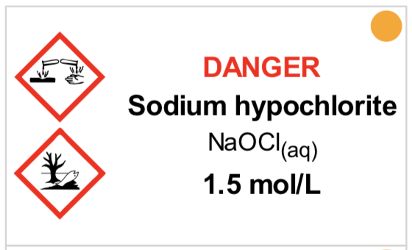
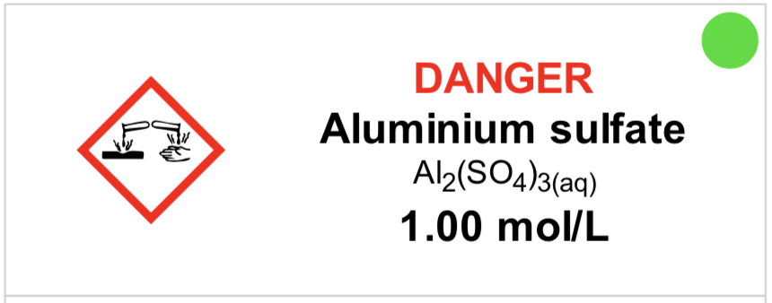
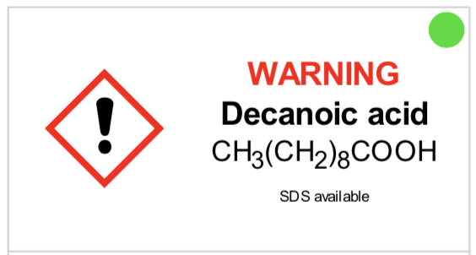
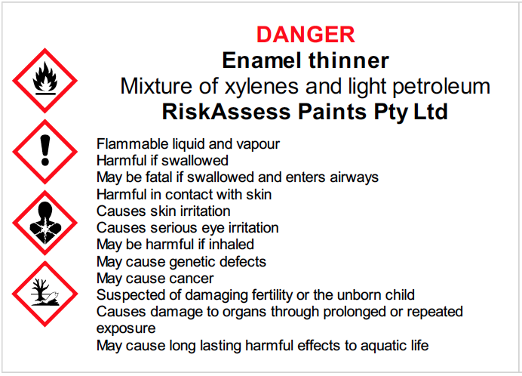
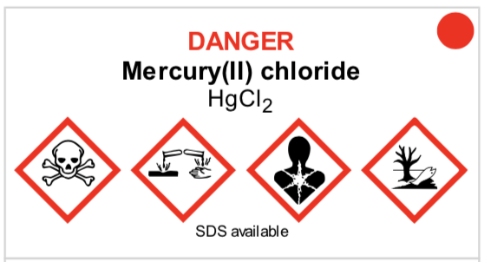
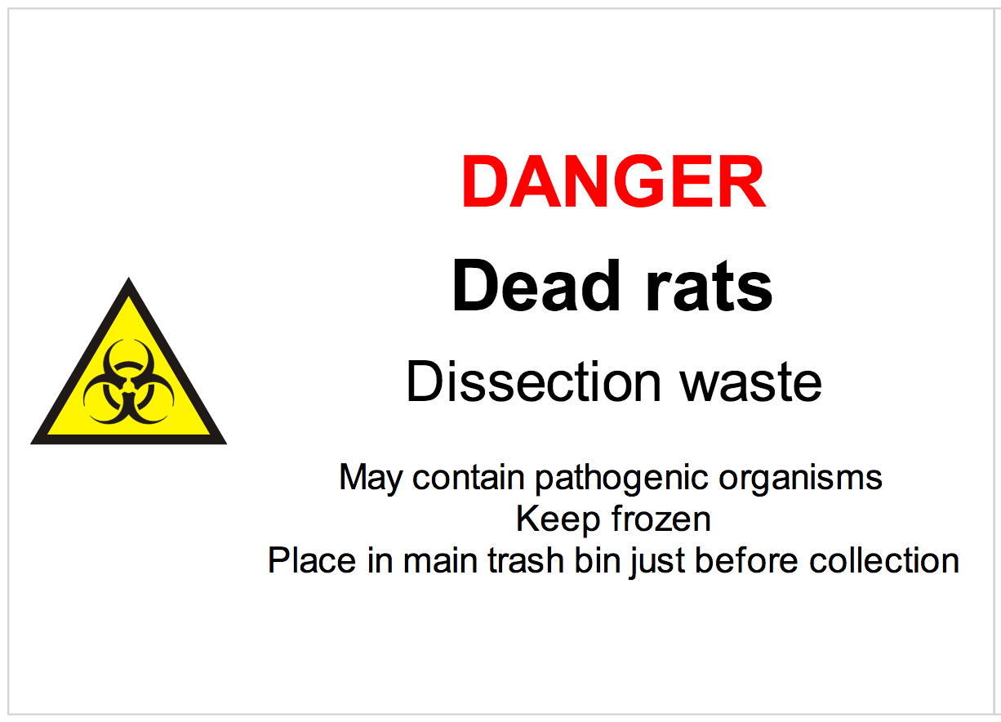
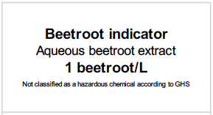
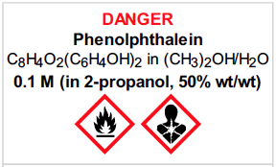

Slide 7
Logic
• separate sections for teacher and science technician
• initial assessment of inherent risk
- if low, go to end
- if medium or more, record control measures
- if high or extreme, third reviewer required
• cross-checking by teacher/scitech/reviewer
• scheduling, ordering, labelling to save time
• inexpensive ($300+GST per campus per year)

Slide 8
Electronic system
• relatively rapid
• prompts sensitive to context
• reduces paper consumption
• easy to review and update
• search and statistics
• long term storage
• demonstrated to work in schools
RiskAssess: 2,500 schools AU+NZ+CA
NZ: 230 (42%)
5,500,000 risk assessments

Slide 9
Details
• access from school/home
• nothing to install on computer, tablet or phone
(instant update)
• unlimited number of simultaneous users and risk assessments
• minimal data entry
• complements SDSs
• continuing input from science staff
• multiple backups of data & backup server
• support and advice

Slide 10
DEMO

Slide 11
Advantages of RiskAssess
proper consideration of risks and control measures
standardisation
storage of records for legal purposes
communication between teachers and science technicians
discourages spur-of-the-moment experiments
useful for new/inexperienced staff

Slide 12
Even more!
• scheduling system
• prac ordering
• GHS labelling
- standard
- custom
• disposal advice
And an exciting video . . .
“Getting Started with RiskAssess”
starring Phillip and Eva!

Slide 13
Outcomes
• reduced frequency of injuries
- to students
- to school staff
• reduced costs for paperwork, litigation and payouts
• compliance with the law
• helps maintain variety of chemicals and equipment
• easy ordering, scheduling and labelling

Slide 14
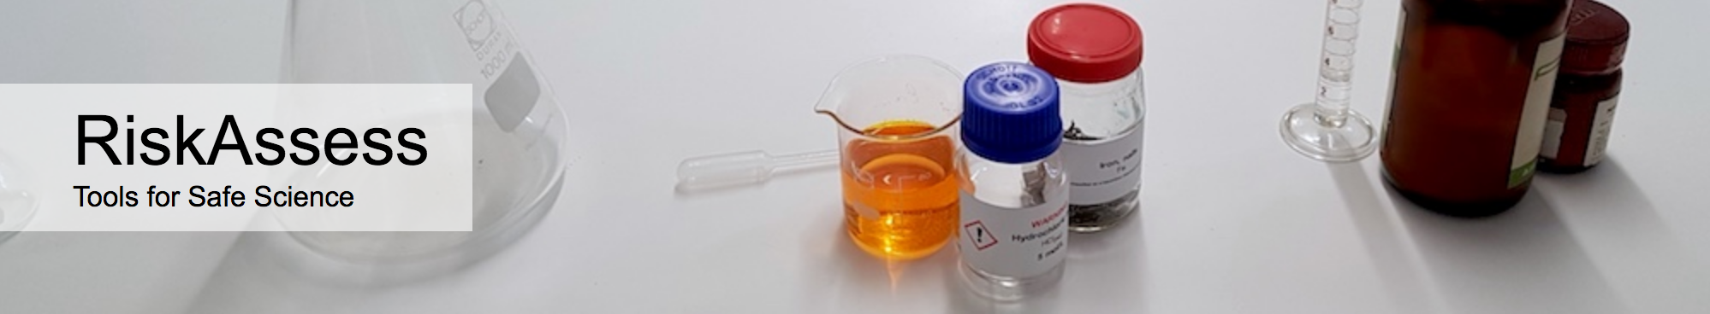

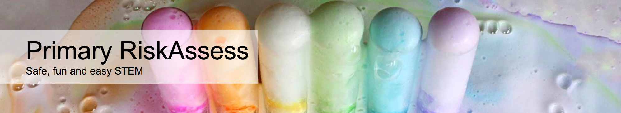

2500 schools
NZ: 230 (42%)
560 schools
NZ: 5
190 schools
NZ: 1
30 schools
NZ: 2
Notes:
Who is RiskAssess made for?

Slide 15
Questions?
Notes:
Any questions before we move on to new features and tips & tricks?

Slide 16
New Features

Slide 17
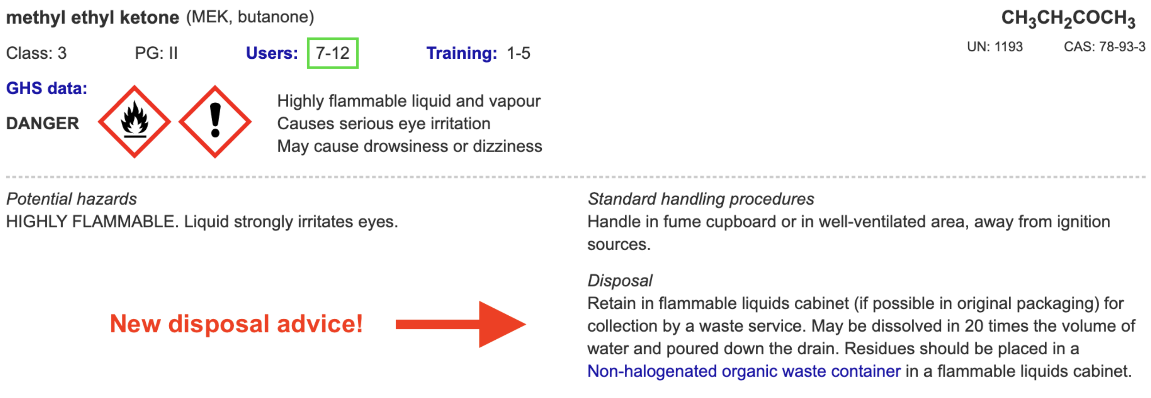
Disposal
Most recent advance in RiskAssess
Advice for all 3000 chemicals and solutions
plus guide to disposal and waste container details
Separate presentation
e.g.

Slide 18
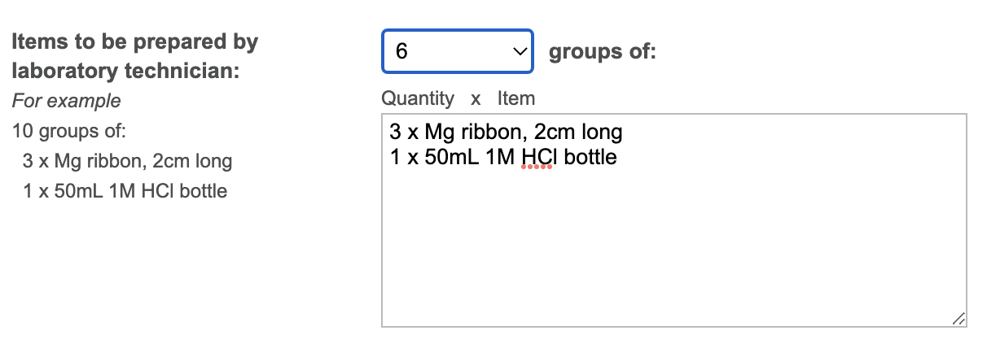
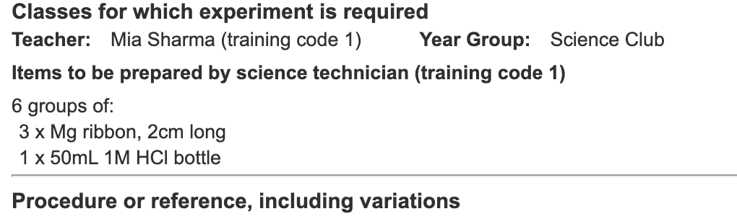
Notes:
Mandatory setting too in tools!

Slide 19
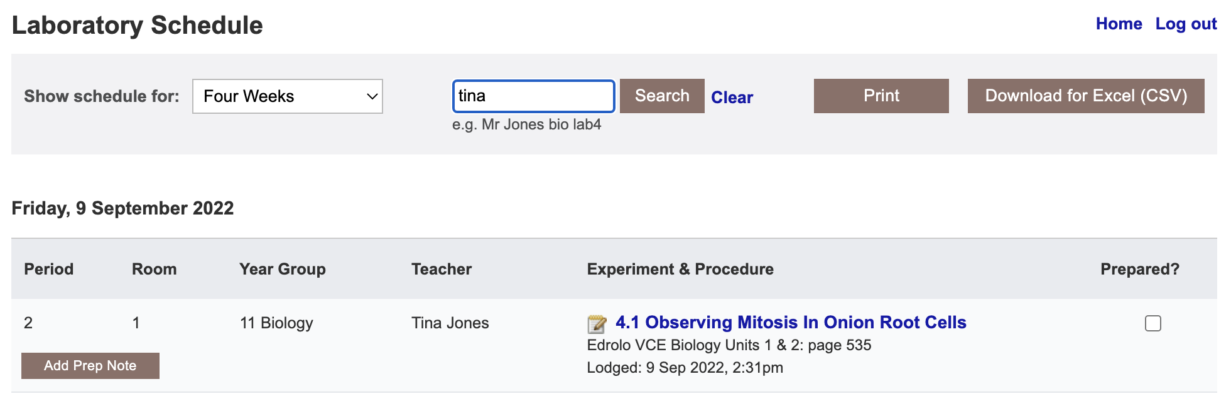
Notes:
Year group, teacher, room, name

Slide 20
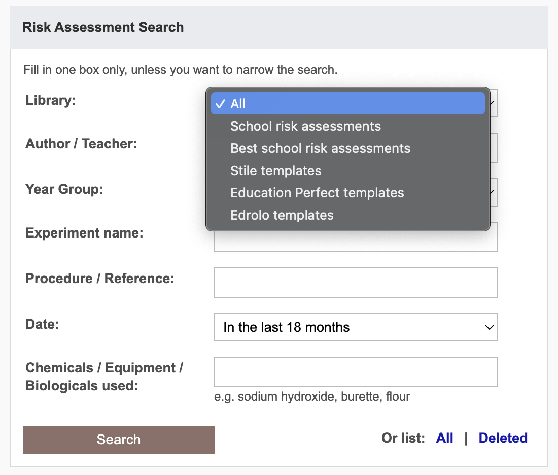

Slide 21
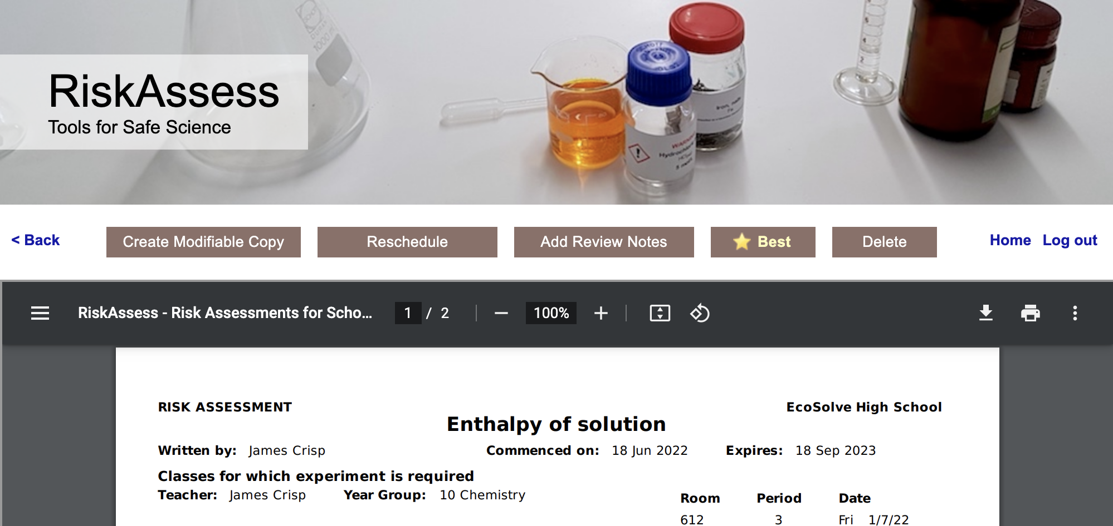
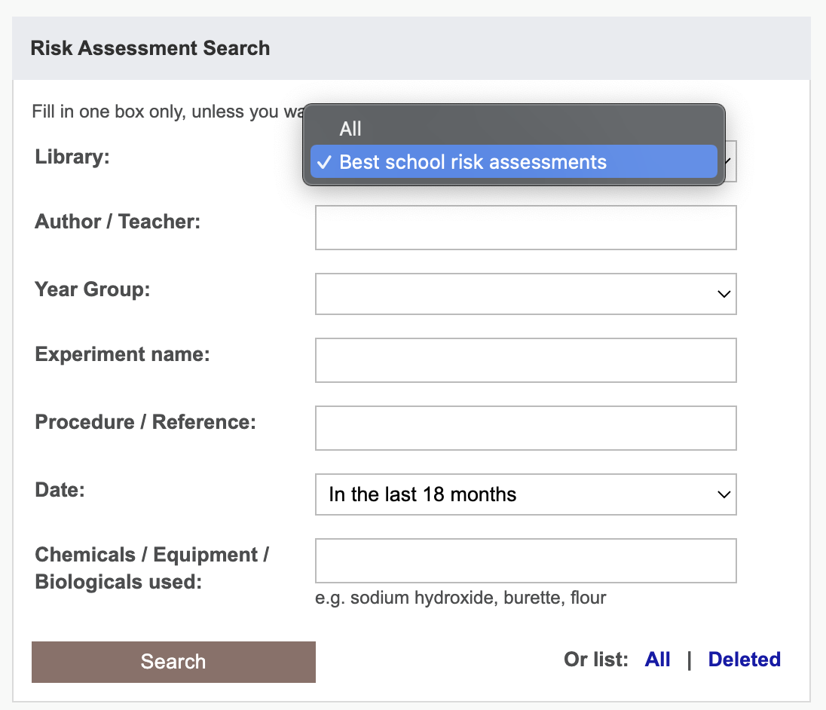
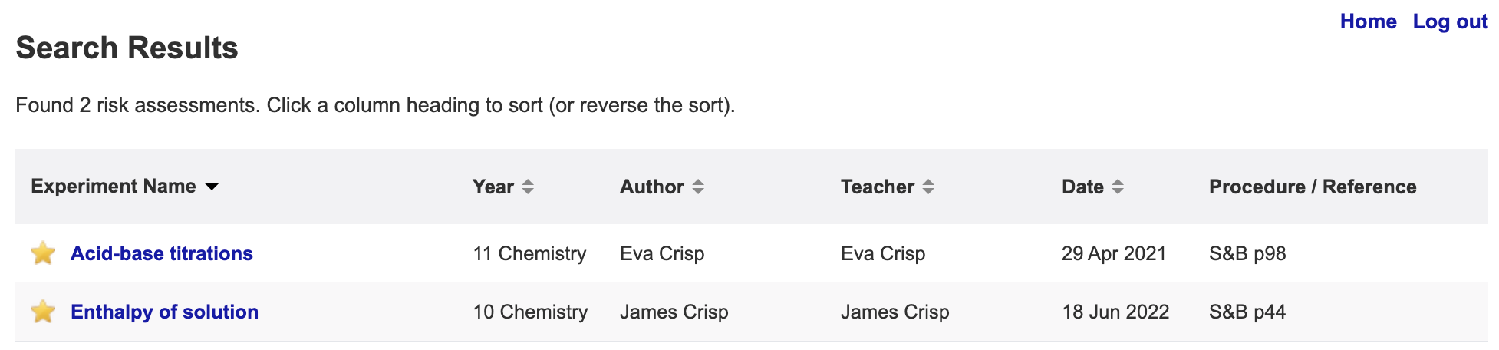

Slide 22
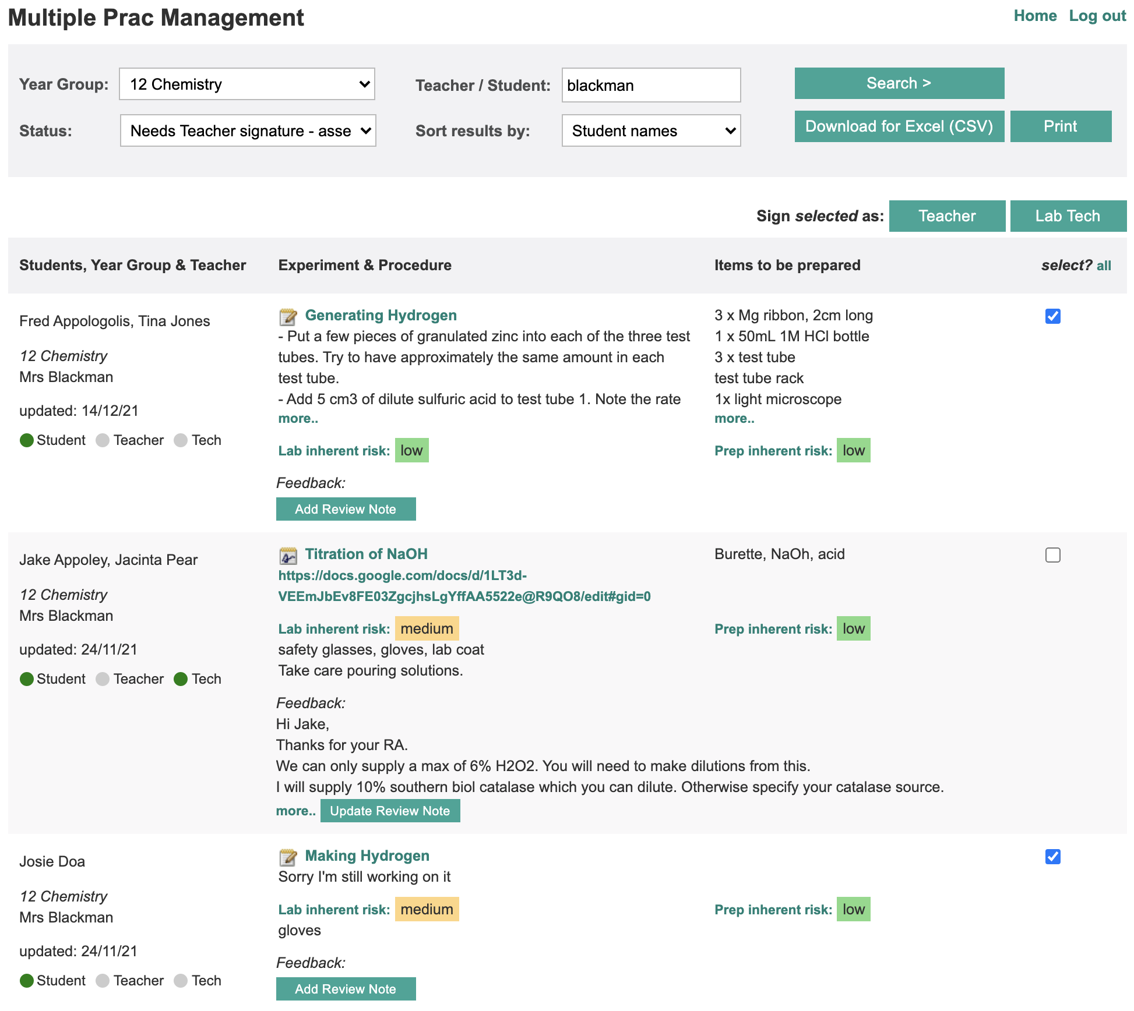

Slide 23
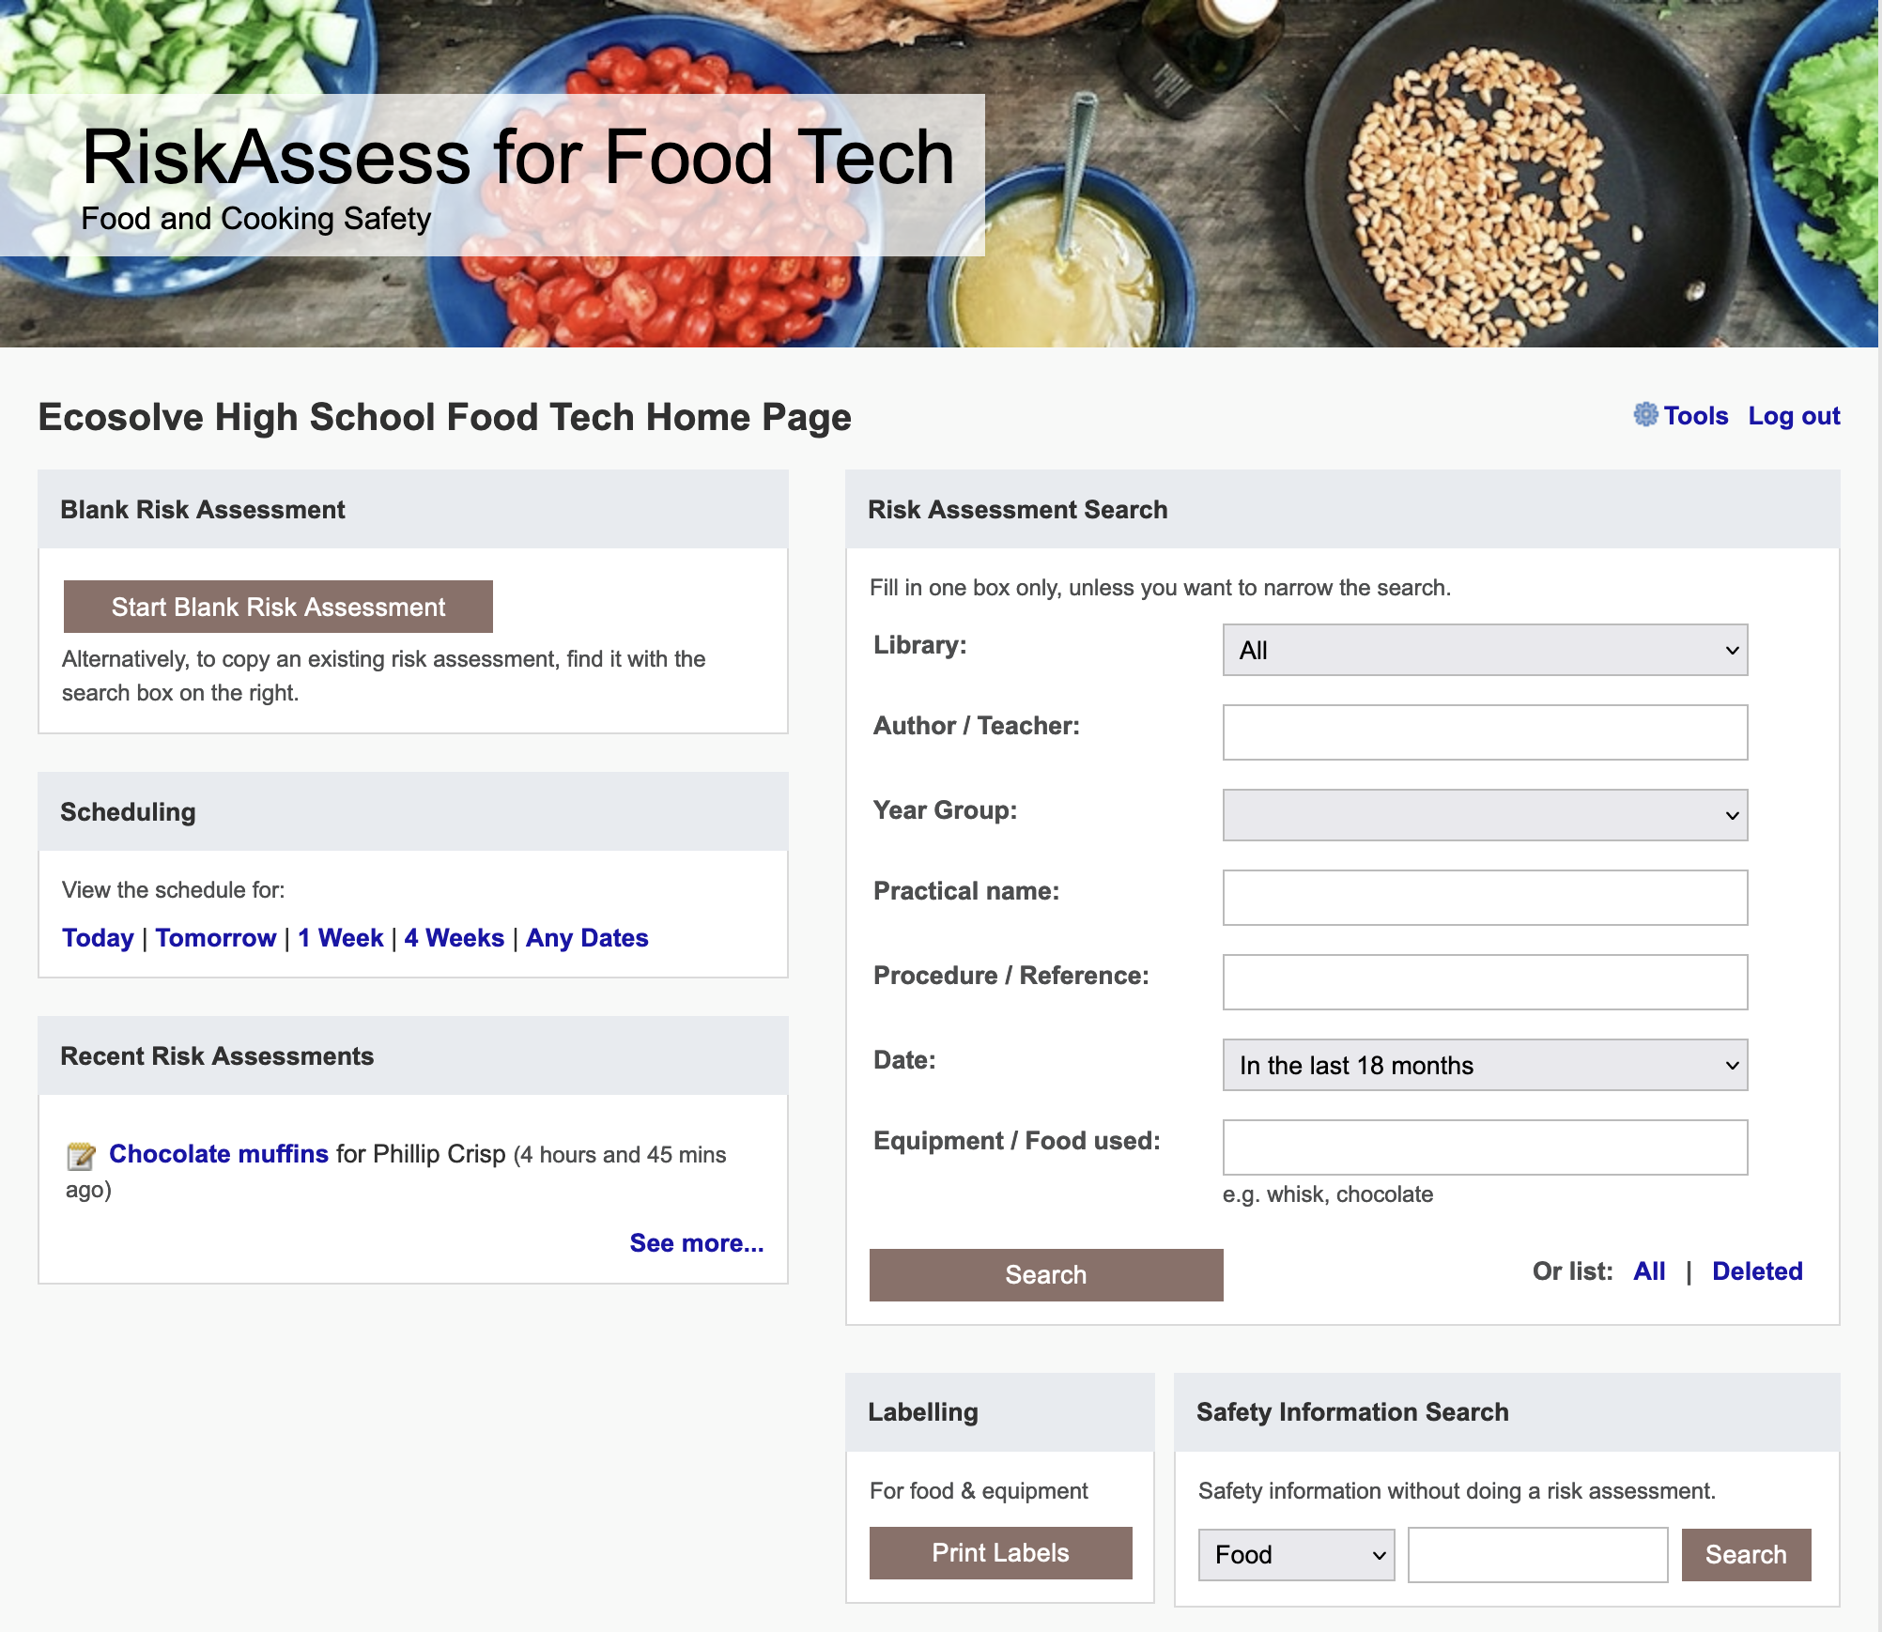

Slide 24
Tips & Tricks

Slide 25
Menu
Shortcuts
icons, hcl, part name, day/month,
click banner, links, hot links,
‘Best’ RAs, delete, search # & sort
Scheduling
Excel/csv, any dates, last week,
search, no# pracs, prep notes,
double booking
Tools
customise year groups,
stocktaking & usage, invoice,
backup system, defaults
Resources
learning resources, faq, eBook,
videos, libraries: Stile+EP+Edrolo
Labels
standard & custom labels
multiple chemicals on sheet
mixtures, non-chemicals
free text, biohazard symbol
Operations
reschedule, archive risk
assessments, annual review,
tech-only RAs, review notes,
high/extreme: 3 signatures, list
Multiple classes
author update/modifiable copy
Student RiskAssess
view student PINs, not last year
multiple prac management

