Slide 1

RiskAssess for New and Experienced Users
James Crisp

Slide 2
• reduce injuries
• increase legal protection
Why do risk assessments?

Slide 3

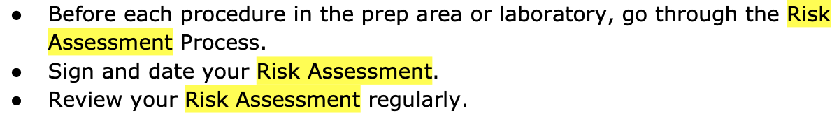
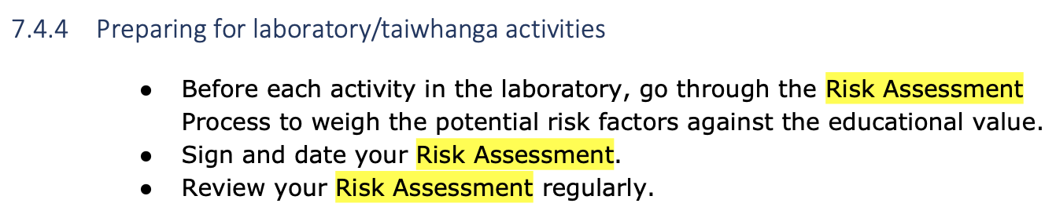
Safety and Science/Pūtaiao (2023)

Slide 4
Issues
facilities available
behaviour of the class
students with special needs
students with allergies
. . . . . . . .
Issues may, and commonly will,
differ from class to class.
No one hat fits all!

Slide 5
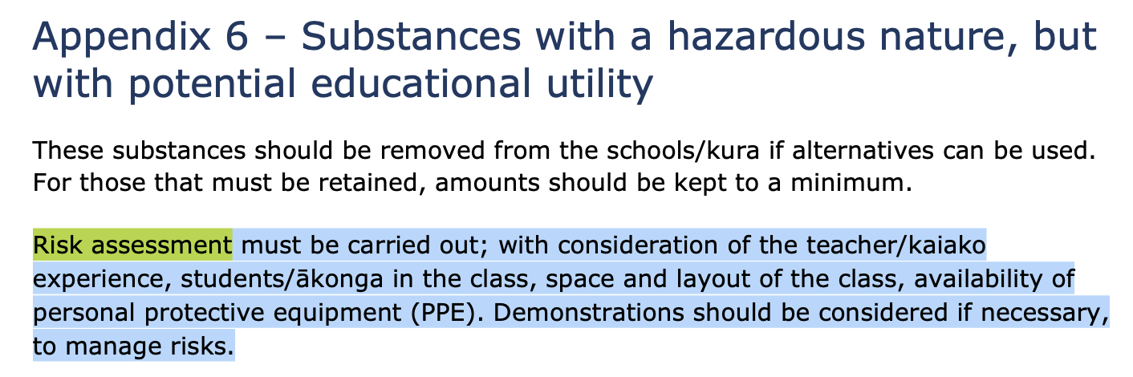
Safety and Science/Pūtaiao (2023)

Slide 6
What is RiskAssess?
• web-based risk assessment tool
• customised to the school situation
• provides
- electronic templates (NZ/ISO)
- databases of information on risks
• easy sharing of risk assessments
• plus ordering, scheduling & labelling

Slide 7
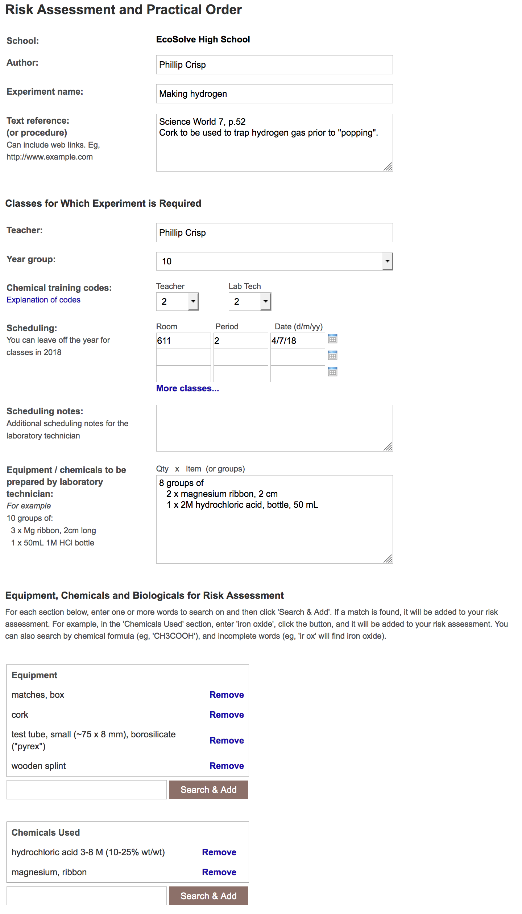
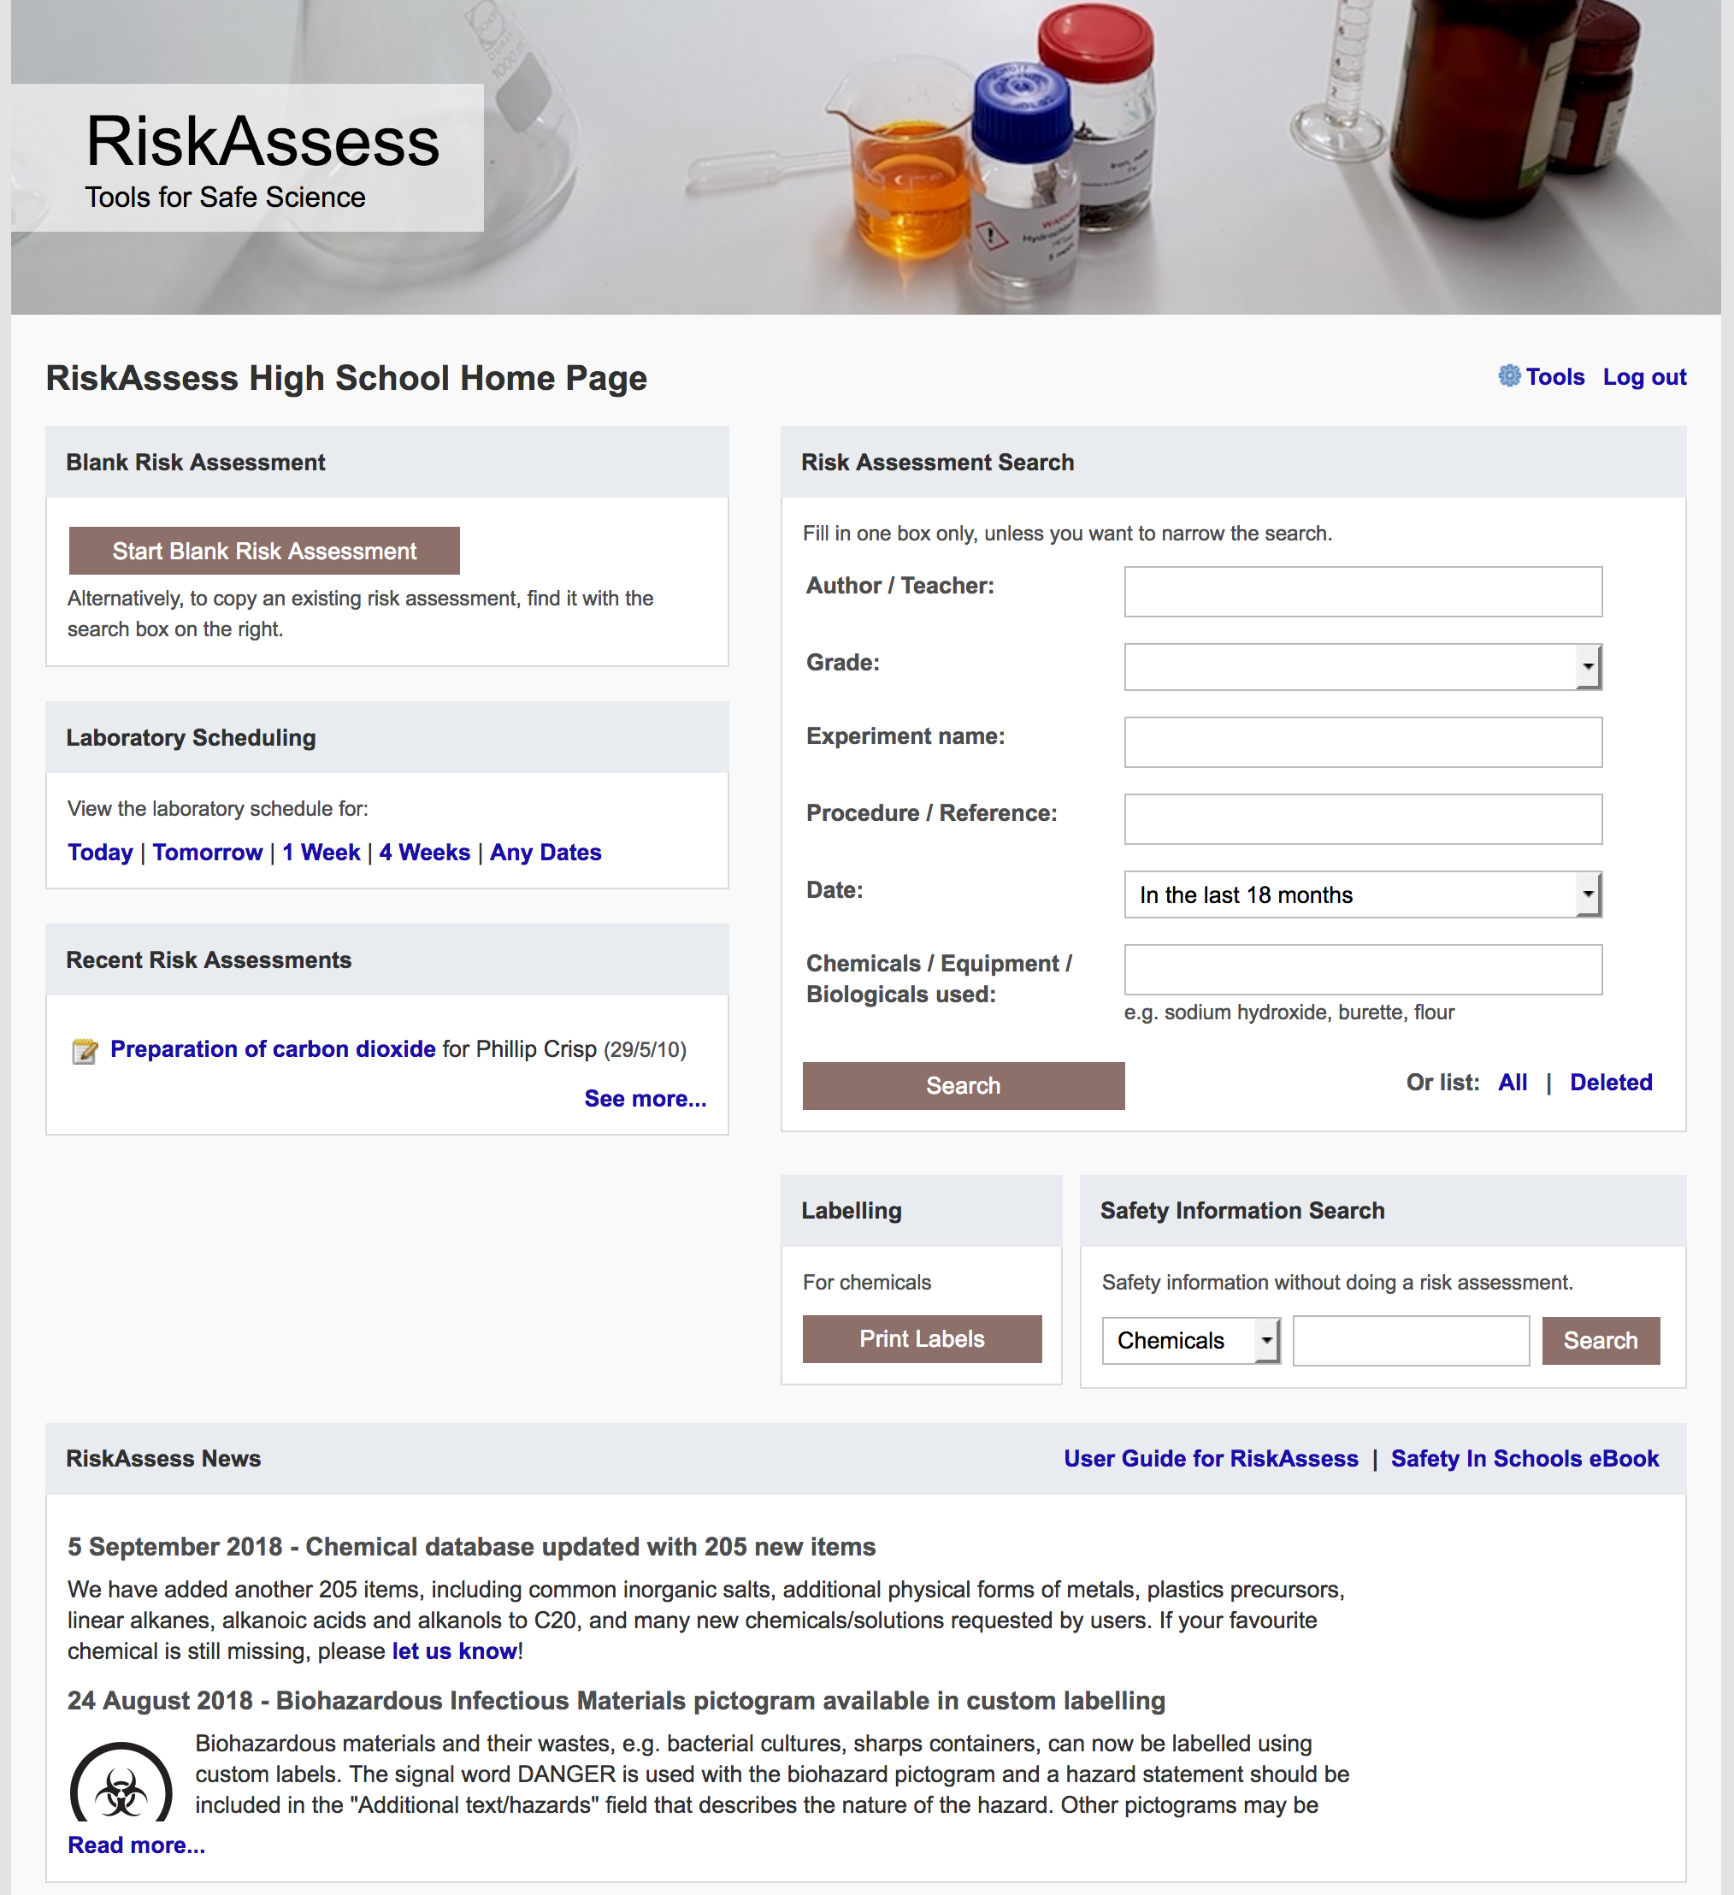

Slide 8
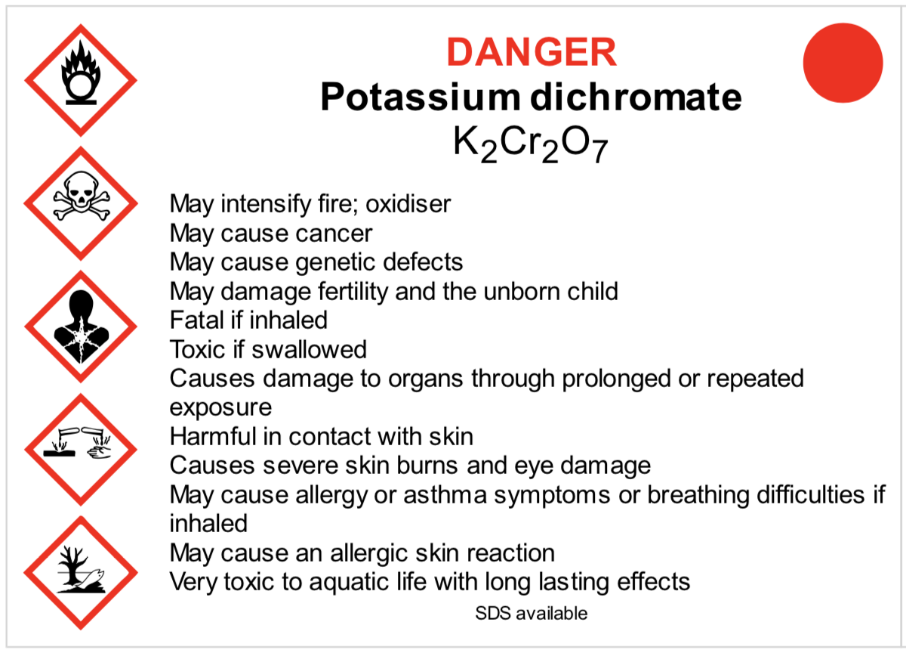
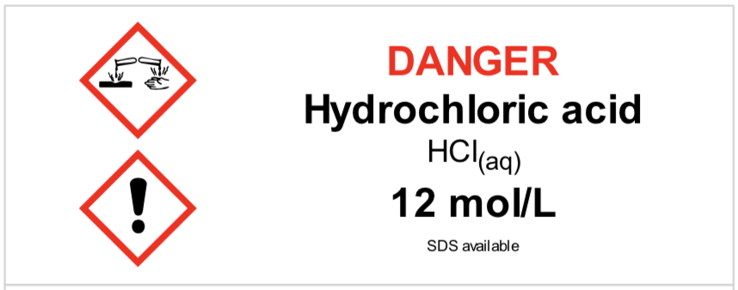
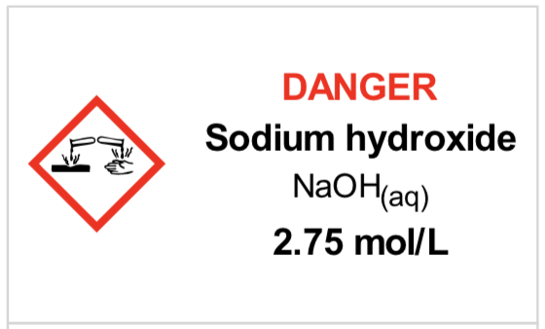
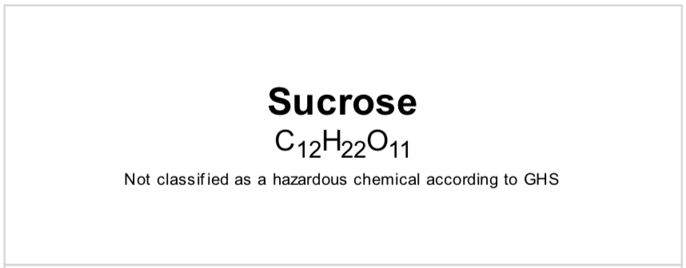
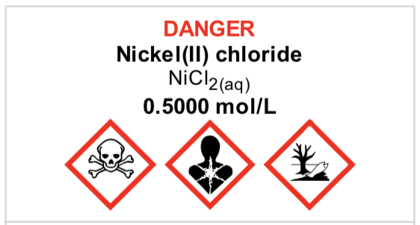
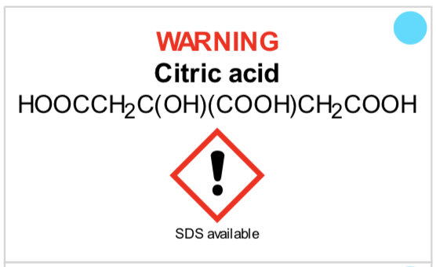
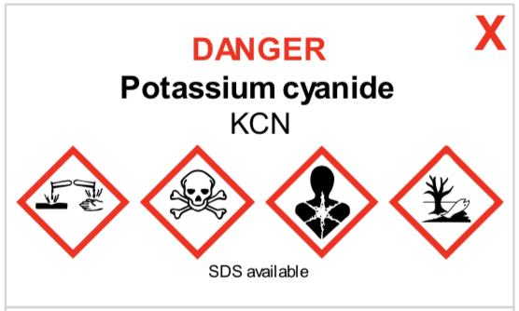
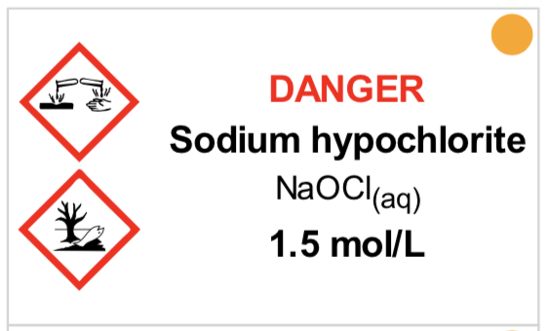
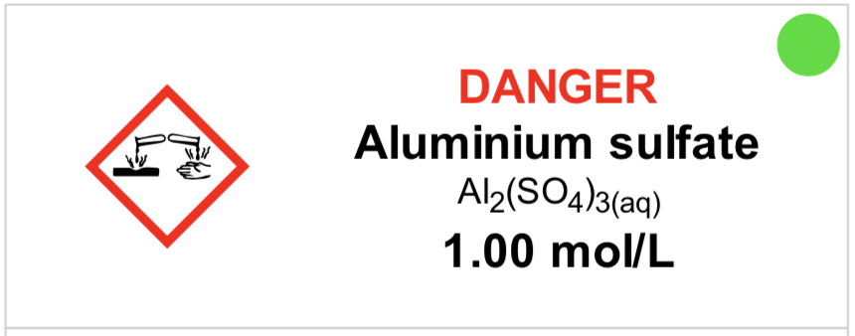
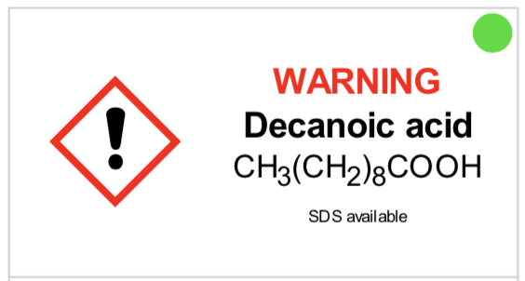
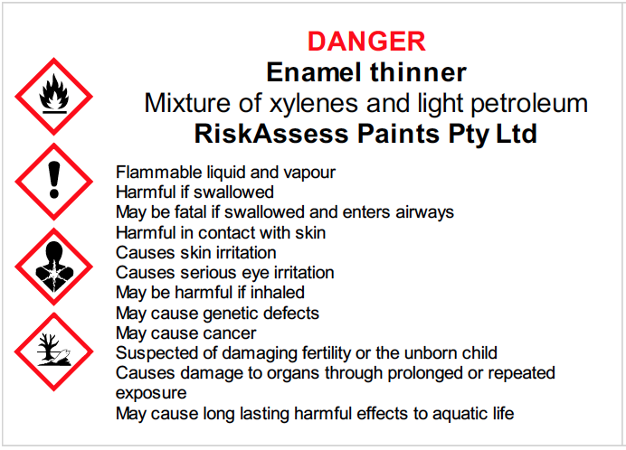
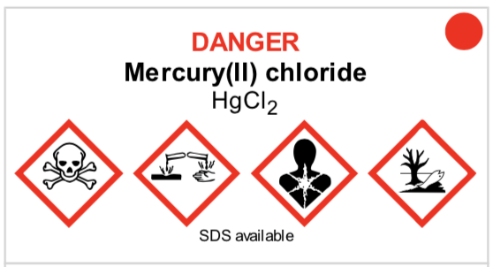
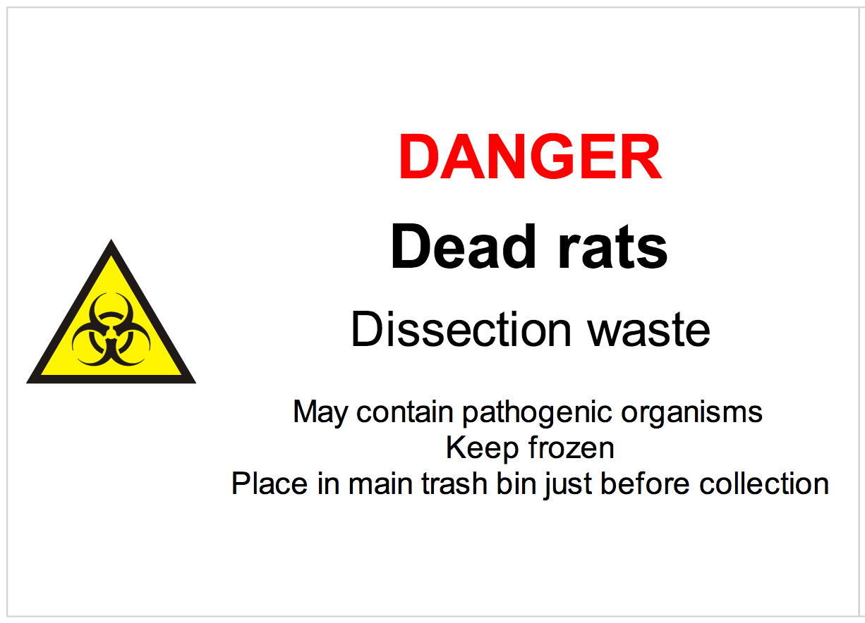
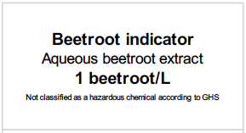
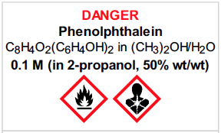

Slide 9
Logic
• separate sections for teacher and science technician
• initial assessment of inherent risk
- if low, go to end
- if medium or more, record control measures
- if high or extreme, third reviewer required
• cross-checking by teacher/scitech/reviewer
• scheduling, ordering, labelling to save time
• inexpensive ($350+GST per campus per year)

Slide 10
Electronic system
• relatively rapid
• prompts sensitive to context
• reduces paper consumption
• easy to review and update
• search and statistics
• long term storage
• demonstrated to work in schools
RiskAssess: 2,700 schools AU+NZ+CA
NZ: 292 (53%)
6,500,000 risk assessments

Slide 11
Details
• access from school/home
• nothing to install on computer, tablet or phone
(instant update)
• unlimited number of simultaneous users and risk assessments
• minimal data entry
• complements SDSs
• continuing input from science staff
• multiple backups of data & backup server
• support and advice

Slide 12
DEMO

Slide 13
Advantages of RiskAssess
proper consideration of risks and control measures
standardisation
storage of records for legal purposes
communication between teachers and science technicians
discourages spur-of-the-moment experiments
useful for new/inexperienced staff

Slide 14
Even more!
• scheduling system
• prac ordering
• GHS labelling
- standard
- custom
• disposal advice
And an exciting video . . .
“Getting Started with RiskAssess”
starring Phillip and Eva!

Slide 15
Outcomes
• reduced frequency of injuries
- to students
- to school staff
• reduced costs for paperwork, litigation and payouts
• compliance with the law & Safety in Science/Pūtaiao
• helps maintain variety of chemicals and equipment
• easy ordering, scheduling and labelling

Slide 16
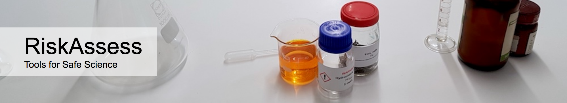

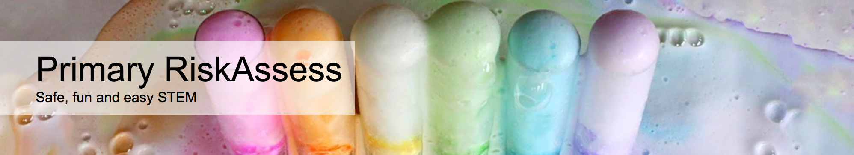

2700 schools
NZ: 292 (53%)
590 schools
NZ: 4
200 schools
NZ: 2
80 schools
NZ: 1
Notes:
Who is RiskAssess made for?

Slide 17
Questions?
Notes:
Any questions before we move on to new features and tips & tricks?

Slide 18
New Features

Slide 19
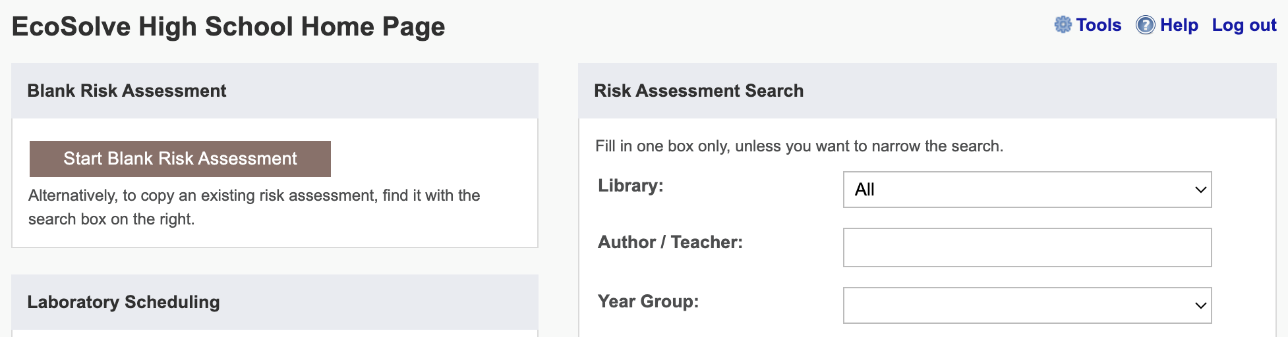
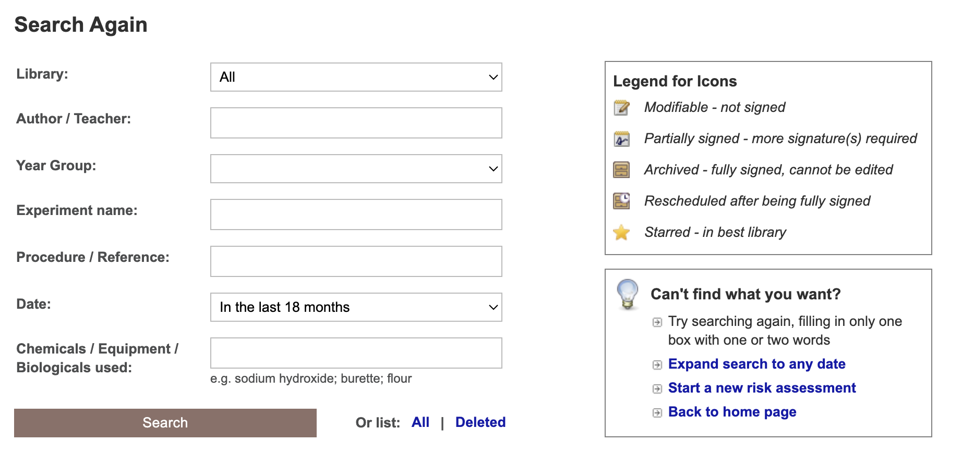
Notes:
Learning resources, videos & faq

Slide 20
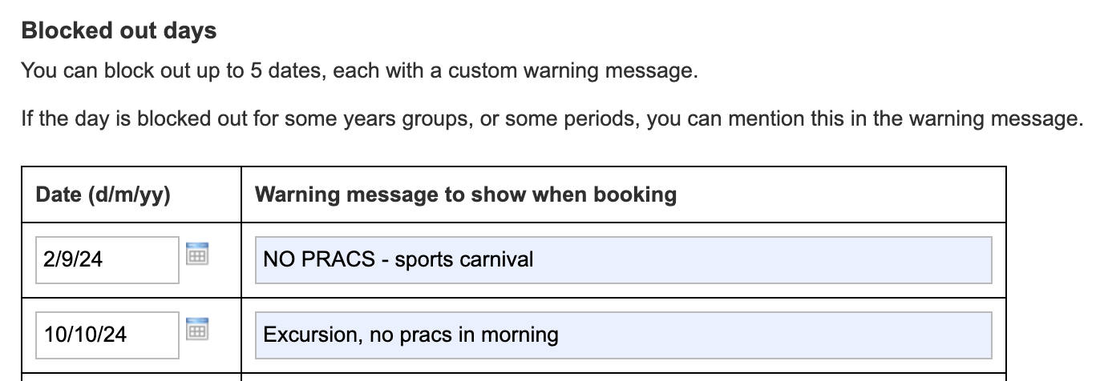
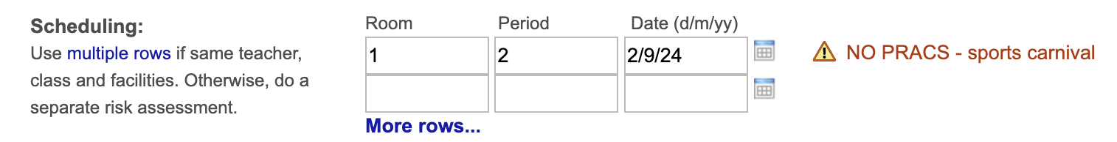

Slide 21
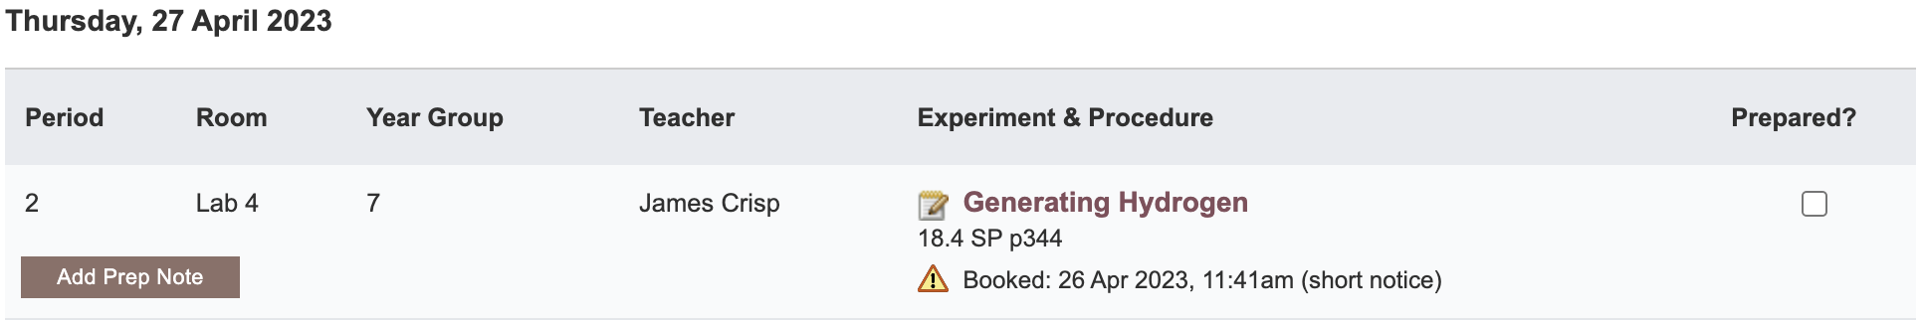

Slide 22
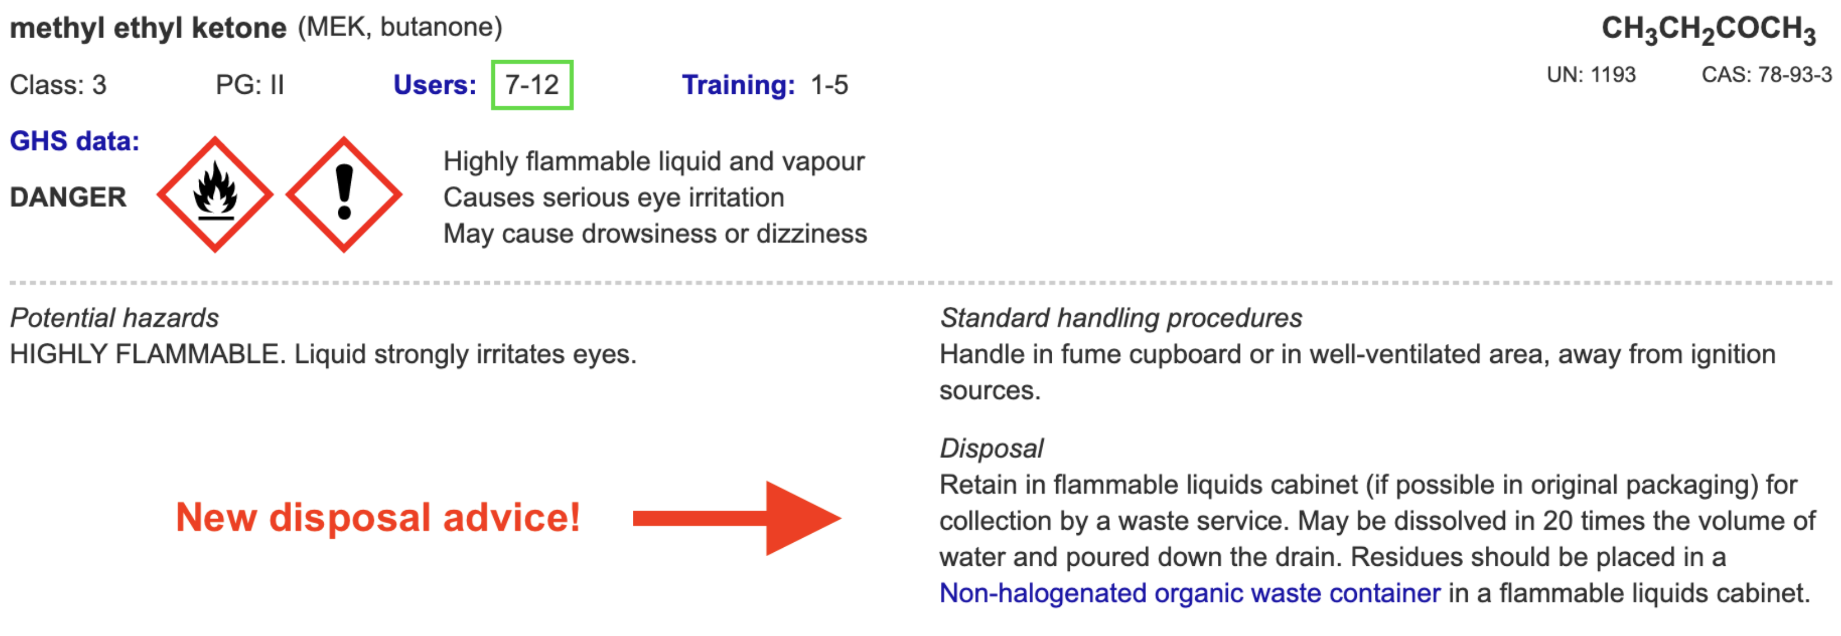
Disposal
Advice for all 3000 chemicals and solutions
Guide to disposal and waste container details
NEW Waste container labels!

Slide 23
Safety Databases
>650
new and updated items!
Especially expanded coverage of
+ saturated solutions
+ test papers & reaction products
+ geological minerals and rocks

Slide 24
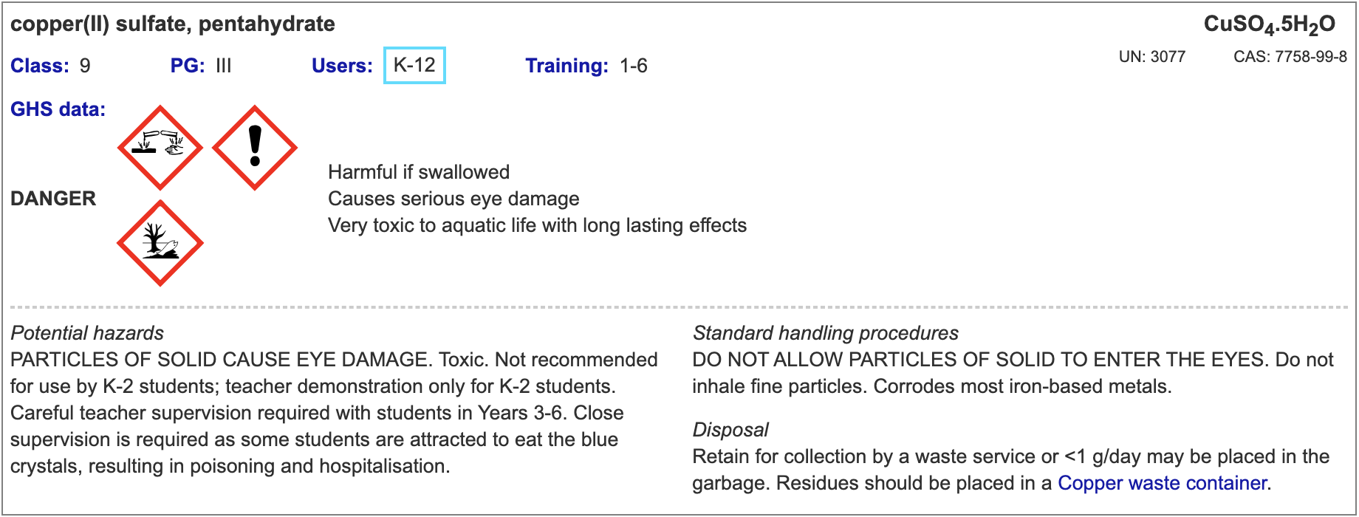
Copper sulfate hazard information upgraded
‘eye irritation’ (reversible) => ‘eye damage’ (> 0.19 M)
Take special care & safety glasses should be worn.
Update labels!

Slide 25
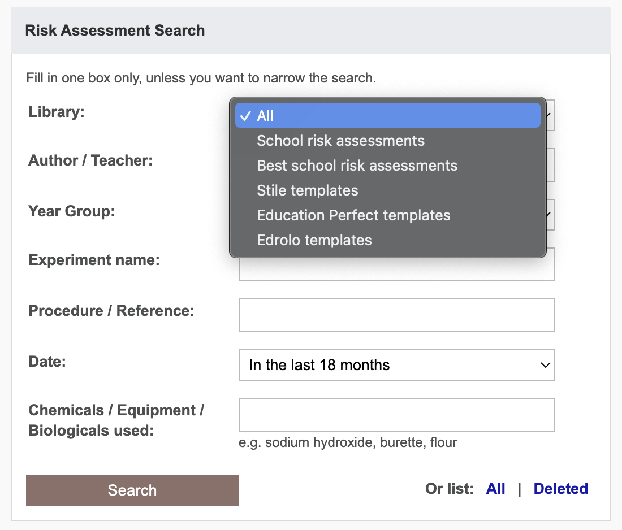

Slide 26
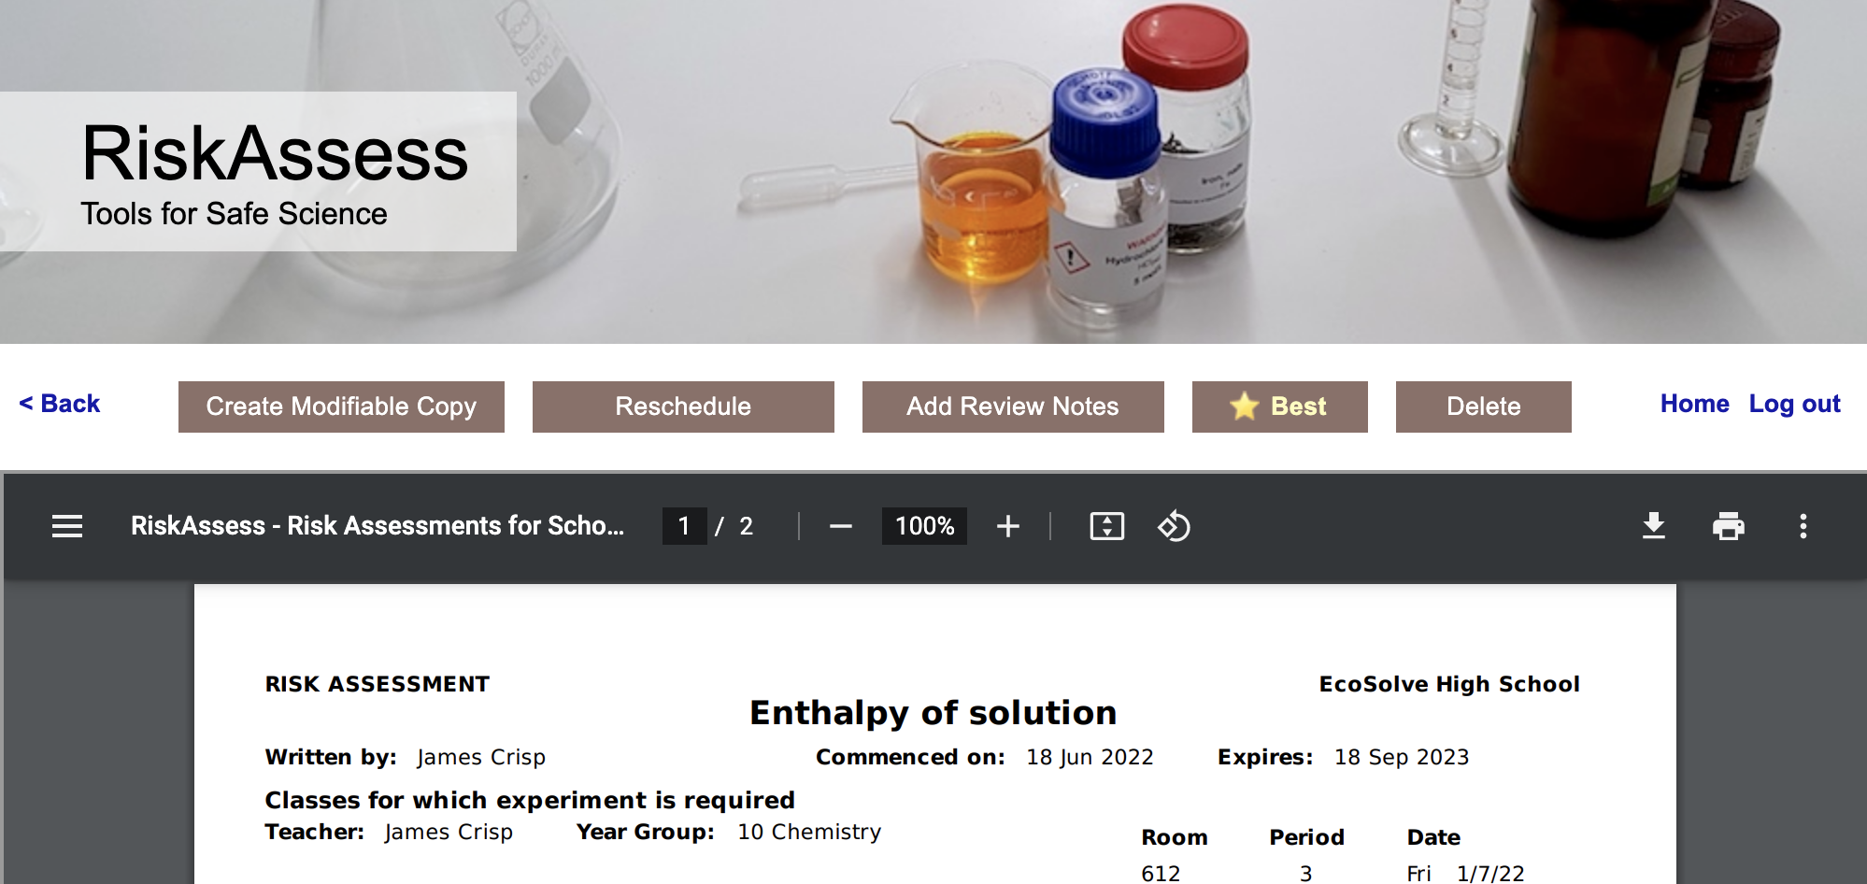
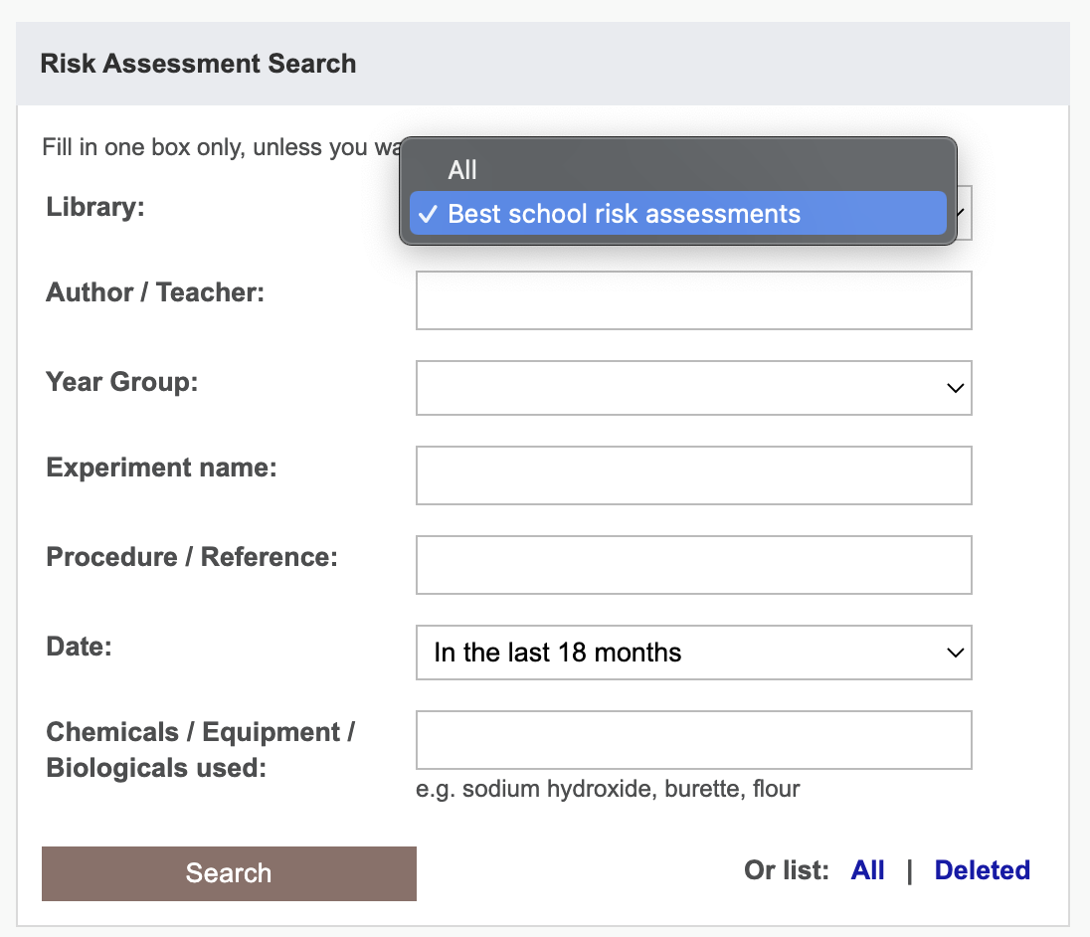
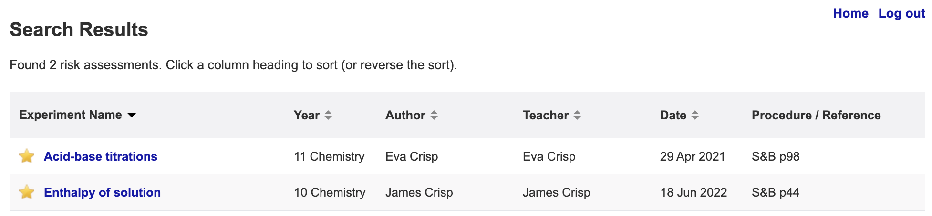

Slide 27
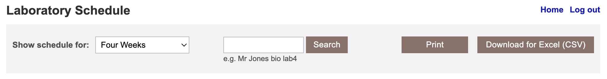
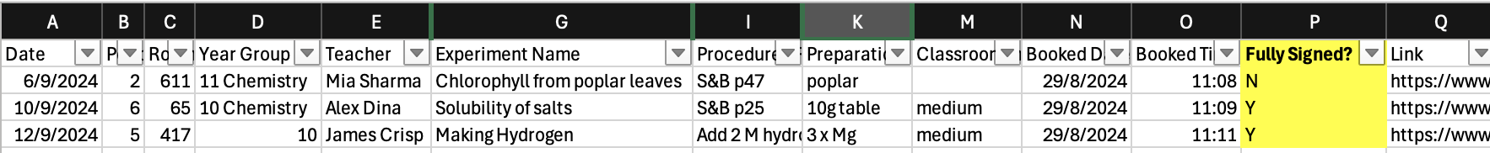

Slide 28
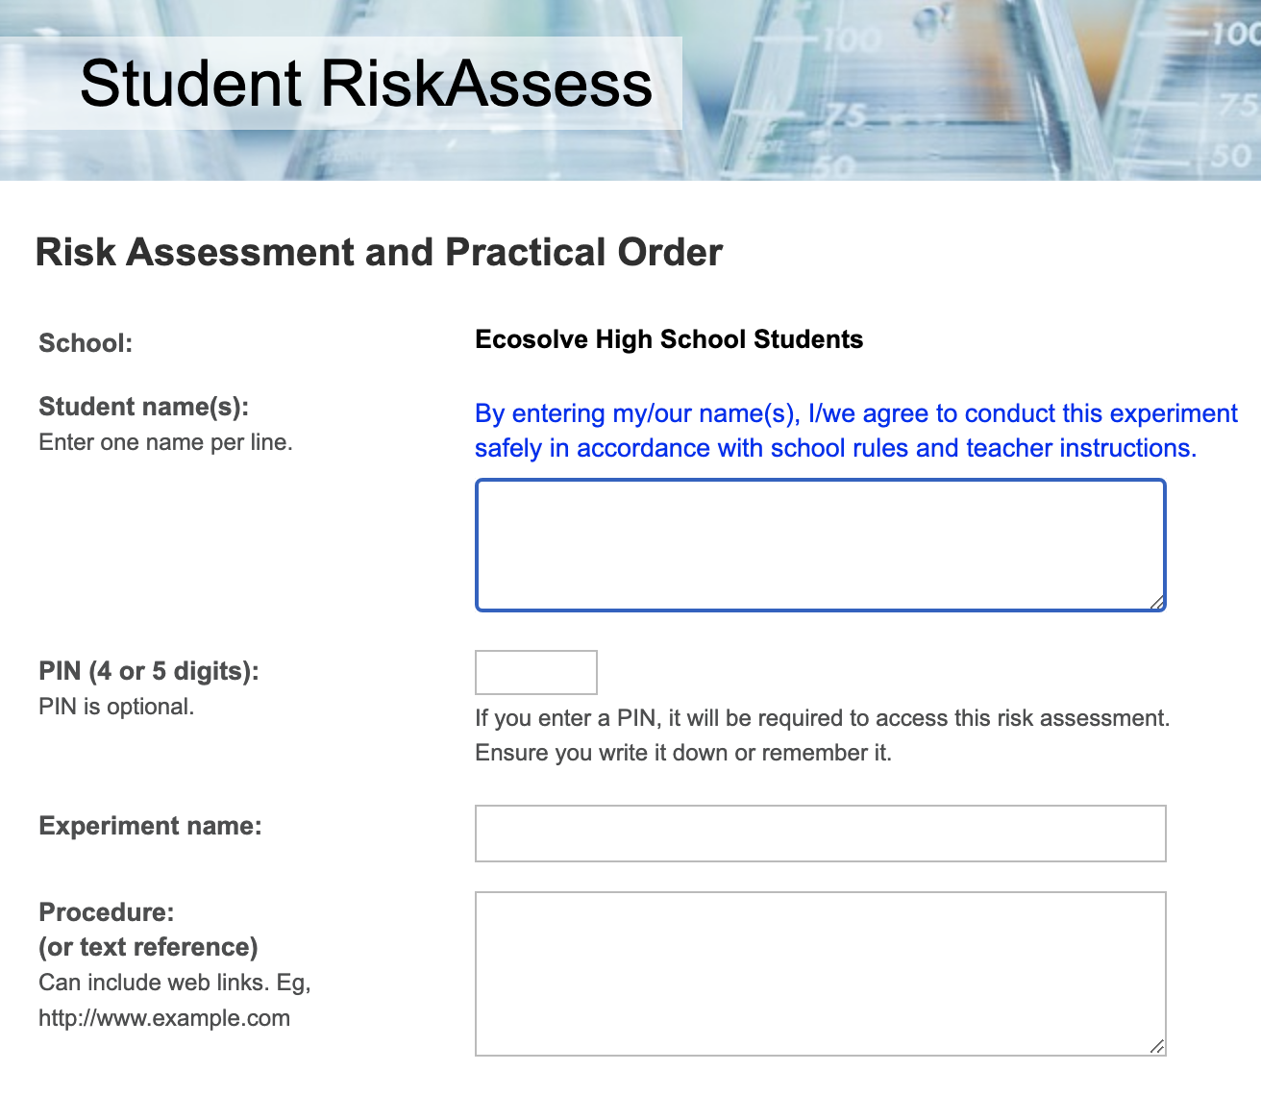

Slide 29
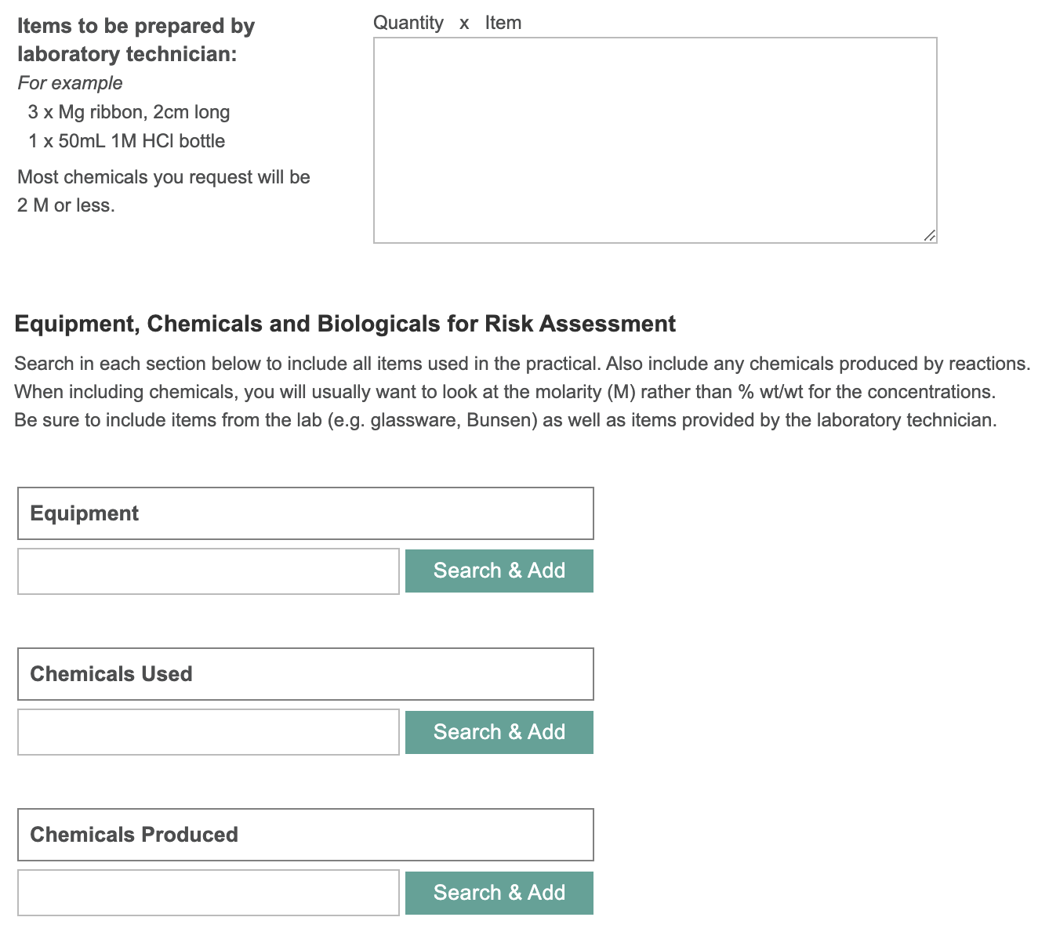

Slide 30
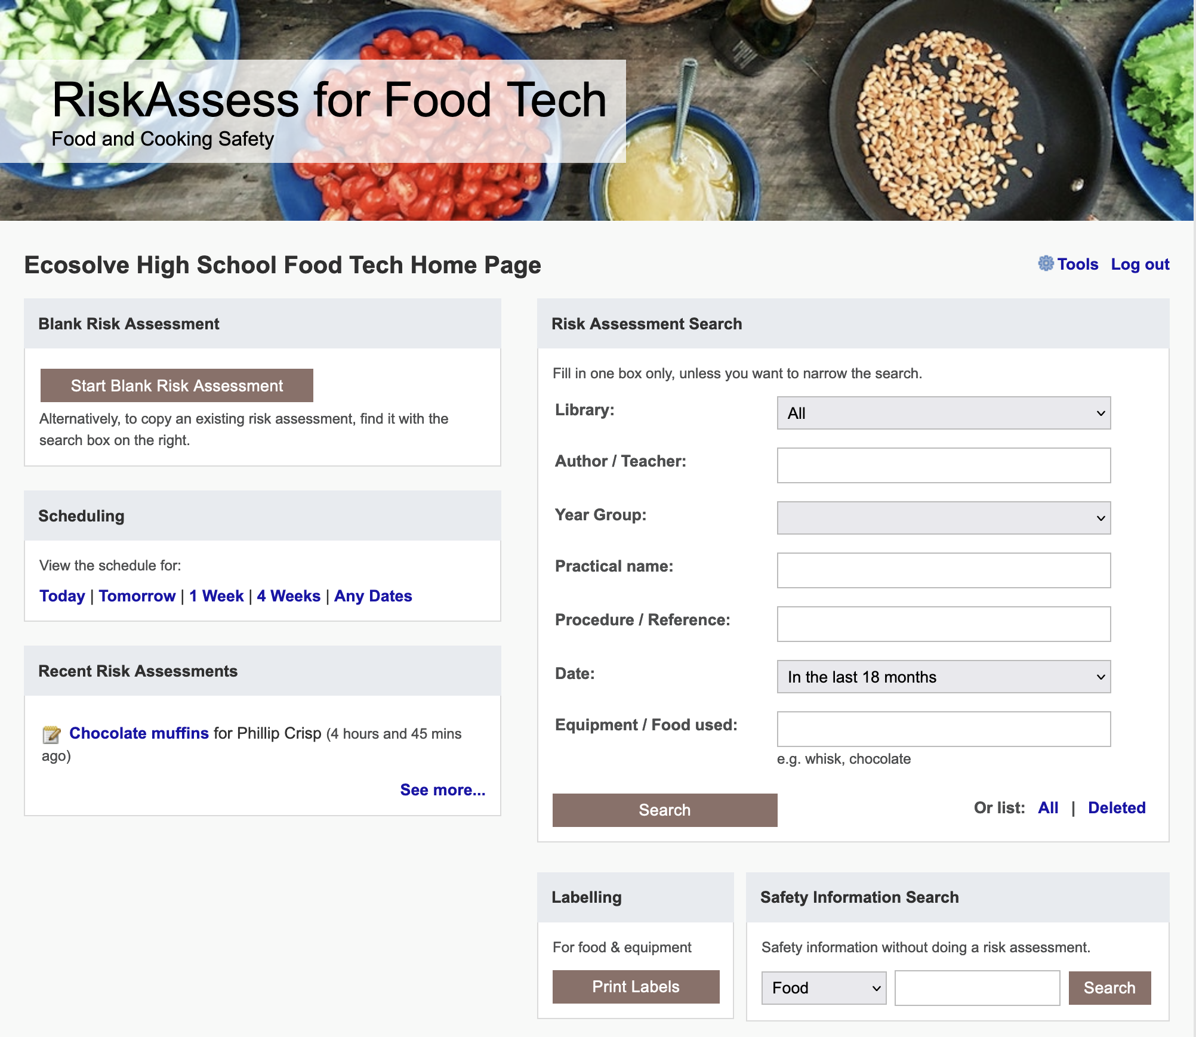

Slide 31
Future Ideas

Slide 32
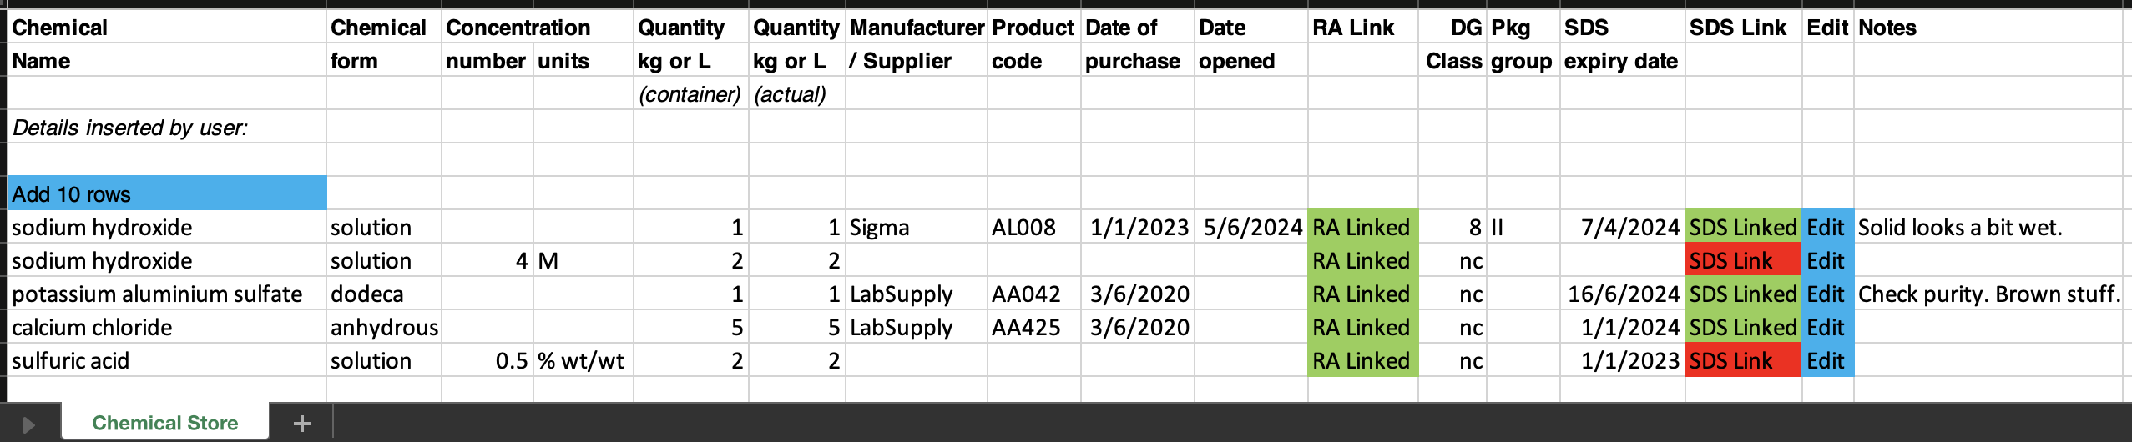
Chemical Register DRAFT
Links to RA safety info & SDS
Import from CSV/template/Chemwatch
Easy print out
Reports/Colours for SDS that need updating
Building (list), room (list), location (text)?
Access for outside Science (read-only link for all, editable link per department)?

Slide 33
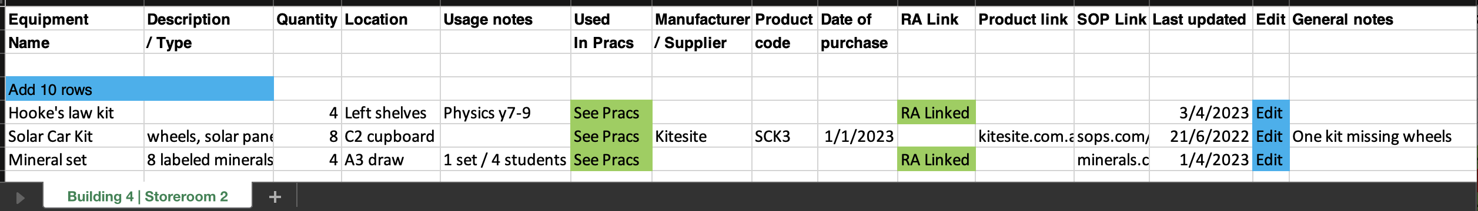
Equipment Inventory DRAFT
Building (list), room (list), location (text)?
Import from CSV/template
Easy print out
Anything missing?

Slide 34
Tips & Tricks

Slide 35
Menu
Shortcuts
icons, hcl, part name, day/month,
click banner, links, hot links, delete,
Best RAs, search on less, # & sort
Scheduling
Excel/csv, any dates, last week,
search, no# pracs, prep notes,
double booking, lodged date
Tools
customise year groups,
stocktaking & usage, invoice,
backup system, defaults
Resources
learning resources, faq, eBook,
videos, libraries: Stile+EP+Edrolo
Labels
standard & custom labels
multiple chemicals on sheet
mixtures, non-chemicals
free text, biohazard symbol
Operations
reschedule, archive risk
assessments, annual review,
tech-only RAs, review notes,
high/extreme: 3 signatures, list
Multiple classes
author update/modifiable copy
Student RiskAssess
view student PINs, not last year
multiple prac management

Slide 36
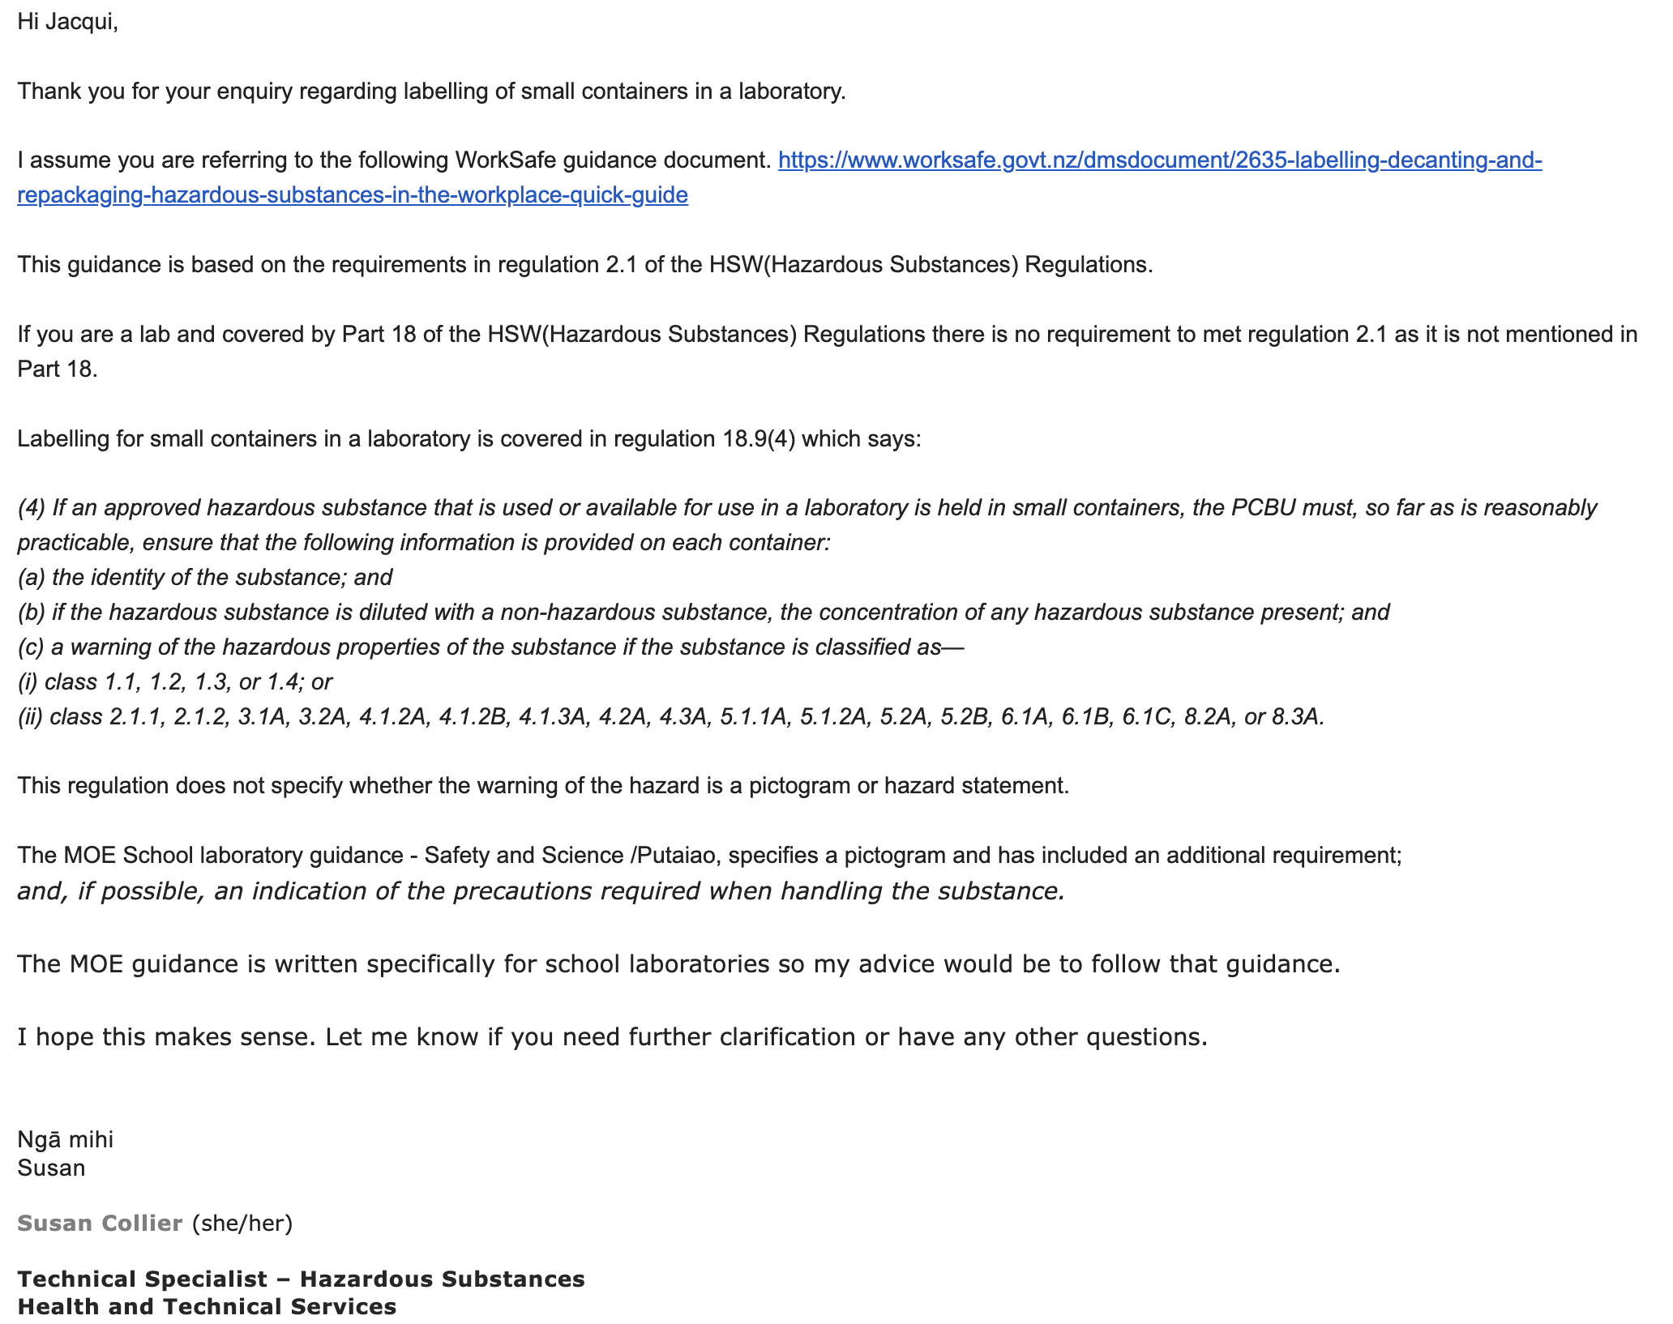
Jacqui Alcock
James Hargest College

