Slide 1

Risk assessment of science experiments: introduction to RiskAssess
Phillip Crisp and Eva Crisp

Slide 2
Why do risk assessments?
reduced frequency of injuries
- to students
- to school staff
reduced costs for paperwork, litigation and payouts
compliance with the law:
OHS Act + OHS Code + WHMIS 2015
helps maintain variety of chemicals and equipment
compliance with Provincial Science Curriculum and IB

Slide 3
What is RiskAssess?
• web-based risk assessment tool
• customized to the school situation
• customized to Canada
• provides
- electronic templates (CA/ISO)
- database information on risks
(chemical, equipment, biological)
- equipment ordering/lab scheduling
- GHS labelling (WHMIS 2015)

Slide 4
6.5 million risk assessments
2,700 schools
16 years

Slide 5




2700 schools
AU: 2400 (84%)
NZ: 300 (54%)
CA: 60 (1%)
580 schools
200 schools
80 schools

Slide 6



93,000 risk assessments
60 schools
+12 schools Calgary/Red Deer/Camrose/Edmonton/Rockies
Qualicum School District

Slide 7
Logic of RiskAssess
• safety information customized for schools
• separate sections for teacher and science technician, allowing cross-checking
• initial assessment of inherent risk
- if low, go to end
- if medium or more, record control measures
- if high or extreme, third reviewer required
• scheduling and ordering system to save time
• labelling for WHMIS 2015 and learning resources
• inexpensive ($350 per school campus per year)

Slide 8
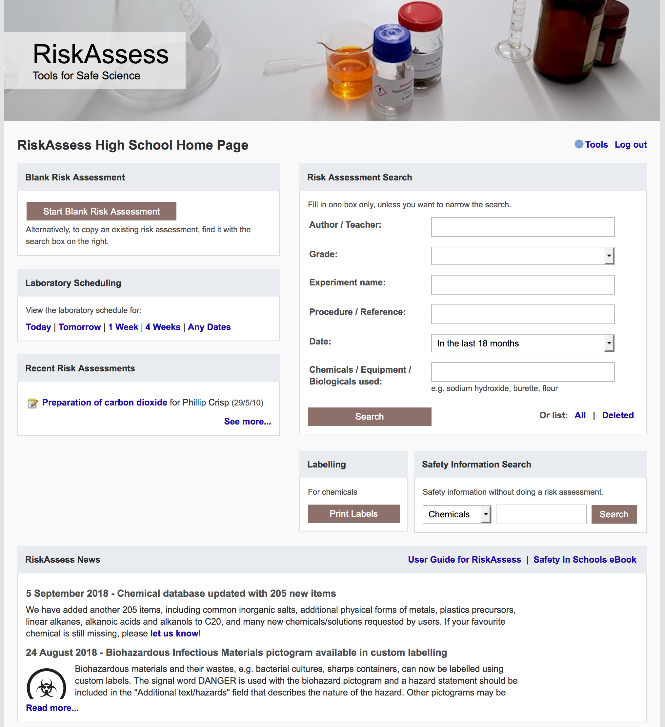
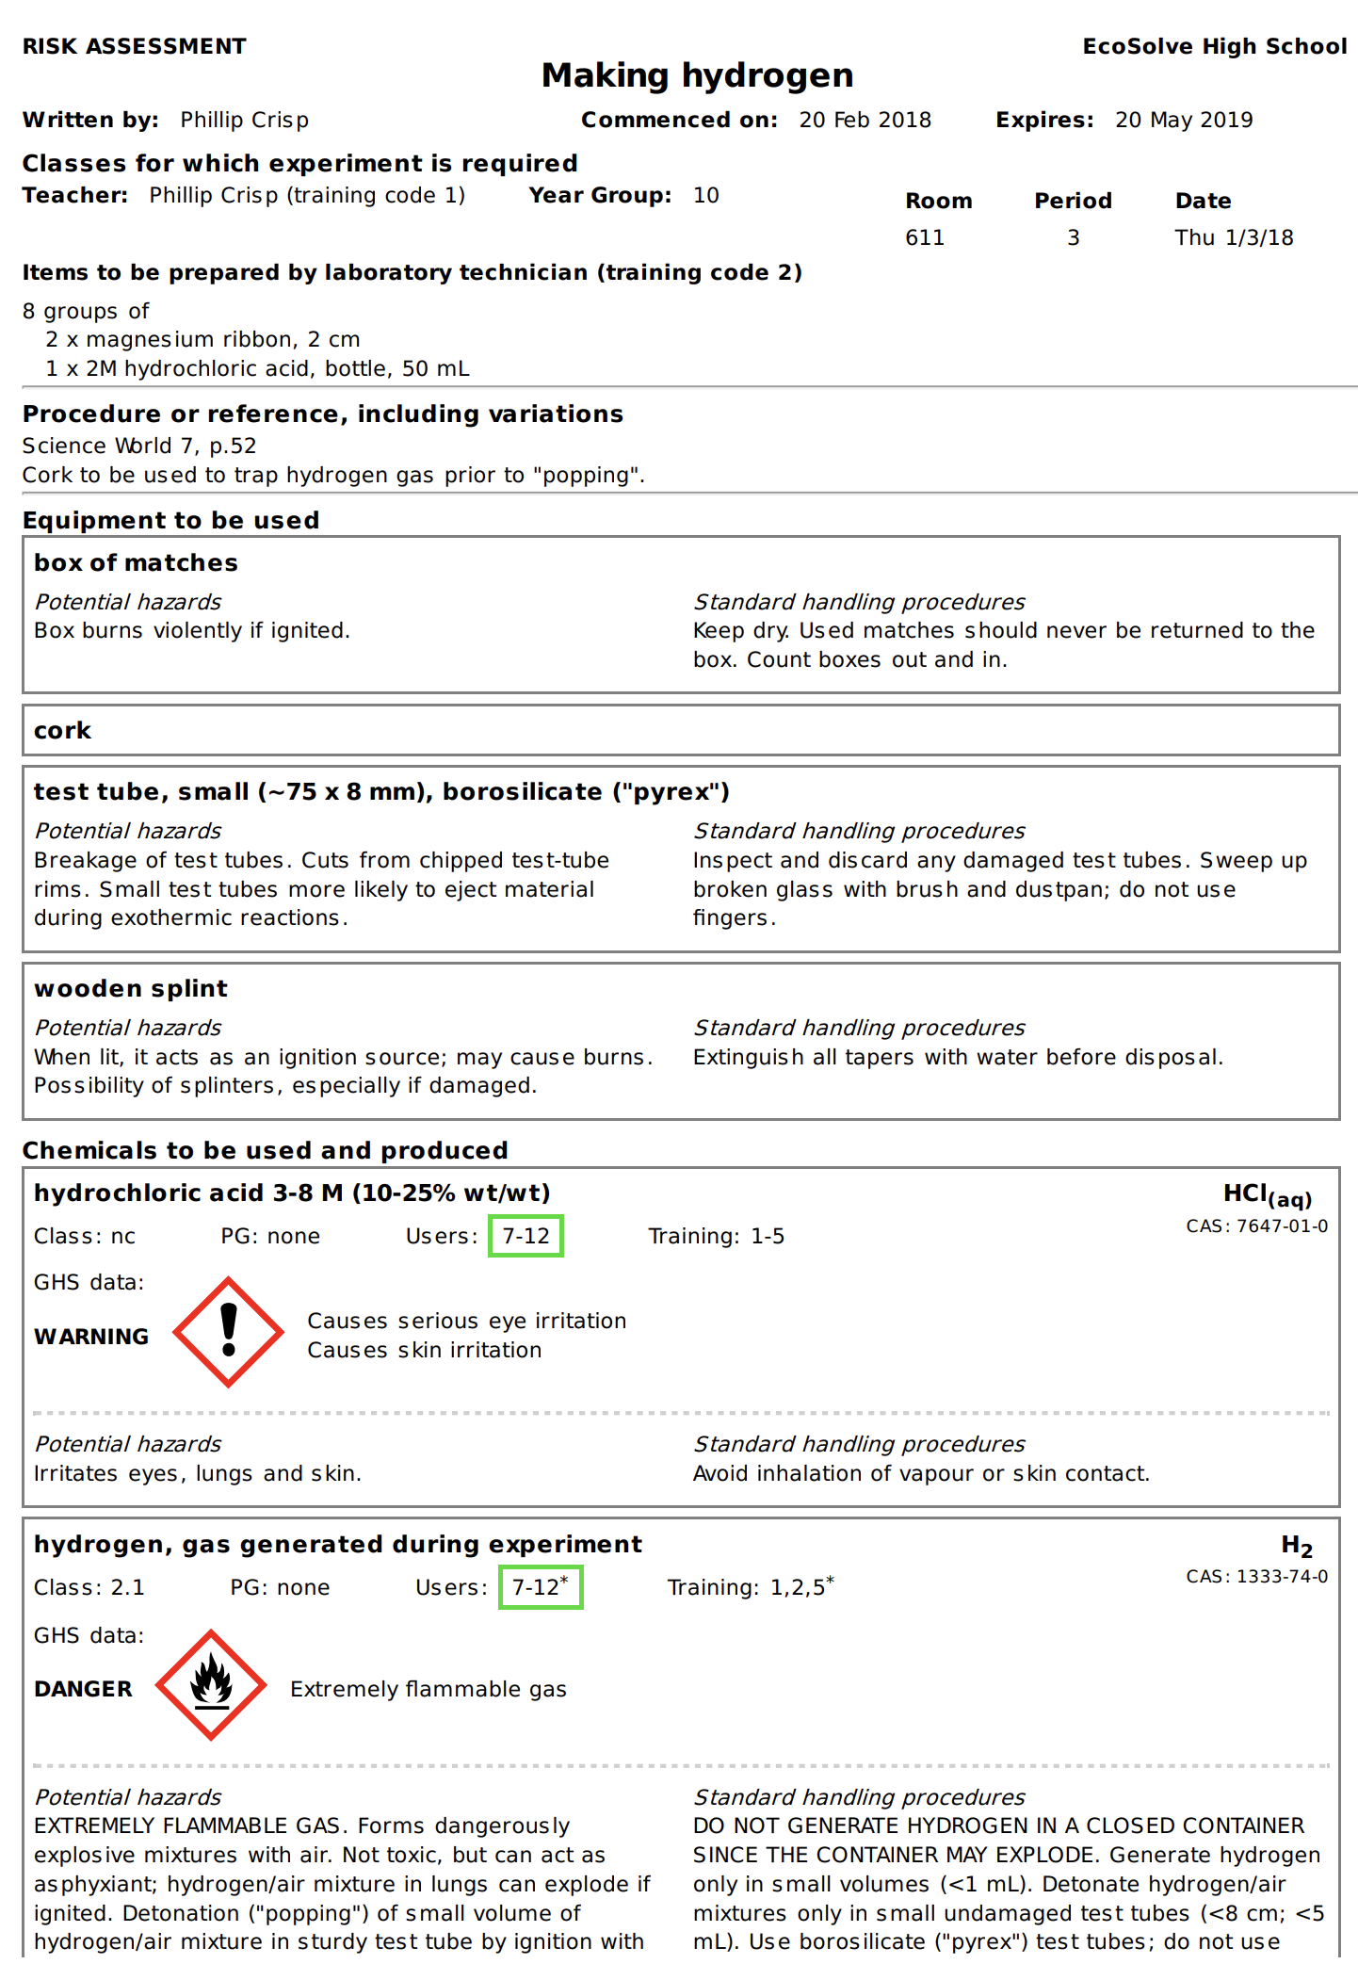

Slide 9
Details
access from school/home
nothing to install on computer, tablet or phone
(instant update)
unlimited number of simultaneous users and risk assessments
minimal data entry
complements SDSs
continuing input from science staff
multiple backups of data & backup server
support and advice

Slide 10
Advantages of RiskAssess
proper consideration of risks and control measures
standardization
storage of records for legal purposes
communication between teachers and science technicians
discourages spur-of-the-moment experiments
useful for new/inexperienced staff
EXTRAS: ordering/scheduling, labelling, waste disposal

Slide 11
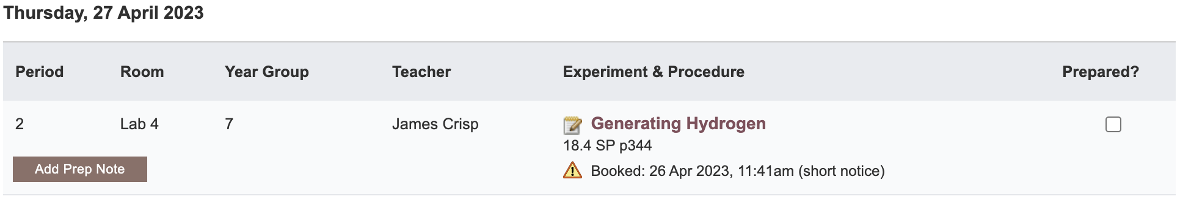
Notes:
Mandatory setting too in tools! Settable cut-off time coming soon (other than noon)

Slide 12
Workplace labels
Required “when a hazardous product is decanted
(e.g. transferred or poured) into another container”
and it is not “going to be used immediately”
In general, a workplace label will require the following information:
• Product name (matching the SDS product name)
• Safe handling precautions, may include pictograms or
other supplier label information
• A reference to the SDS (if available)
Workplace label requirements fall under your Provincial or Territorial jurisdiction . . .
Canadian Centre for Occupational Health and Safety “WHMIS 2015 - Labels” https://www.ccohs.ca/oshanswers/chemicals/whmis_ghs/labels.html

Slide 13
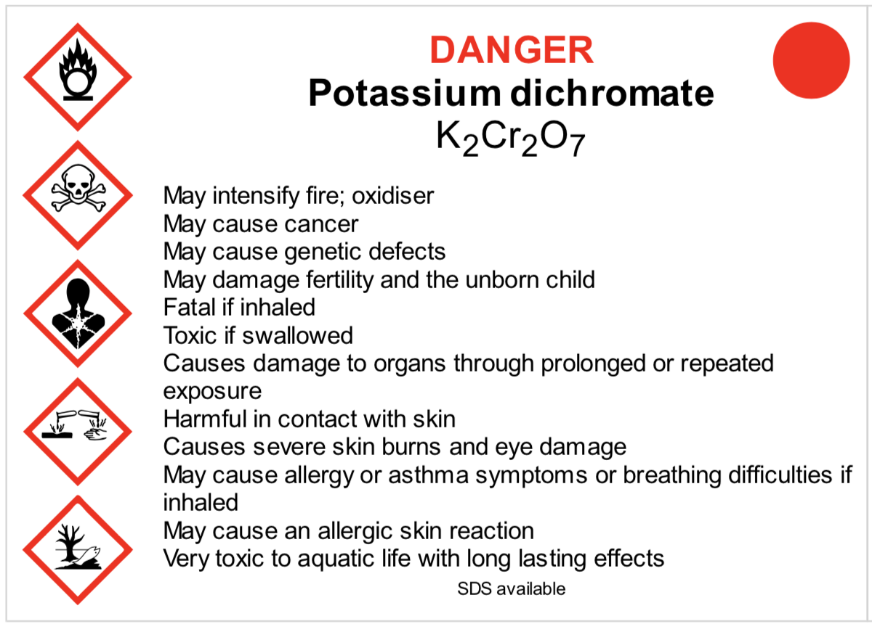
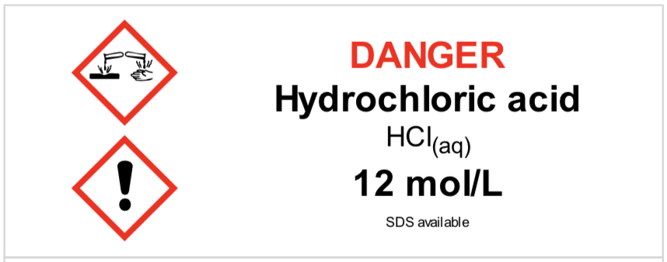
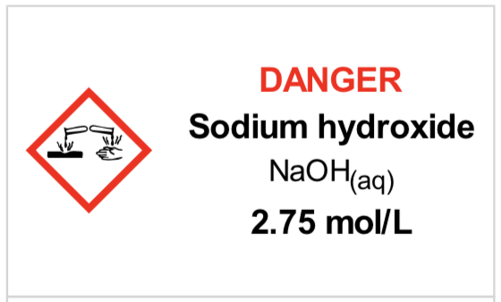
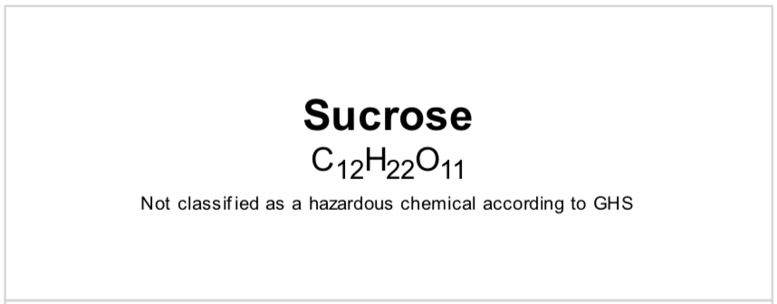
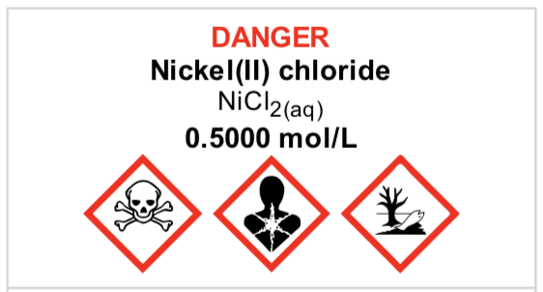
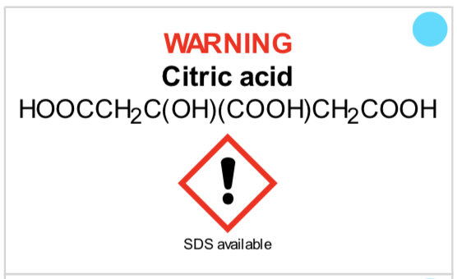
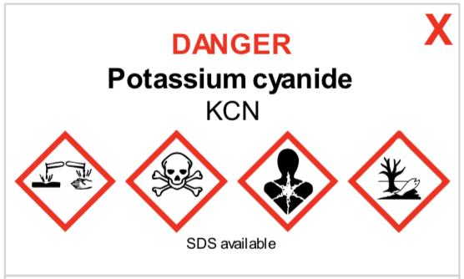
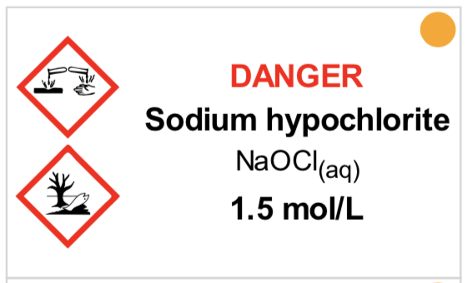
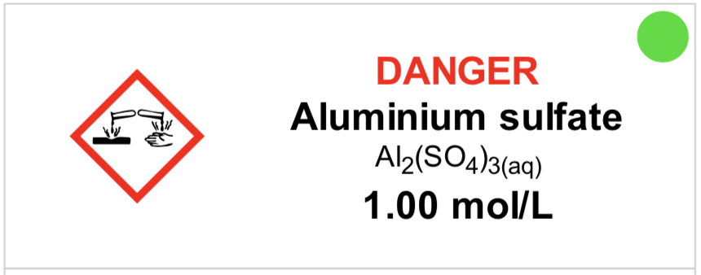
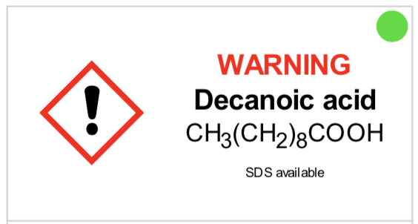
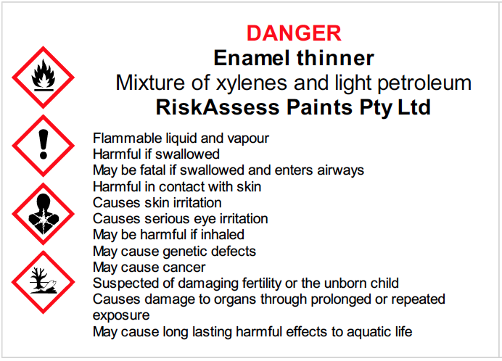
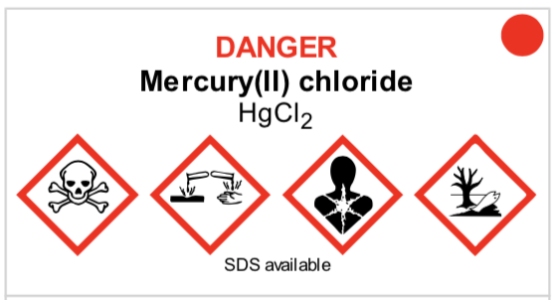
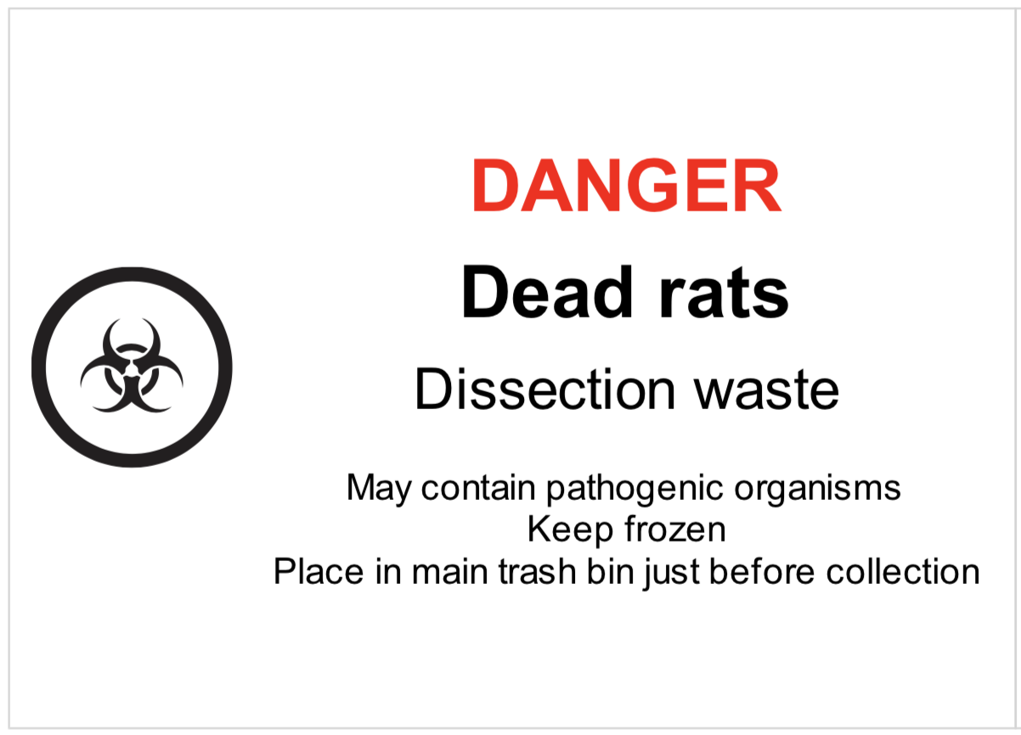
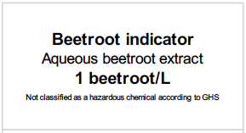
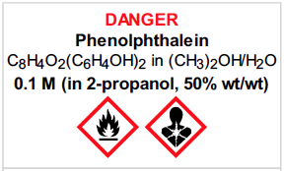

Slide 14
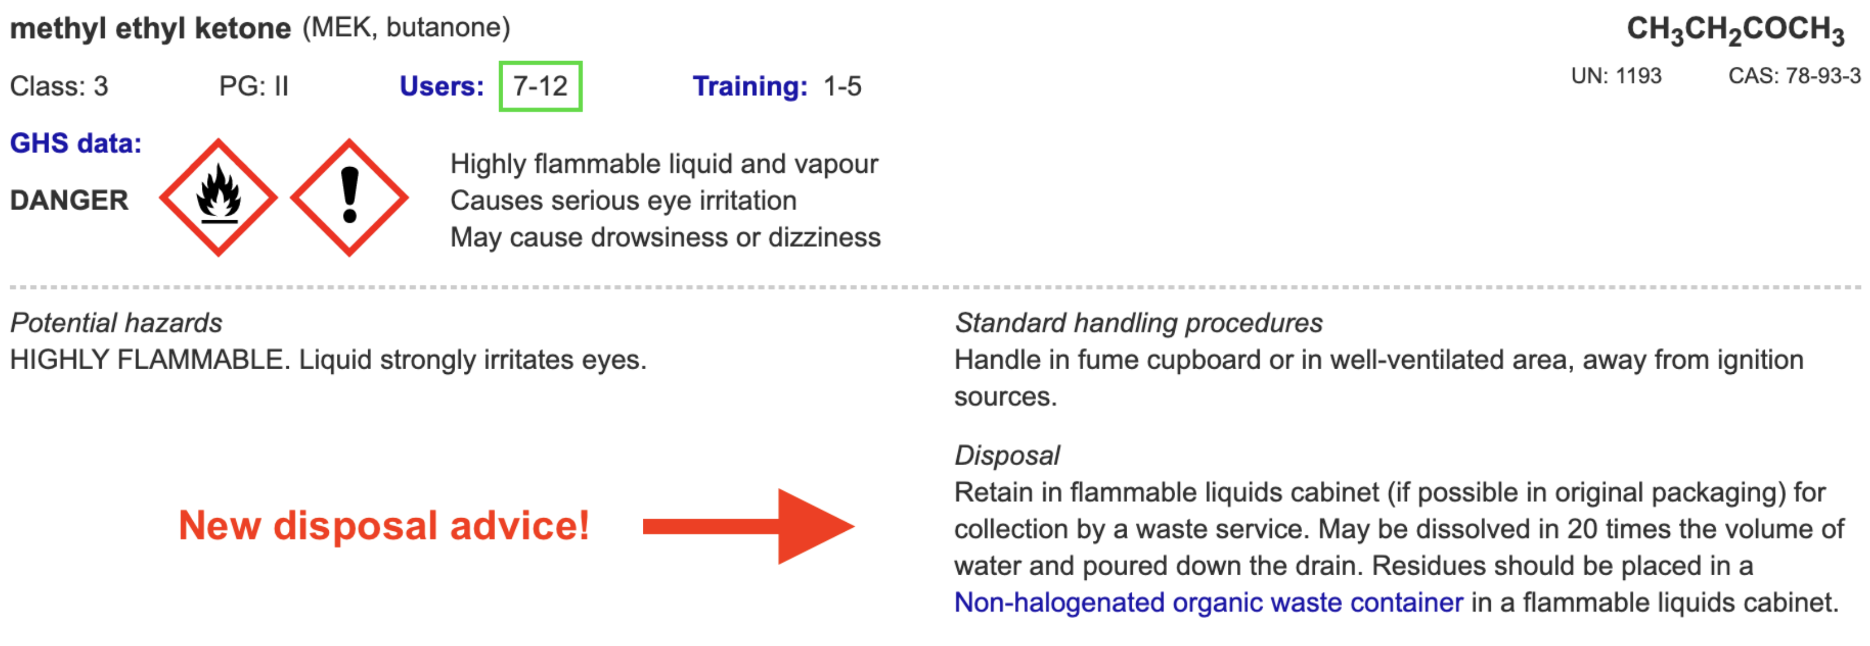

Slide 15
Future developments
• continually adding new features
https://www.riskassess.ca/info/news
e.g. chemical waste labels, short-notice advice
• planned:
- chemical register/inventory
- SDS management system

Slide 16
Conclusion
safer science laboratories
legally compliant system for risk assessment
easy-to-use GHS/WHMIS labelling
extensive databases, continually updated
scheduling system for lab efficiency
learning resources, staff and student
new features regularly added

Slide 17
DEMO

Slide 19
RiskAssess data source
ECHA (European Chemicals Association)
http://echa.europa.eu/information-on-chemicals/cl-inventory-database
Classification and Labelling (CL) Inventory
• notifications by chemical companies in Europe of
classifications according to GHS criteria
• harmonised classifications
Provides latest information on classification and labelling.
Some solution information.
Clumsy to use, due to need to translate codes.
Notes:
If needed for question time.

Slide 20
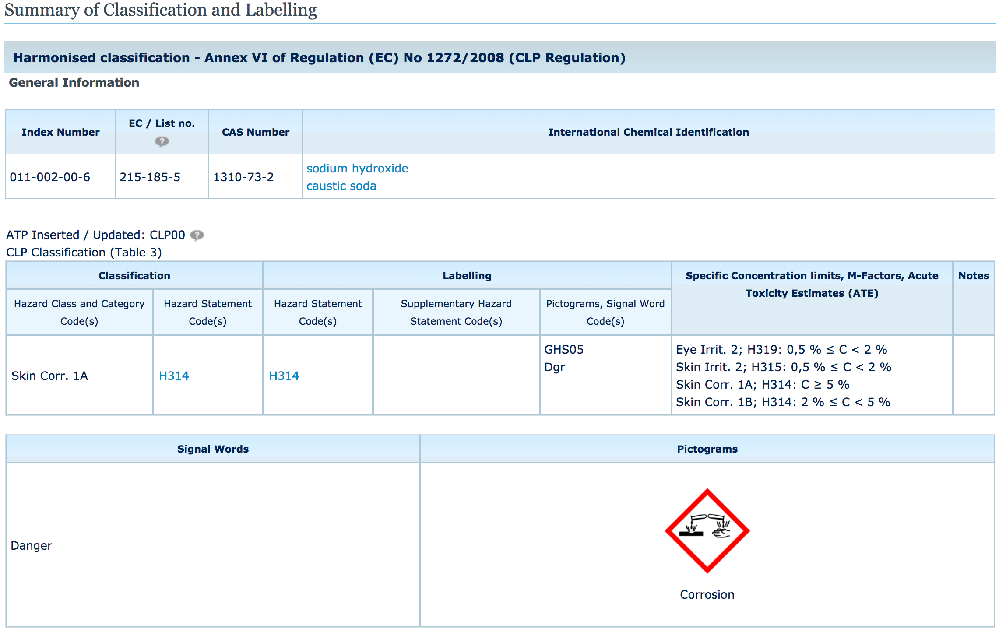
H314: Causes severe skin burns and eye damage
Notes:
If needed for question time.

Slide 21
RiskAssess data
Pure chemicals (>1500)
ECHA data “Harmonised classification”, if available
If not, most common classification (more conservative, if two)
Solutions (>1600)
ECHA data “Specific concentration limits”, if available.
If not, application of GHS rules for mixtures to ECHA data for pure chemical
RiskAssess data are updated as ECHA updates
Notes:
If needed for question time.

Slide 22
Menu
Shortcuts
icons, hcl, part name, day/month,
click banner, links, hot links, delete,
Best RAs, search on less, # & sort
Scheduling
Excel/csv, any dates, last week,
search, no# pracs, prep notes,
double booking, lodged date
Tools
customise year groups,
stocktaking & usage, invoice,
backup system, defaults
Resources
learning resources, faq, eBook,
videos
Labels
standard & custom labels
multiple chemicals on sheet
mixtures, non-chemicals
free text, biohazard symbol
Operations
reschedule, archive risk
assessments, annual review,
tech-only RAs, review notes,
high/extreme: 3 signatures, list
Multiple classes
author update/modifiable copy
Student RiskAssess
view student PINs, not last year
multiple prac management

