Slide 1

RiskAssess: latest tips & tricks for new and experienced users
Phillip Crisp and Eva Crisp

Slide 2


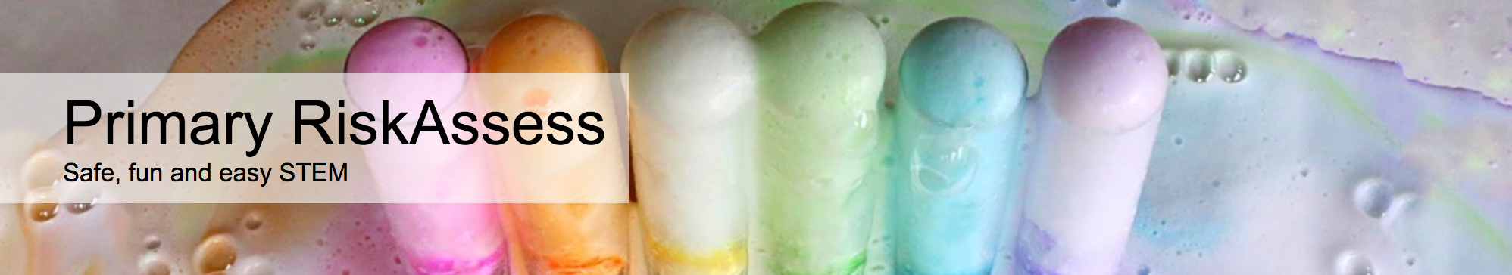
2300 schools
VIC: 544 (93%)
540 schools
VIC: 152 (26%)
190 schools
VIC: 0 (0%)

Slide 3
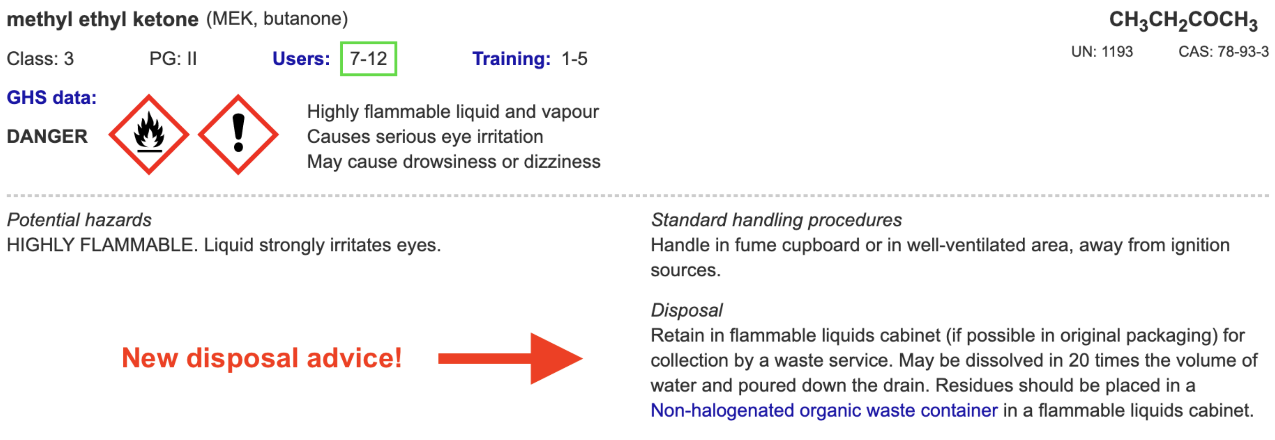
Disposal
Most recent advance
Advice for all 3000 chemicals and solutions
plus guide to disposal and waste container details
Separate presentation
e.g.

Slide 4
Menu
Shortcuts
login, hcl, icons
part name, click banner
links, hot links, ‘Best’ RAs
Scheduling
download csv, double booking
new schedule search
Tools
customise year groups
stocktaking & usage, invoice,
new backup system, defaults
Resources
learning resources
questions and answers
eBook, video, EP&Stile
Labels
standard & custom labels
multiple chemicals on sheet
mixtures, non-chemicals
free text, biohazard pictogram
Operations
reschedule experiments
archive risk assessments
labtech-only risk assessments
annual review, backup, delete
CARA: 3rd reviewer
Student RiskAssess
view student PINs, not last year
Multiple classes
author update/modifiable copy

Slide 6
GHS
Internationally agreed system (UN, esp. Europe)
Classification of
- physical hazards, e.g. flammability
- health hazards, e.g. carcinogenicity
- environmental hazards, e.g. acute aquatic toxicity
Labelling with
- 9 new hazard pictograms
- signal words
- hazard statements
- precautionary statements
Safety Data Sheets (SDSs) with
- updated & more extensive information

Slide 7
Literature
The Purple Book
“Globally Harmonized System of Classification and Labelling of Chemicals (GHS)” 561pp, 3.2MB download as pdf
- official text, Australia using Rev. 3 (2009), but Rev. 9 (2021) latest
The Companion Guide
“Understanding the Globally Harmonized System of Classification and Labelling of Chemicals (GHS)” 89pp, 0.9MB download as pdf
- easy-to-read summary and learning tool, from UNITAR website
www.unece.org
Our Work/Transport/Dangerous Goods: “GHS official text and corrigenda”
GHS (Rev. 9) 2021 [one document] or GHS (Rev. 3) 2009 [in pieces]
or obtain the latest version directly at
www.unece.org/trans/danger/publi/ghs/ghs_rev07/07files_e0.html

Slide 8
Label for original container
Product identifier (e.g. name)
Proper shipping name & UN Number (if Dangerous Good)
Name, address and phone number of Australian importer or manufacturer
Identity and proportions, if a mixture
Signal word e.g. Danger or Warning
Hazard Statement
Hazard Pictogram
Precautionary Statements
Any other information, e.g. first aid & emergency procedures
Expiry date of the chemical, if applicable

Slide 9










Slide 10
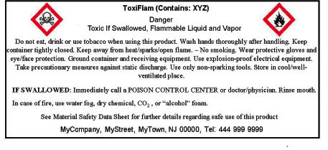

Slide 11
Label for a
“Decanted or transferred hazardous chemical”
“must, at a minimum, be written in English and include the following:
• the product identifier, and
• a hazard pictogram or hazard statement consistent with the correct classification of the chemical”
Guidelines for minimum text and pictogram size:
Volume Text Pictogram
< 500 mL 2.5 mm 15 mm
500 mL to 5 L 3 mm 20 mm
[Safe Work Australia “Labelling of Workplace Hazardous Chemicals Code of Practice” March 2015, adopted in every jurisdiction except WA; VIC indirect]
RiskAssess follows the Code of Practice for labelling!

Slide 12
HCIS
Hazardous Chemical Information System
www.hcis.safeworkaustralia.gov.au
You can “Search Hazardous Chemicals” using
chemical name (sometimes use weird names!)
CAS Registry Number (more reliable)
Provides recent information on classification and labelling
No solution information

Slide 13
ECHA
European Chemicals Association
http://echa.europa.eu/information-on-chemicals/cl-inventory-database
Classification and Labelling (CL) Inventory
• notifications by chemical companies in Europe of
classifications according to GHS criteria
• harmonised classifications
Provides latest information on classification and labelling
Some solution information
Clumsy to use, due to need to translate codes

Slide 14
Solutions
Experimental data available only for common industrial chemicals (e.g. NaOH)
Otherwise, a solution is regarded as mixture, with water as an inert diluent.
GHS rules for mixtures apply.
See
https://www.riskassess.com.au/docs/GHSdataSolutions.pdf
for a summary of the process

Slide 15
RiskAssess data
Pure chemicals (1500)
ECHA data “Harmonised classification”, if available
If not, most common classification (more conservative, if two)
Solutions (1500)
ECHA data “Specific concentration limits”, if available.
If not, application of GHS rules for mixtures to ECHA data for pure chemical
RiskAssess data updated following ECHA updates!
RiskAssess data may not agree with
• data from other sources, or
• old data

Slide 16
Standard Labels
For pure substances and aqueous solutions
For common indicators/dyes in aqueous alcohol and for common reagents
Automatically uses information from RiskAsssess database to generate labels
Automatically calculates solution labels based on the concentration you enter
Options for colour spots and “SDS available”

Slide 17
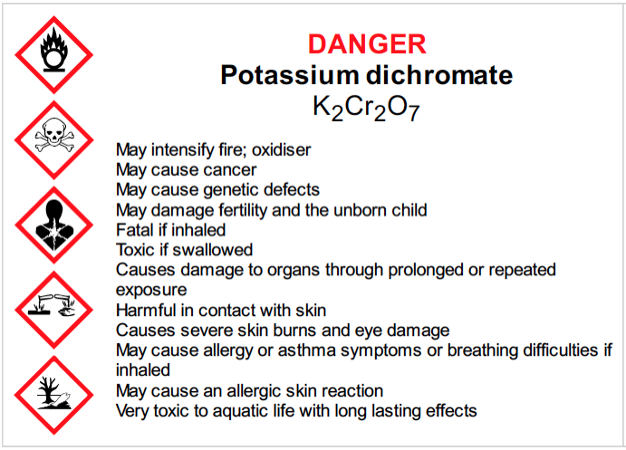
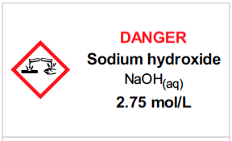
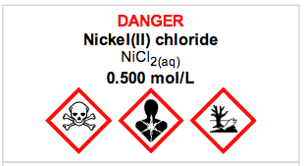
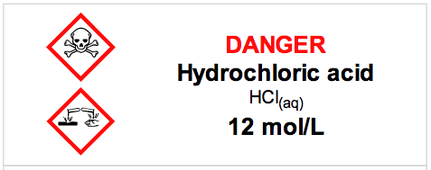
>600,000 label sheets downloaded
by 2300 secondary schools since 25/9/16

Slide 18
Custom Labels
For commercial products, using data from SDSs
For mixtures of chemicals not in the RiskAssess database (calculate yourself)
Allows you to make any GHS label, by selecting signal word, pictograms and hazard statements
GHS checking of signal word and pictograms
options for colour spots and “SDS available”

Slide 19
