Slide 1
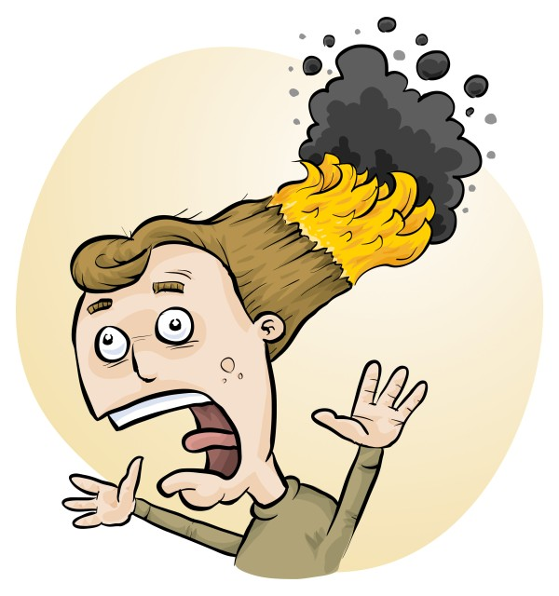
Disposal of Chemical Wastes: RiskAssess advice and lab tricks
Phillip Crisp and Eva Crisp

Slide 2
The law
Follow local regulations for disposal of wastes to sewer and garbage, rather than the advice in RiskAssess.
Retain wastes for collection by a waste collection service, if not allowed to put down drain or in garbage
Inland waters usually have special requirements.

Slide 3
Disposal advice
Disposal advice in RiskAssess:
• provides a ‘default’, when no other advice is available
• prioritizes safety
• minimizes harm to the environment
• offers a responsible approach to student learning.

Slide 4
RiskAssess Advice
Individual chemical advice in ‘Disposal’
for each of 3000 chemicals and solutions
‘Disposal of chemical wastes’
https://www.riskassess.com.au/docs/DisposalOfChemicalWastes.pdf
‘Chemical waste containers’
https://www.riskassess.com.au/info/waste_containers
‘How to dispose of chemical wastes’
In: ‘Safety in Schools’ book, chapter C7

Slide 5
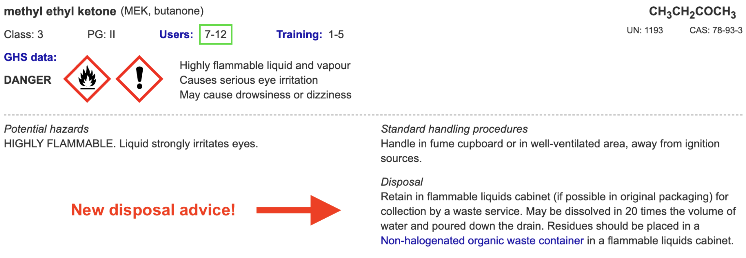

Slide 6
Chemical Disposal
The quantity of chemical wastes generated in a school is very small compared with industry, agriculture, mining, etc.
HOWEVER
• A school is an educational institution
• Attitudes adopted during youth continue into
adulthood
• Proper training should be given to those who
will later be decision makers

Slide 7
The improvement process
eliminate unwanted chemicals
redesign procedures to minimize waste production, e.g. spot reactions, recycling, destruction, less toxic chemicals
dispose of wastes LEGALLY
SAFELY by
- sewer
- garbage
- waste collection service

Slide 8
Chemical wastes in schools
*
Aqueous liquid wastes
• dissolved salts
• acidic or basic
• suspended particles
Water-miscible organic wastes
alcohols, e.g. methylated spirits
ketones, e.g. acetone
Water-immiscible organic wastes
• hydrocarbons, e.g. hexane, kerosene
• special chemicals, mostly for organic chemistry
Solid wastes
• precipitates, e.g. BaSO₄, Fe oxides

Slide 9
Problems in the sewer!
• toxic metals
e.g. Hg, Cd, Pb, As, . . . VERY BAD
Cu, Ni, Co, . . . BAD
since contaminate sludge $$$
• toxic persistent organic chemicals
e.g. pesticides
since contaminate sludge $$$
• highly acidic/alkaline liquids
since may damage pipes
• flammable liquids (water-immiscible)
since may cause an explosion!

Slide 10
Aqueous liquid wastes
Pour down the sewer ONLY if the criteria of the water authority are met.
Otherwise, an environmentally responsible approach:
• neutralize to ~pH 6.5-8.5 (natural waters)
• only “safe” amount of each chemical down the drain
in order to minimise environmental harm from treated sewage when it is released into river or ocean.
All wastes exceeding a “safe” amount of a chemical should be retained for a waste collection service.
WHAT IS SAFE?

Slide 11
Estimation of “safe” quantities*
Consider the cation and anion in a salt separately.
Toxicity of a salt is dominated by the most toxic ion:
e.g. lead chloride, potassium dichromate
Some ions should not go down the drain at all
e.g. Hg²⁺, Pb²⁺, Cd²⁺, . . .
while others are OK almost without (school) limit
e.g. Na⁺, Ca²⁺, Cl⁻, SO₄²⁻, . . .
and other ions in between
* RiskAssess “Disposal of chemical wastes”, in Learning Resources

Slide 12
Tabulation and calculation
“Safe” disposal quantity for an ion for a class:
0 – 1000 g/day
Copper sulfate
copper: 1 g/day [Very toxic to aquatic life
with long lasting effects]
sulfate: 1000 g/day. [In solid laundry detergent]
Therefore, copper sulfate: 1 g/day (as solid or solution)
Enough for some spot tests down the drain.
Beyond that, wastes need to be collected!

Slide 13
Organic liquid wastes
Water-miscible
e.g. methylated spirits, acetone
Dilute 1 part to 20 parts water, then down the drain.
Prevents explosive air/vapour mixture.
Microorganisms in sewer will consume the chemicals.
Water-immiscible
e.g. hexane, kerosene
Retain for collection by waste service.
Separate hydrocarbon waste from halogenated waste.

Slide 14
Waste processing
Collection
Large bottles (e.g. 2.5 L ‘Winchesters’)
correctly labelled, funnel at top (fume cupboard)
Treatment
Only if time and skilled people available
Disposal
To maximum recommended daily quantity:
• down the drain or into garbage
Otherwise, retain for waste collection
SEPARATE CONTAINER FOR EACH WASTE!

Slide 15
Solid wastes
Only “material of a domestic nature”
is allowed to be disposed of in the garbage
Consider
transport of garbage
leaching from landfill
Geologically-stable minerals
(precipitated during reactions)
e.g. barium sulfate (baryte)
No leaching of toxic chemicals in a domestic landfill.

Slide 16
Labelling and storage of wastes
All wastes must be
• labelled according to GHS
e.g. RiskAssess custom label
• stored according to Dangerous Goods Class.
Flammable wastes in a flammable liquids cabinet!
Place each toxic waste in a SEPARATE container!
Recommend both:
large RA custom label with GHS information
large blank label for hand-writing the quantity and
identity of each waste added to the container

Slide 17
Purpose of disposal advice
• assists decision making
• promotes safe disposal techniques
• focuses on avoiding serious environmental harm
• reduces the cost of waste collection service
• decreases emphasis on less harmful substances
• provides a learning tool for staff and students
• promotes care for the environment

Slide 18
DEMONSTRATION
• Learning resources
• Examples
• Waste treatment and recycling
QUESTIONS
team@riskassess.com.au

