Slide 1
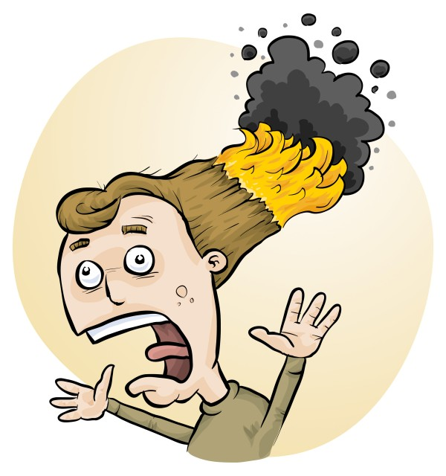
Understanding RiskAssess and using it effectively
Phillip Crisp and Eva Crisp
Notes:
Hands who uses RA at their school?

Slide 2
You should:
identify
assess
control
risks
Before: Establish the context
After: Monitor and review
Always: Consult and communicate

Slide 3
The law
Risk assessments must take into account
all relevant matters including
facilities available
behaviour of the class
students with special needs
students with allergies, etc
Each class doing each experiment should be the subject of a separate risk assessment

Slide 4
Risk assessment
To assess the severity of a risk,
you need to consider:
• the consequences of the event, and
• the chance that it will occur (likelihood)
Severity (risk level) may be
Low Medium High Extreme
AU ISO 31000:2018 “Risk management”
Risk matrices used in schools are 3 x 3 to 5 x 5
See www.riskassess.com.au/learning_resources

Slide 5
Assess risks
≥Medium
risk level
Low
risk level
Add control measures
DO
EXPERIMENT
Inherent level of risk
= risk level without any control measures besides “routine procedures”
Residual level of risk
= risk level with control measures in place

Slide 6
2400 schools VIC: 571 (97%)
560 schools VIC: 163 (27%)
190 schools VIC: 4
30 schools VIC: 5
Notes:
Hands up for usage of each. If some non RA users, show very quick doing a RA before the menu.

Slide 7
New Features

Slide 8
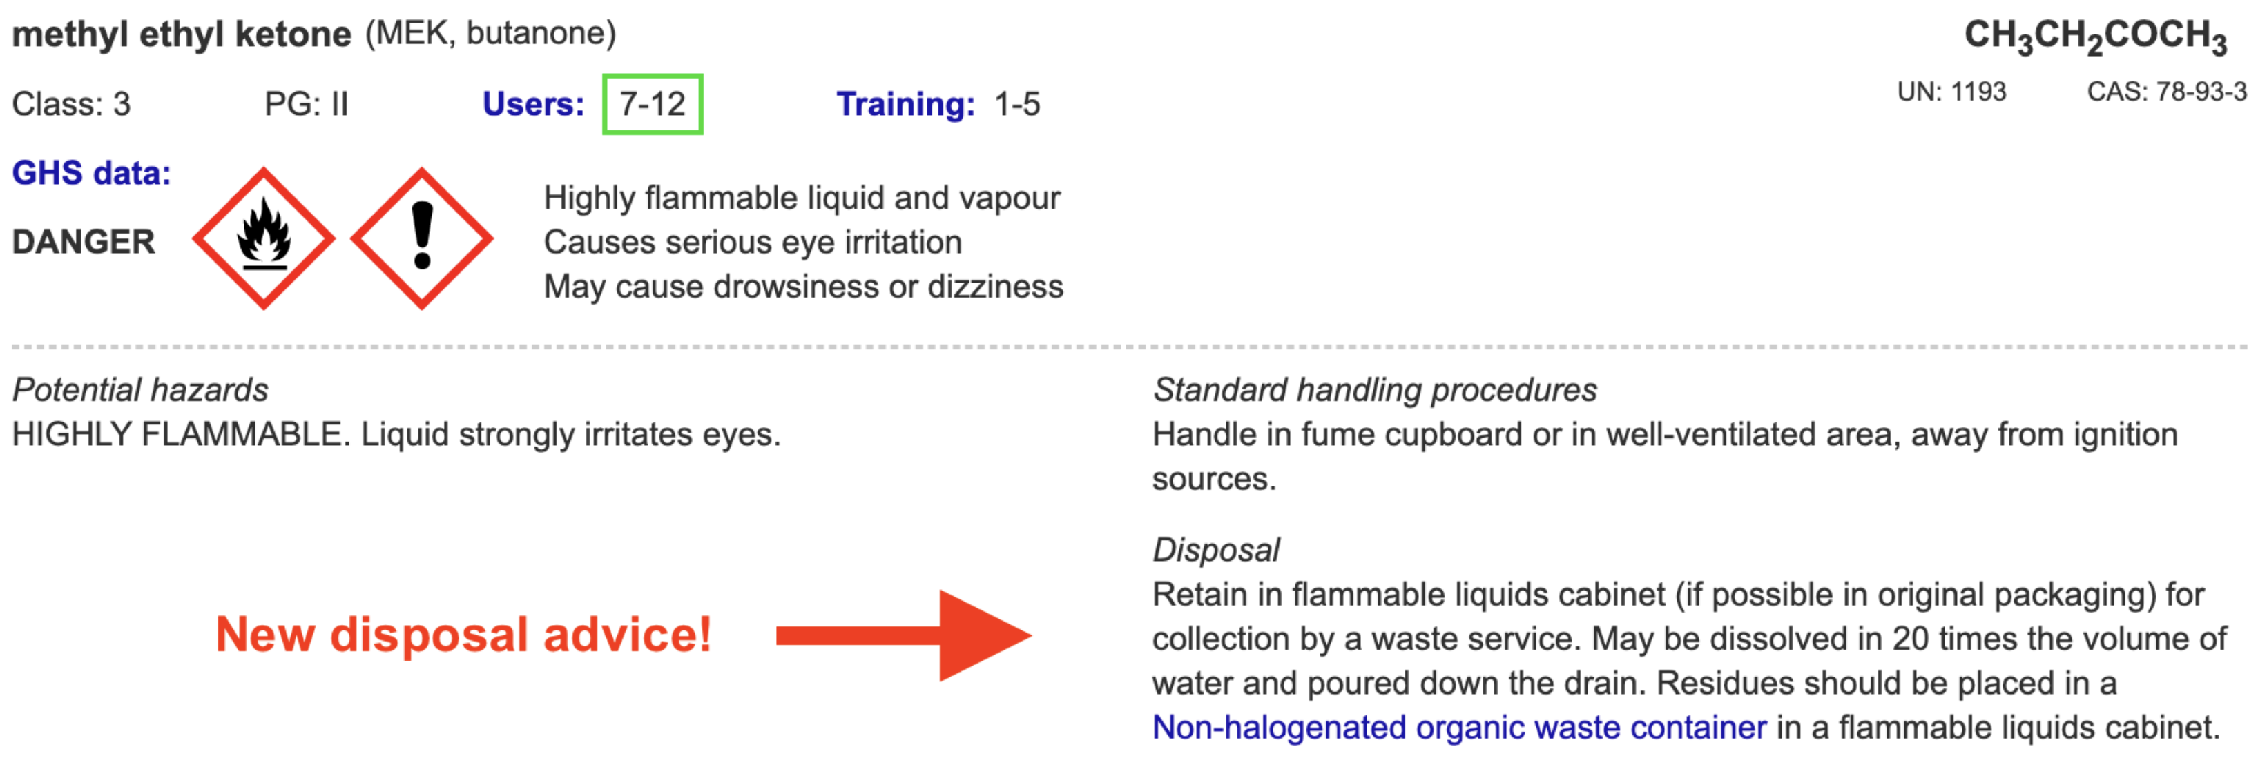
Disposal
Most recent advance in RiskAssess
Advice for all 3000 chemicals and solutions
Guide to disposal and waste container details

Slide 9
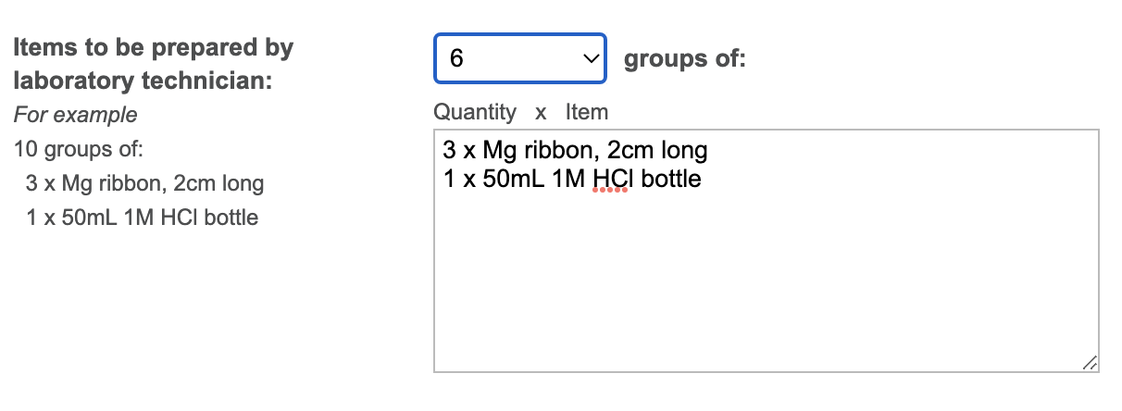
Notes:
Mandatory setting too in tools!

Slide 10
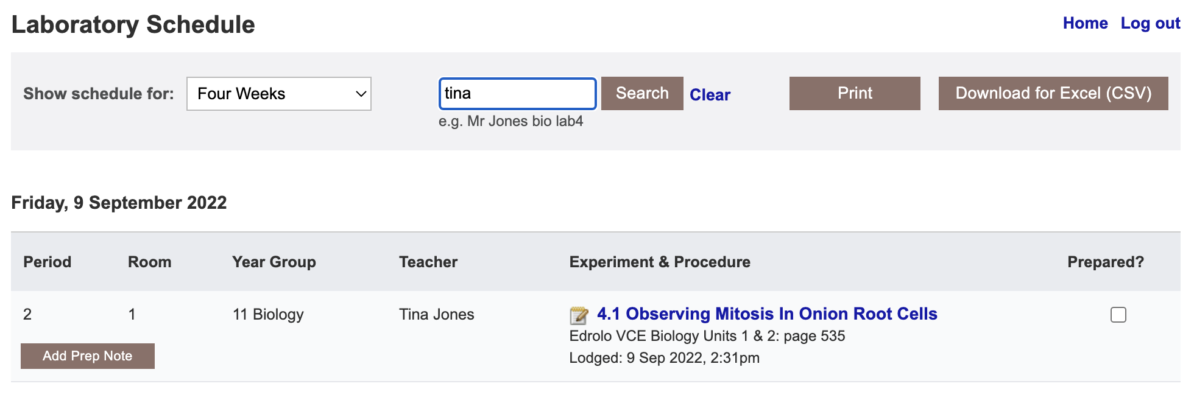

Slide 11
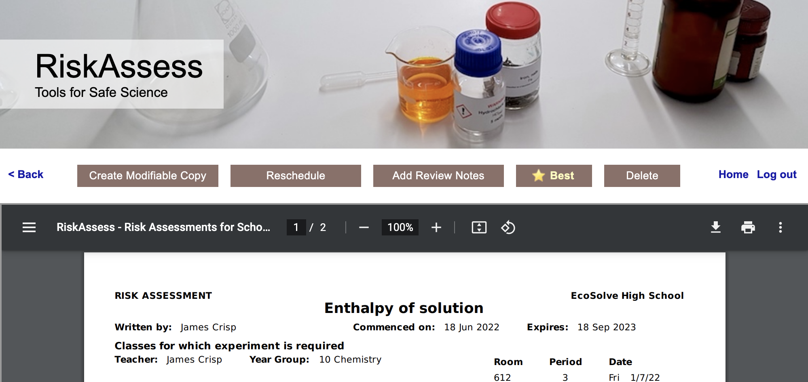
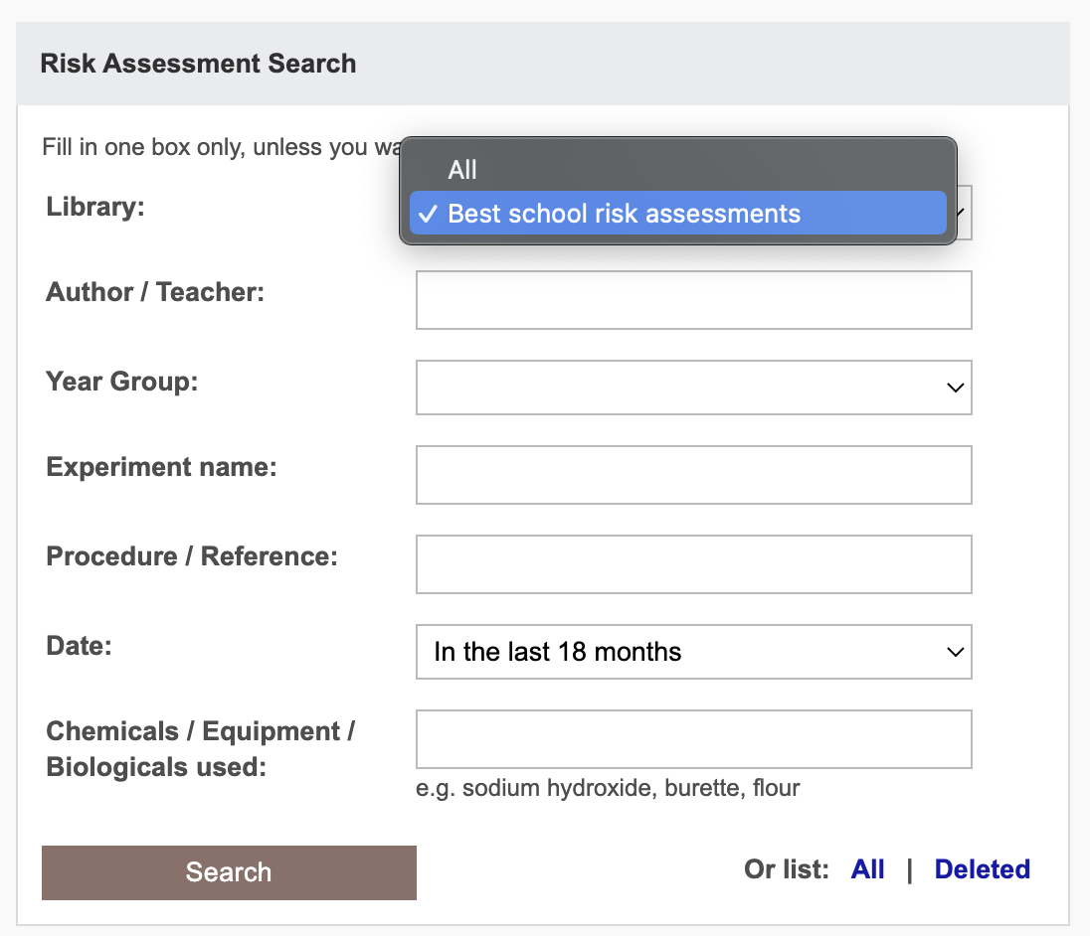

Slide 12
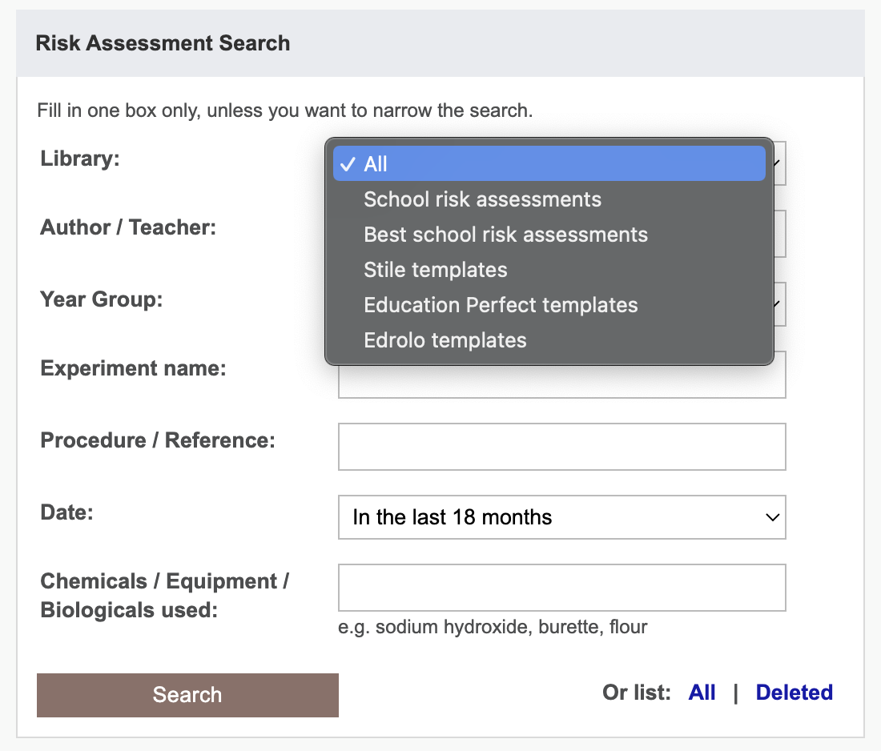

Slide 13
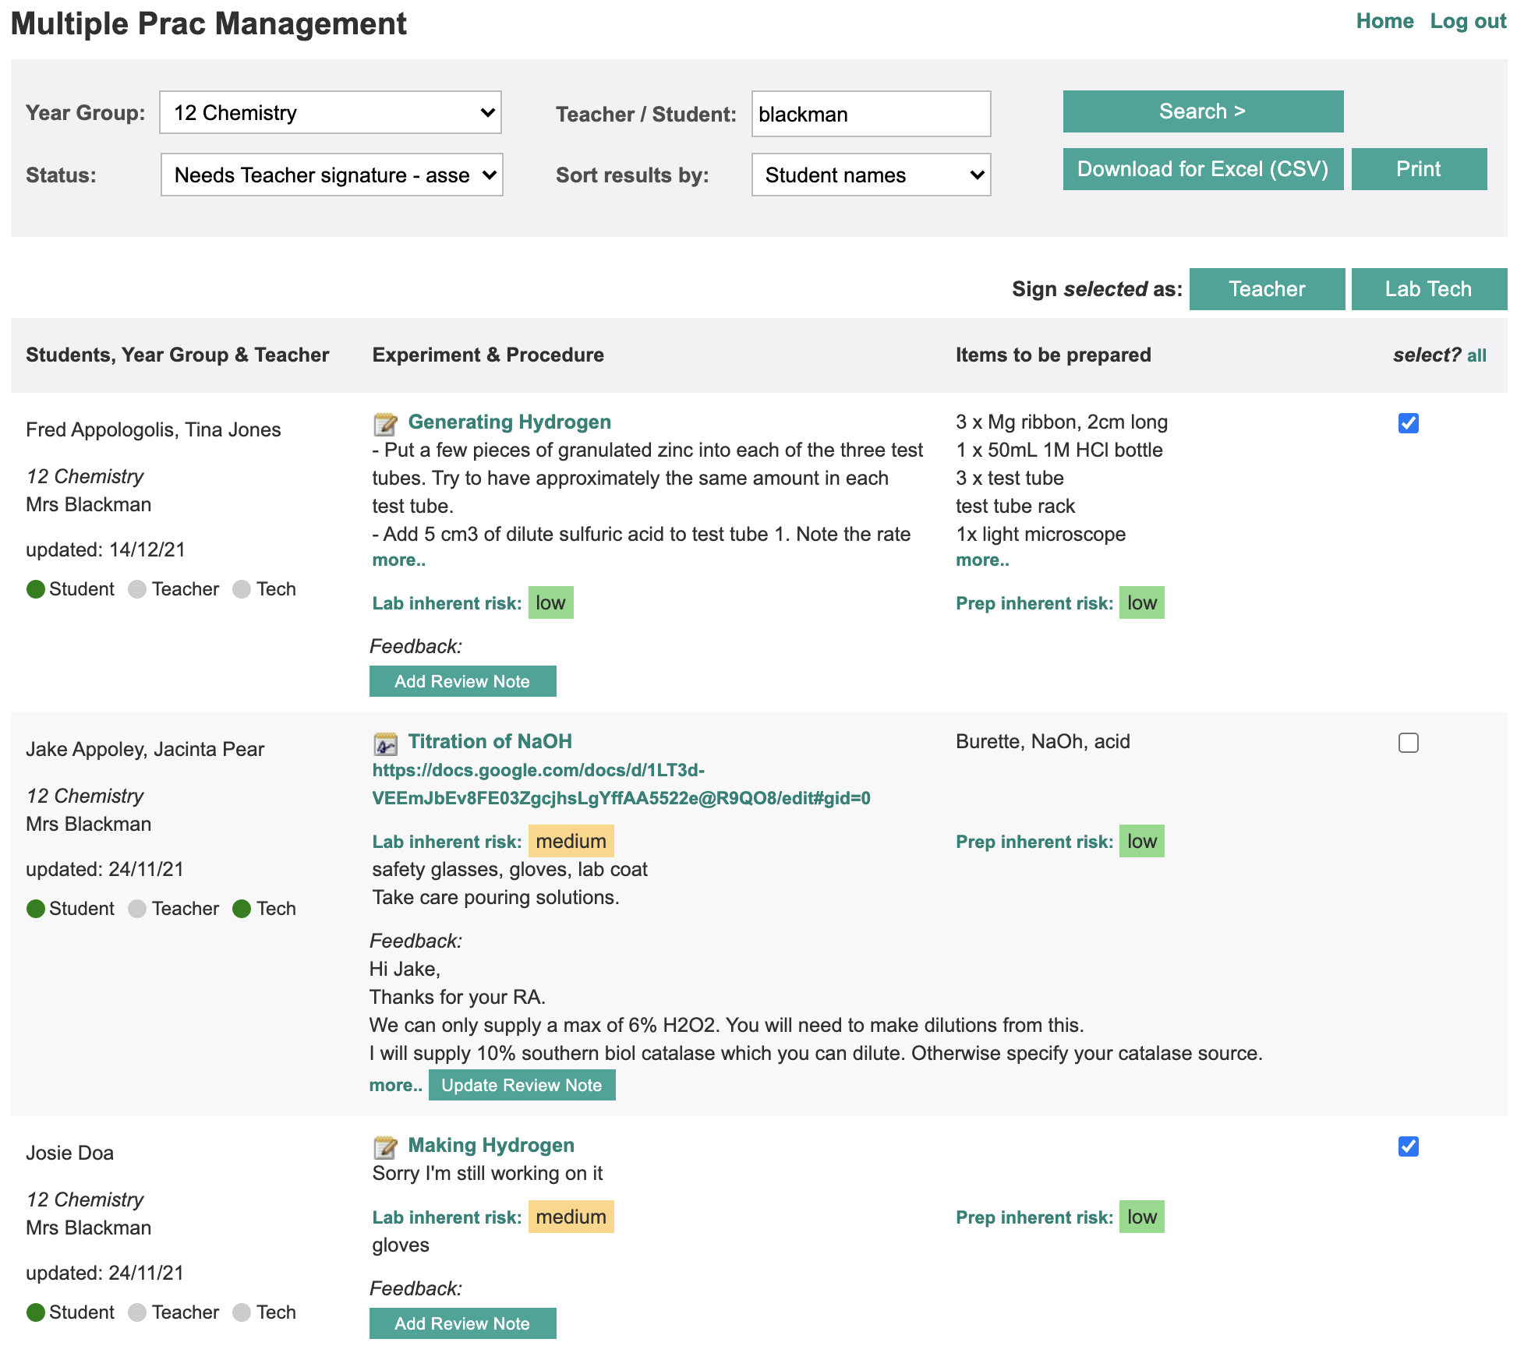

Slide 14
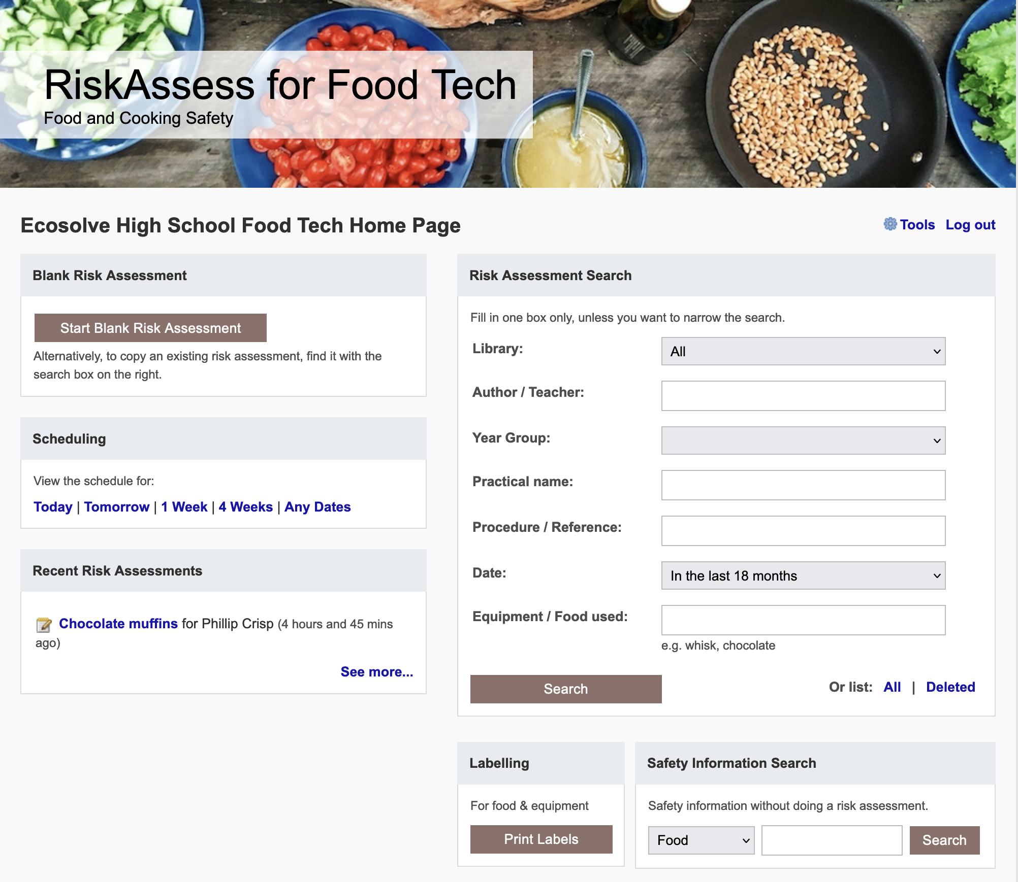

Slide 15
Tips & Tricks
Notes:
Doing RA and seeing in scheduling, modifiable copy etc

Slide 16
Menu
Shortcuts
icons, hcl, part name, day/month,
click banner, links, hot links, delete,
Best RAs, search on less, # & sort
Scheduling
Excel/csv, any dates, last week,
search, no# pracs, prep notes,
double booking, lodged date
Tools
customise year groups,
stocktaking & usage, invoice,
backup system, defaults
Resources
learning resources, faq, eBook,
videos, libraries: Stile+EP+Edrolo
Labels
standard & custom labels
multiple chemicals on sheet
mixtures, non-chemicals
free text, biohazard symbol
Operations
reschedule, archive risk
assessments, annual review,
tech-only RAs, review notes,
high/extreme: 3 signatures, list
Multiple classes
author update/modifiable copy
Student RiskAssess
view student PINs, not last year
multiple prac management

