Slide 1
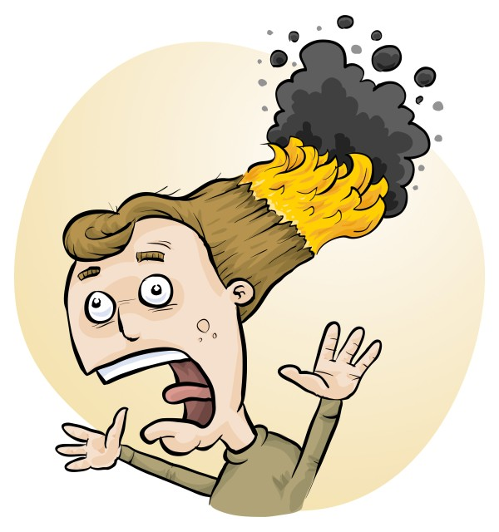
Science Lab Dangers and Risk Assessment
Phillip Crisp and Eva Crisp

Slide 2
Science lab dangers
student injuries
staff injuries
damage to facilities
reputational loss
administrative and legal costs
compensation, fines

Slide 3
Particular dangers
chemicals and their products
- fire, explosion
- skin & eye damage, allergic reactions
chemical storage, esp. fire, toxic spillage
equipment breakage
- flying glass
- chemical release
biological issues
- infection, contamination
- allergy

Slide 4
Core issue for science labs
Do you have a method to
• identify and assess potential risks and
• introduce appropriate control measures
to lower the risk to an acceptable level?
Acceptable level of risk is low risk,
in the case of science labs

Slide 5
Why do risk assessments?
reduced frequency of injuries
reduced costs for paperwork, litigation and payouts
compliance with the law:
OHS Act + OHS Code + WHMIS 2015
better legal position, in the event of litigation

Slide 6
What is RiskAssess? www.riskassess.ca
• web-based risk assessment tool
• customized to the school situation
• customized to Canada
• quick and easy to use!

Slide 7
RiskAssess provides:
• electronic templates (CA/ISO)
• database information on risks
(chemical, equipment, biological)
• GHS labelling (WHMIS 2015)
• chemical disposal advice
• prac ordering and scheduling
• extensive learning resources

Slide 8
Does RiskAssess work?
World-wide:
2,700 schools
6.5 million risk assessments
16 years

Slide 9
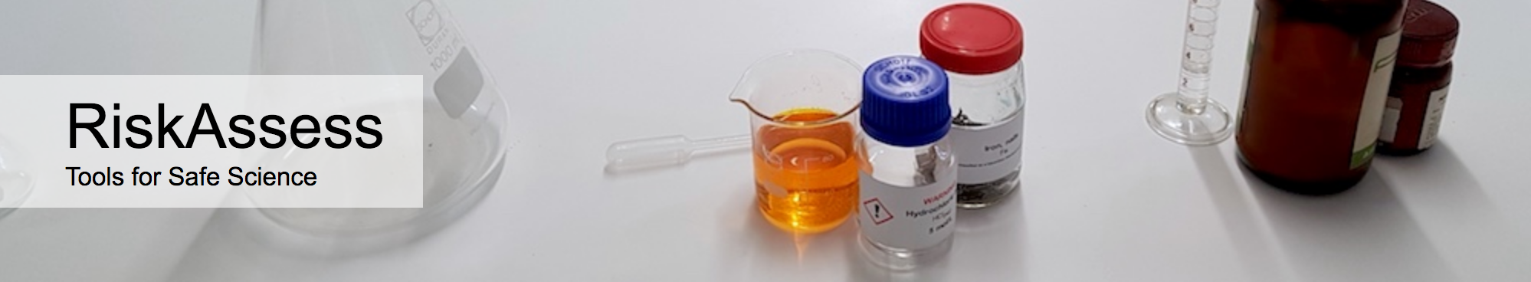

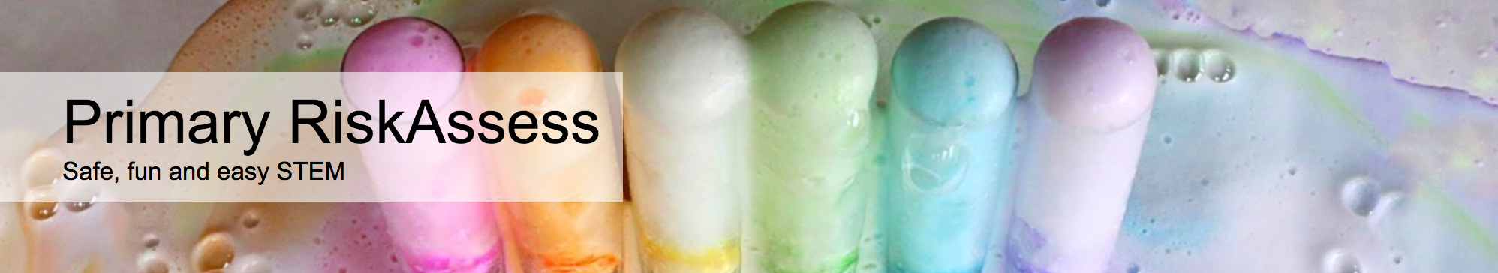

2700 schools
AU: 2400 (84%)
NZ: 300 (54%)
CA: 60 (1%)
590 schools
200 schools
80 schools

Slide 10
Does RiskAssess work in Canada?
60 schools
43,000 risk assessments
(including CBE schools for 12 years)
6 schools Calgary/Red Deer/Edmonton

Slide 11
Logic of RiskAssess
• safety information customized for school labs:
3500 chemicals and solutions
2000 equipment items
1500 biological items
• initial assessment of inherent risk
- if low, go to end
- if medium or more, record control measures
- if high or extreme, third reviewer required
• labelling for WHMIS 2015 (for whole school)
• chemical disposal advice (for whole school)
• learning resources
• inexpensive ($350 per school campus per year)

Slide 12
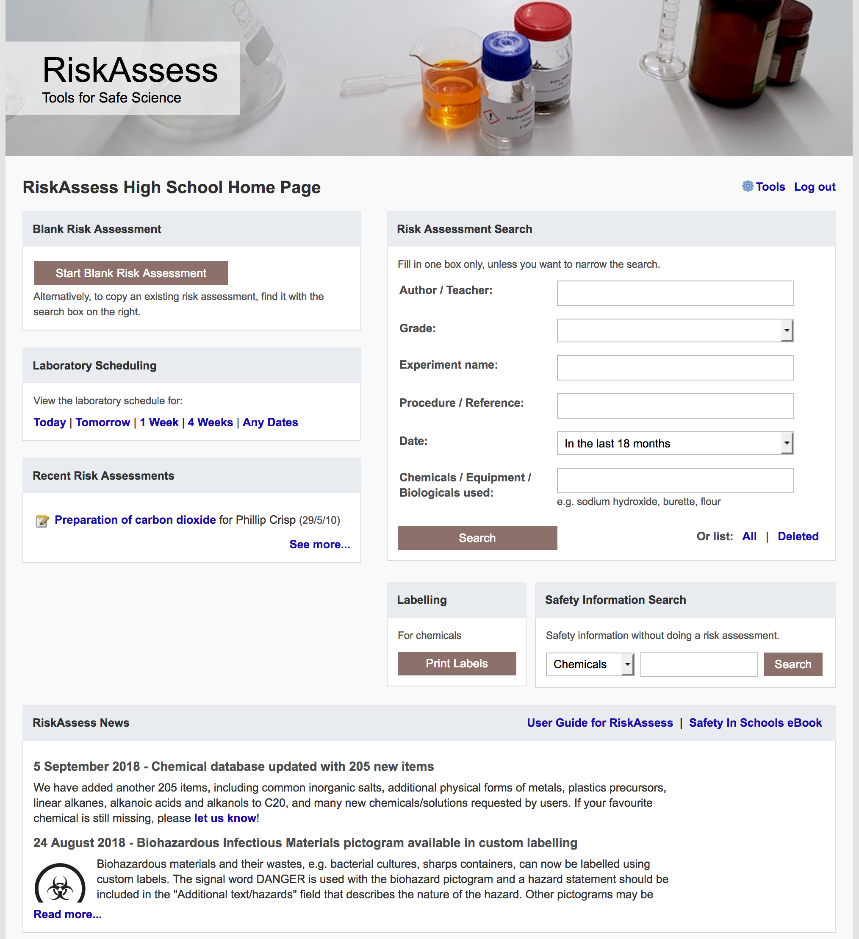
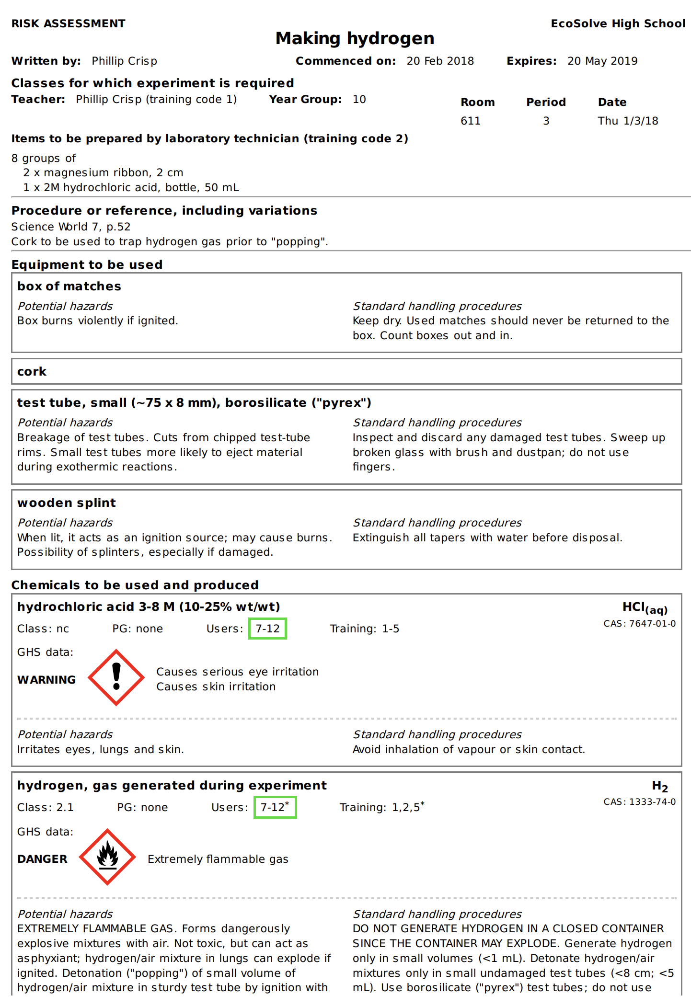

Slide 13
Details
access from school/home, fast and easy
nothing to install on computer, tablet or phone
(instant update)
unlimited number of simultaneous users and risk assessments
minimal data entry
complements SDSs
continuing input from science staff
multiple backups of data & backup server
support and advice

Slide 14
Advantages of RiskAssess
proper consideration of risks and control measures
standardization in school and between schools
storage of records for legal purposes
WHMIS labelling (for whole school)
waste disposal advice (for whole school)
communication between teachers and science technicians
discourages spur-of-the-moment experiments
useful for new/inexperienced staff

Slide 15
Workplace labels
Required “when a hazardous product is decanted
(e.g. transferred or poured) into another container”
and it is not “going to be used immediately”
In general, a workplace label will require the following information:
• Product name (matching the SDS product name)
• Safe handling precautions, may include pictograms or
other supplier label information
• A reference to the SDS (if available)
Workplace label requirements fall under your Provincial or Territorial jurisdiction . . .
Canadian Centre for Occupational Health and Safety “WHMIS 2015 - Labels” https://www.ccohs.ca/oshanswers/chemicals/whmis_ghs/labels.html

Slide 16
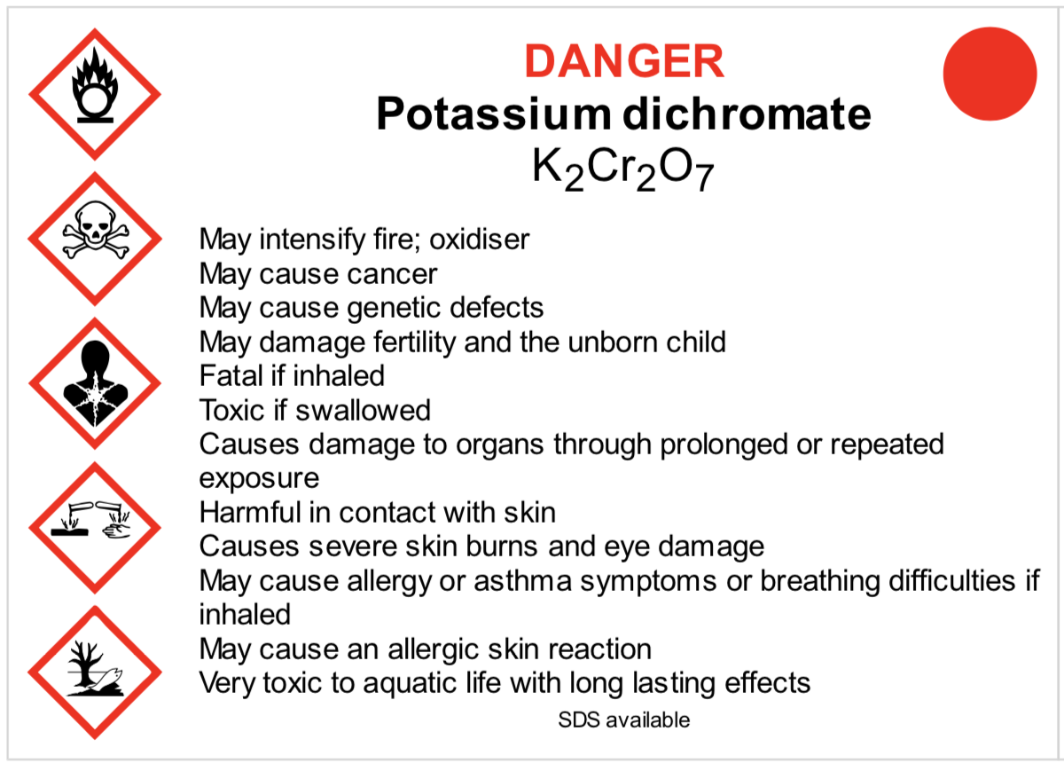
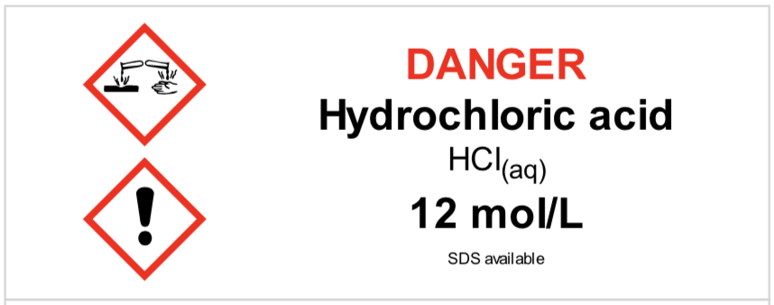
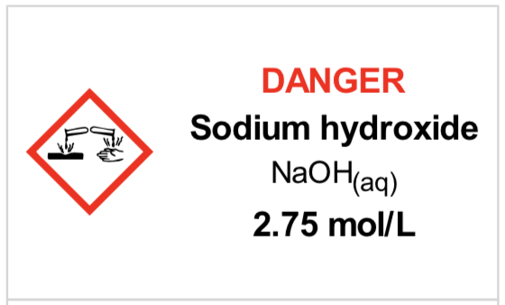
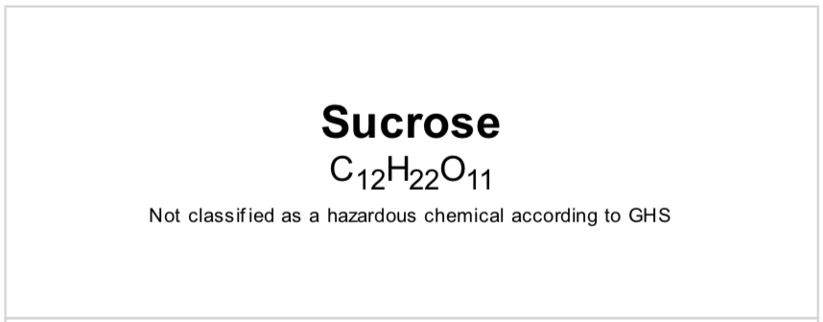
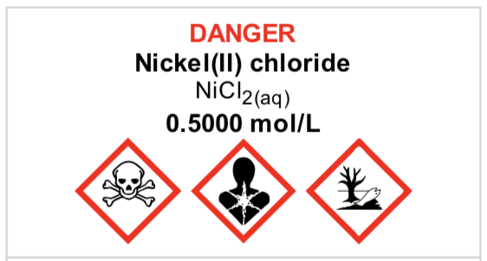
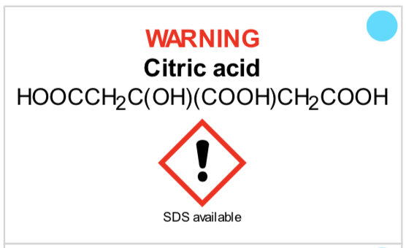
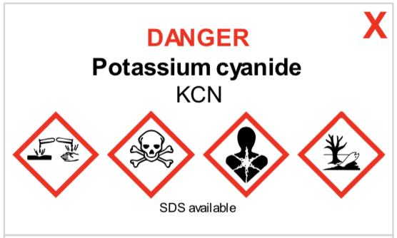
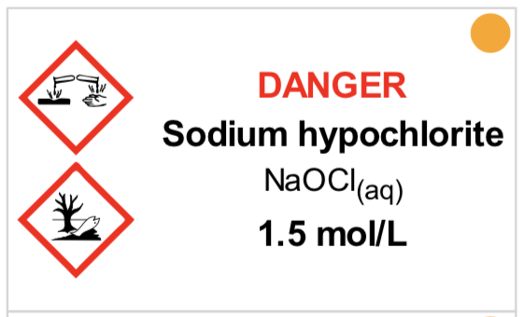
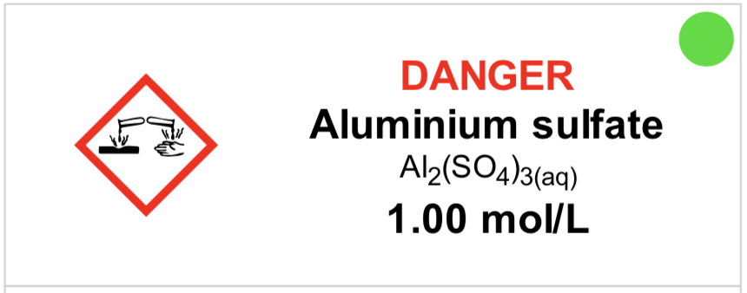
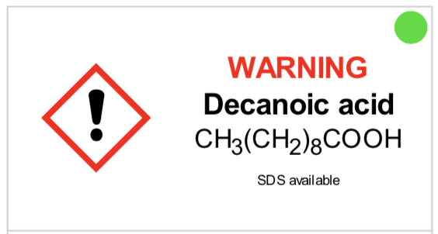
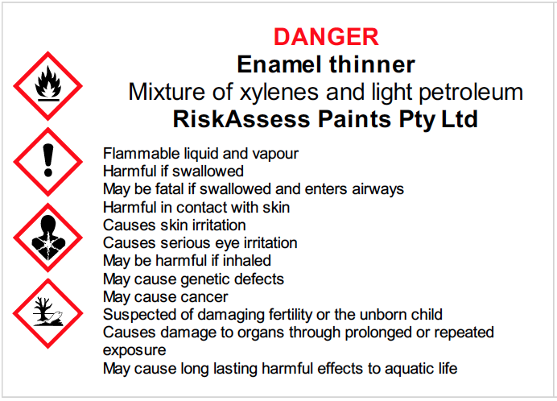
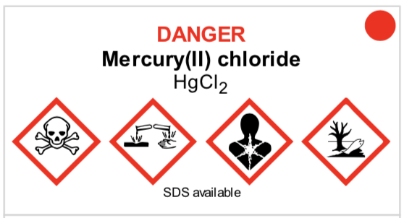
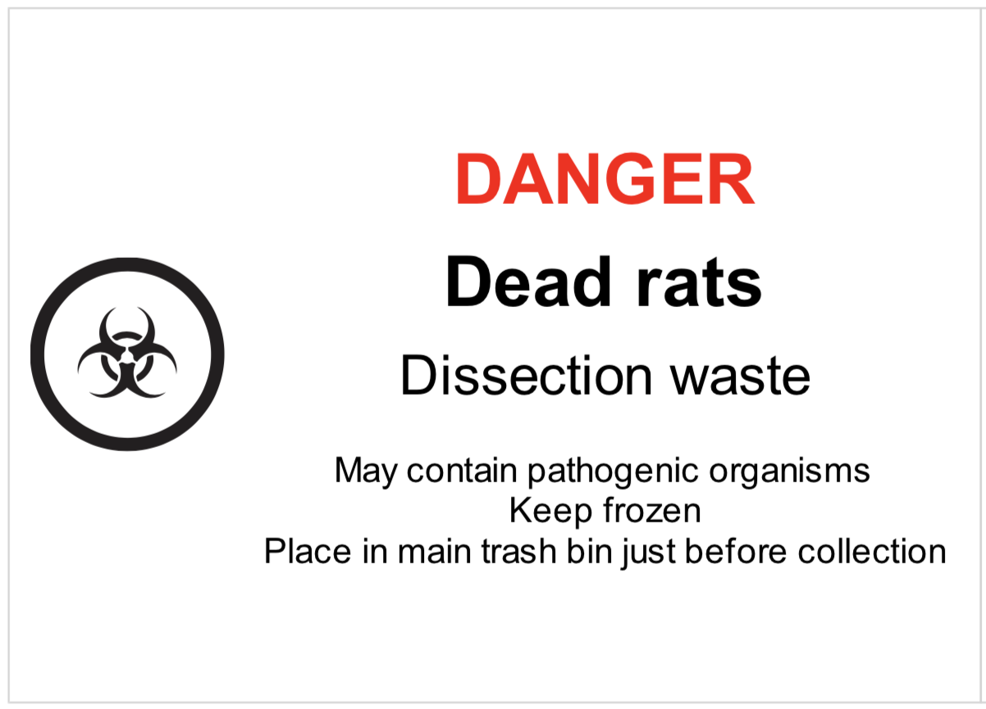
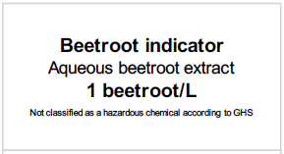
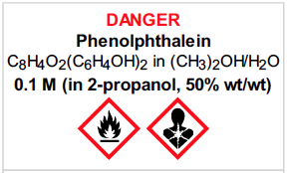

Slide 17
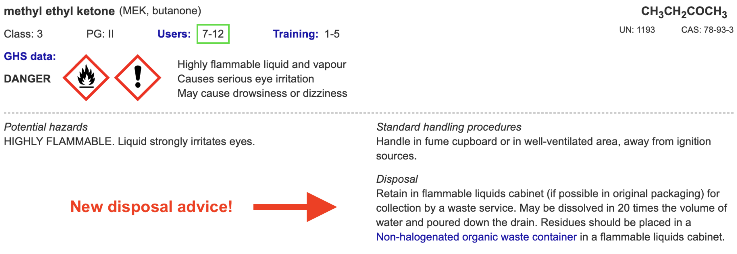
Disposal of chemical wastes
environmentally responsible chemical disposal
https://www.riskassess.ca/docs/DisposalOfChemicalWastes.pdf
waste containers
waste container labels

Slide 18
Safety journey
Start
On the way
Best practice
Unwanted
chemical
(equipment)
disposal
SDSs
WHMIS
labelling
General
safety
info
Risk assessment
• experiment
Risk assessment
• experiment
+ class + lab
Risk assessment
review + storage
Environmental
waste collection
+ recycling

Slide 19
Future developments
• continually adding new features
https://www.riskassess.ca/info/news
e.g. chemical waste labels
• planned for 2025:
- chemical register/inventory
- SDS management system
initially Science, then extending to whole school

Slide 20
Conclusion
safer science laboratories
legally compliant system for risk assessment
easy-to-use GHS/WHMIS labelling
environmentally responsible waste disposal
extensive safety databases, continually updated
learning resources, staff and students
legal records, institutional memory

Slide 21
DEMO

