Slide 1
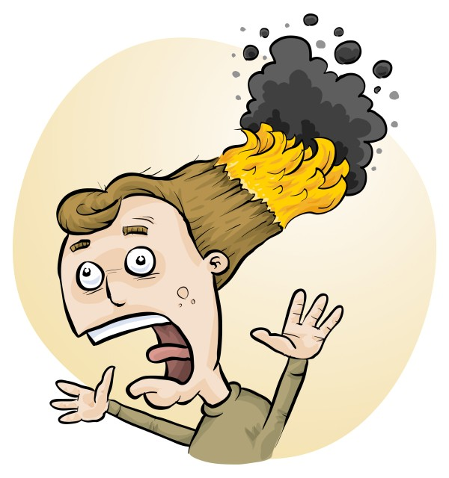
Safety in Science: risk assessment and RiskAssess
Phillip and Eva Crisp

Slide 2
• Logic of the risk assessment process
• RiskAssess and Student RiskAssess
• Included in RiskAssess: ordering & scheduling system labelling general safety (250 page book) chemical safety (GHS, DG, Register) chemical disposal biological safety
MENU

Slide 3
• reduce injuries
• increase legal protection*
*See www.riskassess.com.au/info/legally_required
Why do risk assessments?

Slide 4
Work Health & Safety Act 2011
. . . a duty . . . to eliminate/minimise risks to health and safety as far as is reasonably practicable.
. . . taking into account and weighing up
all relevant matters including:
(a) the likelihood of the hazard or the risk concerned occurring; and
(b) the degree of harm that might result from the hazard or the risk
. . . .
Part 2, Sections 17 and 18

Slide 5
The law
Risk assessments must take into account
all relevant matters including
facilities available
behaviour of the class
students with special needs
students with allergies, etc
Each class doing each experiment should be the subject of a separate risk assessment

Slide 6
Risk assessment
To assess the severity of a risk,
you need to consider:
• the consequences of the event, and
• the chance that it will occur (likelihood)
Severity (risk level) may be
Low Medium High Extreme
AU ISO 31000:2018 “Risk management”
Risk matrices used in schools are 3 x 3 to 5 x 5
See www.riskassess.com.au/learning_resources

Slide 7
Assess risks
≥Medium
risk level
Low
risk level
Add control measures
DO
EXPERIMENT
Inherent level of risk
= risk level without any control measures besides “routine procedures”
Residual level of risk
= risk level with control measures in place

Slide 8
What is RiskAssess?
• web-based risk assessment tool
• customised to the school situation
• provides
- electronic templates (AU/ISO)
- databases of information on risks
• easy sharing of risk assessments
• plus ordering, scheduling & labelling
• plus extensive learning resources

Slide 9
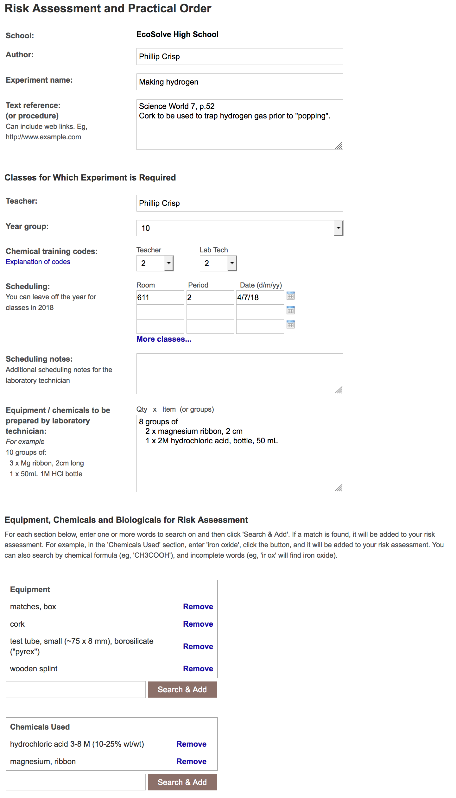
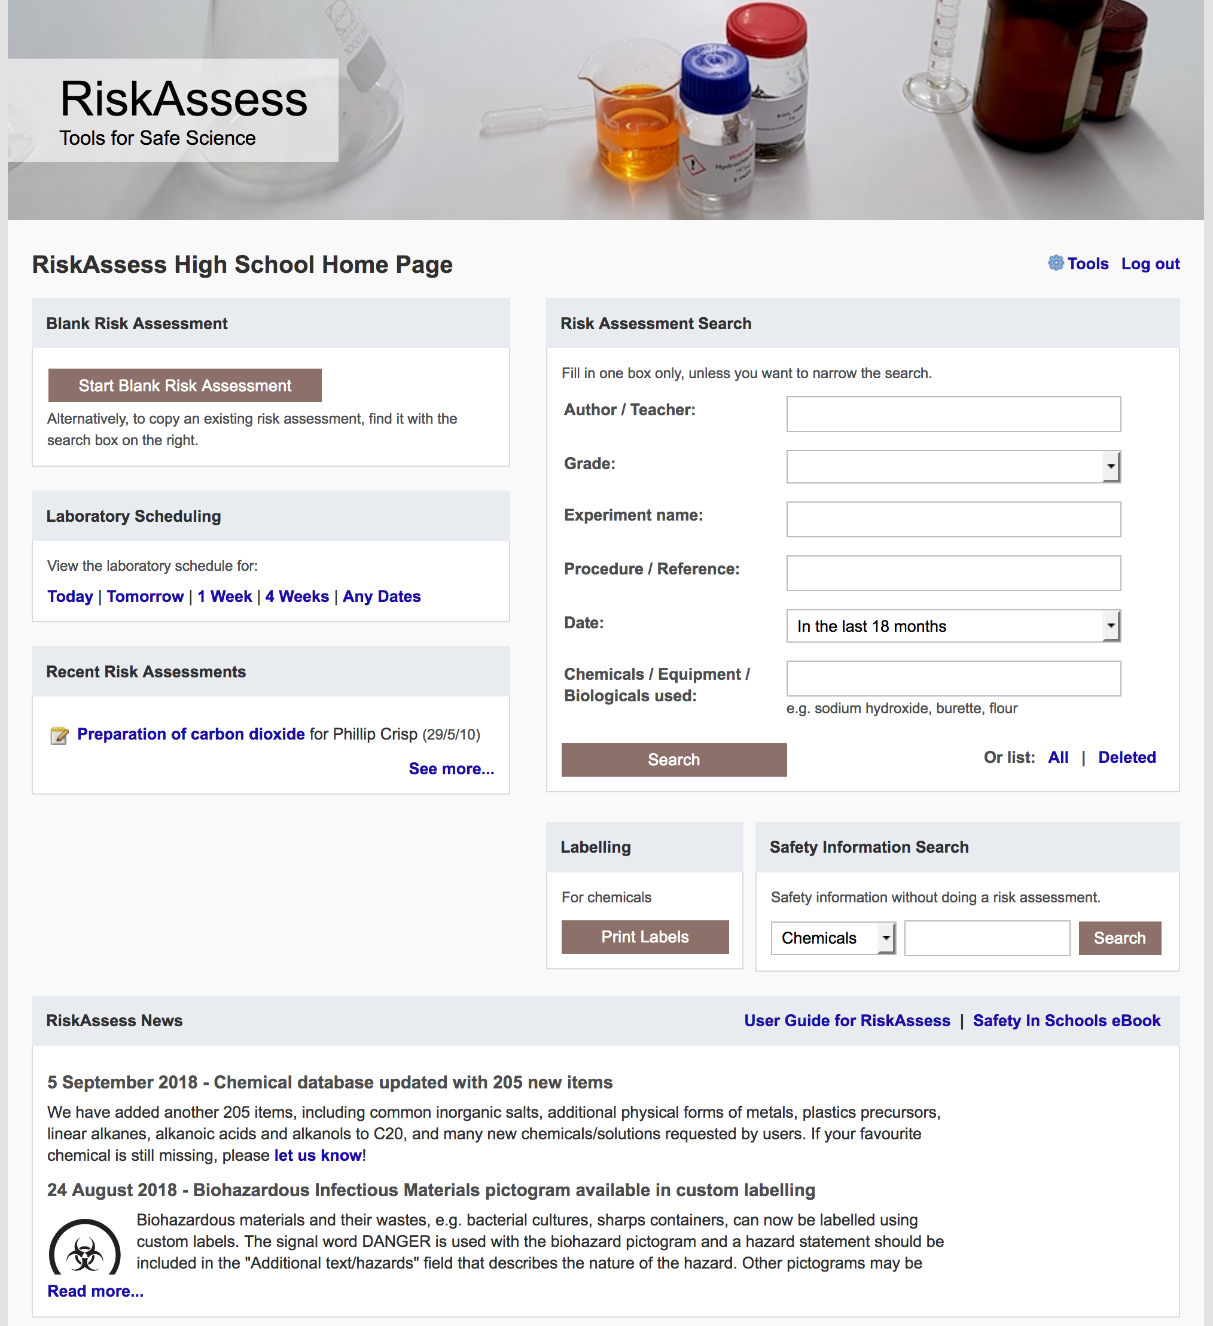

Slide 10
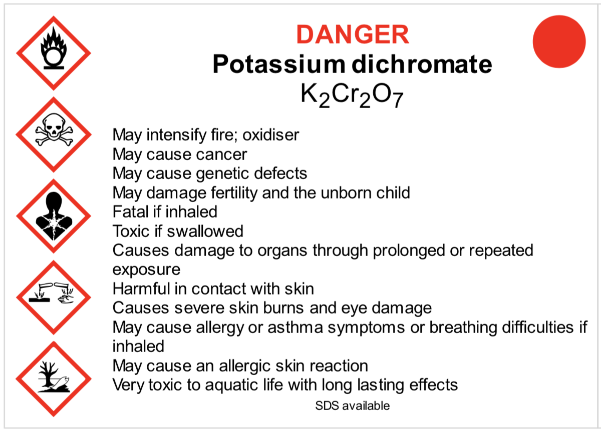
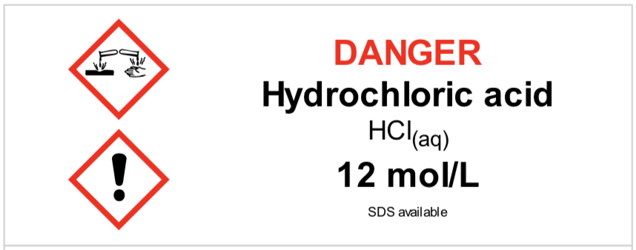
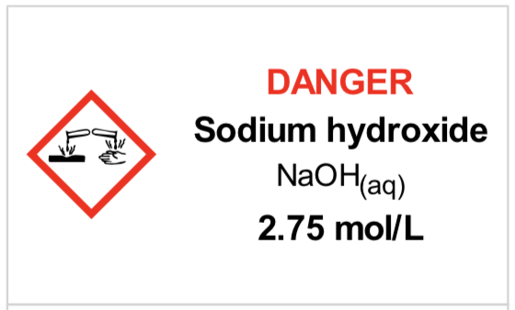
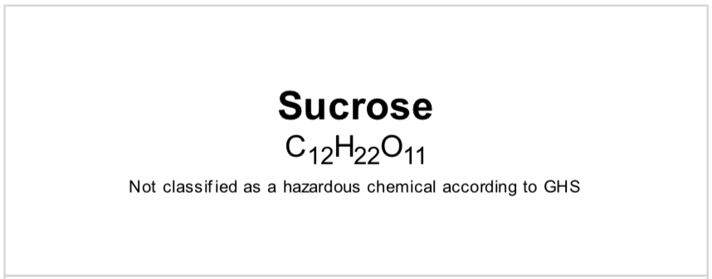
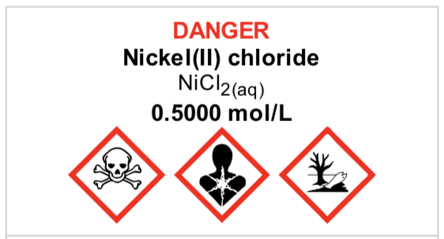
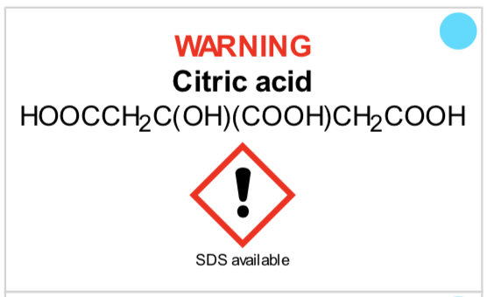
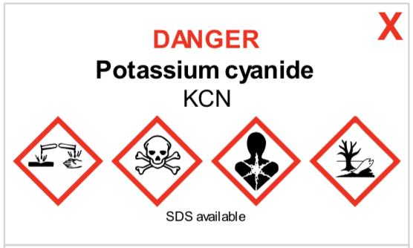
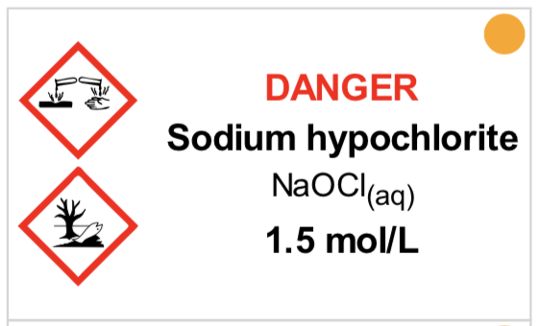
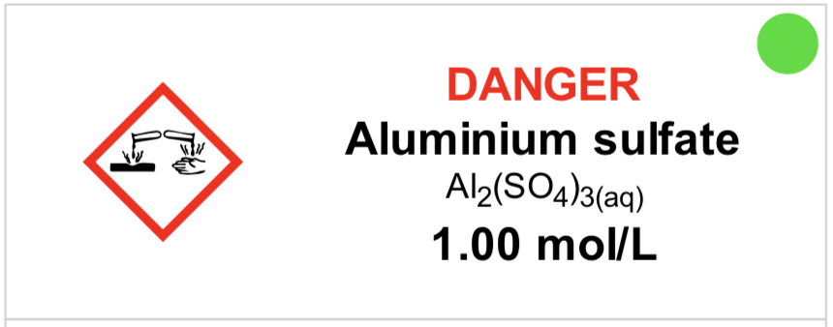
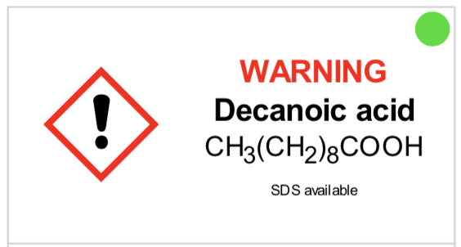
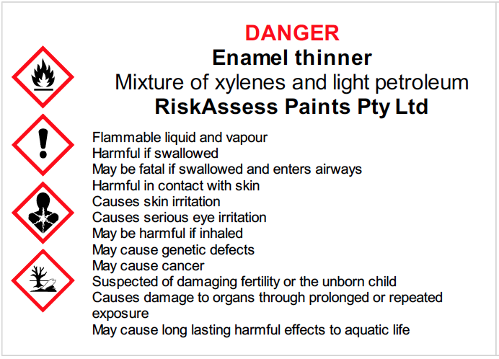
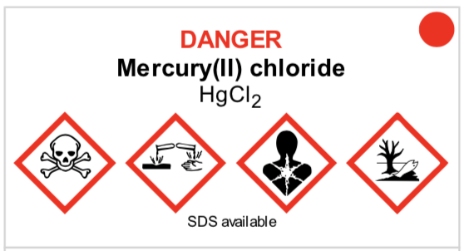
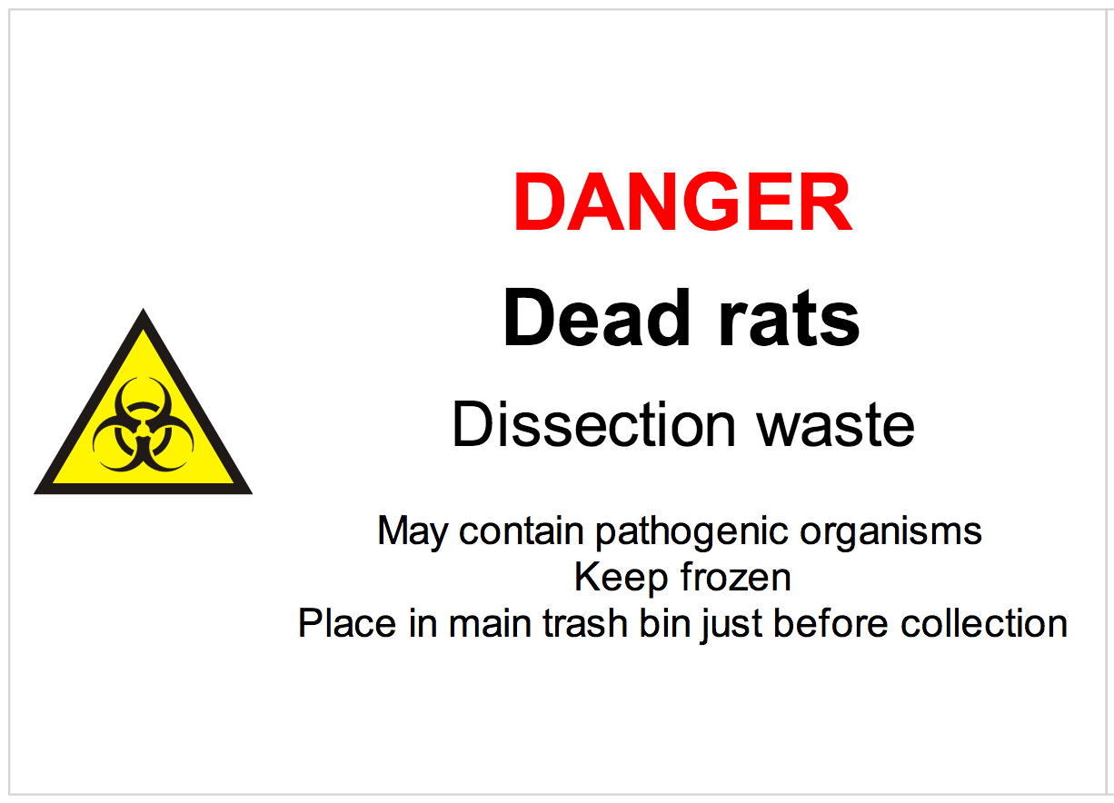
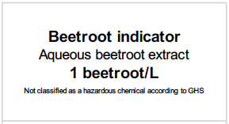
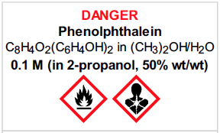

Slide 11
Logic
• separate sections for teacher and lab technician
• initial assessment of inherent risk
- if low, go to end
- if medium or more, record control measures
- if high or extreme, third reviewer required
• cross-checking by teacher/tech/reviewer
• scheduling, ordering, labelling to save time
• inexpensive ($350+GST per campus per year)

Slide 12
Electronic system
• relatively rapid
• prompts sensitive to context
• reduces paper consumption
• easy to review and update
• search and statistics
• long term storage
RiskAssess: 2,700 schools AU+NZ+CA
82% AU, 96% NSW
6,500,000 risk assessments

Slide 13
Details
• access from school/home
• nothing to install on computer, tablet or phone
(instant update)
• unlimited number of simultaneous users and risk assessments
• minimal data entry
• complements SDSs
• continuing input from science staff
• multiple backups of data & backup server
• support and advice

Slide 14
Student RiskAssess
Allows students to carry out risk assessments of experiments that they design themselves, e.g. Depth Studies, student-centred work, IB
Like RiskAssess, but with student-specific features for
student names, PINs, teacher feedback, etc
“Multiple prac management system” for teachers to manage large numbers of RAs
Meets curriculum requirements
Easy to use (esp. if know RiskAssess)
Inexpensive ($350+GST) per campus per year

Slide 15
Advantages of RiskAssess and Student RiskAssess
proper consideration of risks and control measures
standardisation within and between schools
storage of records for legal purposes
communication between teachers and lab technicians
discourages spur-of-the-moment experiments
useful for new/inexperienced staff

Slide 16
Outcomes
• reduced frequency of injuries
- to students
- to school staff
• reduced costs for paperwork, litigation and payouts
• compliance with the law
• helps maintain variety of chemicals and equipment
• easy ordering, scheduling and labelling
• helps with learning

Slide 17
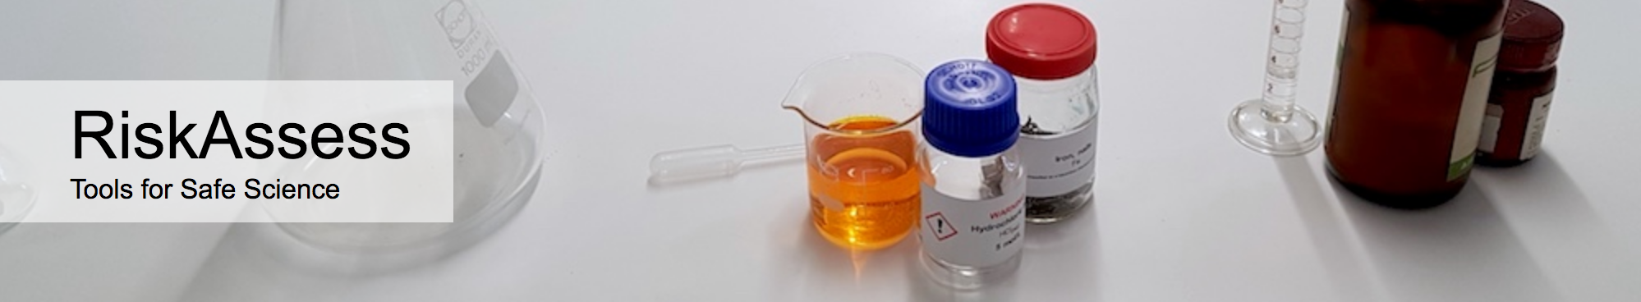

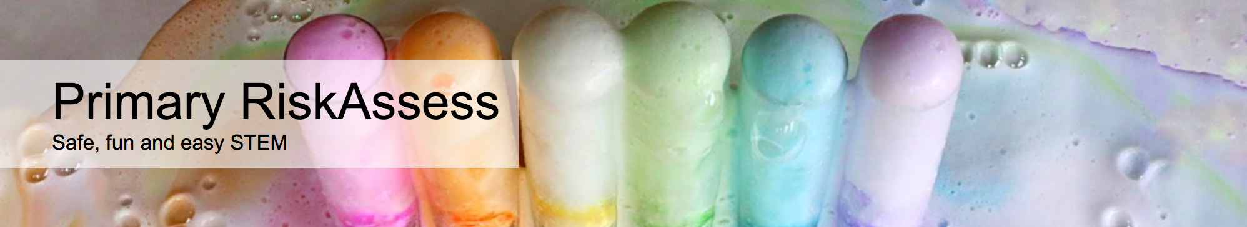

2700 schools
NSW: 805 (96%)
580 schools
NSW: 128 (15%)
200 schools
NSW: 180
70 schools
NSW: 18

Slide 18
DEMO

