Slide 1
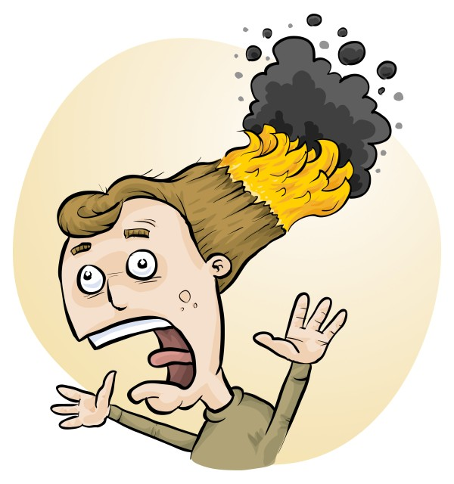
Chemical Waste Disposal
Phillip Crisp and James Crisp

Slide 2
Chemical Disposal
The quantity of chemical wastes generated in a school is insignificant.
HOWEVER
• A school is an educational institution
• Attitudes adopted during youth continue into adulthood
• Proper training should be given to those who will later be decision makers

Slide 3
The improvement process
eliminate unwanted chemicals
redesign procedures to minimize waste production, e.g. spot reactions, recycling, destruction, less toxic chemicals
dispose of wastes LEGALLY
SAFELY by
- sewer
- garbage
- waste collection service

Slide 4
THE LAW
Follow all
* national laws
* local government regulations
instead of the advice in RiskAssess
whenever there is conflict between the two

Slide 5
Chemical wastes in schools
*
Aqueous liquid wastes
• dissolved salts
• acidic or basic
• suspended particles
Water-miscible organic wastes
alcohols, e.g. methylated spirits
ketones, e.g. acetone
Water-immiscible organic wastes
• hydrocarbons, e.g. hexane, kerosene
• special chemicals, mostly for organic chemistry
Solid wastes
• precipitates, e.g. BaSO₄, Fe oxides

Slide 6
Problems in the sewer!
• toxic metals
e.g. Hg, Cd, Pb, As, . . . VERY BAD
Cu, Ni, Co, . . . BAD
since contaminate sludge $$$
• toxic persistent organic chemicals
e.g. pesticides
since contaminate sludge $$$
• highly acidic/alkaline liquids
since may damage pipes
• flammable liquids (water-immiscible)
since may cause an explosion!

Slide 7
Aqueous liquid wastes
Pour down the sewer ONLY if the criteria of the water authority are met.
Otherwise, an environmentally responsible approach:
• neutralize to ~pH 6.5-8.5 (natural waters)
• only “safe” amount of each chemical down the drain
in order to minimise environmental harm from treated sewage when it is released into river or ocean.
All wastes exceeding a “safe” amount of a chemical should be retained for a waste collection service.
WHAT IS SAFE?

Slide 8
Estimation of “safe” quantities*
Consider the cation and anion in a salt separately.
Toxicity of a salt is dominated by the most toxic ion:
e.g. lead chloride, potassium dichromate
Some ions should not go down the drain at all
e.g. Hg²⁺, Pb²⁺, Cd²⁺, . . .
while others are ok almost without (school) limit
e.g. Na⁺, Ca²⁺, Cl⁻, SO₄²⁻, . . .
and other ions in between
* RiskAssess “Disposal of chemical wastes”, in Learning Resources

Slide 9
Tabulation and calculation
“Safe” disposal quantity for an ion for a class:
0 – 1000 g/day
Copper sulfate
copper: 1 g/day [Very toxic to aquatic life
with long lasting effects]
sulfate: 1000 g/day. [In solid laundry detergent]
Therefore, copper sulfate: 1 g/day (as solid or solution)
Enough for some spot tests down the drain.
Beyond that, wastes need to be collected!

Slide 10
Organic liquid wastes
Water-miscible
e.g. methylated spirits, acetone
Dilute 1 part to 20 parts water, then down the drain.
Prevents explosive air/vapour mixture.
Microorganisms in sewer will consume the chemicals.
Water-immiscible
e.g. hexane, kerosene
Retain for collection by waste service.
Separate hydrocarbon waste from halogenated waste.

Slide 11
Aqueous waste containers
Cations
Large bottles half-filled with 110 g/L Na₂CO₃
e.g. Cd, Co, Cu, Pb, Hg, Ni, Zn ions
Large bottle half-filled with 180 g/L NaCl
e.g. silver ions
Anions
Large bottle half-filled with 150 g/L FeSO₄
e.g. chromate ions
Large bottle half-filled with 350 g/L CaCl₂
e.g. fluoride ions
SEPARATE CONTAINER FOR EACH ION !

Slide 12
Solid wastes
Only “material of a domestic nature”
is allowed to be disposed of in the garbage
Consider
transport of garbage
leaching from landfill
Geologically-stable minerals
(precipitated during reactions)
e.g. barium sulfate (baryte)
No leaching of toxic chemicals in a domestic landfill.

Slide 13
Labelling and storage of wastes
All wastes must be
• labelled according to GHS, and
• stored according to Dangerous Goods Class.
Especially:
Flammable wastes in a flammable liquids cabinet!
Place each toxic waste in a SEPARATE container!
Most easily, use RiskAssess labels:
standard labels for single-component wastes
custom labels for multicomponent wastes

Slide 14
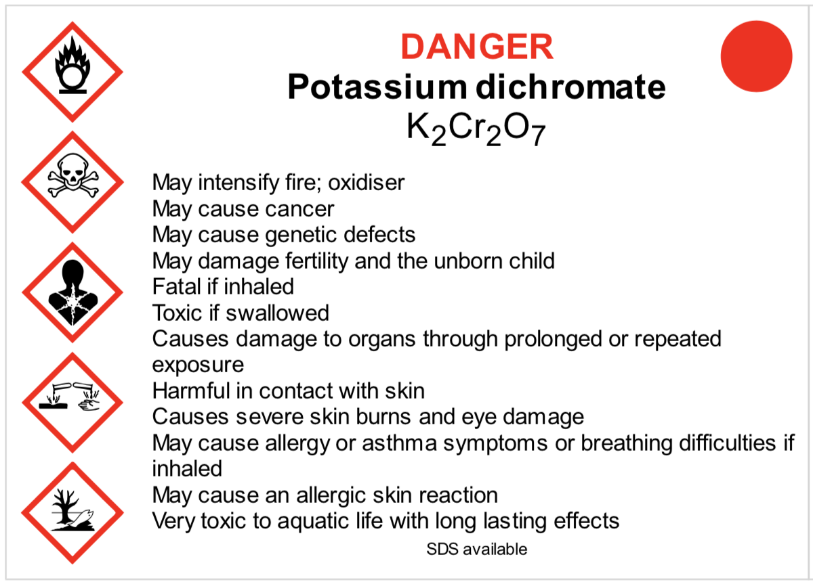
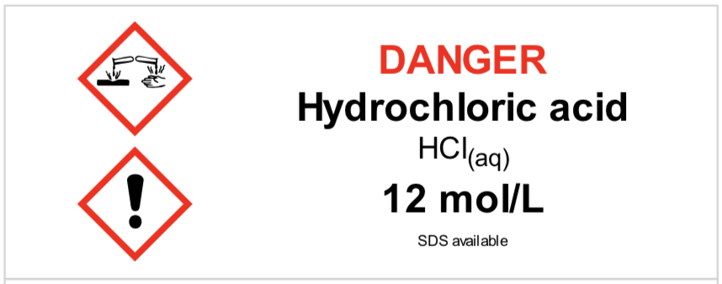
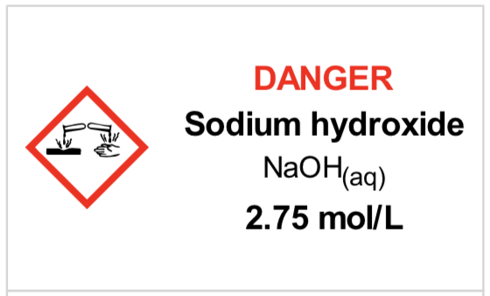
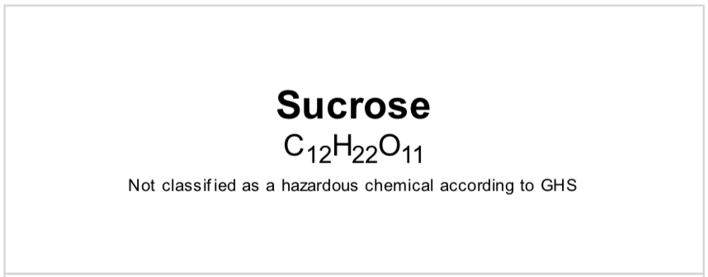
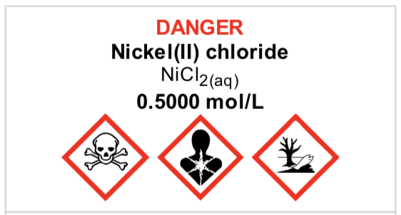
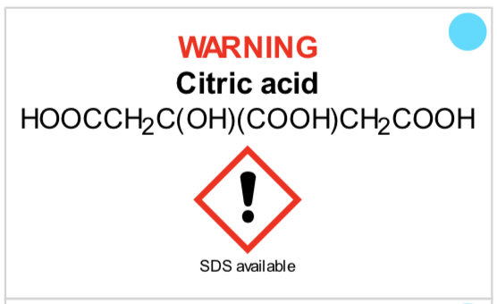
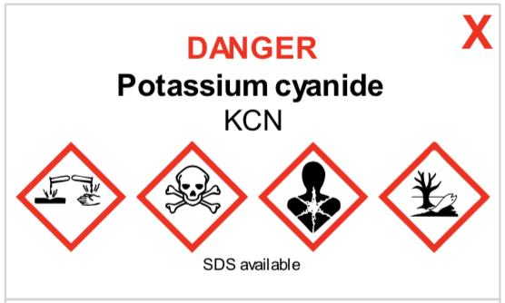
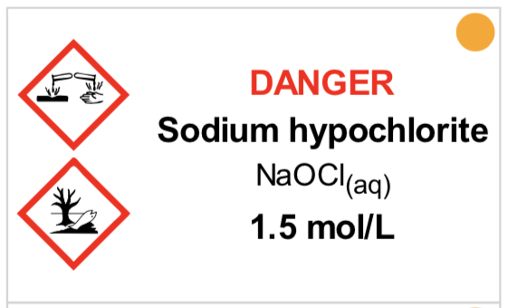
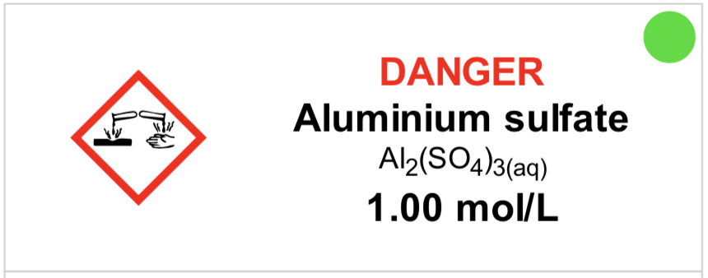
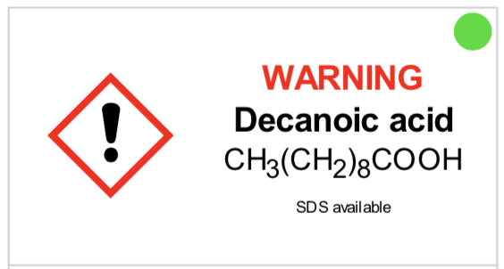
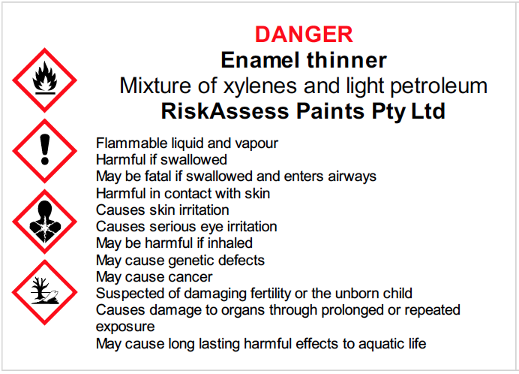
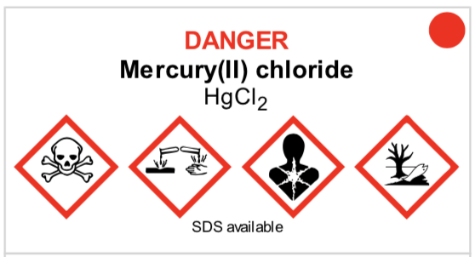
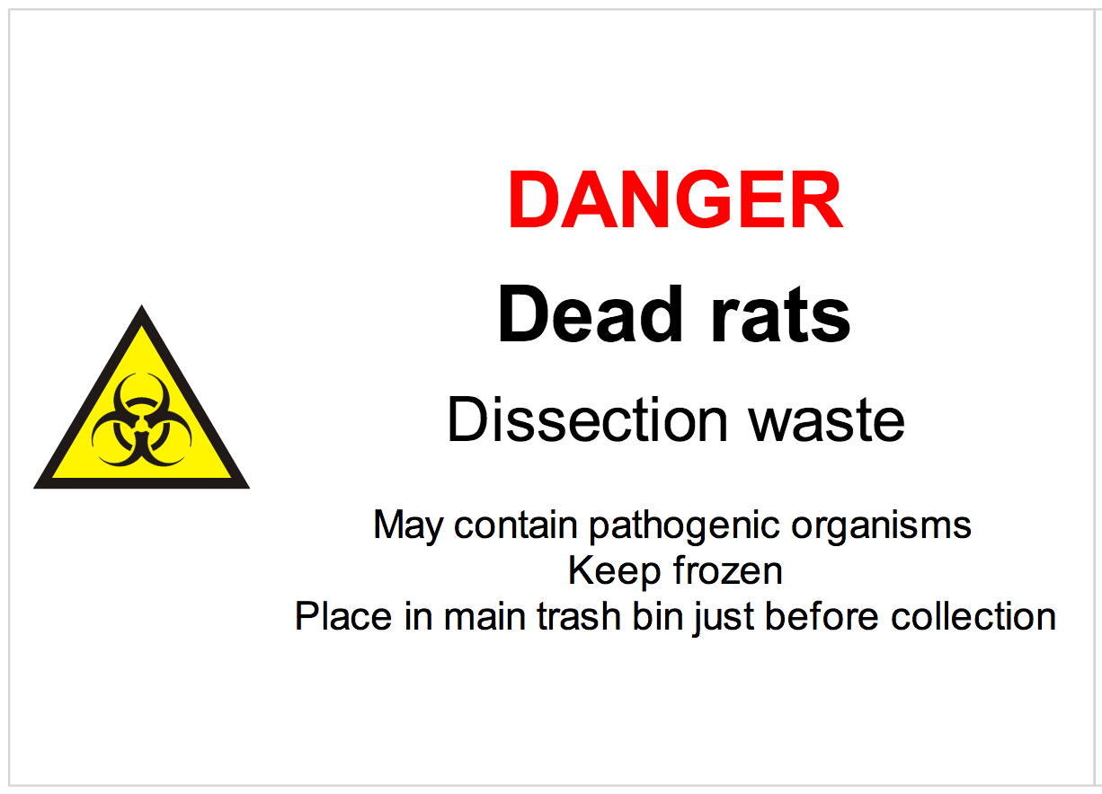
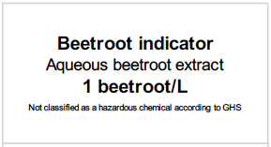
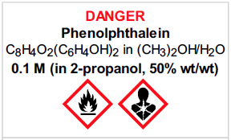

Slide 15
Purpose of disposal advice
• focuses on avoiding serious environmental harm
• reduces the cost of waste collection service
• decreases emphasis on less harmful substances
• provides a learning tool for staff and students
• promotes care for the environment

Slide 16
Current disposal advice
Free Learning resources:
• ‘Disposal of Chemical Wastes’ document
• this presentation (for teaching others)
Within RiskAssess:
• ‘Safety in Schools’ book, chapter C7:
‘How to dispose of chemical wastes’

Slide 17
Future disposal advice: advice for each individual chemical
• advice for each of the 3000 chemicals/solutions
• following logic of ‘Disposal of Chemical Wastes’
• under ‘Standard handling procedures’
• no need to calculate for each chemical/solution
• dedicated waste container information
• simplify disposal and save money
• completion early 2021 (Big job!)

Slide 18
CHEMICAL SPILLS
Deal with injured persons
Prevent further injuries
Seek assistance
e.g. Emergency 111
. . . . . . . . . . . . . . . . . . . . . . . . . . . .
• Contain the spill
• Clean up the spill
• Render spilled material harmless

Slide 19
Procedures for chemical spills
• Acids
• Alkalis
• Organic solvents
• Mercury
• Solids

Slide 20
Spills kit
Rubber gloves
Safety goggles
Mop and bucket
Dust pan and brush
Four 5 L plastic buckets
Plastic shovel
10 kg kitty litter (dried bentonite clay NOT paper)
2 kg sodium bicarbonate
2 kg calcium hydroxide
(10 kg dry sand)
(2 kg sulfur for mercury decontamination)
Paper towels
NOTE:
Keep in front of chemical store!

Slide 22
What is RiskAssess?
• web-based risk assessment tool
• customised to the school situation
• provides
- electronic templates (NZ/ISO)
- database information on risks
(chemical, equipment, biological)
- equipment ordering/lab scheduling
- labelling (GHS)
- learning resources
• easy sharing of experiment templates for customisation

Slide 23
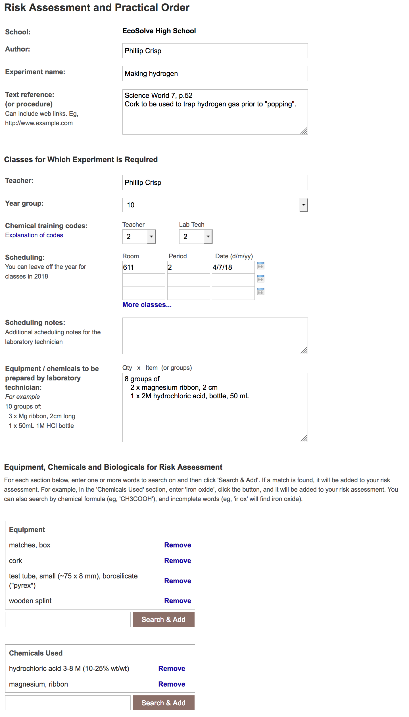
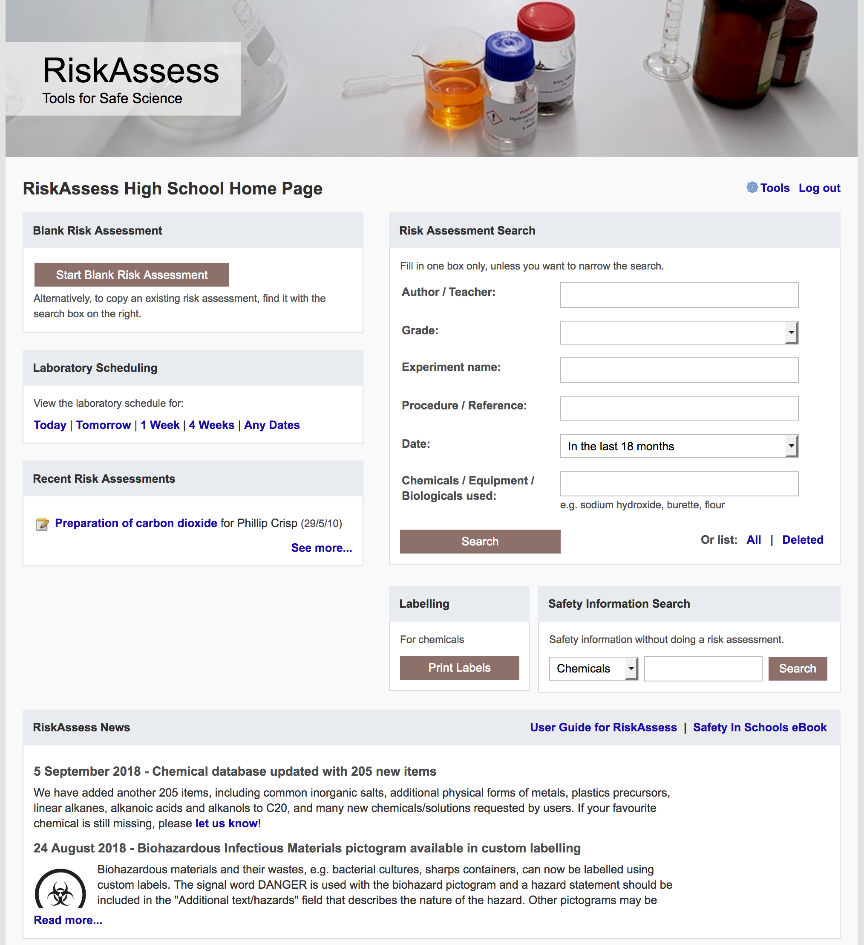

Slide 24
Logic
• separate sections for teacher and laboratory technician
• initial assessment of inherent risk
- if low, go to end
- if medium or more, record control measures
- if high or extreme, third reviewer required
• cross-checking by teacher/labtech/reviewer
• scheduling, ordering, labelling to save time
• inexpensive ($250+GST per campus per year)

Slide 25
Electronic system
• relatively rapid
• prompts sensitive to context
• reduces paper consumption
• easy to review and update
• easy monitoring and statistics
• easy storage
• demonstrated to work in schools
RiskAssess: 2250 schools AU+NZ+CA
NZ: 180 (33%)
3,700,000 risk assessments

Slide 26
Details
• access from school/home
• nothing to install on computer, tablet or phone
(instant update)
• unlimited number of simultaneous users and risk assessments
• minimal data entry See brochure!
• complements SDSs
• continuing input from science staff
• multiple backups of data & backup server
• support and advice

Slide 27
Advantages of RiskAssess
• proper consideration of risks and control measures
• standardisation
• storage of records for legal purposes
• communication between teachers and laboratory technicians
• discourages spur-of-the-moment experiments
• useful for new/inexperienced staff

Slide 28
Even more!
• scheduling system
• prac ordering
• GHS labelling
- standard
- customised
And an exciting new video . . .
“Getting Started with RiskAssess”
starring Phillip and Eva!

