Slide 1
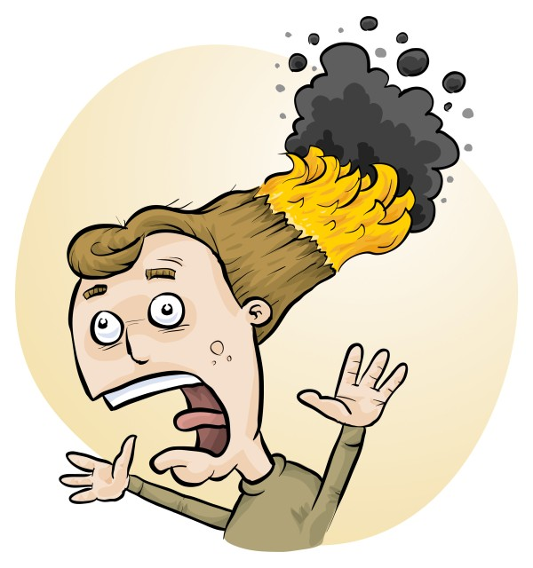
Chemical Waste Disposal in Western Australia
Phillip Crisp and Eva Crisp

Slide 2
Chemical Disposal
The quantity of chemical wastes generated in a school is insignificant
(compared with agriculture, mining and industry)
HOWEVER
Wastes can pose hazards, if stored poorly
A school is an educational institution
• Attitudes adopted during youth continue into adulthood
• Proper training should be given to those who will later be decision makers

Slide 3
The improvement process
eliminate unwanted chemicals
redesign procedures to minimize waste production, e.g. spot reactions, recycling, destruction, less toxic chemicals
dispose of wastes LEGALLY
SAFELY by
- sewer
- garbage
- waste collection service

Slide 4
THE LAW
Follow all
* WA laws
* local government/authority regulations
instead of the advice in RiskAssess
whenever there is conflict between the two

Slide 5
Water Corporation
Laboratory chemical waste
https://www.watercorporation.com.au/Help-and-advice/Trade-waste/Trade-waste-in-your-business/Other-industries/Laboratory-chemical-waste
• chemicals of major concern
• waste avoidance and minimisation
• best management practices & specific requirements
Laboratory waste from schools
http://www.labnetwest.asn.au/wp-content/uploads/2020/06/Laboratory-waste-from-schools.pdf
Acceptance criteria for trade waste
https://www.watercorporation.com.au/Help-and-advice/Trade-waste/Permits/Trade-waste-permits/Acceptance-criteria-for-trade-waste
• substances subject to acceptance criteria
acceptance criteria for common waste components
acceptance criteria for heavy metals (metropolitan)

Slide 6
Waste Authority
• WasteSorted Schools program
https://www.wasteauthority.wa.gov.au/wss/
programs, resources, grants, accredited schools
Household Hazardous Waste free dropoff
https://www.wasteauthority.wa.gov.au/programs/view/household-hazardous-waste
items that can and can’t be dropped off
school laboratory garbage?

Slide 7
Chemical wastes in schools
*
Aqueous liquid wastes
• dissolved salts
• acidic or basic
• suspended particles
Water-miscible organic wastes
alcohols, e.g. methylated spirits
ketones, e.g. acetone
Water-immiscible organic wastes
• hydrocarbons, e.g. hexane, kerosene
• special chemicals, mostly for organic chemistry
Solid wastes
• precipitates, e.g. BaSO₄, Fe oxides

Slide 8
Problems in the sewer!
• toxic metals
e.g. Hg, Cd, Pb, As, . . . VERY BAD
Cu, Ni, Co, . . . BAD
since contaminate sludge $$$
• toxic persistent organic chemicals
e.g. pesticides
since contaminate sludge $$$
• highly acidic/alkaline liquids
since may damage pipes
• flammable liquids (water-immiscible)
since may cause an explosion!

Slide 9
Aqueous liquid wastes
Pour down the sewer ONLY if the ‘acceptance criteria’ of the Water Corporation are met (known for metropolitan schools).
Otherwise, an environmentally responsible approach:
• neutralize to ~pH 6.5-8.5 (natural waters)
• only “safe” amount of each chemical down the drain
in order to minimise environmental harm from treated sewage when it is released into river or ocean.
All wastes exceeding a “safe” amount of a chemical should be retained for a waste collection service.
WHAT IS SAFE?

Slide 10
Estimation of “safe” quantities*
Consider the cation and anion in a salt separately.
Toxicity of a salt is dominated by the most toxic ion:
e.g. lead chloride, potassium dichromate
Some ions should not go down the drain at all
e.g. Hg²⁺, Pb²⁺, Cd²⁺, . . .
while others are ok almost without (school) limit
e.g. Na⁺, Ca²⁺, Cl⁻, SO₄²⁻, . . .
and other ions in between
* RiskAssess “Disposal of chemical wastes”, in Learning Resources

Slide 11
Tabulation and calculation
“Safe” disposal quantity for an ion for a class:
0 – 1000 g/day
Copper sulfate
copper: 1 g/day [Very toxic to aquatic life
with long lasting effects]
sulfate: 1000 g/day. [In solid laundry detergent]
Therefore, copper sulfate: 1 g/day (as solid or solution)
Enough for some spot tests down the drain.
Beyond that, wastes need to be collected!

Slide 12
Comparison (g/day) to sewer
Element Water Corporation* RiskAssess
Arsenic 1 0
Cadmium 1 0
Chromium 30 (10)** 10
Copper 30 (10)** 1
Lead 30 (10)** 0
Mercury 0.1 (1)** 0
Molybdenum 1 1
Nickel 6 (10)** 1
Selenium 1 1
Silver 2 1
Zinc 50 (10)** 10
* Acceptance criteria for large metropolitan WWTPs only (Beenyup, Subiaco and Woodman
Point); otherwise, case by case
** Water Corporation “Laboratory chemical waste”, criteria for treatment before discharge

Slide 13
Organic liquid wastes
Water-miscible
e.g. methylated spirits, acetone
Dilute 1 part to 20 parts water, then down the drain.
Prevents explosive air/vapour mixture.
Microorganisms in sewer will consume the chemicals.
Water-immiscible
e.g. hexane, kerosene
Retain for collection by waste service.
Separate hydrocarbon waste from halogenated waste.

Slide 14
Waste processing
Collection
Large bottles (e.g. 2.5 L ‘Winchesters’)
correctly labelled, funnel at top (fume cupboard)
Treatment
Only if time, equipment and skilled people available
Disposal
To maximum recommended daily quantity:
• down the drain or into garbage
Otherwise, retain for waste collection
SEPARATE CONTAINER FOR EACH WASTE!

Slide 15
Solid wastes
Only material of a domestic nature
is allowed to be disposed of in the garbage
Consider
transport of garbage
leaching from landfill
Geologically-stable minerals
(precipitated during reactions)
e.g. barium sulfate (baryte)
No leaching of toxic chemicals in a domestic landfill.

Slide 16
Purpose of disposal advice
• improves understanding of harmful properties
• focuses on avoiding serious environmental harm
• reduces the cost of waste collection service
• provides a learning tool for staff and students
• promotes care for the environment

Slide 17
RiskAssess Advice
Individual chemical advice in ‘Disposal’ SUBSCRIBER
for each of >3000 chemicals and solutions
‘Disposal of chemical wastes’ FREE
https://www.riskassess.com.au/docs/DisposalOfChemicalWastes.pdf
‘Chemical waste containers’ FREE
https://www.riskassess.com.au/info/waste_containers
‘Labels for chemical waste containers’ FREE
https://www.riskassess.com.au/info/waste_container_labels
‘How to dispose of chemical wastes ’ SUBSCRIBER
In: ‘Safety in Schools’ book, chapter C7

Slide 18
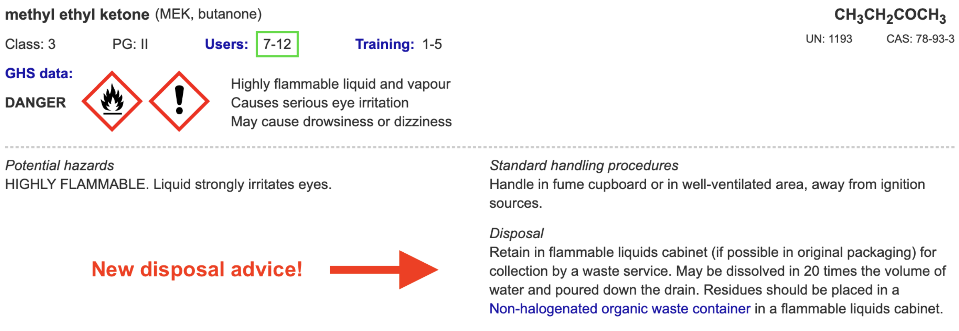

Slide 19
Labelling and storage of wastes
All wastes must be
• labelled according to GHS, and
• stored according to Dangerous Goods Class.
Flammable wastes in a flammable liquids cabinet!
Place each toxic waste in a SEPARATE container!
Recommend both:
large RA label with GHS information
large blank label for hand-writing the quantity and
identity of each waste added to the container

Slide 20
RiskAssess pre-prepared waste labels
Labels for 25 common wastes ready to print
Based on the likely compositions and likely maximum concentrations
Otherwise, use Custom Labels,
especially if wastes are less hazardous

Slide 21
DEMONSTRATION
• Learning resources
• Examples
• Waste treatment and recycling
• Labels
QUESTIONS
team@riskassess.com.au

